Slide 1

Quasi – parallel &
Quasi – perpendicular Magnetosheath Jets Using MMS
Savvas Raptis, Tomas Karlsson &
Per-Arne Lindqvist
KTH - Department of Space and Plasma Physics
EGU 2019
12/04/2019, Vienna

Slide 2
Introduction

Slide 3
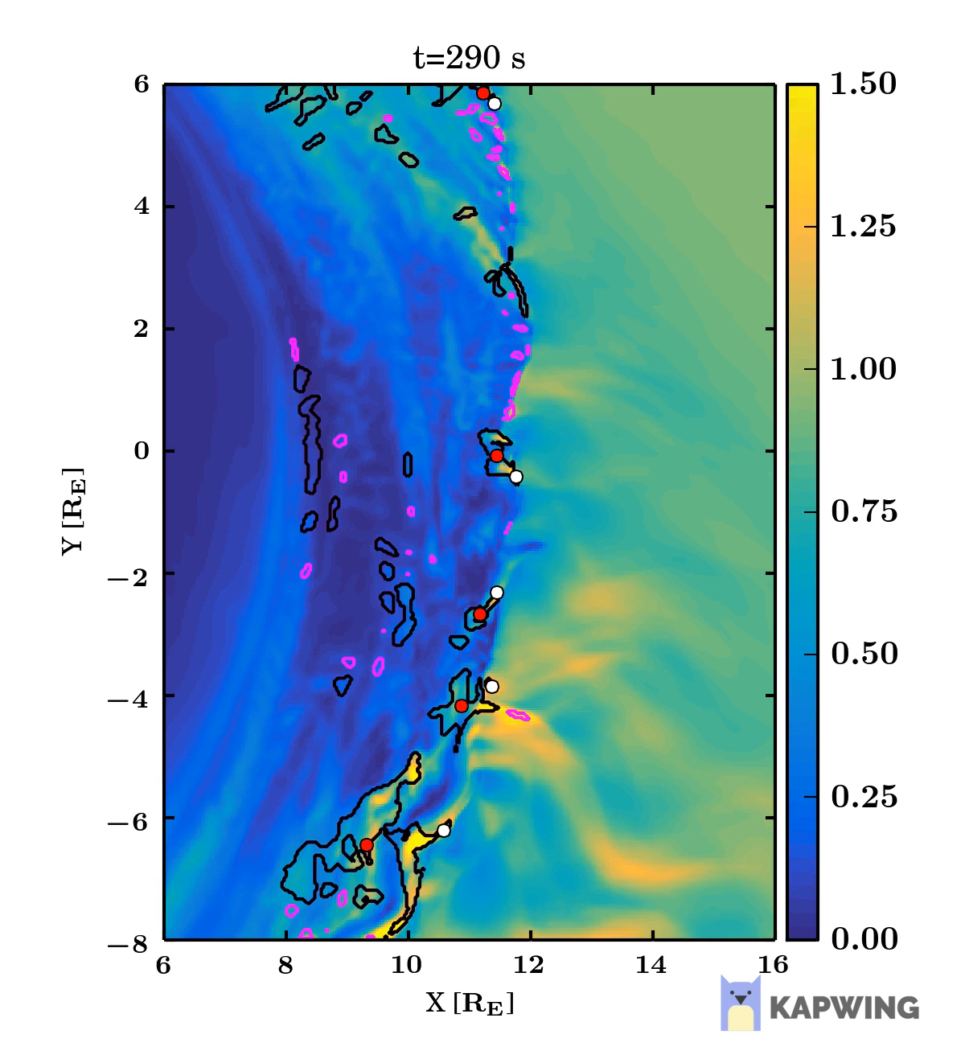
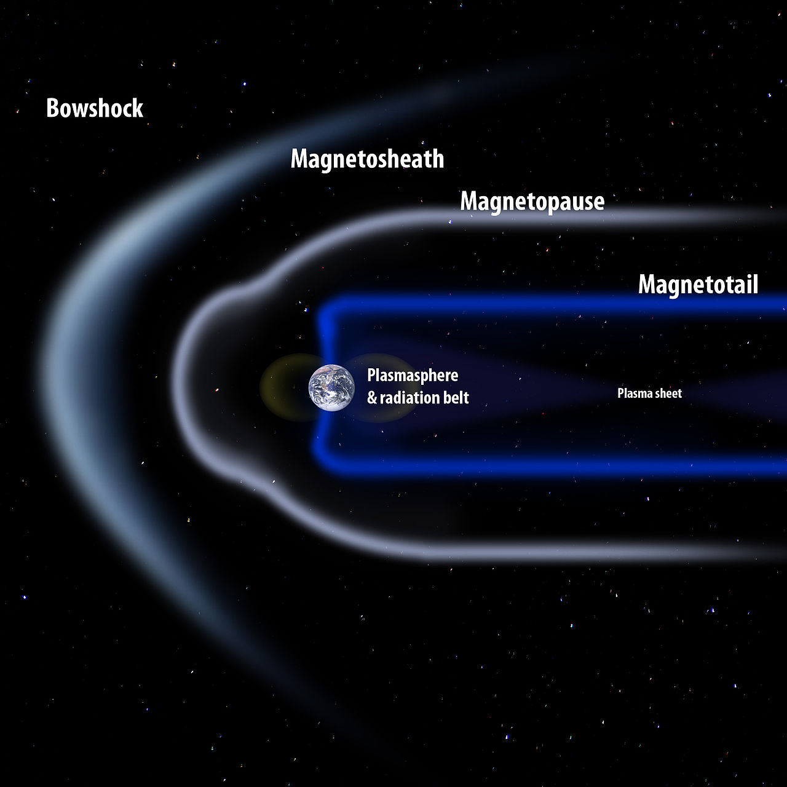
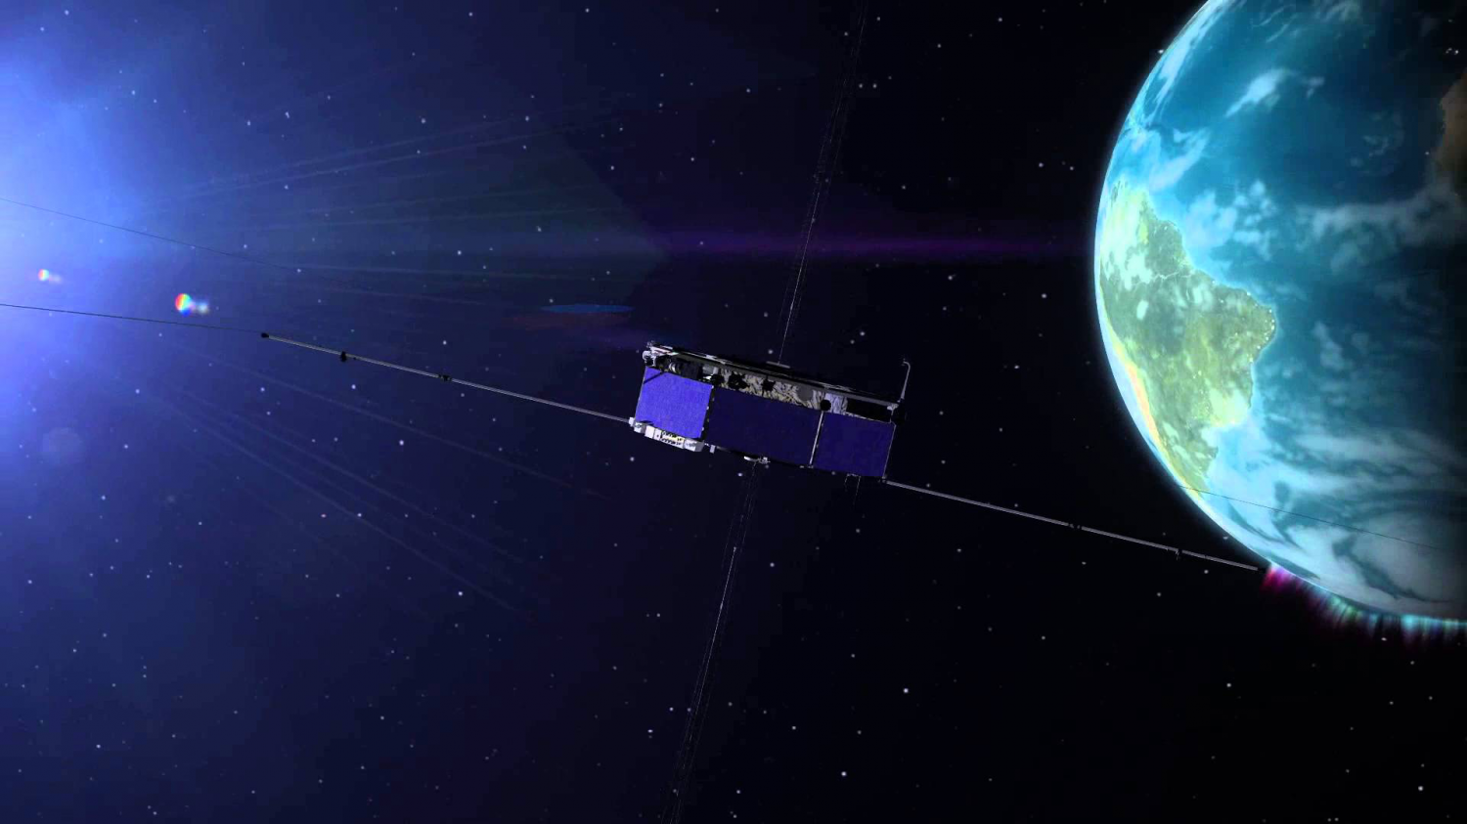
Magnetosheath Jets
What: Enhancements of dynamic pressure above the general fluctuations level
Where: Magnetosheath
Data: MMS (Magnetospheric Multiscale Mission)
Why: Interaction of SW & Magnetosphere, magnetopause reconnection, radiation belts, auroral features…
Palmroth Minna et al. (2018)

Slide 4
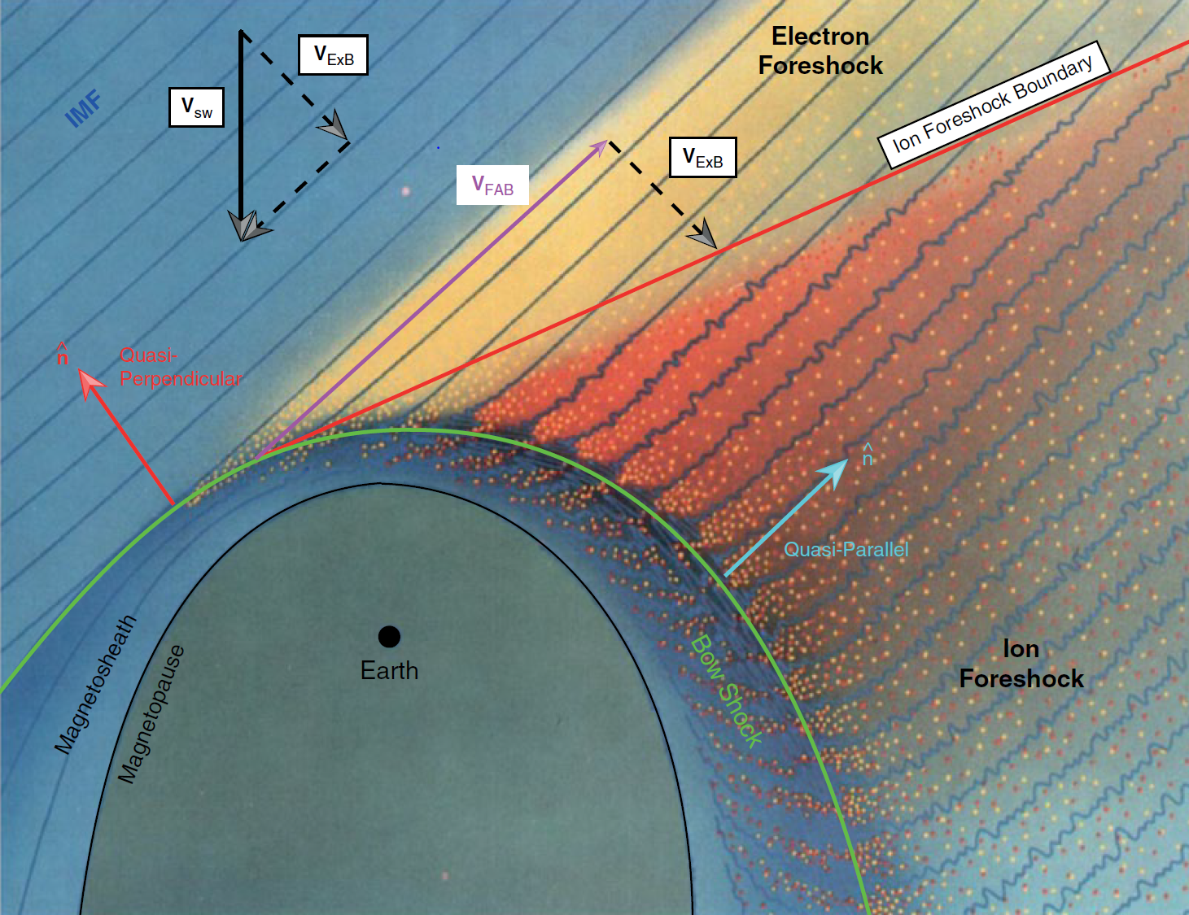
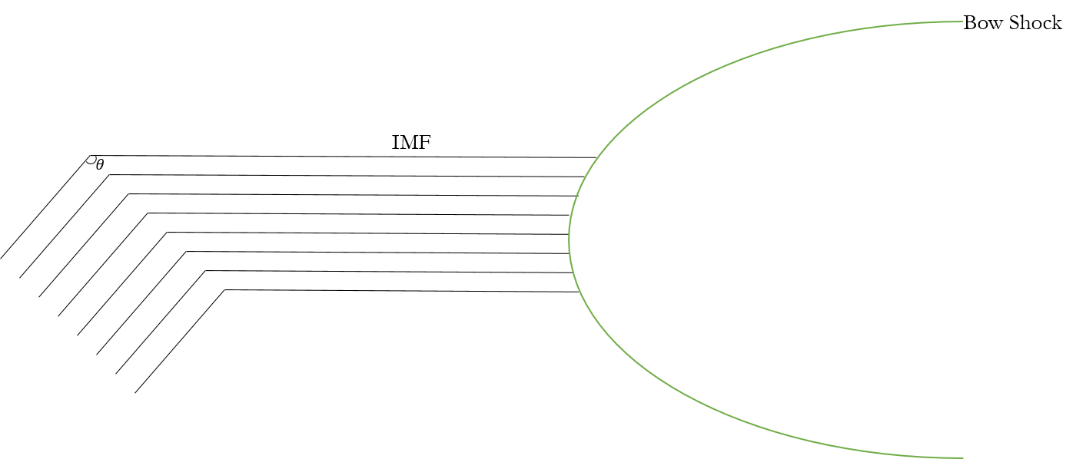
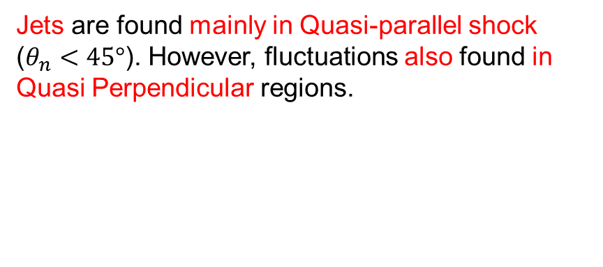

Motivation – Main Subcategories
Jets are found mainly in Quasi-parallel shock ($θ_{n}<45°$). However, fluctuations also found in Quasi Perpendicular regions.
$$Q_{par}$$ | $$Q_{per}$$ | $$Boundary$$
L. B. Wilson (2016)

Slide 5
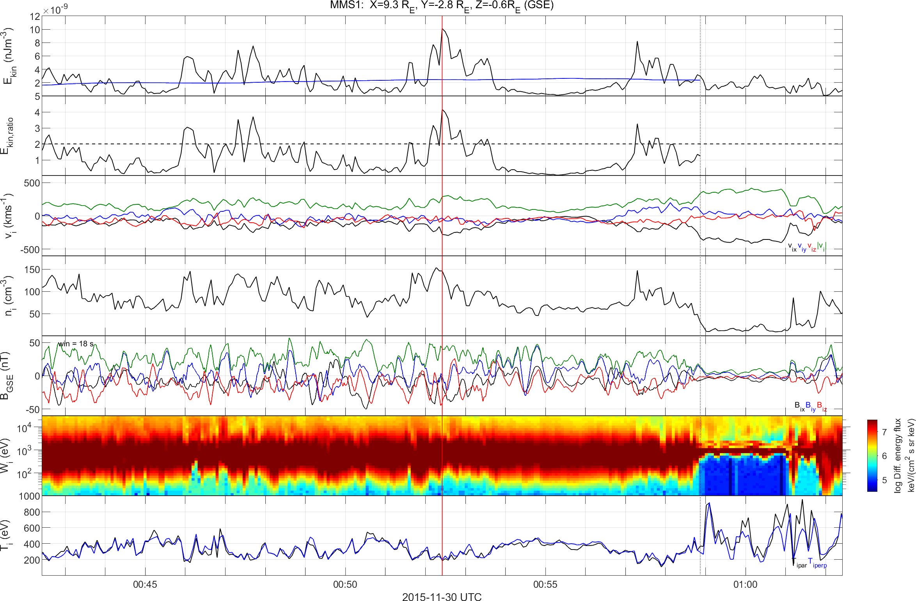
How Jet look like – Quasi Parallel
High $B$ Variance, High Energetic Particles, Low Anisotropy
Kinetic Energy Density
Kinetic Energy Density Ratio
Velocity
Density
Magnetic Field
Ion Energy Spectrum
Temperature

Slide 6
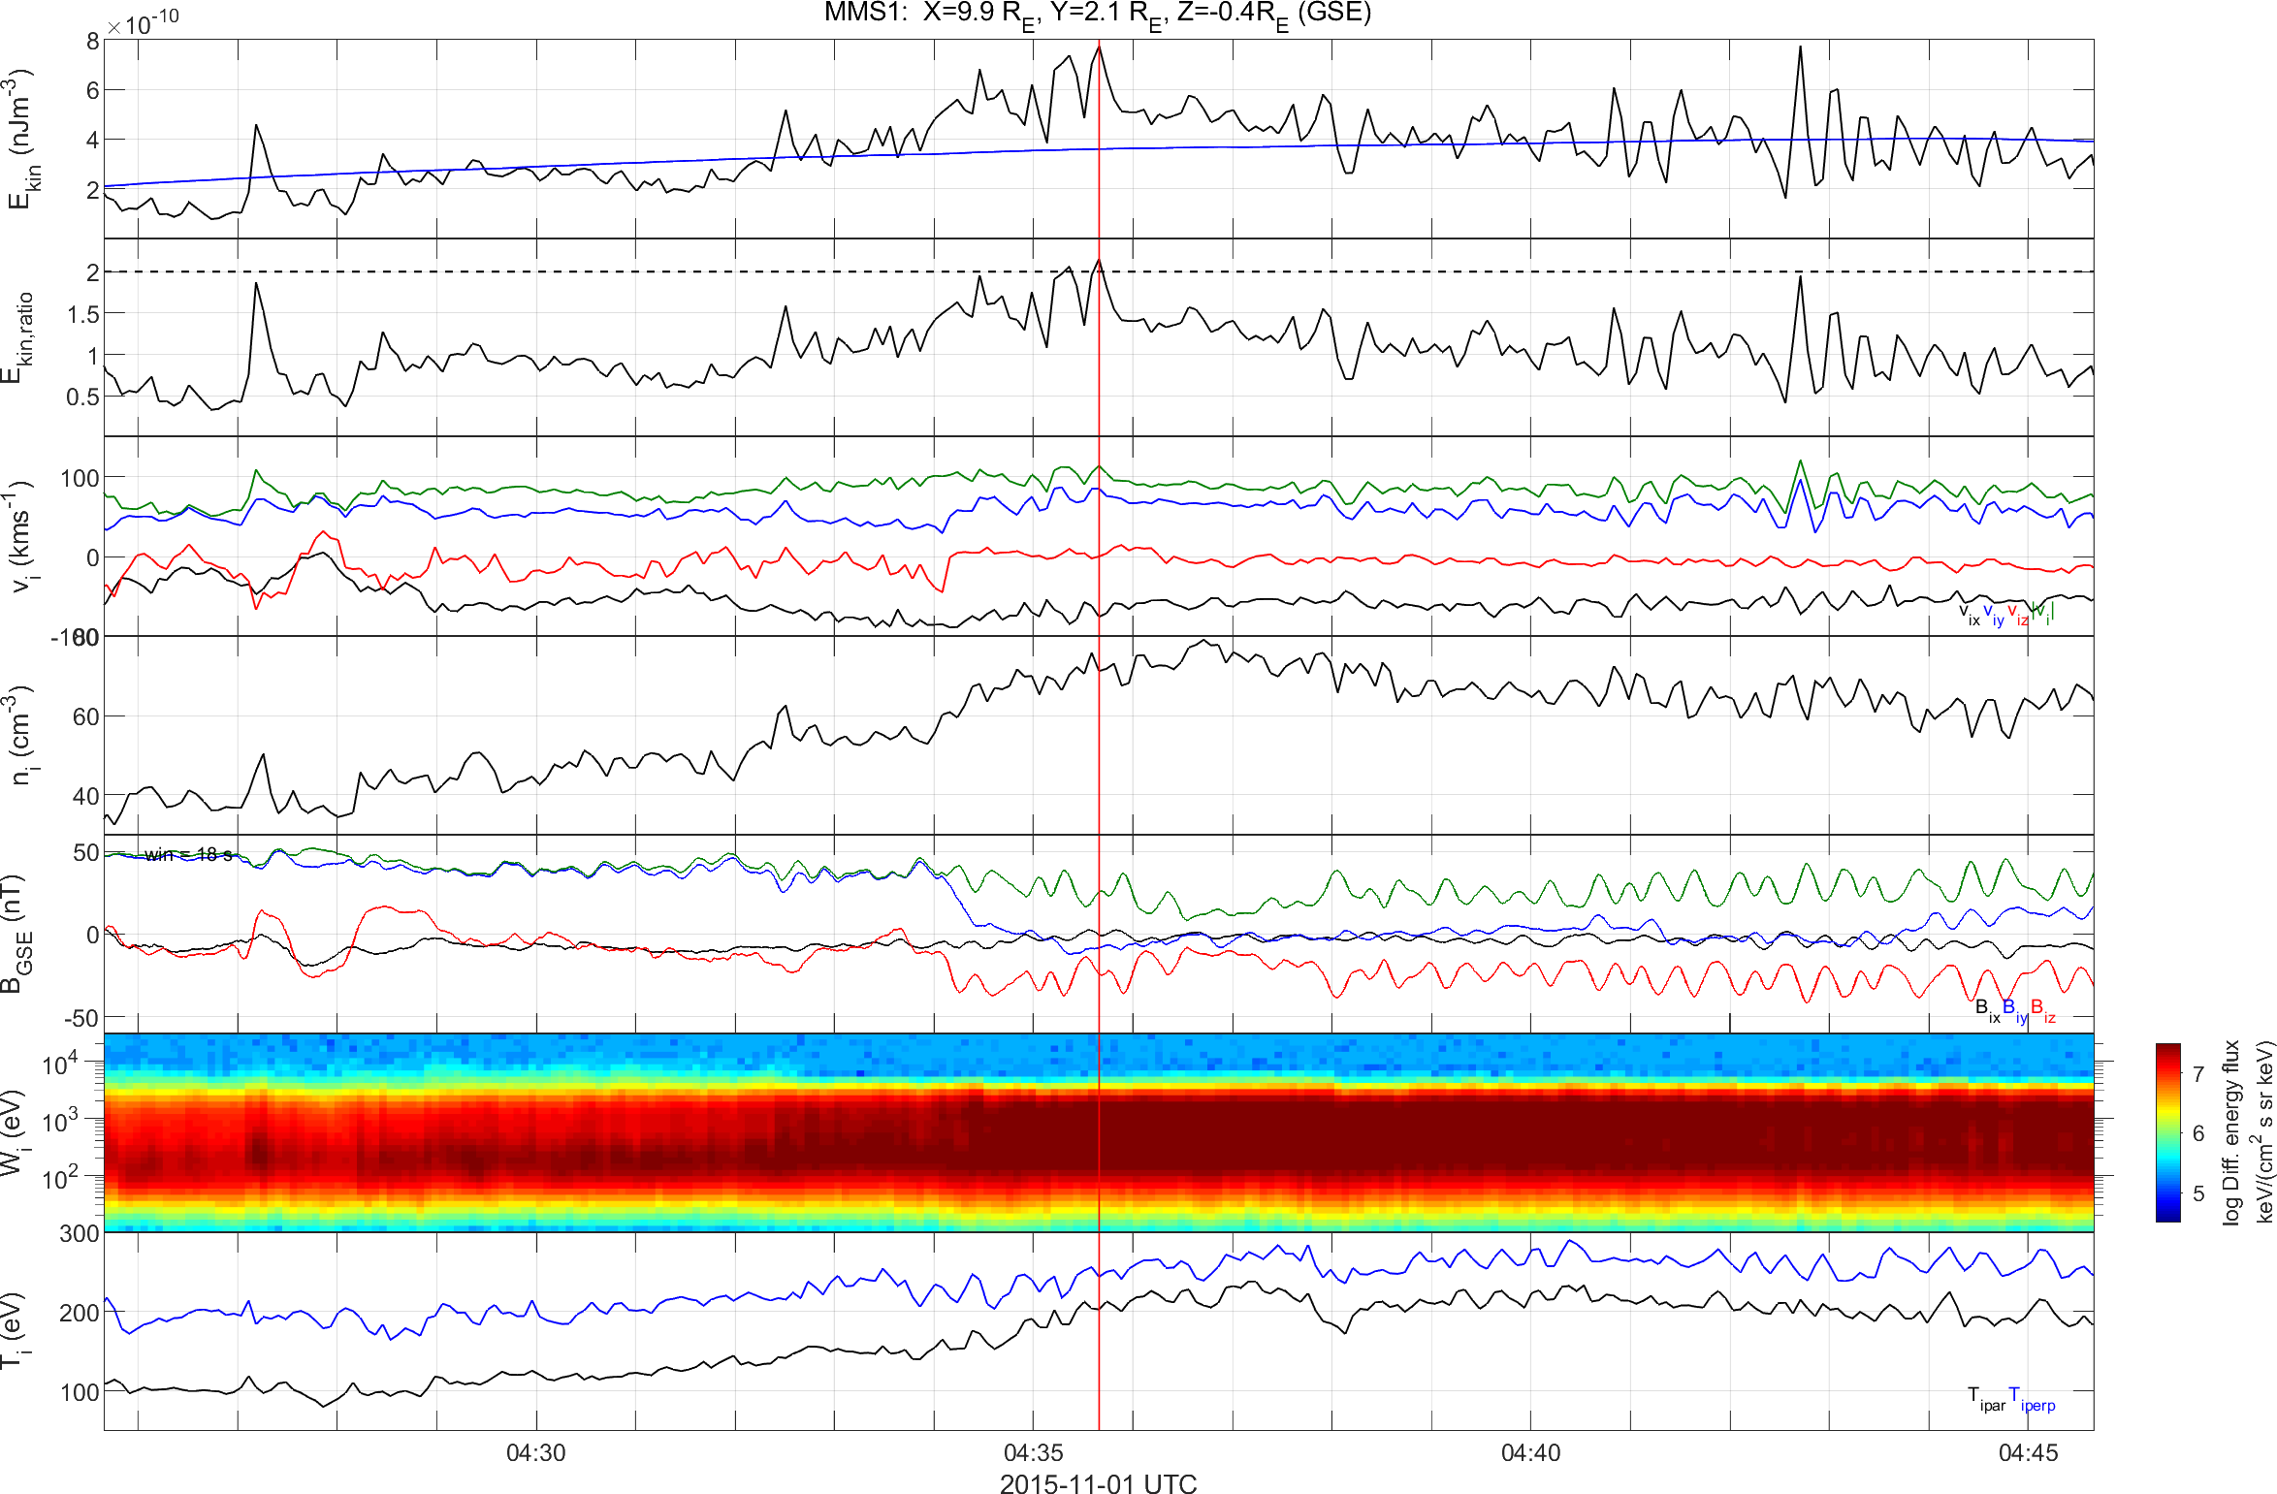
How Jet look like – Quasi Perpendicular
Low $B$ Variance, Low Energetic Particles, High Anisotropy
Kinetic Energy Density
Kinetic Energy Density Ratio
Velocity
Density
Magnetic Field
Ion Energy Spectrum
Temperature

Slide 7
See the differences?
High Variance, High Energetic Particles, Low Anisotropy
Low Variance, No Energetic Particles, High Anisotropy
Quasi – Parallel Jet
Quasi – Perpendicular

Slide 8
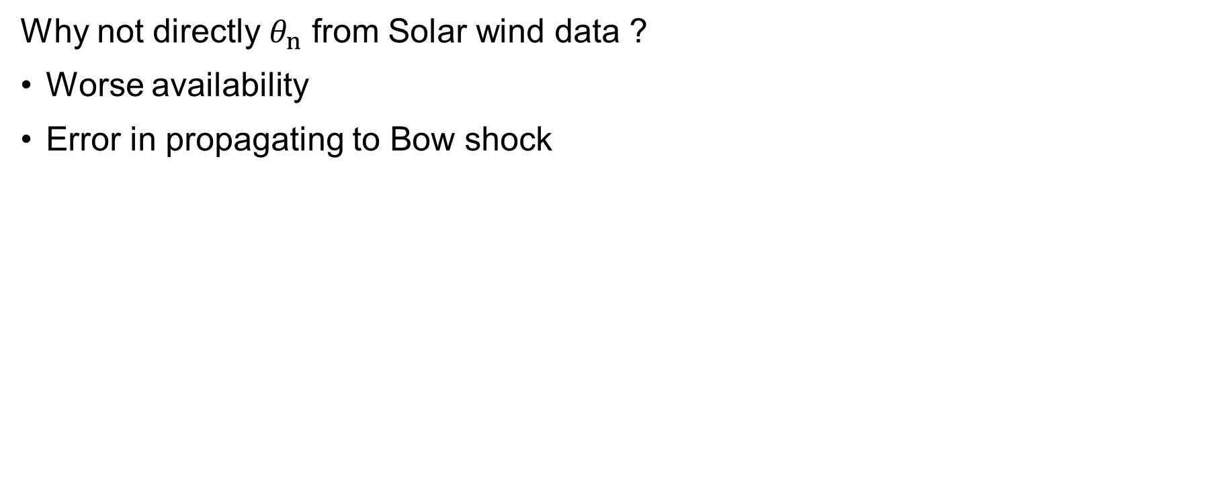

Angle & Bow shock configuration
Why not directly $θ_{n}$ from Solar wind data ?
Worse availability
Error in propagating to Bow shock
Bow Shock
Magnetopause
$$ACE$$
ΗRO Data (1 min average)
Jets
MMS

Slide 9
Angle & Bow shock Verification

Slide 10
Angle & Bow shock Verification
Q-par region
Q-perp region

Slide 11
Main Categories
Qpar Jet
Qperp Jet
Boundary Jet
Encapsulated Jet

Slide 12
Results

Slide 13

Classification in progress!
Ion Spectrum (1:32)
High Flux (27:29)
Very High Flux (30:32)
$$\sum_{i}{σ\left(B_{i}\right)}$$
Temperature Anisotropy

Slide 14
Classification in progress!
Ion Spectrum (1:32)
High Flux (27:29)
Very High Flux (30:32)
$$\sum_{i}{σ\left(B_{i}\right)}$$
Temperature Anisotropy

Slide 15


Classification in progress!
Ion Spectrum (1:32)
High Flux (27:29)
Very High Flux (30:32)
Level I
$$\sum_{i}{σ\left(B_{i}\right)}$$
Temperature Anisotropy
Level II

Slide 16
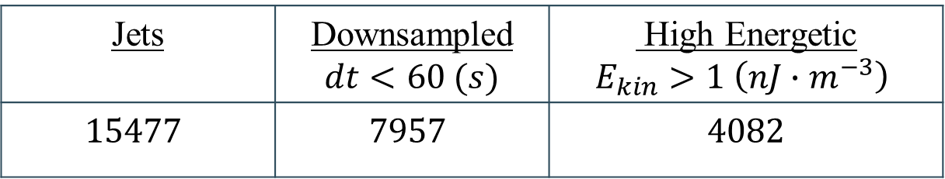
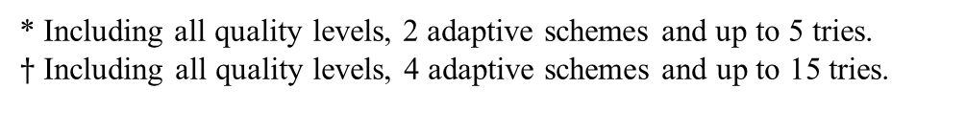
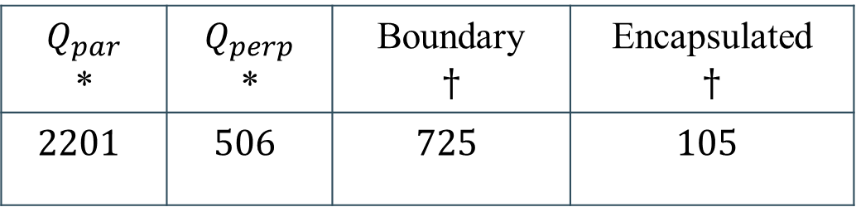
Updated database for Jets: 11/2015 – 01/2019
Jets | Downsampled $$dt<60 (s)$$ | High Energetic $$E_{kin}>1 \left(nJ∙m^{−3}\right)$$
$$15477$$ | $$7957$$ | $$4082$$
$$Q_{par}$$ * | $$Q_{perp}$$ * | Boundary $$†$$ | Encapsulated $$†$$
$$2201$$ | $$506$$ | $$725$$ | $$105$$
* Including all quality levels, 2 adaptive schemes and up to 5 tries.
$†$ Including all quality levels, 4 adaptive schemes and up to 15 tries.

Slide 17
Where are they?
Notes:
Maybe ()

Slide 18
Duration of each jet
Notes:
207

Slide 19
Characteristics of Qpar – Qperp – Boundary

Slide 20

Characteristics of Qpar – Qperp – Boundary
*Diff = $X−{\left\langle X\right\rangle }_{10min}$

Slide 21
Characteristics of Qpar – Qperp – Encapsulated

Slide 22
Characteristics of Qpar – Qperp – Encapsulated
*Diff = $X−{\left\langle X\right\rangle }_{10min}$

Slide 23
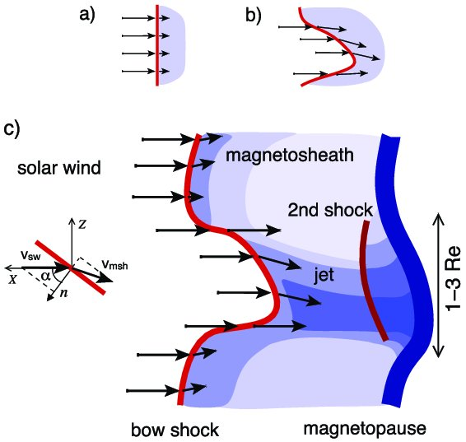
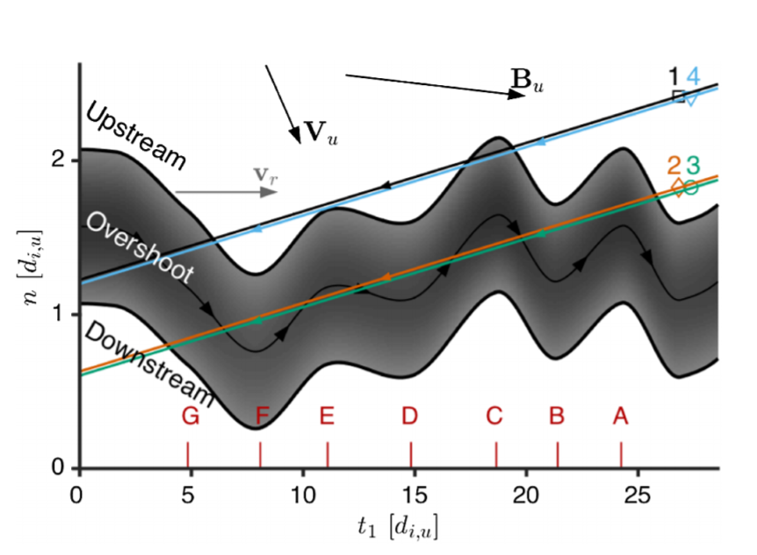
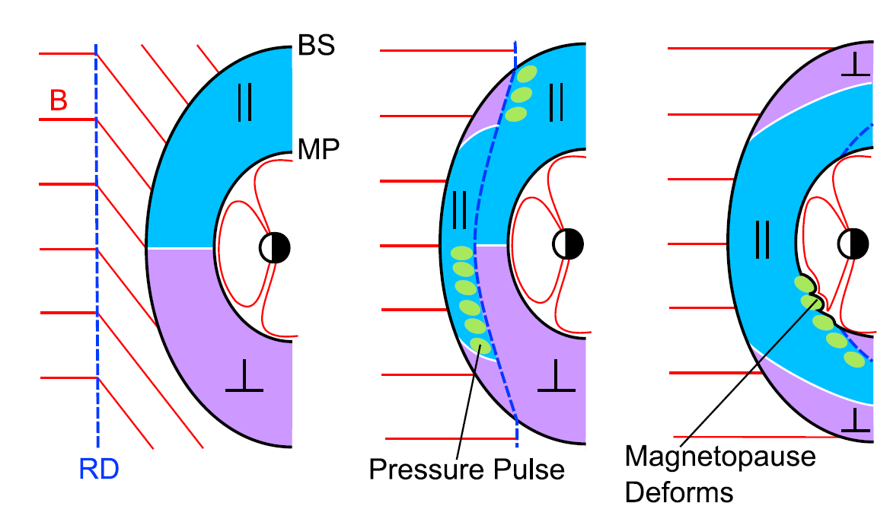
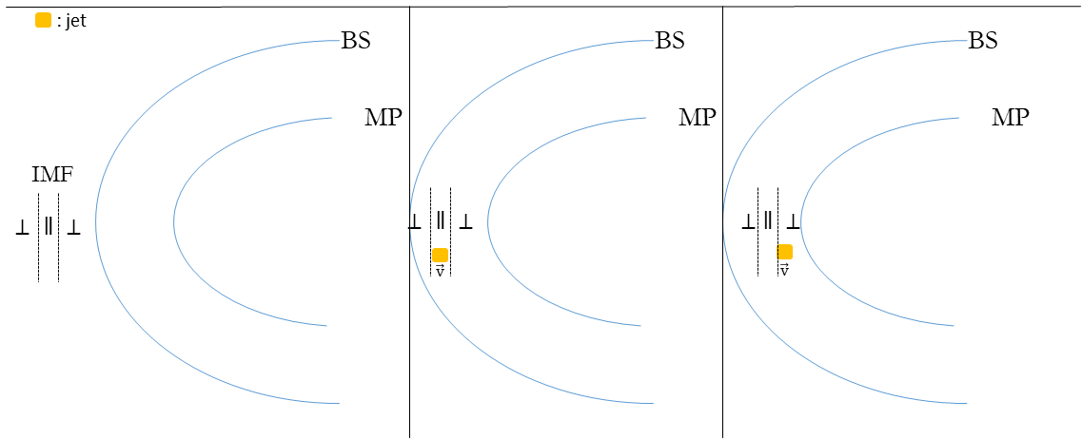
Mechanisms ideas for each jets
Quasi – Parallel
Quasi – Perpendicular
Hietala et al. (2012)
Johlander et al. (2016)
Boundary
Encapsulated
Archer et al. (2012)
Notes:
Quasi parallel and quasi perpendicular: Variations of “Shock ripple” mechanism (Local curvature effects). Solar wind crosses locally inclined part of the bow shock. The flow suffers less deceleration and heating than when parallel (Jet).
From Jump conditions we have normal component getting smaller and tangential staying the same.
Archer’s idea is connected changes in the IMF orientation.
Also shown in simulations, predicted large amplitude pulses when the local geometry changes from quasi perpendicular to quasi parallel. So we can say that there is an association to Rotational discontinuity in that case.

Slide 24












Encapsulated Jet – Idea proposed
Stage 1
Stage 2
Stage 3
: jet
BS
BS
BS
MP
MP
MP
IMF
$$∥$$
$$⊥$$
$$∥$$
$$⊥$$
$$∥$$
$$⊥$$
$$⊥$$
$$⊥$$
$$⊥$$
$$\vec{v}$$
$$\vec{v}$$
$${\vec{v}}_{J}>{\vec{v}}_{p}$$

Slide 25
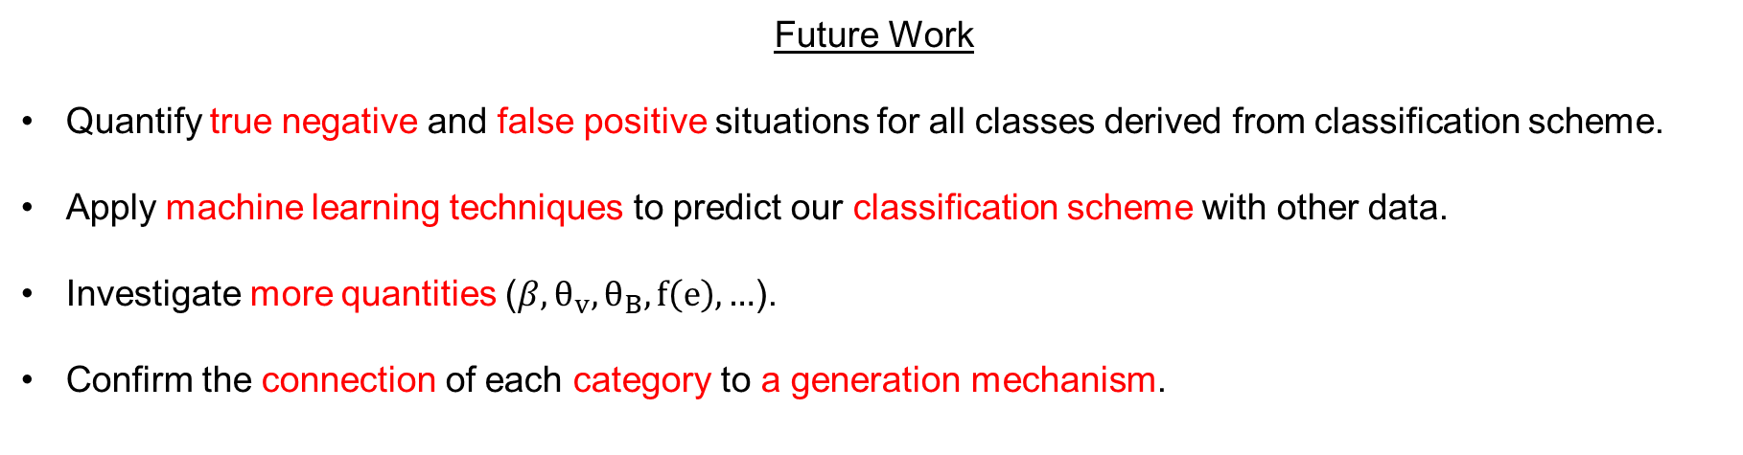
Conclusion
Summary
Obtained a vast database of Magnetosheath Jets (~10.000) using all available MMS data.
Successfully classified jets into several different categories showing different attributes.
Analyzed their characteristics and found interesting similarities & differences compared to earlier results.
Proposed a different generation mechanism for each jet class that was found.
Future Work
Quantify true negative and false positive situations for all classes derived from classification scheme.
Apply machine learning techniques to predict our classification scheme with other data.
Investigate more quantities ($β,θ_{v},θ_{Β},f\left(e\right), …$).
Confirm the connection of each category to a generation mechanism.

Slide 26
Extras

Slide 27
Characteristics of Qpar – Qperp – Boundary

Slide 28
Characteristics of Qpar – Qperp – Boundary

Slide 29
Characteristics of Qpar – Qperp – Encapsulated

Slide 30
Characteristics of Qpar – Qperp – Encapsulated

Slide 31
“Extra” Categories
Border Jets
Unclassified Jets

Slide 32
Multistage Classification – Simplified Scheme
Stages
Pre-jet-post
Categories
Quasi – Par.
Quasi – Perp.
Boundary
Encapsulated
Unknown
Quality Check
Criteria Number
Level I – III

Slide 33
Multistage Classification – Simplified Scheme
Stages
Pre-jet-post
(2) Adjust times & Values
(a) Jet Period
(b) Pre/post Period
Categories
Quasi – Par.
Quasi – Perp.
Boundary
Encapsulated
Unknown
Quality Check
Criteria Number
Level I – III
Tries Required
1 – 5 / stage

Slide 34
Multistage Classification – Simplified Scheme
Stages
Pre-jet-post
(2) Adjust times & Values
(a) Jet Period
(b) Pre/post Period
Categories
Quasi – Par.
Quasi – Perp.
Boundary
Encapsulated
Unknown
Quality Check
Criteria Number
Level I – III
Tries Required
1 – 5 / stage

Slide 35
Multistage Classification – Simplified Scheme
Stages
Pre-jet-post
(2) Adjust times & Values
(a) Jet Period
(b) Pre/post Period
(3) Normalizing
Categories
Quasi – Par.
Quasi – Perp.
Boundary
Encapsulated
Unknown
Quality Check
Criteria Number
Level I – III
Tries Required
1 – 5 / stage

Slide 36
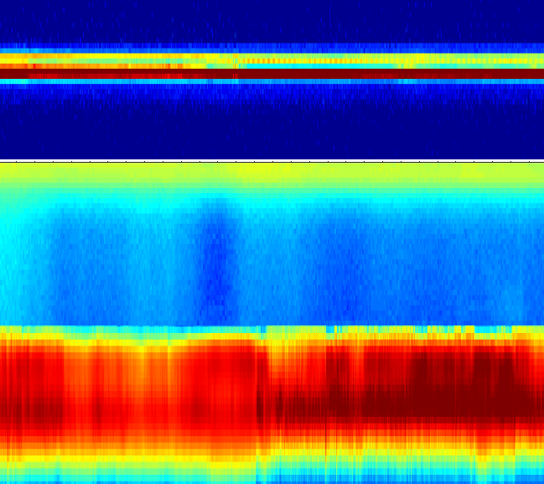
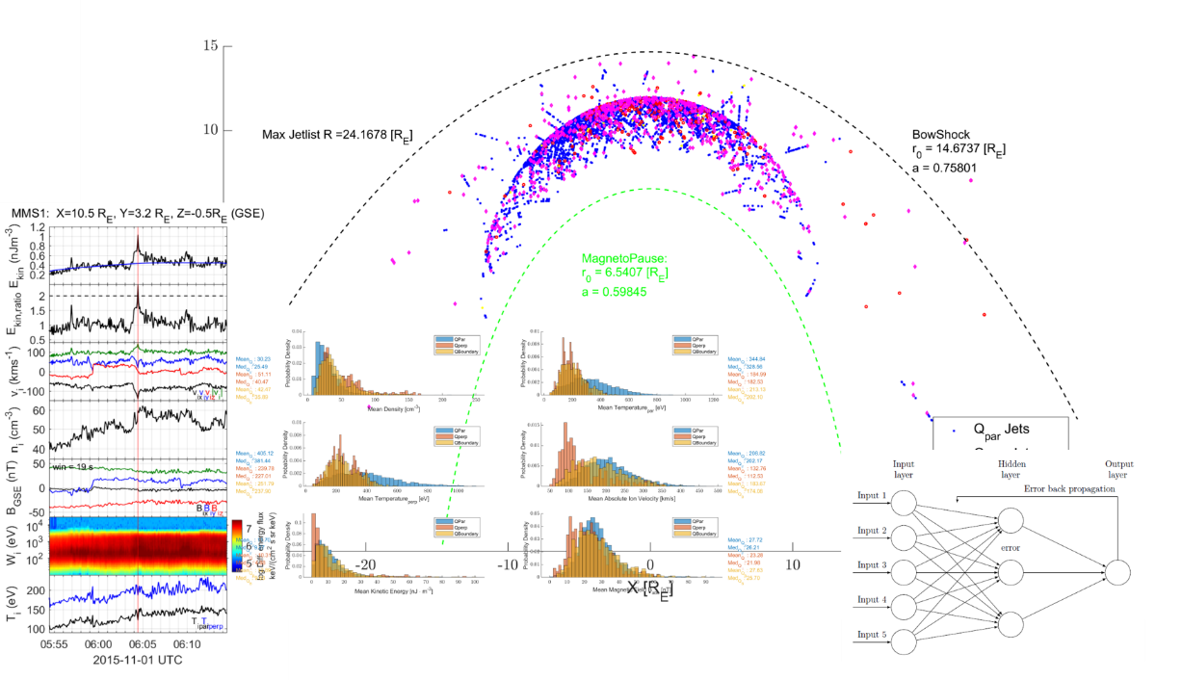
Searching for Jets
Loading MMS data
Classify regions (MS/SW/PSH)
Search for Magnetosheath Jets on MS
Save Area and Jet Values ($v,P_{dyn},ρ,P,Β,Ε, T,θ$...)
Save Area and Jet Values (v,𝑃_𝑑𝑦𝑛,𝜌,𝑃,Β,Ε, T,θ...)
Jet Classification
Statistics – Jet Comparison
Find patterns & Possible origin and generation mechanism
TBD …
SW
PSH
MS
Notes:
Briefly explain procedure

