Slide 1



Magnetosheath Jets Close to the Bow Shock: Generation Mechanisms Using MMS
Savvas Raptis¹, Tomas Karlsson¹ , and collaborators
¹Division of Space and Plasma Physics, KTH Royal Institute of Technology, Sweden
The 15th Hellenic Astronomical Conference
07/07/2021

Slide 2
Introduction

Slide 3
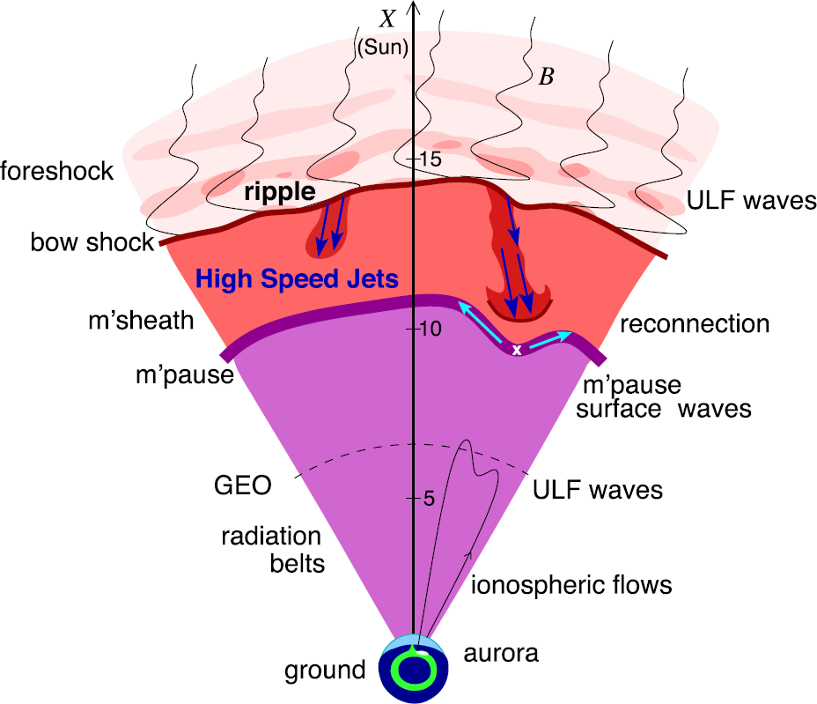
Magnetosheath Jets
Definition
Magnetosheath jets are transient localized enhancements of dynamic pressure (density and/or velocity increase)
e.g. 200% dynamic pressure enhancement compared to background magnetosheath
Related phenomena
Radiation belts
Aurora
Magnetopause reconnection
Magnetopause penetration
Shock acceleration
Magnetopause surface eigenmodes
ULF waves (see Christos’ talk few minutes ago)
Plaschke F. et al. (2018); sketch by H. Hietala | Space Sci. Rev

Slide 4
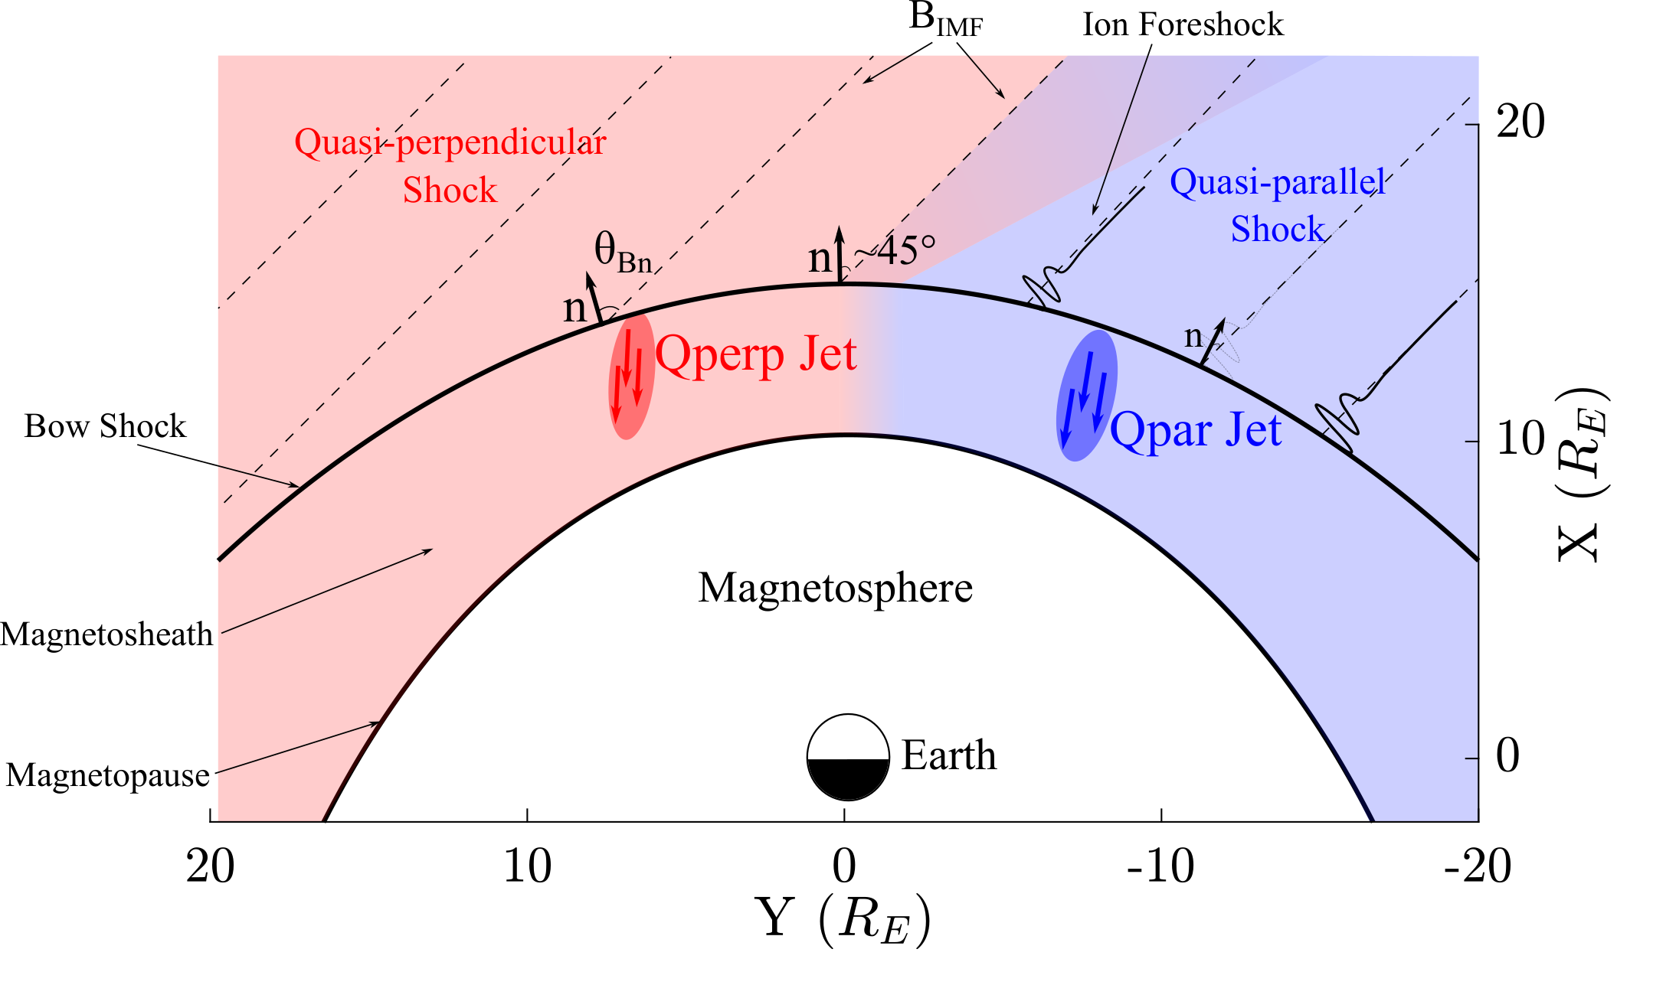
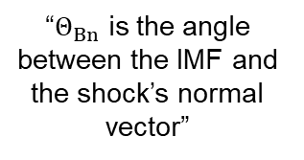
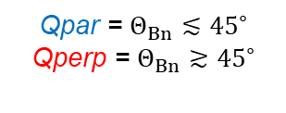
Shock, Magnetosheath & Jet classification
“$Θ_{Βn}$ is the angle between the IMF and the shock’s normal vector”
Qpar = $Θ_{Βn}≲{45}^{∘}$
Qperp = $Θ_{Βn}≳{45}^{∘}$
”Jets are found ~9 times more often behind the Qpar bow shock”
Raptis, Karlsson, et al. (2020) | JGR
Raptis, Aminalragia-Giamini et al. (2020) | Front. Astron. Space Sci
Palmroth M., Raptis S., et al. (2021) | ANGEO
Kajdič, Raptis et al. (2021) | GRL
Karlsson, Raptis, et al. (2021) | JGR - Under Review
Raptis, et al. (2021b) | Ongoing

Slide 5
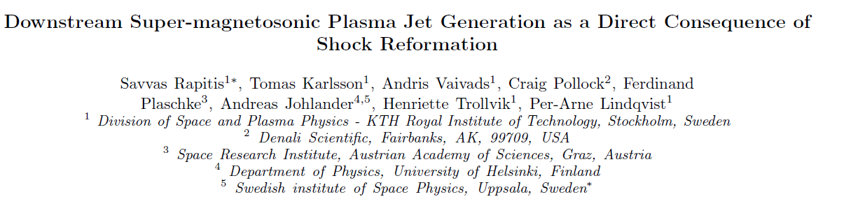
Latest Results (to be submitted)
Raptis, Karlsson et al. (2021a) | Ongoing

Slide 6
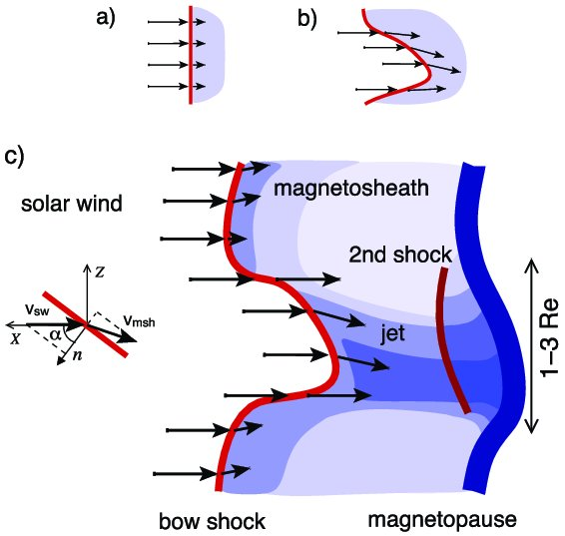
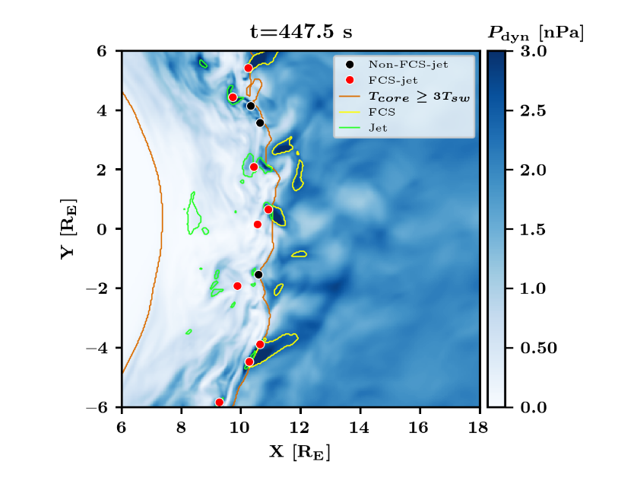
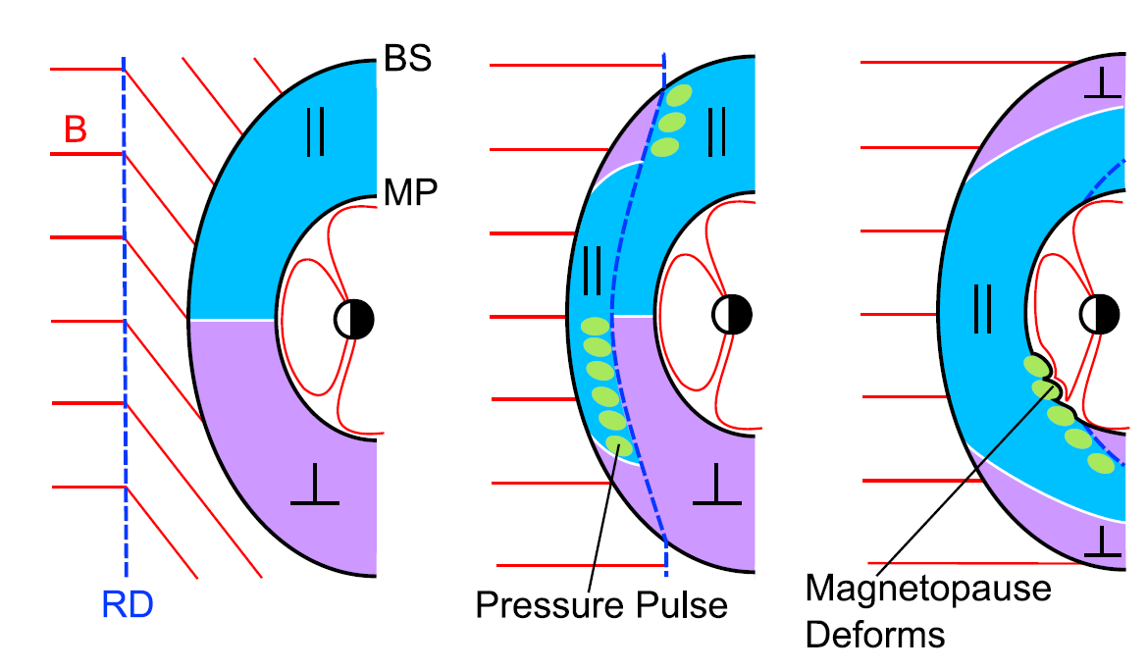
How are these jets created ?
Shock ripples
SW discontinuities
Foreshock Structures
Hietala et al. (2009,2012)
Archer et al. (2012)
Suni et al. (2021)

Slide 7
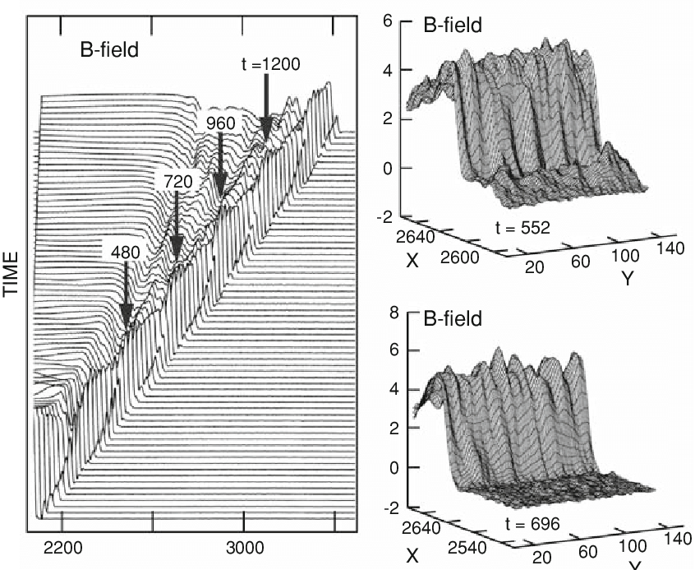
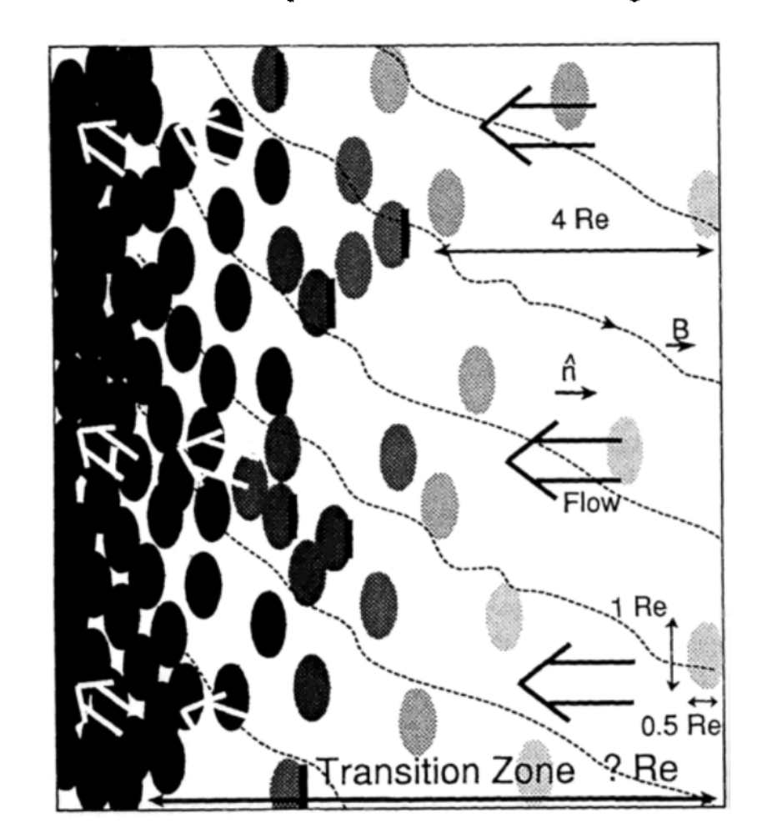
Shock Reformation idea
Lembège and Savoini 2002
Schwartz, 1990

Slide 8
Results

Slide 9
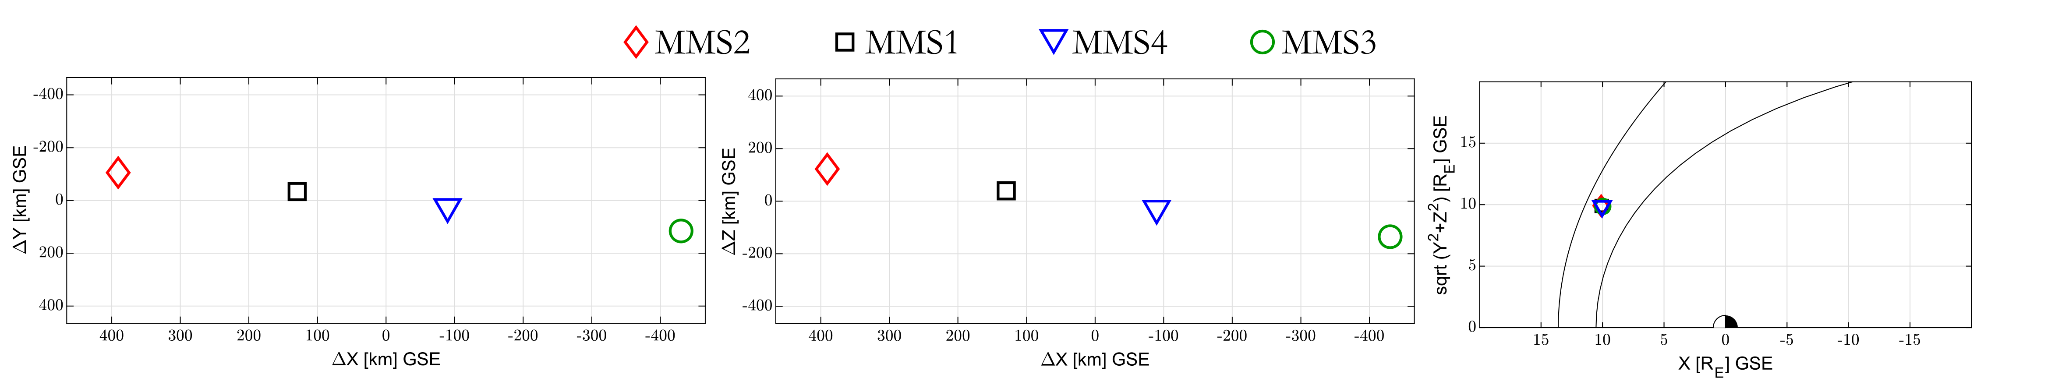
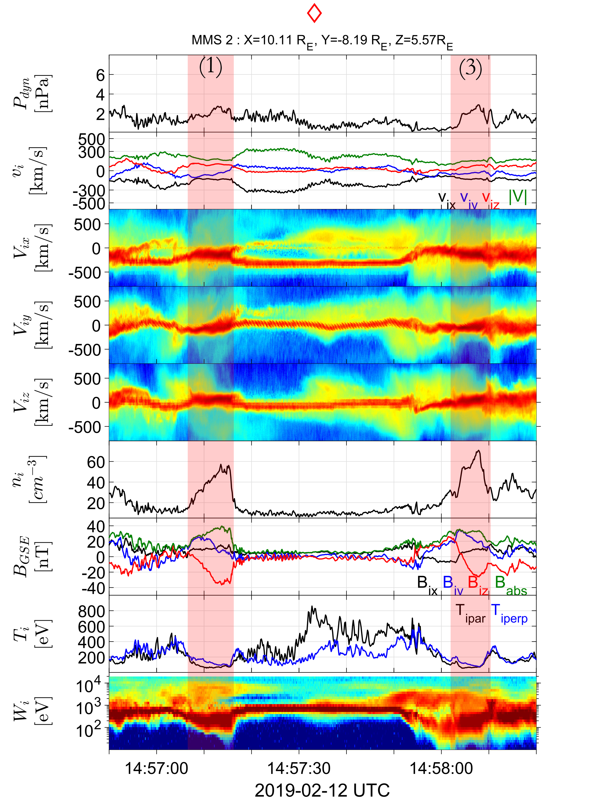
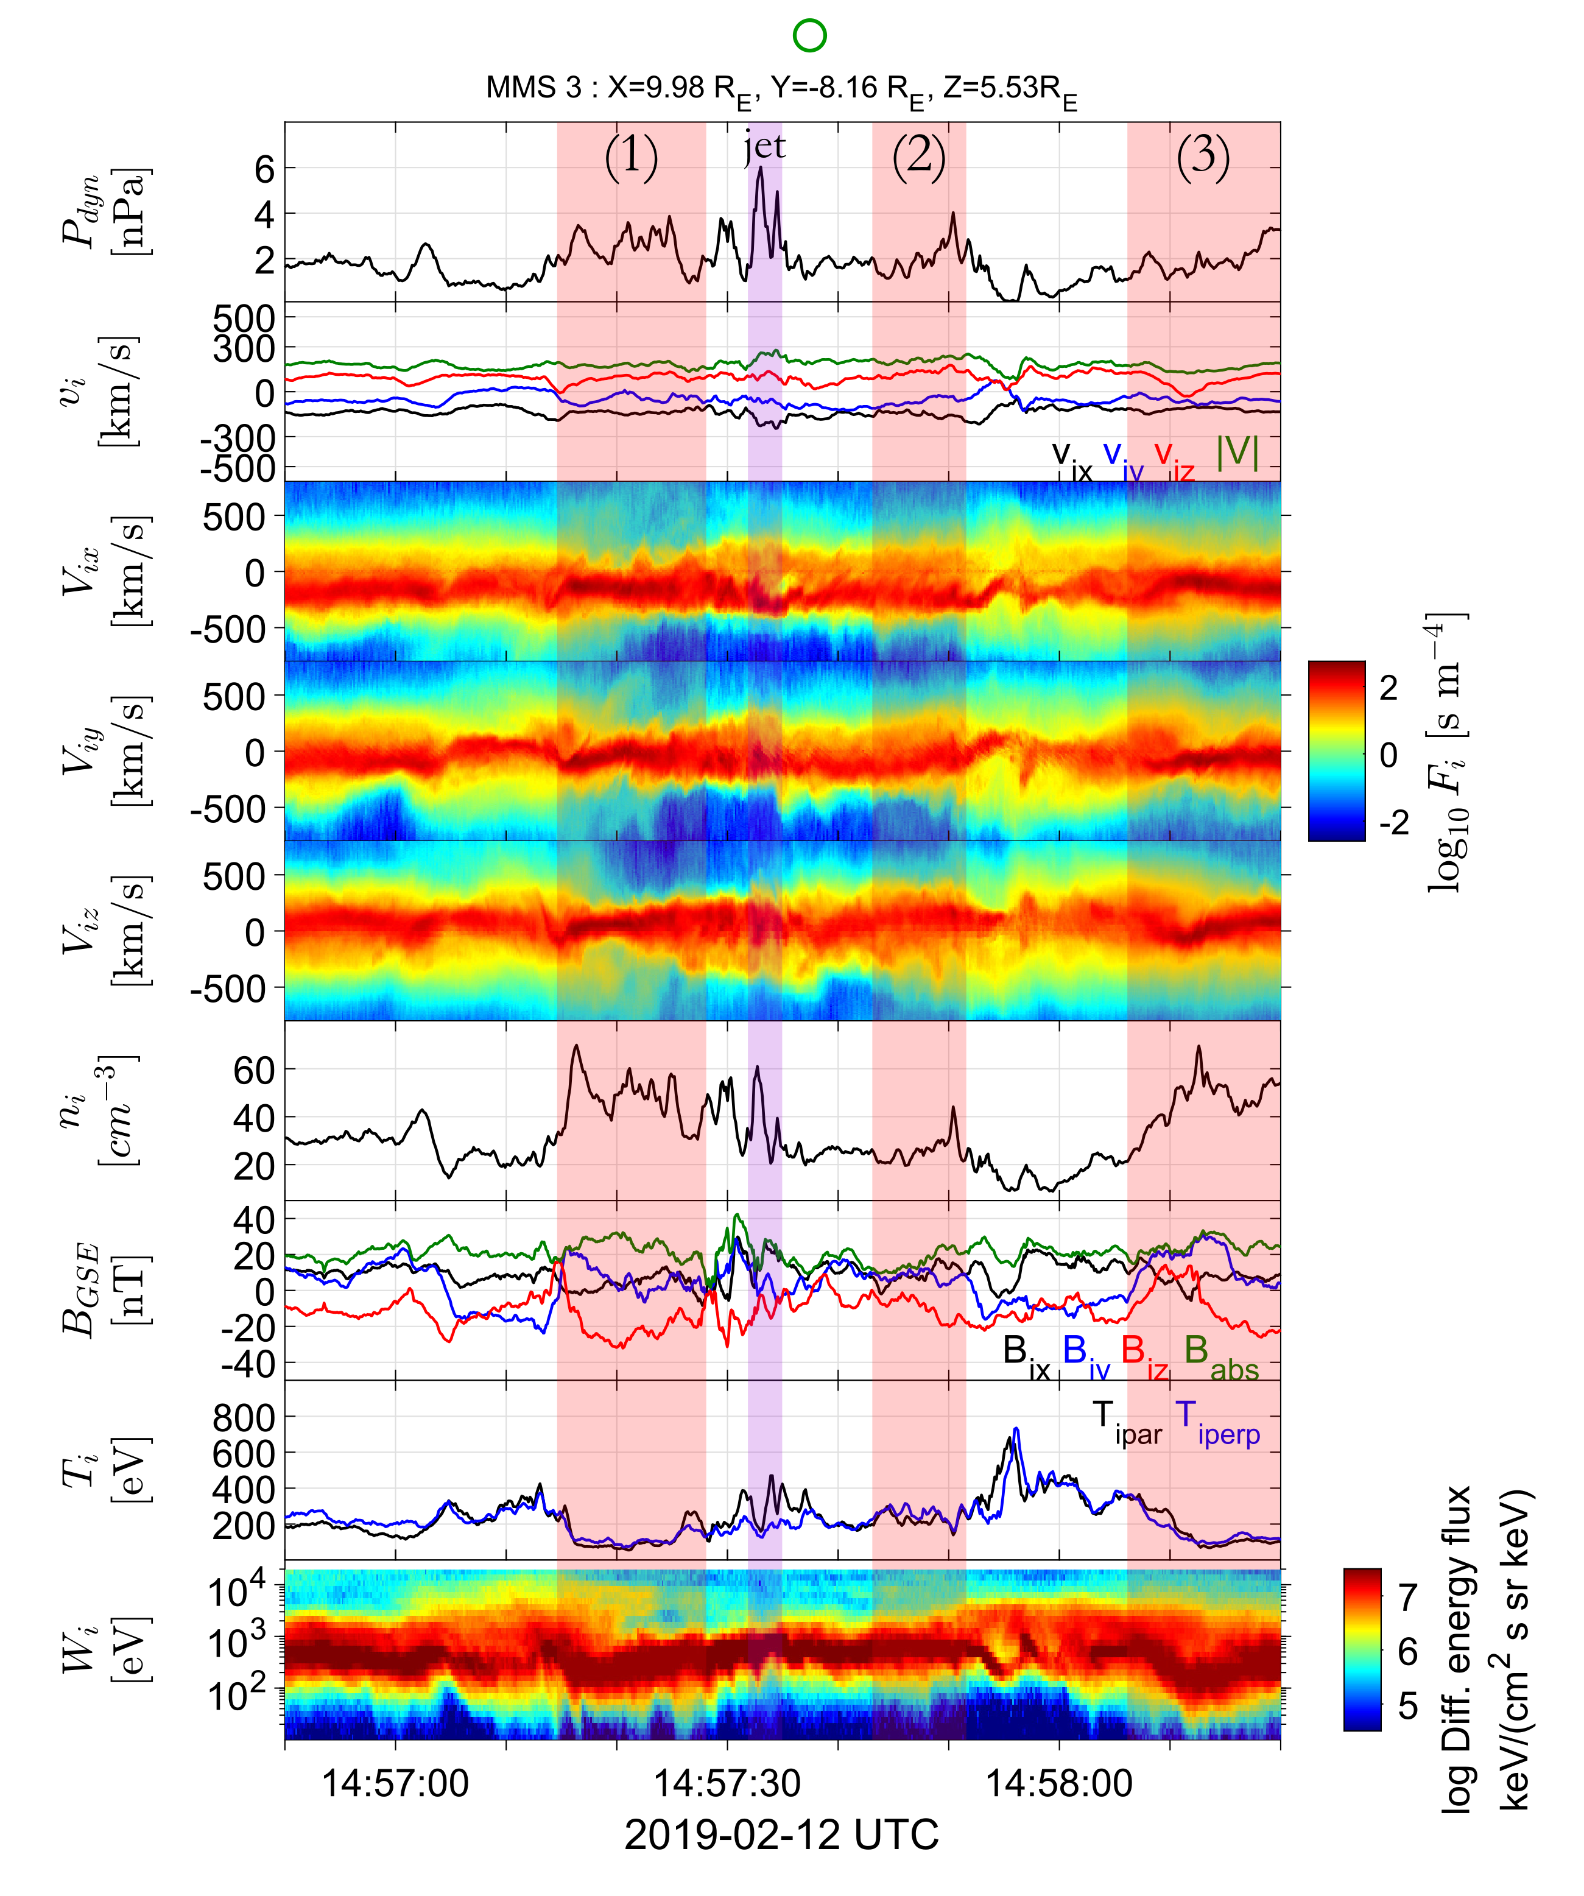
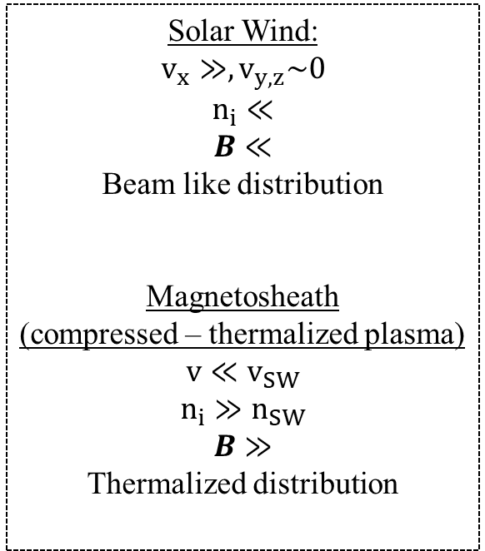
Solar Wind:
$$v_{x}≫, v_{y,z}\sim 0$$
$$n_{i}≪$$
$$B≪$$
Beam like distribution
Magnetosheath
(compressed – thermalized plasma)
$$v≪v_{SW}$$
$$n_{i}≫n_{SW}$$
$$B≫$$
Thermalized distribution
Dyn. Pres
Ion velocity
Reduced VDFs
Ion Density
Magnetic Field
Ion Temperature
Energy Spectrum
Raptis, et al. (2021a) | Ongoing

Slide 10
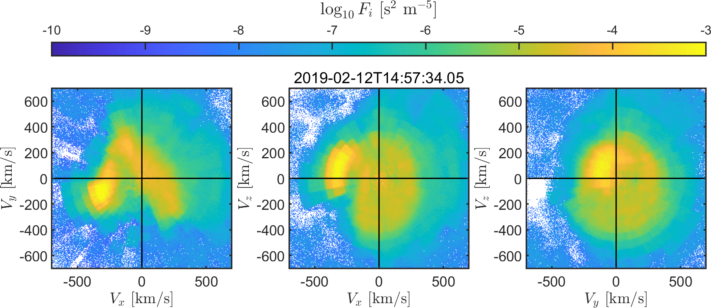
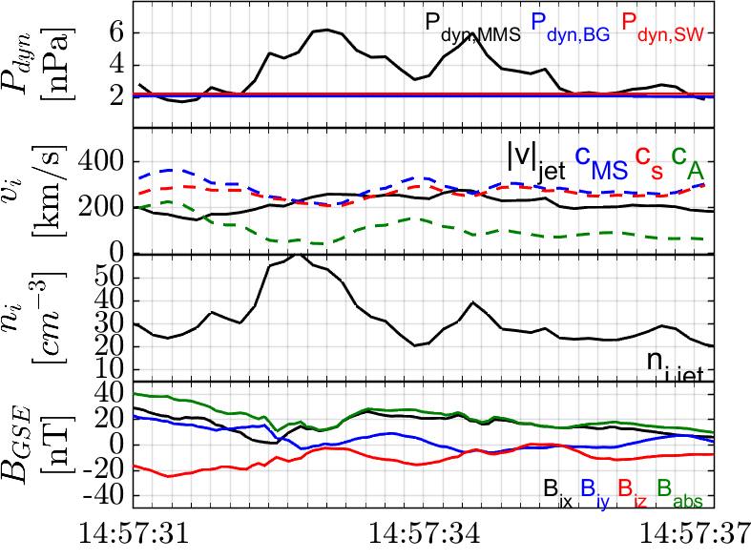
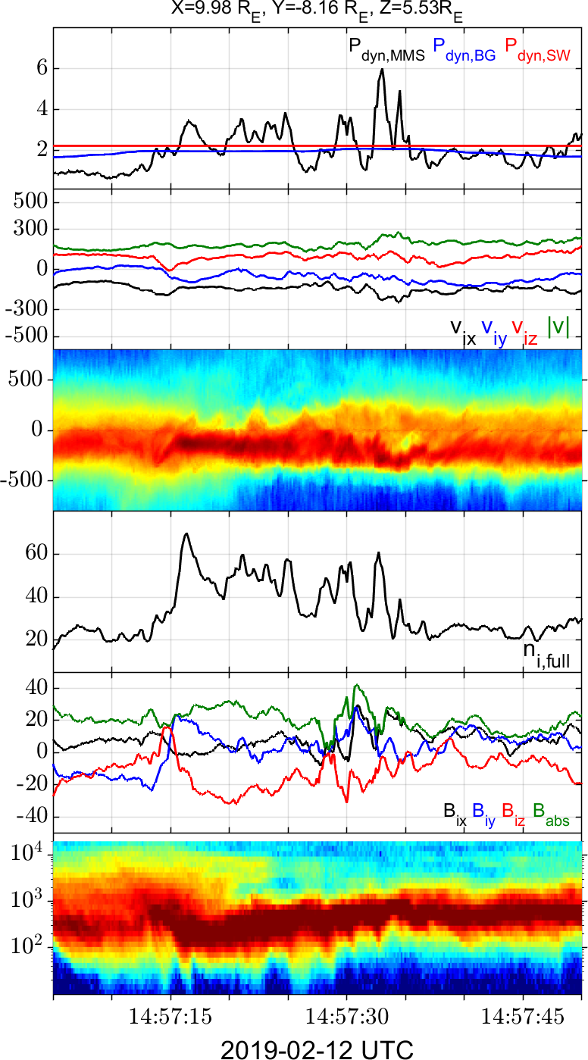
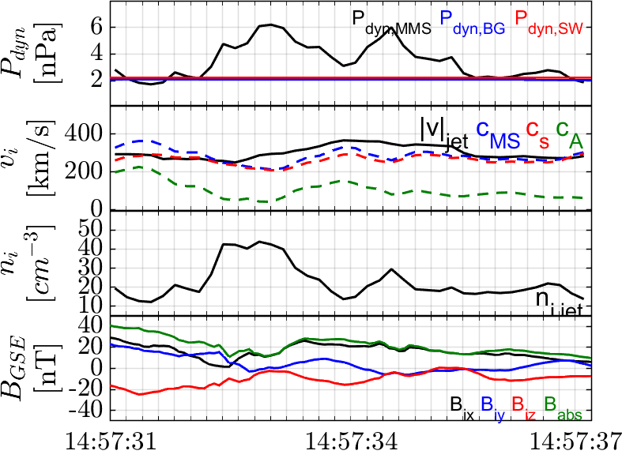



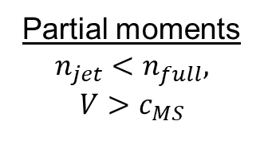

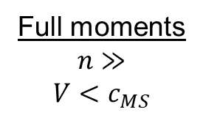


Jet : Full vs Partial plasma moments
Actual jet
$$P_{dyn}$$
$$V$$
Full moments
$$n≫$$
$$V<c_{MS}$$
$$V_{x}$$
$$n_{i}$$
$$B$$
Partial moments
$$n_{jet}<n_{full},$$
$$V>c_{MS}$$
$$W_{i}$$

Slide 11
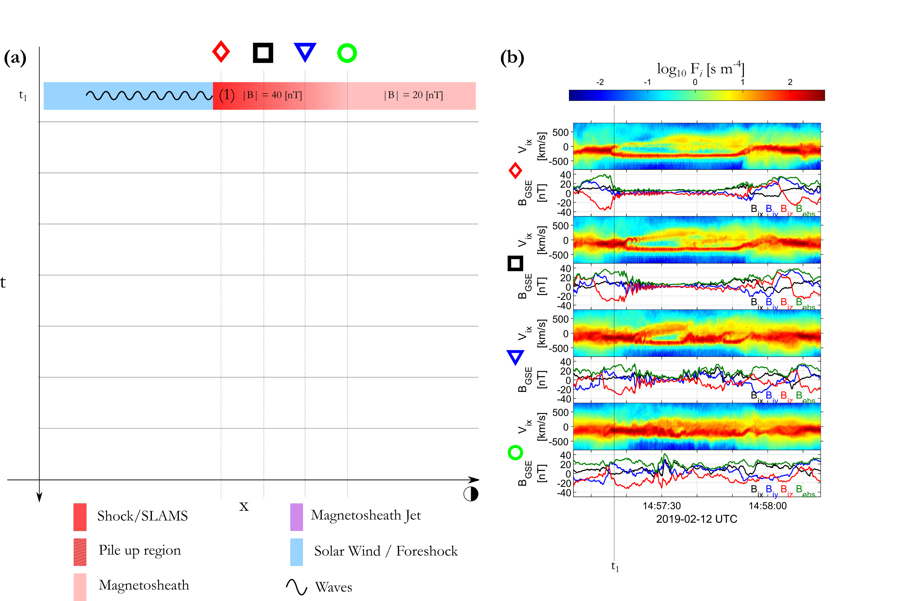
Whole mechanism & physical picture
Raptis, Karlsson et al. (2021a) | Ongoing

Slide 12
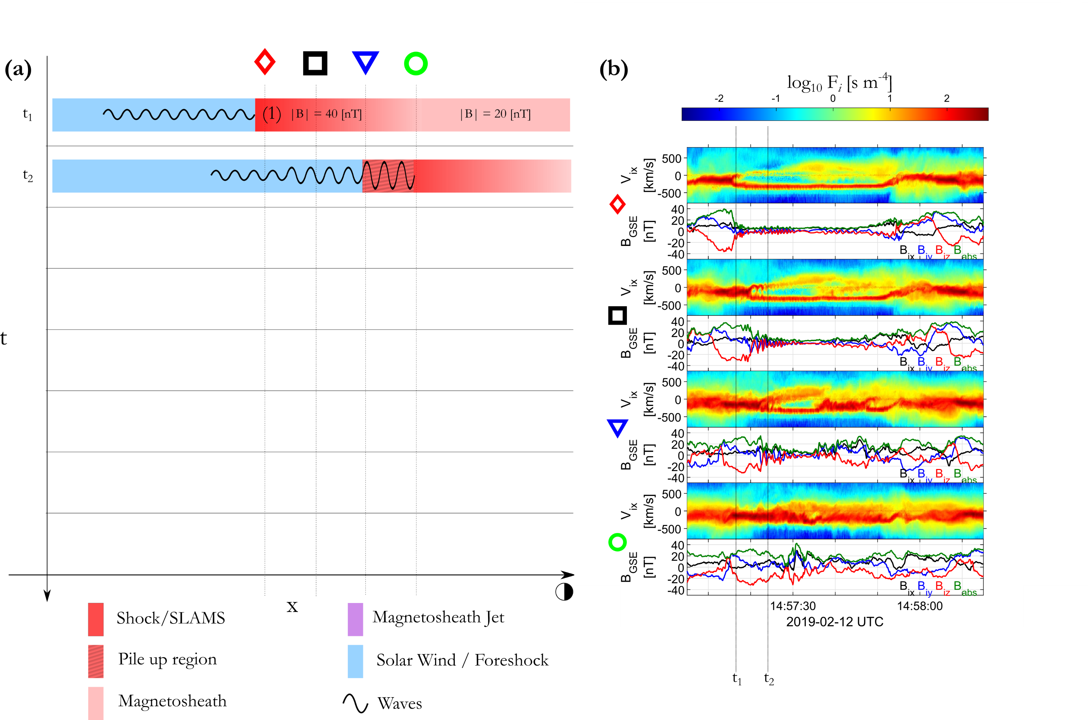
Whole mechanism & physical picture
Raptis, Karlsson et al. (2021a) | Ongoing

Slide 13
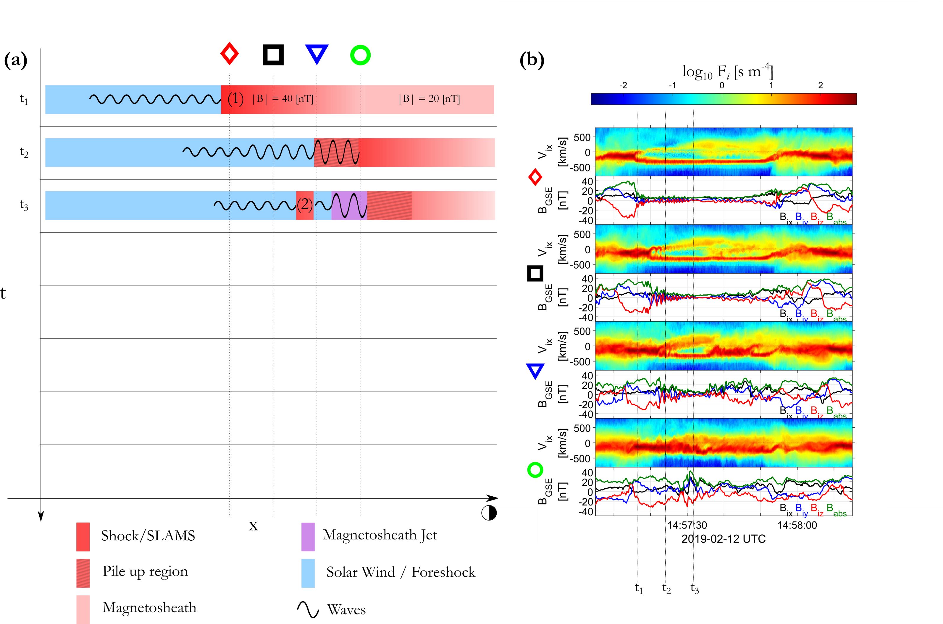
Whole mechanism & physical picture
Raptis, Karlsson et al. (2021a) | Ongoing

Slide 14
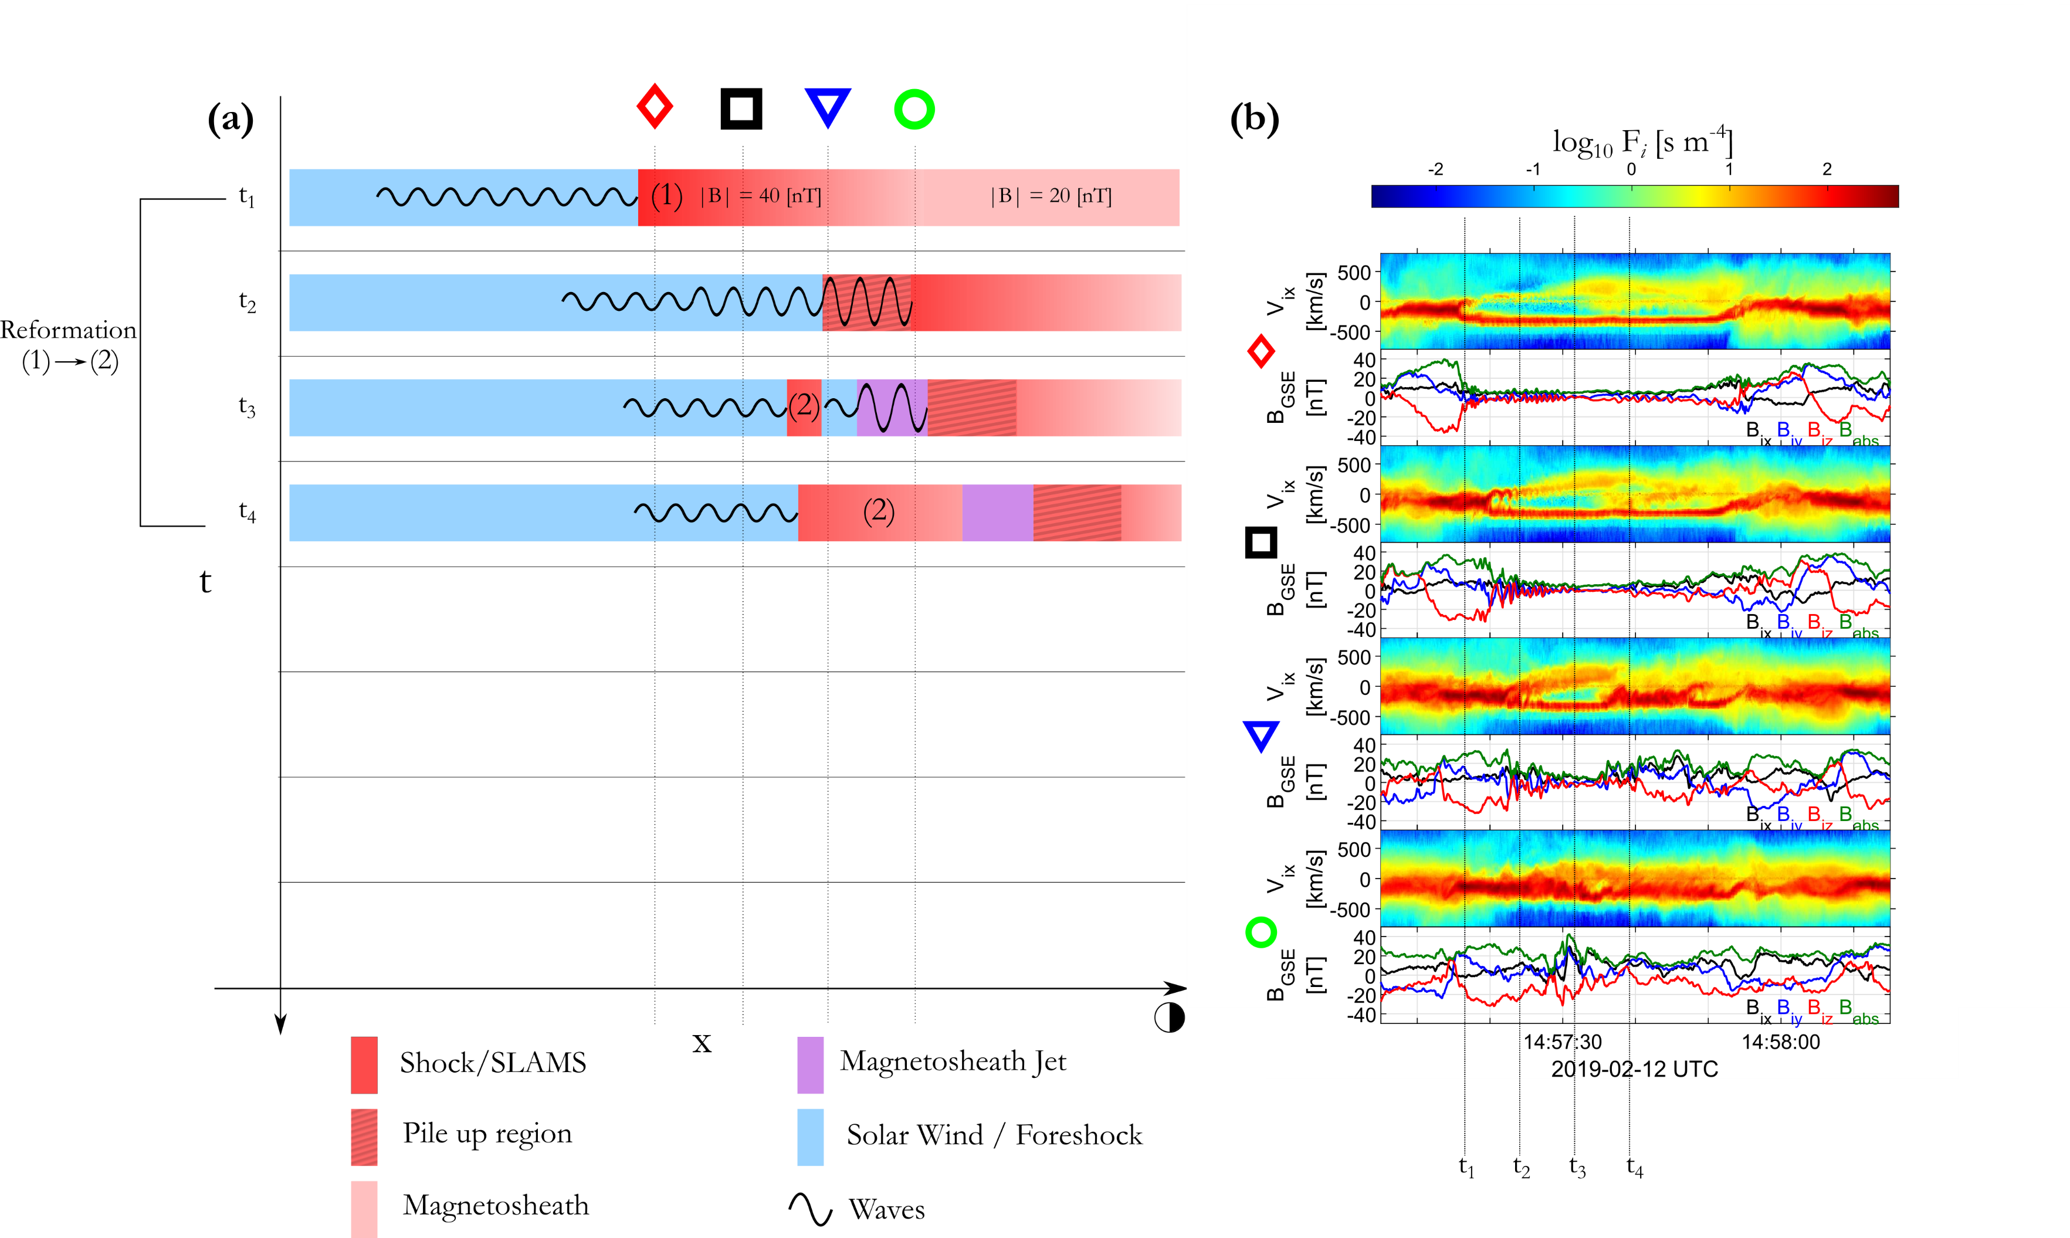
Whole mechanism & physical picture
(1)
(2)
Raptis, Karlsson et al. (2021a) | Ongoing

Slide 15
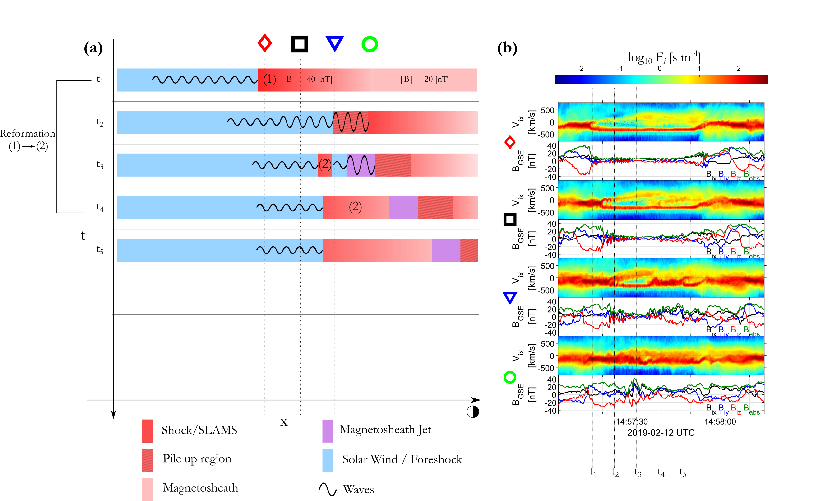
Whole mechanism & physical picture
Raptis, Karlsson et al. (2021a) | Ongoing

Slide 16
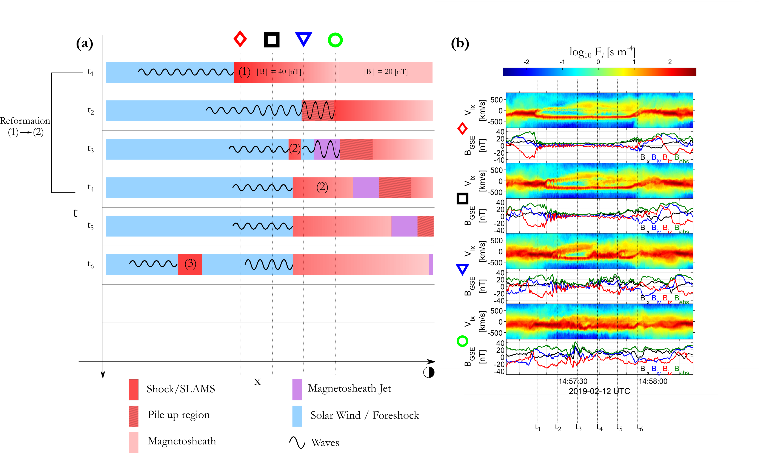
Whole mechanism & physical picture
Raptis, Karlsson et al. (2021a) | Ongoing

Slide 17
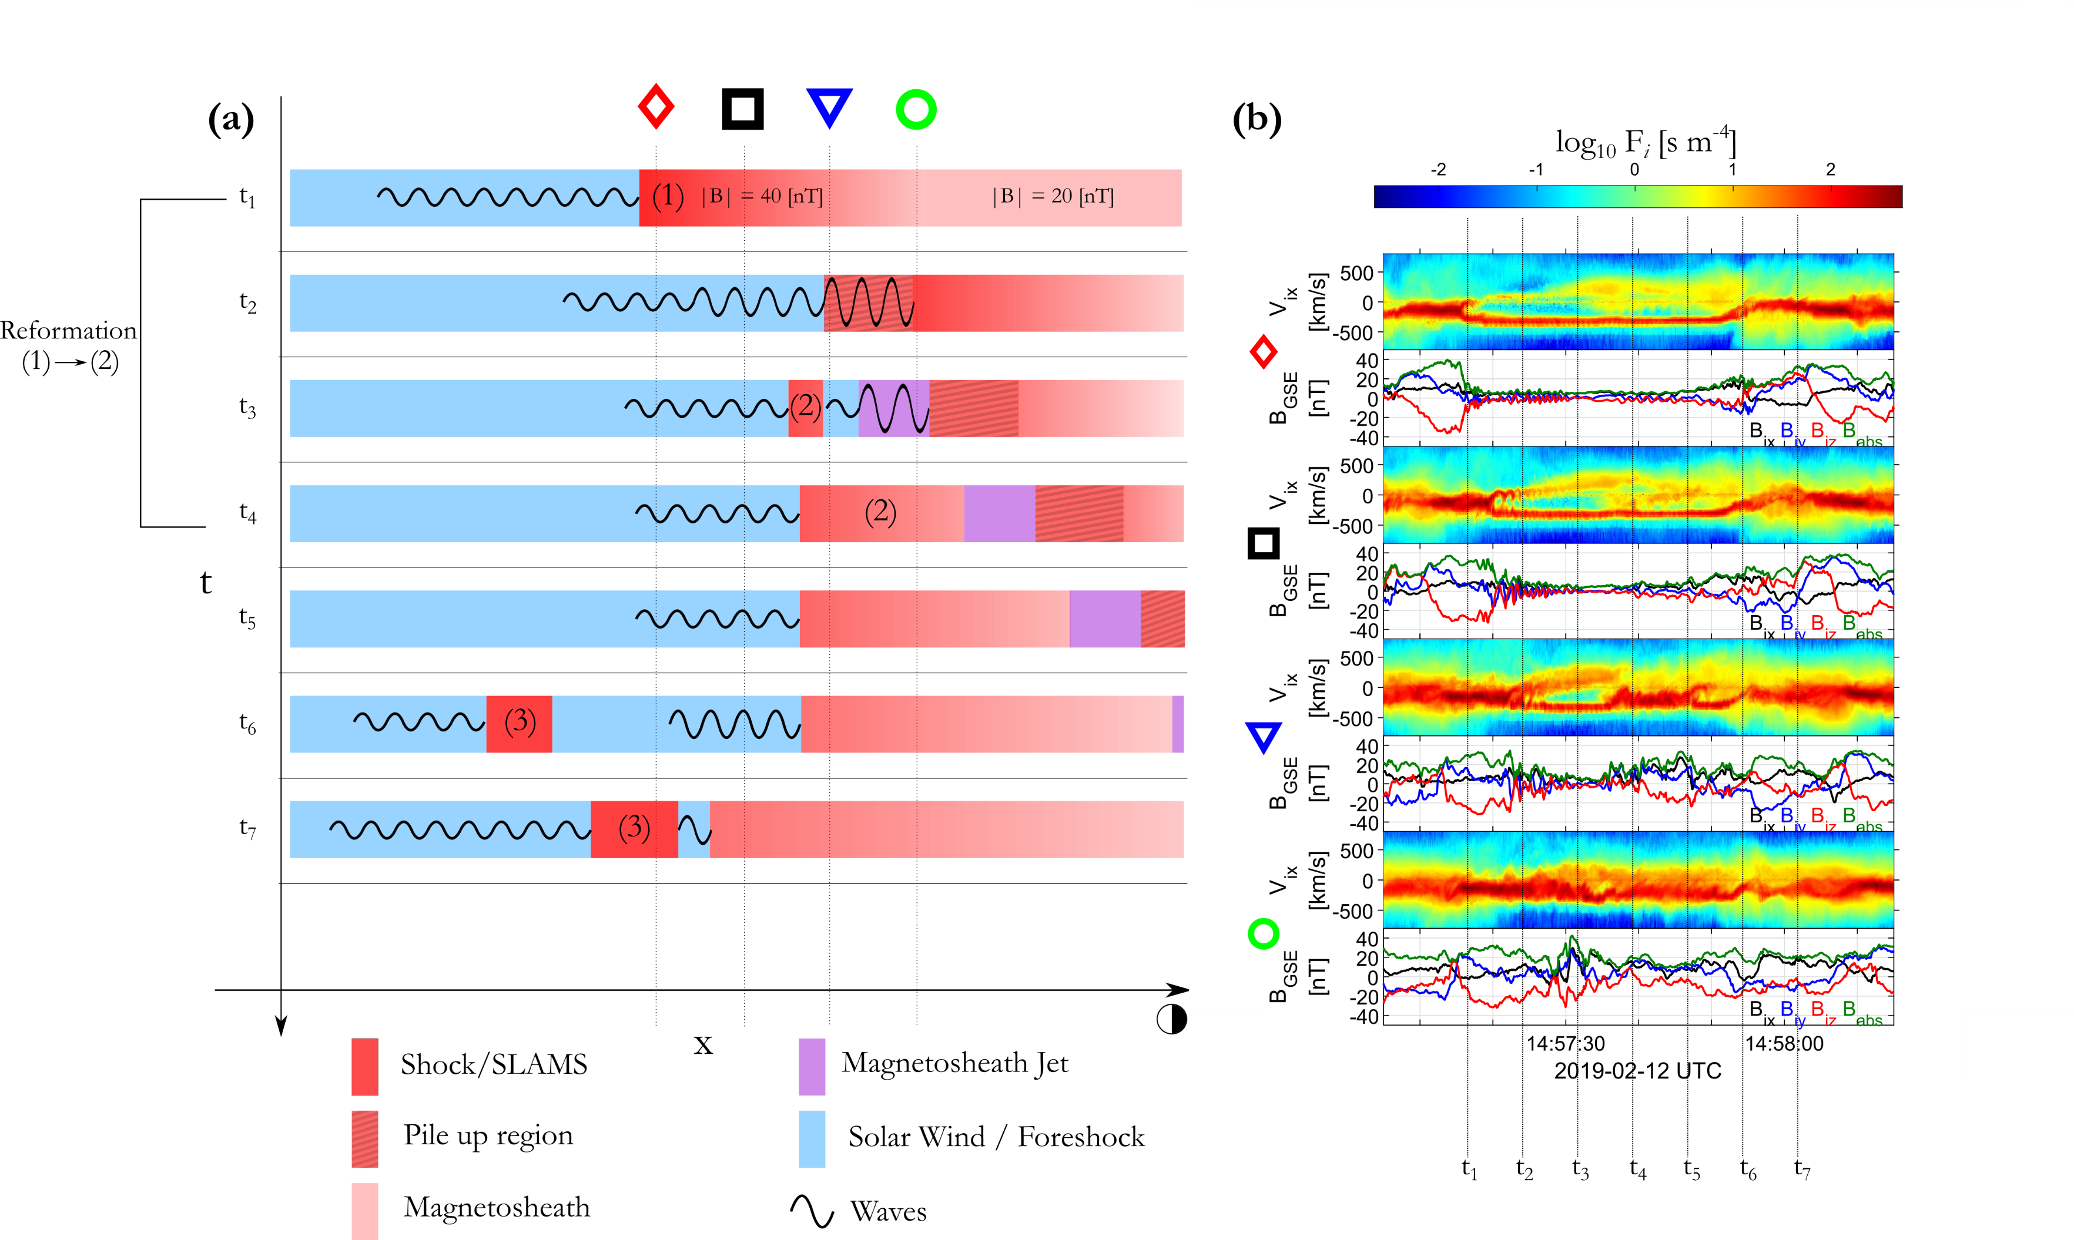
Whole mechanism & physical picture
Raptis, Karlsson et al. (2021a) | Ongoing

Slide 18
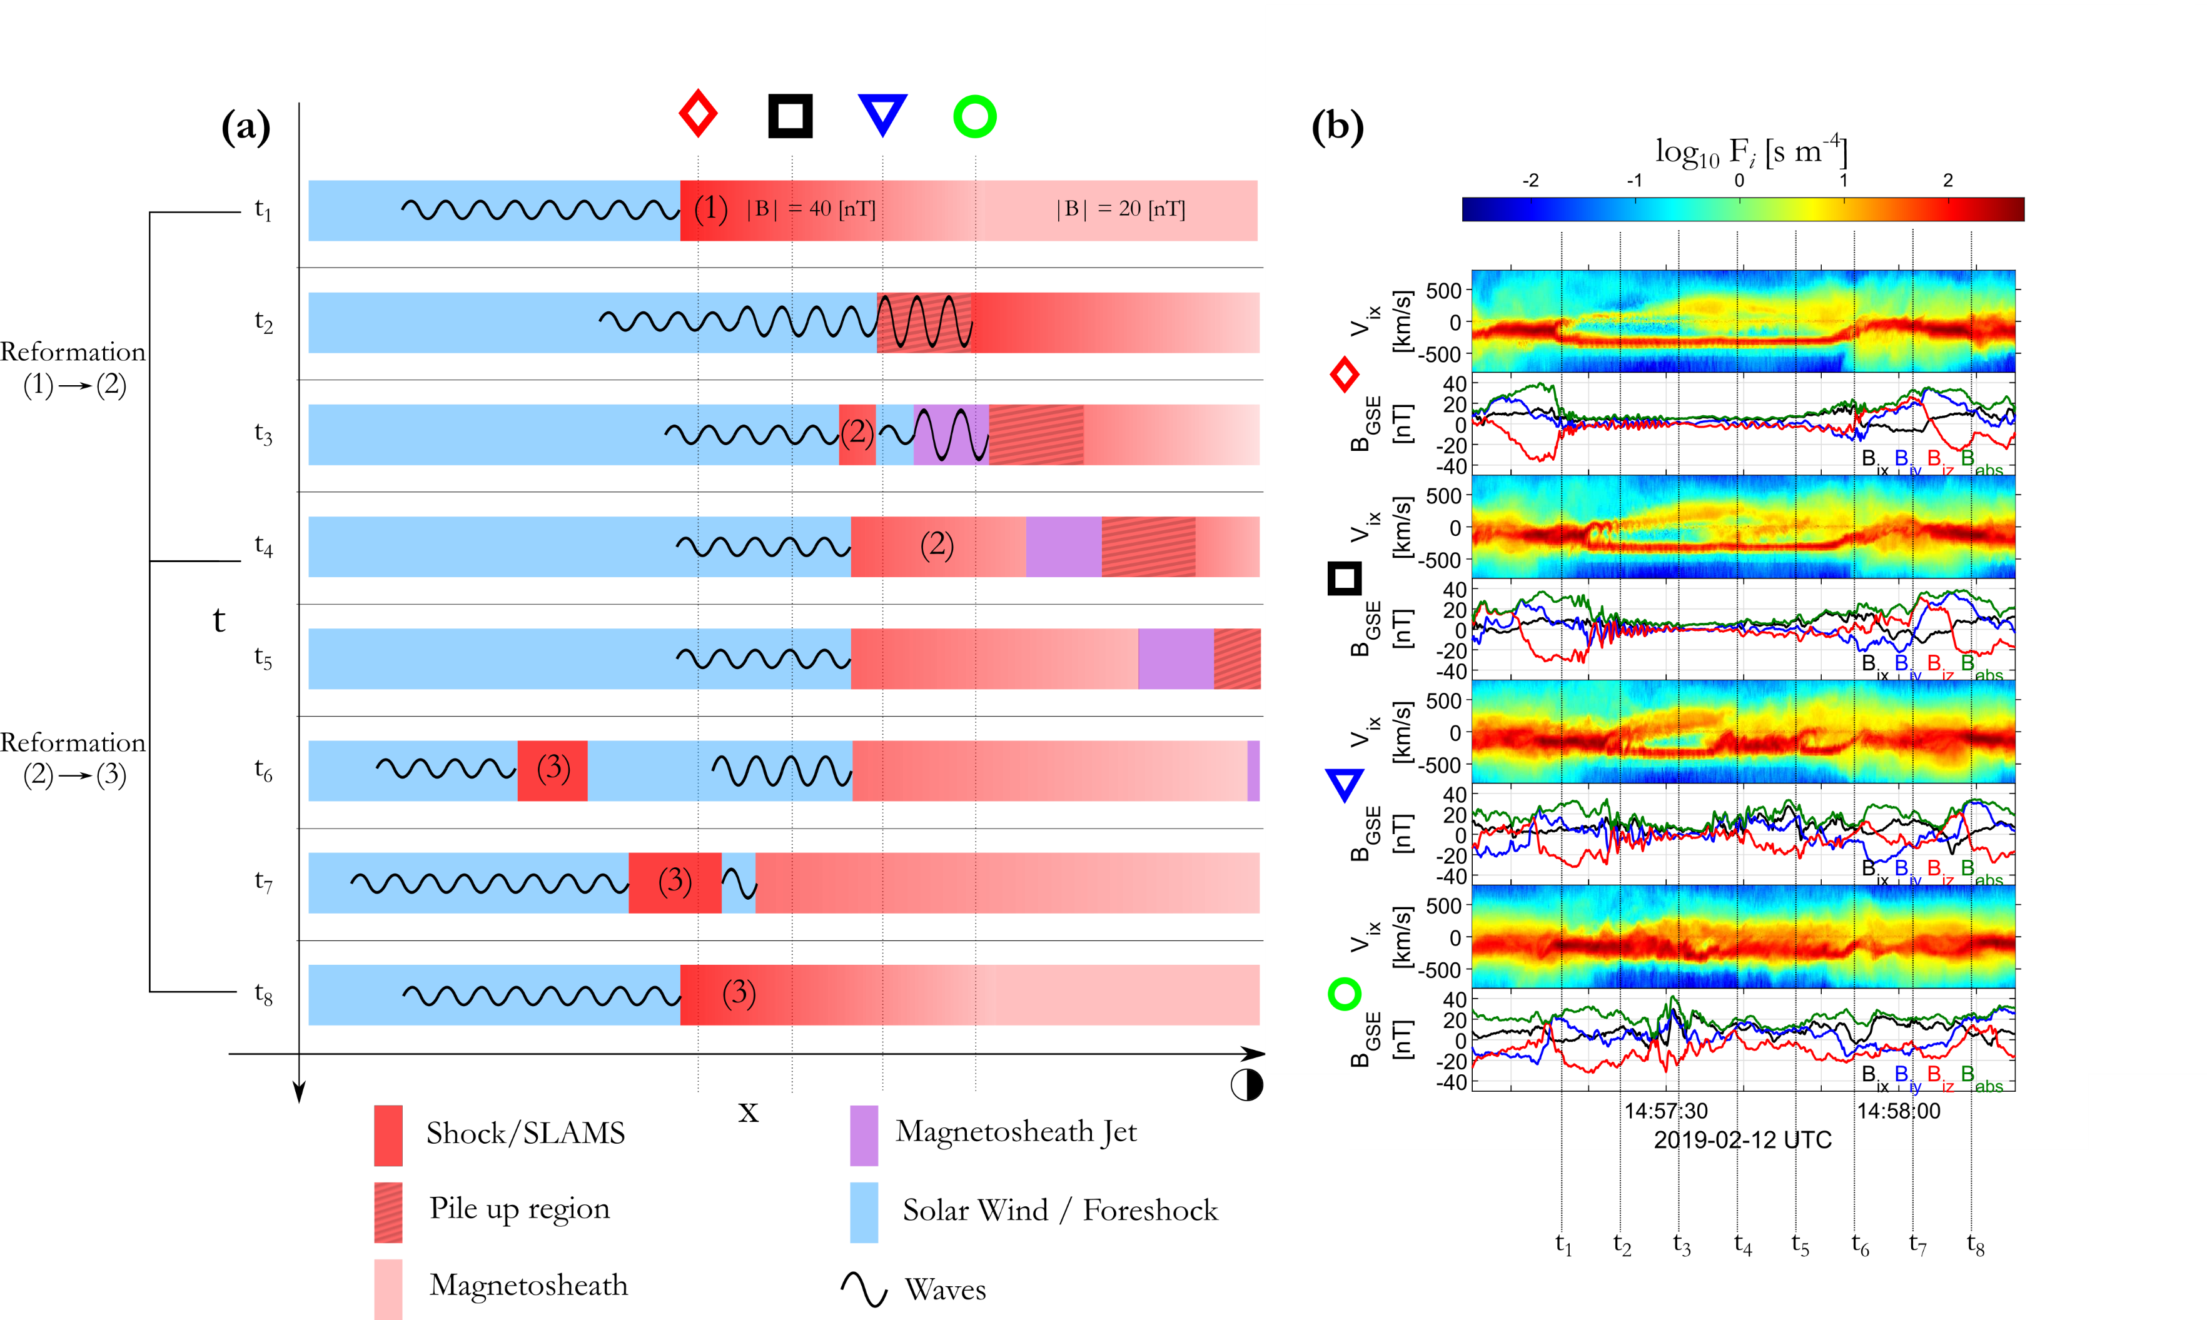
Whole mechanism & physical picture
(1)
(2)
(3)
Raptis, Karlsson et al. (2021a) | Ongoing

Slide 19


Summary & Conclusion
Main points
In-situ observations of shock fronts (SLAMS) becoming “embedded plasmoids” (density enhanced downstream regions).
First in-situ observations of jets generated by the dynamical evolution of collisionless shock (Reformation)
Implications
Direct observations of jets generated as consequence of the dynamical evolution of shocks. Possibly a fundamental process of collisionless shocks that can be found everywhere in planetary, astrophysical and laboratory shocks.
Future work
Simulation comparison (ongoing, already very supportive results from various groups)
Statistical confirmation (need more events, currently 3 of very similar signatures)
Further physical modeling (Can this process explain jets close to MP ? How exactly are the dynamic evolution of this particular population change in time while they propagate ?)

Slide 20
Extras

Slide 21
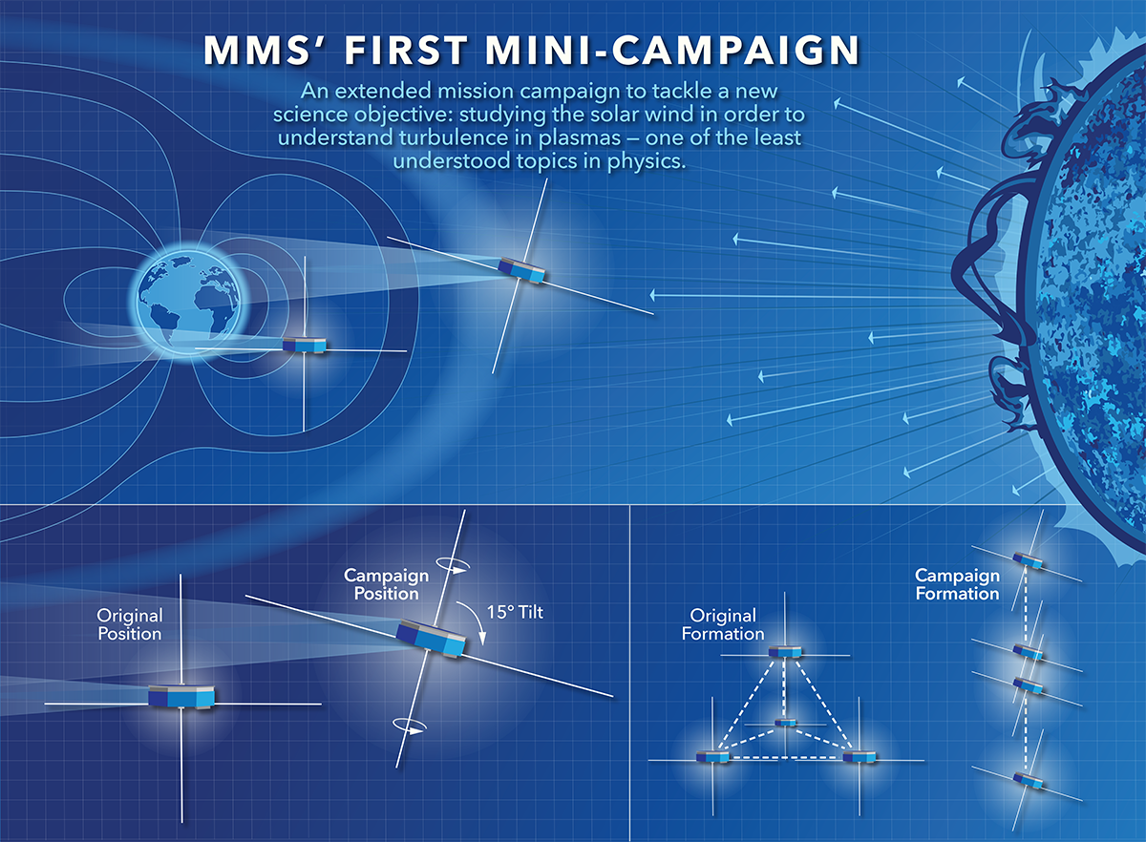


MMS spacecraft + String of Pearl Configuration
Very useful for people studying the collisionless shock evolution
Bow Shock
Magnetopause
Earth

Slide 22
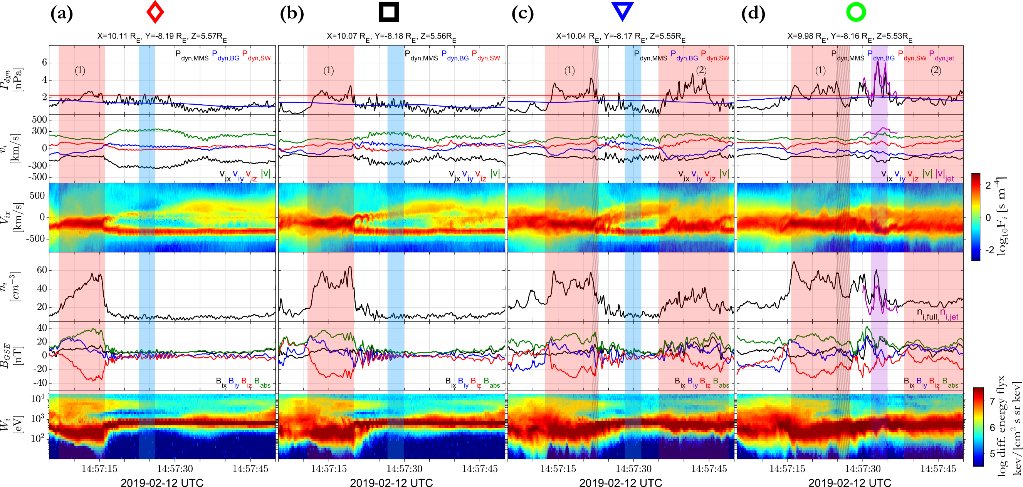
Evolution of the event from MMS1-4
Embedded plasmoid
SLAMS/Shock
Whistlers
Magnetosheath jet

Slide 23
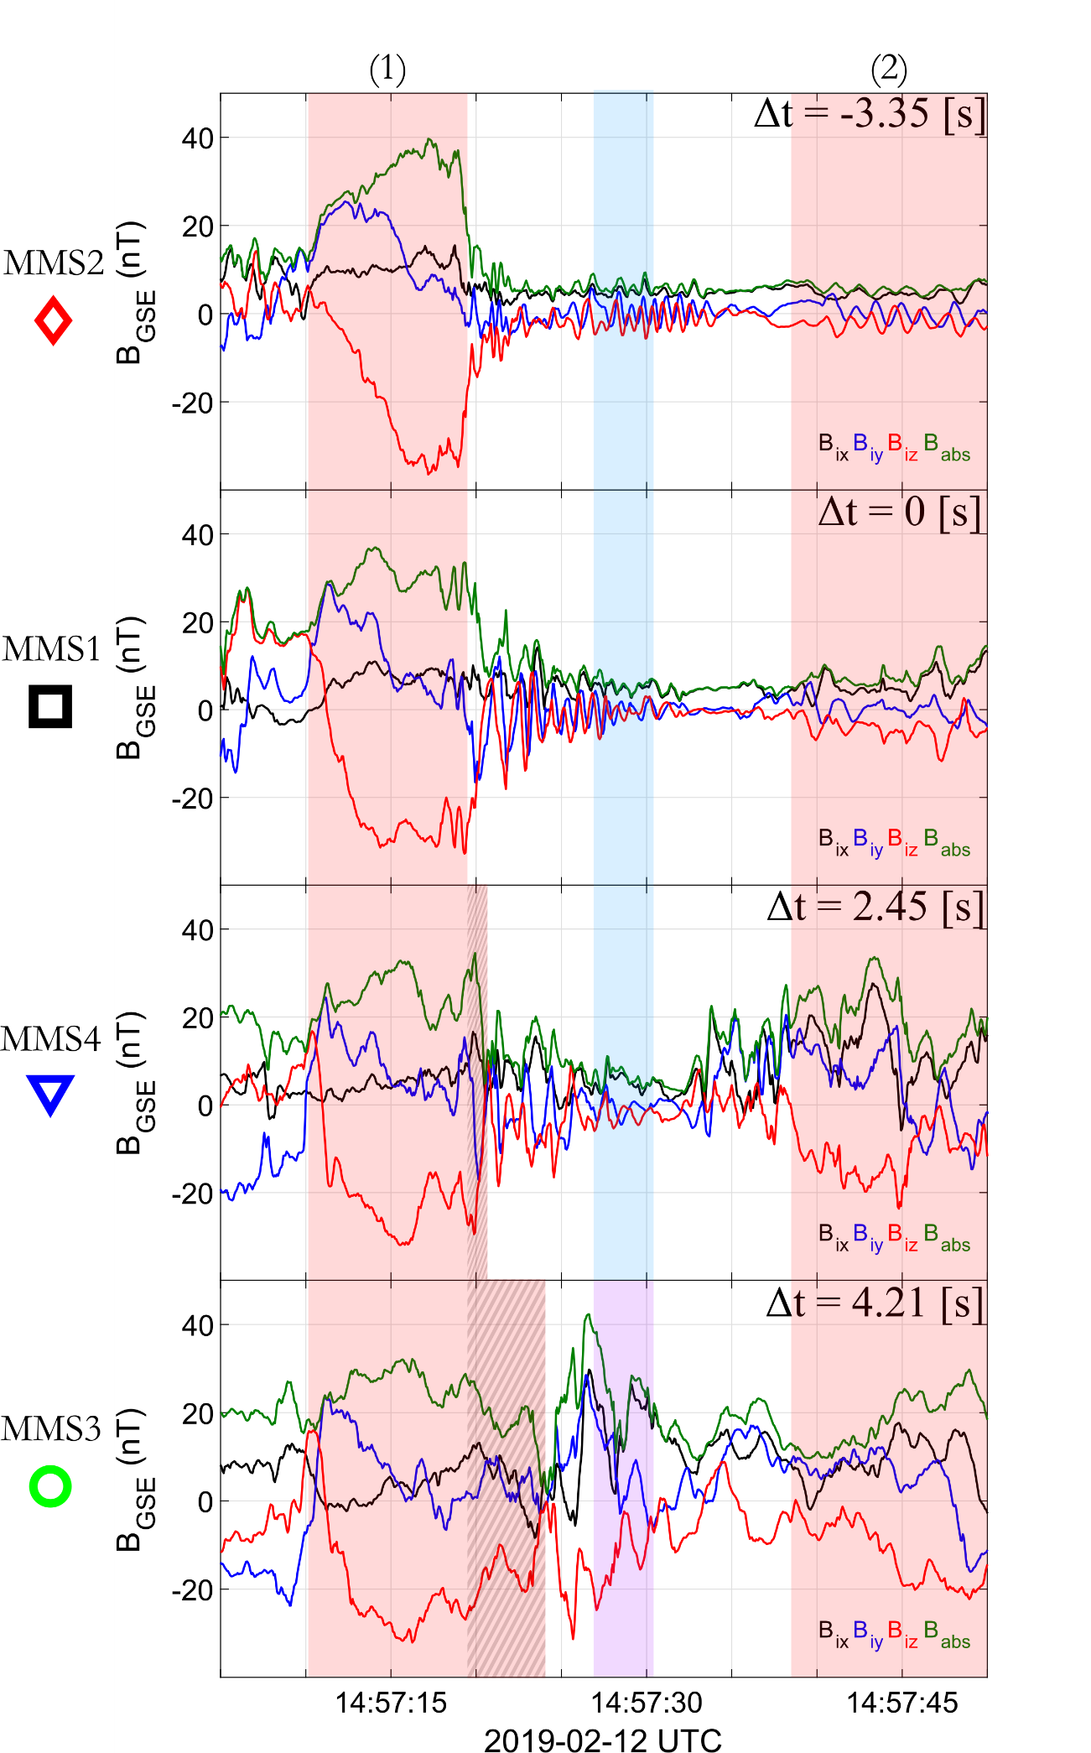
Evolution of local shock front
4 Key points:
Viewed from a co-moving reference point of “1”
Evolution of local shock front “1”
Generation of new shock ramp
Location of jet observations
New shocked plasma (MSH) “2”

Slide 24
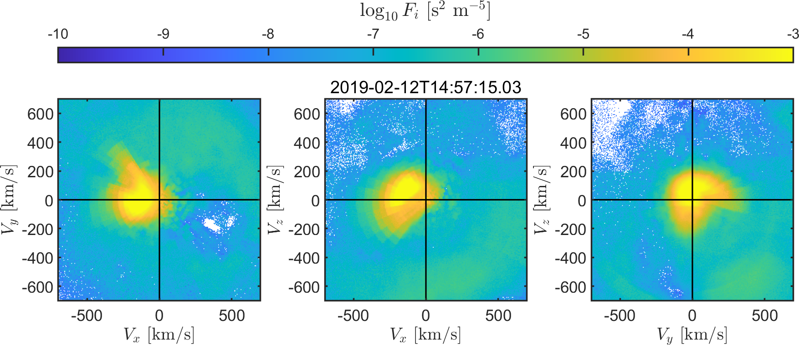
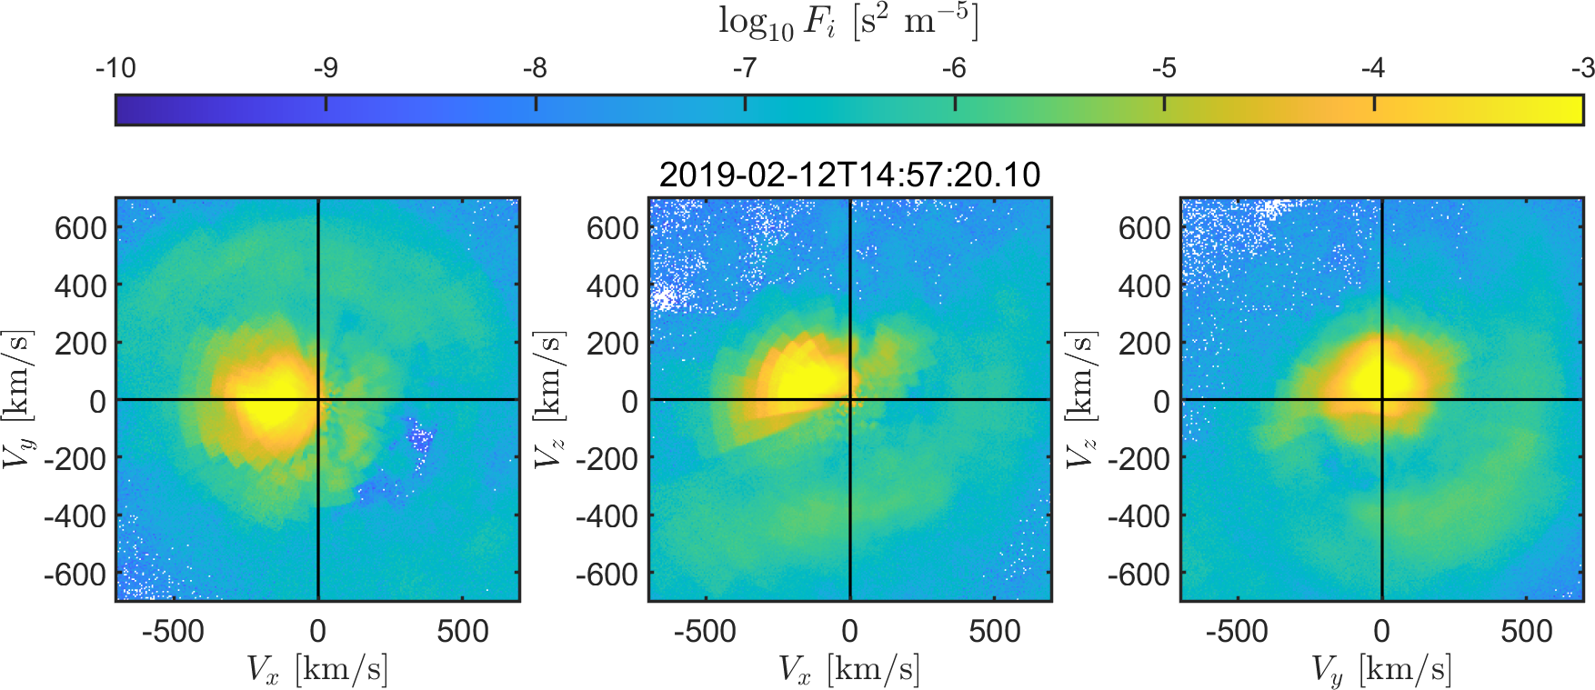
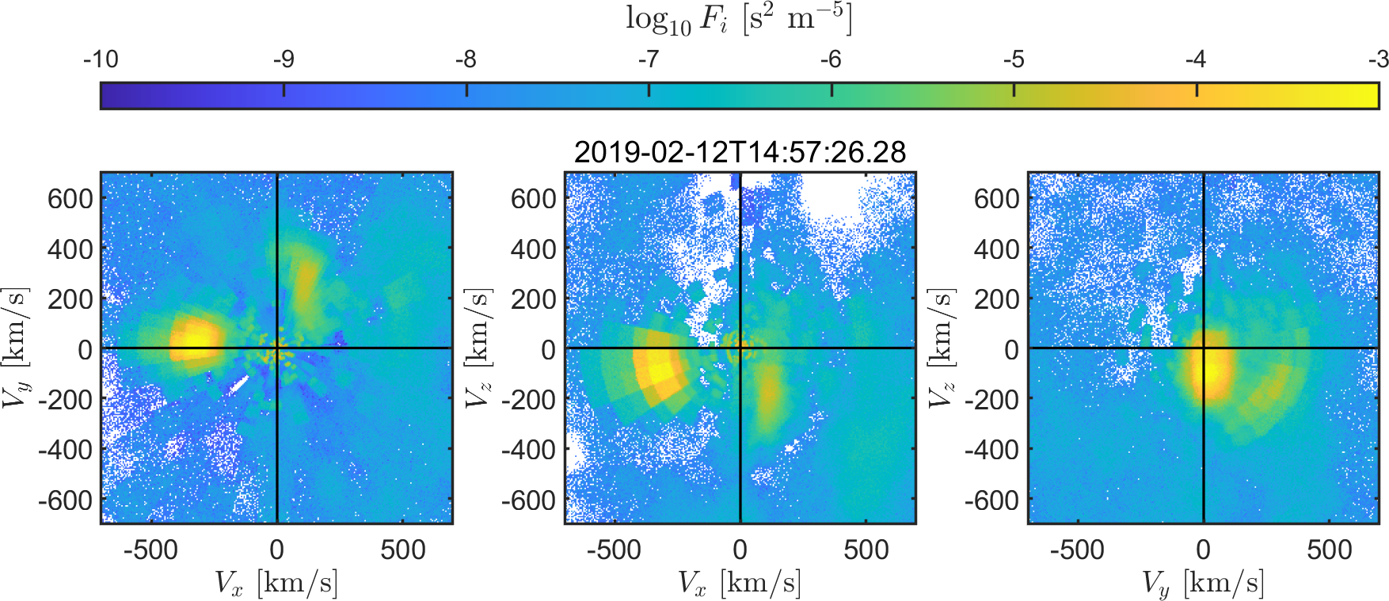
2D reduced VDFs
MMS 2 - Upstream
MMS 3 - Downstream
Region 1 – Shock
Upstream waves – Jet

Slide 25
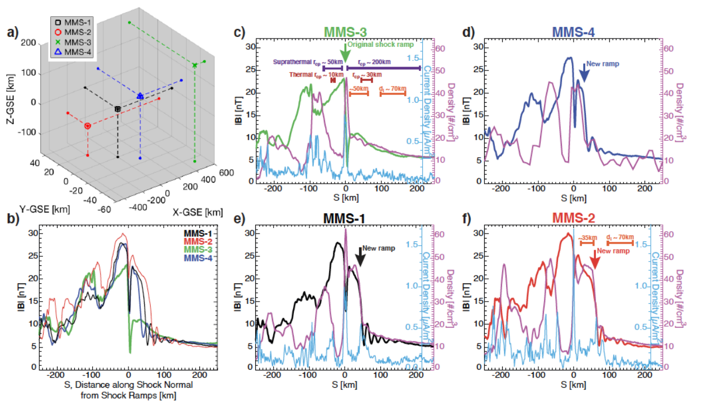
Turner et al. 2021 (local reformation/evolution)

Slide 26
Jets Database

Slide 27
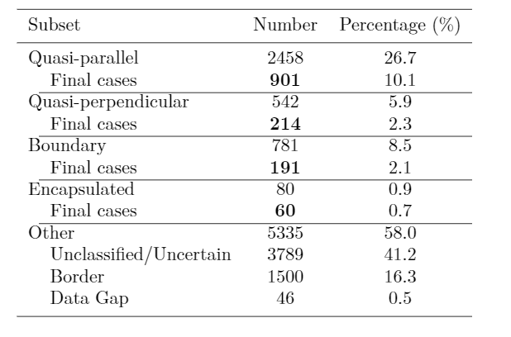
Jets database of MMS
Fast/Survey
Burst
9/2015 - 9/2020
Jets with full burst data
Qpar | 423
Qperp | 34
Boundary | 35
Encapsulated | 31
Close to BS / MP | 495
Others | 428
Useful to study early properties & generation
Raptis S., Karlsson T., et al. (2020) | JGR
Raptis S., Aminalragia-Giamini S., et al. (2020) | Frontiers
Palmroth M., Raptis S., et al. (2021) | Annales
Kajdic P., Raptis S., et al. (2021) | GRL
Raptis, Karlsson, et al. | Submitted
Raptis, Karlsson, et al. | Ongoing

Slide 28

Fast/Survey MMS data
Burst MMS data
Resolution (samples/s)
Resolution (samples/s)
FGM (magnetic field):
FPI (plasma moments | ions):
EDP (electric field):
0.0625
4.5
0.0313
0.0078
0.15
0.00012218
Pros
Always available
Decent resolution
Can be good for statistics due to availability
Pros
Very high resolution
Able to resolve structures close to boundary surfaces (e.g. mix of plasma close to magnetopause, bow shock, foreshock etc.)
Cons
Not available all the time, mostly available close to vital mission objectives (magnetopause, diffusion regions, shock transitions etc.)
Hard to do proper large scale statistics due to biases generated from specific availability and manual choice of intervals
Cons
Not suitable for small scale studies especially these related to ion moments
Could be misleading close to boundary surfaces (Magnetopause, Bow shock etc.) due to very similar observational signatures
More information: Baker, et al. (2016) | Space Sci Rev 19

