Slide 1
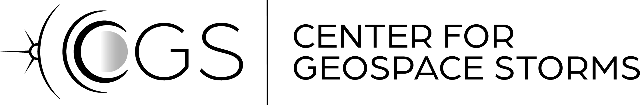
Transient phenomena in foreshock, shock, and magnetosheath – Expectations from large separation campaign
Savvas Raptis^{1,2,3}
¹ APL/JHU, Laurel, MD, USA
² KTH, Stockholm, Sweden
³ ESA/ESTEC, Leiden, The Netherlands
SR acknowledges the support by John Hopkins University Applied Physics Laboratory independent R&D fund
savvas.raptis@jhuapl.edu / https://savvasraptis.github.io

Slide 2
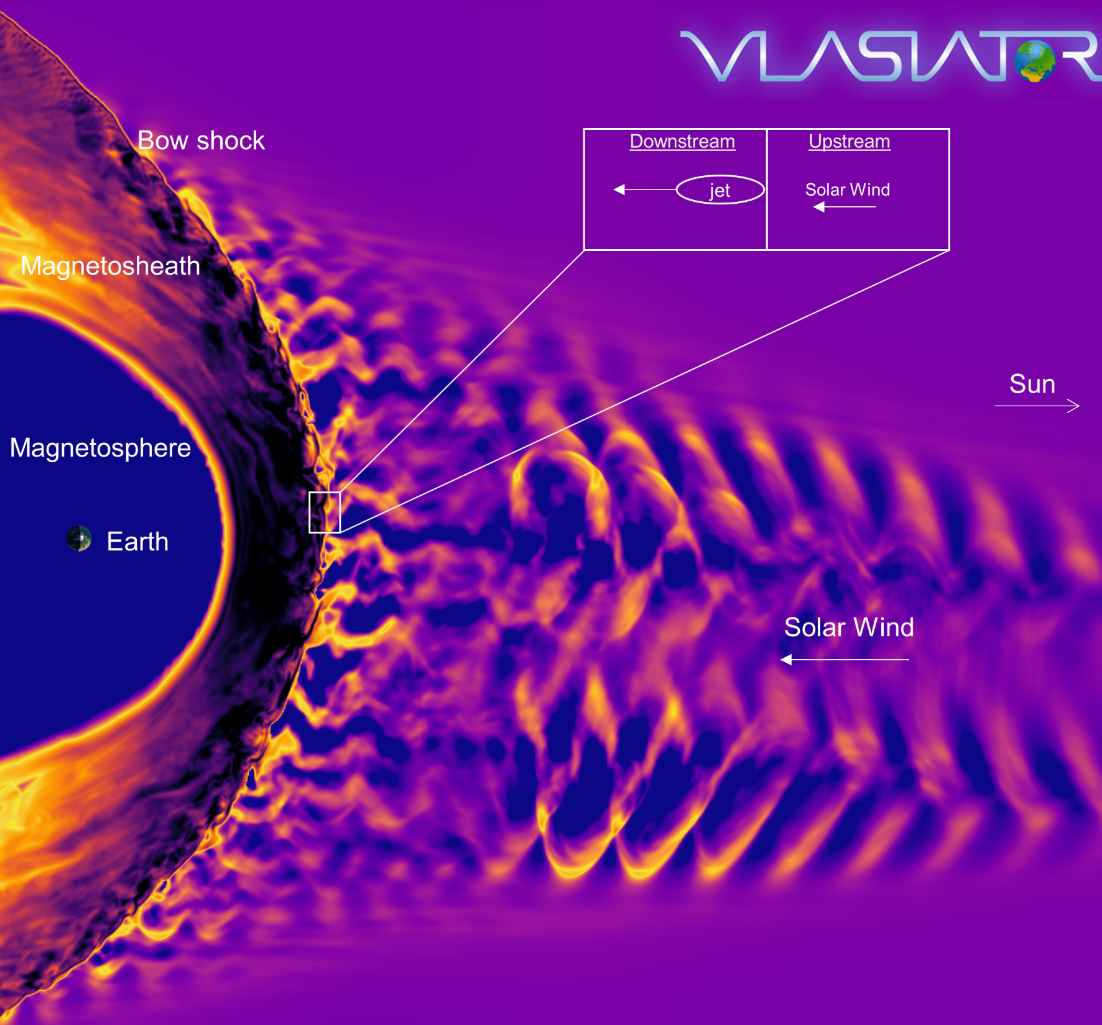
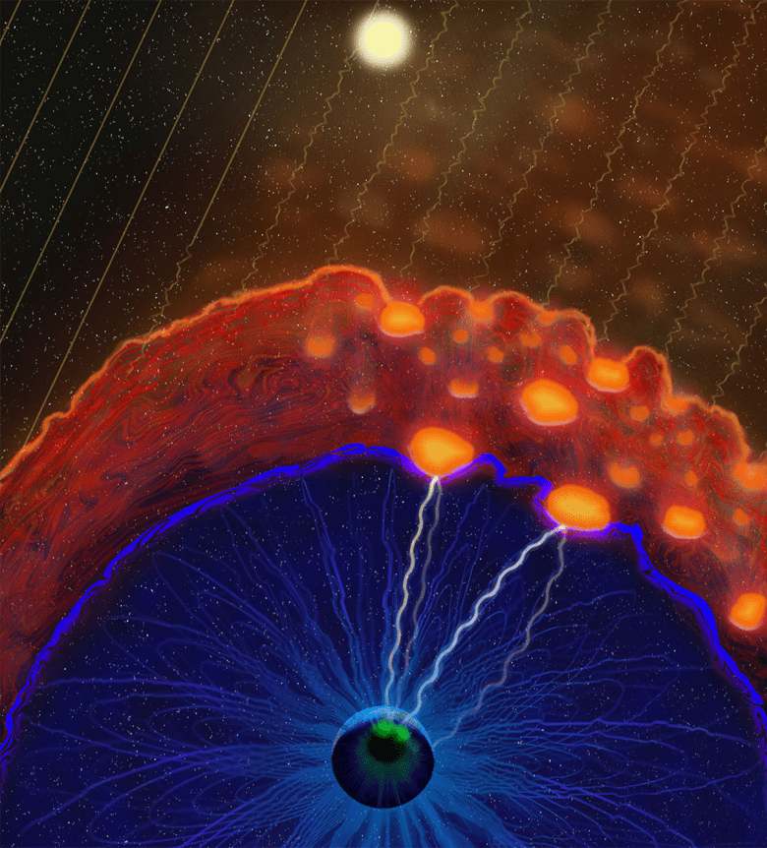
Transient Phenomena in Foreshock & Magnetosheath
Courtesy of M. Palmroth, U Helsinki
Credits: Vuorinen et al. (2022) https://eos.org/features/space-raindrops-splashing-on-earths-magnetic-umbrella

Slide 3
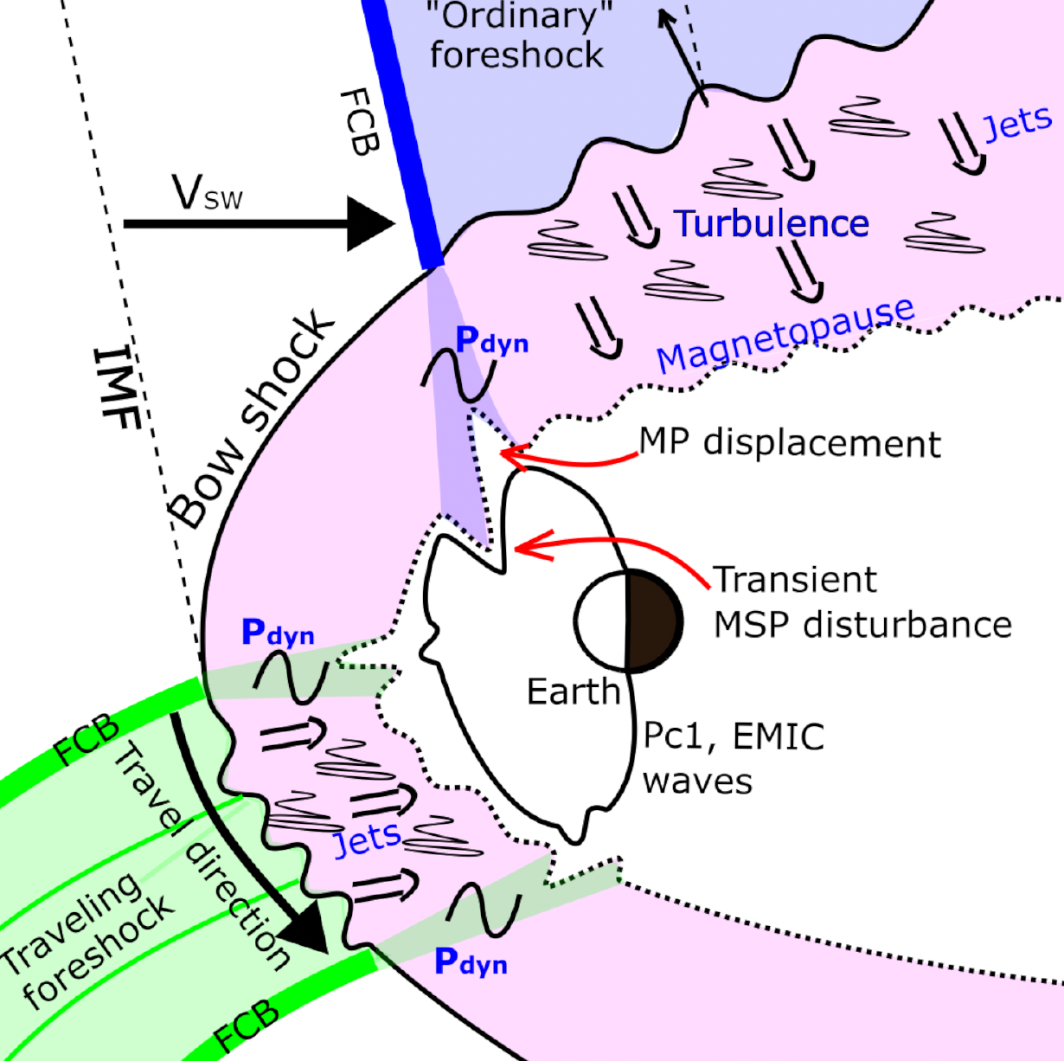
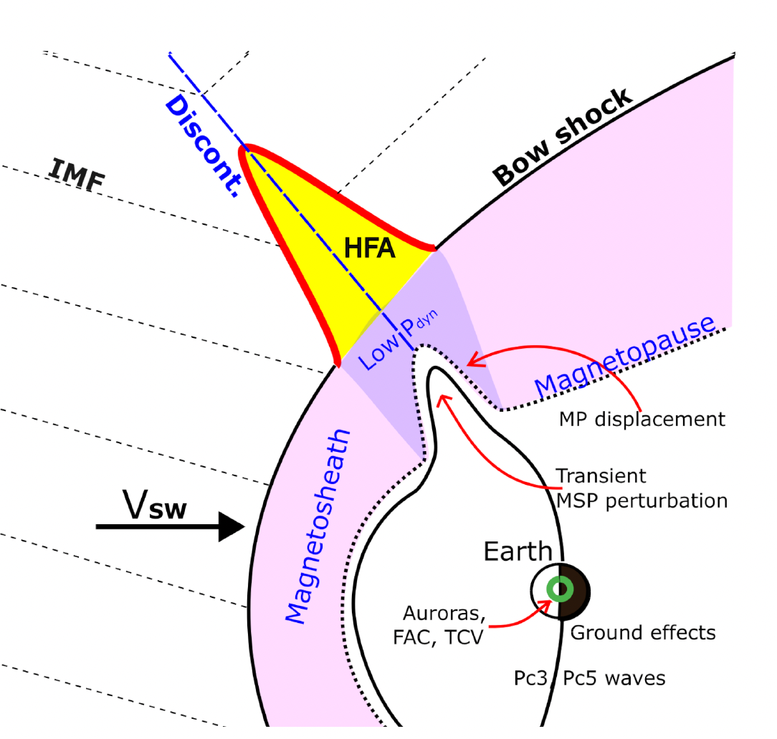
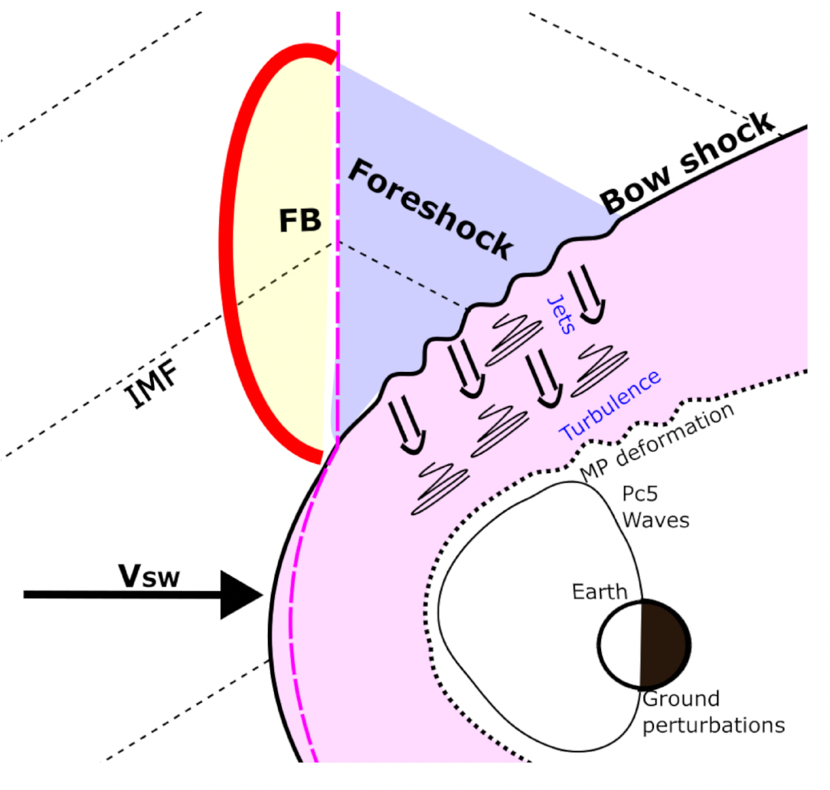
Foreshock Transients
Travelling Foreshocks and Foreshock Compressive Boundaries
Hot Flow Anomalies
Foreshock Bubbles
Primož K. et al. (2023 ongoing)
Different type of TUMS (Transient Upstream Mesoscale Structures)
Notes:
Travelling foreshocks : This happens when a bundle of magnetic field lines from a relatively thin magnetic flux tube connects to the nominally quasi-perpendicular bow shock in such a way that the shock’s geometry is locally changed from quasi-perpendicular to quasi-parallel
Foreshock Compressive Boundaries: FCBs are characterized by a strong compression of magnetic field magnitude and density that is followed by strong decreases of these two quantities on the foreshock side
Hot Flow Anomalies : when an IMF directional discontinuity intersects the bow shock and the convection electric field (−V X B) points towards the sheet on at least one side
Foreshock Bubbles: form due to the interaction of IMF rotational discontinuities with the backstreaming ions in the foreshock region. If the convection electric field on the upstream of the rotational discontinuity has a larger earthward component than the electric field on its downstream side, foreshock ions become concentrated on the upstream side.

Slide 4
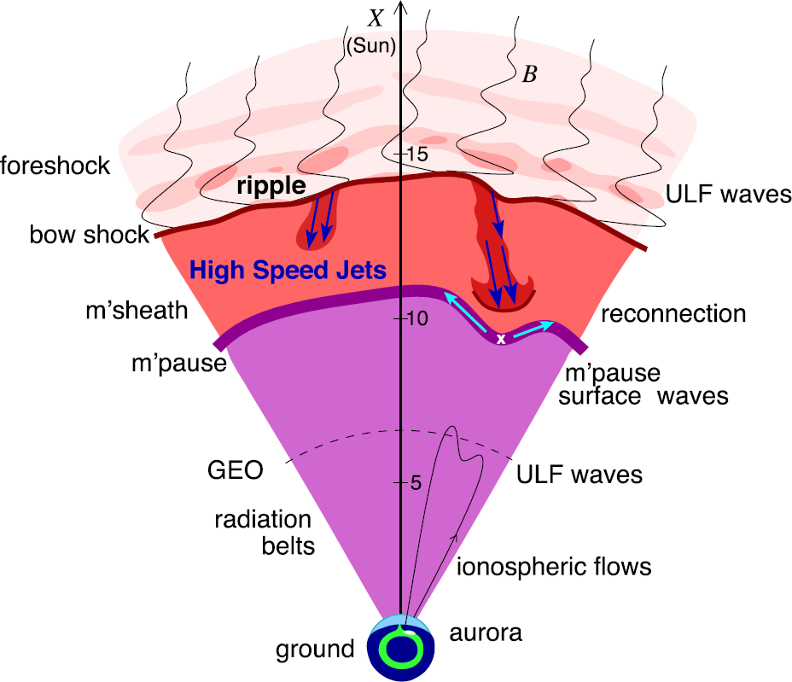
Magnetosheath jets
Definition
Magnetosheath jets are transient localized enhancements of dynamic pressure (density and/or velocity increase)
e.g., 200% dynamic pressure enhancement compared to background magnetosheath
Shock acceleration
Related phenomena
Radiation belts
Throat aurora
Magnetopause reconnection
Magnetopause penetration
Shock acceleration
Magnetopause surface eigenmodes
ULF waves
Substorms
Ground magnetometer detection
Plaschke F. et al. (2018); sketch by H. Hietala | Space Sci. Rev

Slide 5
Jets – references update (>2019)
Associated phenomena & effects
Excitation of surface eigenmodes at magnetopause: Archer et al. (2019, 2021)
Mirror mode waves and jets: Bianco-Cano et al. (2020)
Bursty magnetic reconnection at the Earth's magnetopause: Ng et al. (2021)
Ground-based magnetometer response: Norenius et al. (2021)
Generation of Pi2 pulsations: Katsavrias et al. (2021)
B in jets, Bz variations near magnetopause: Vuorinen et al. (2021)
High-Speed Jets Triggering Dayside Ground ULF: Wang et al. (2022)
Waves and jets using burst MMS data: Krämer et al. (2023)
Modeling & formation
Velocity & magnetic field alignment in jets: Plaschke et al. (2020)
Classification of jets using MMS & Neural Networks: Raptis et al. (2020a,2020b)
Comparison MMS vs simulations: Palmroth et al. (2021)
Solar wind effect on jet formation: LaMoury et al. (2021)
Magnetosheath Jets and Plasmoids - Hybrid Simulations: Preisser et al. (2020)
Formation of jets in Quasi-perpendicular magnetosheath: Primoz et al. (2021)
Occurrence in relation to CMEs and SIRs: Koller et al. (2022)
Shock reformation and the formation of high-speed jets: Raptis et al. (2022a)
Electron acceleration and bow waves in jets: Vuorinen et al. (2022)
Kinetic structure of jets and partial plasma moments: Raptis et al. (2022b)
~110 citations
Jets Downstream of Collisionless Shocks
Plaschke et al. (2018)
https://link.springer.com/article/10.1007/s11214-018-0516-3
And more : Liu et al. (2020a,2020b), Omelchenko et al (2021), Sibeck et al. (2021), Suni et al. (2021), Tinoco-Arenas et al. (2022) … etc.

Slide 6
Jets – references update (>2019)
Jets Downstream of Collisionless Shocks:
The Last Five Years
Ongoing review (TBD)
~110 citations
Jets Downstream of Collisionless Shocks
Plaschke et al. (2018)
https://link.springer.com/article/10.1007/s11214-018-0516-3

Slide 7
Dayside transient community & expectations from MMS
Primož Kajdič | Geophysics Institute, UNAM, Mexico
Xóchitl Blanco-Cano | Geophysics Institute, UNAM, Mexico
Lucile Turc | University of Helsinki, Finland
Yann Pfau-Kempf | University of Helsinki, Finland
Terry Z. Liu | University of California, Los Angeles, USA
Hui Zhang | Geophysical Institute, University of Alaska Fairbanks, Fairbanks, USA
Boyi Wang | Harbin Institute of Technology (Shenzhen), China
Yufei Hao | KLPS, PMO, Chinese Academy of Sciences, China
Martin O. Archer | Imperial College London, UK
Nojan Omidi Luis Preisser | Solana Scientific Inc., USA Space Research Institute, Austrian Academy of Sciences, Graz, Austria
Yu Lin | Physics Department, Auburn University, USA
Savvas Raptis | ESA/ESTEC, Noordwijk, The Netherlands
Adrian LaMoury | Imperial College London, UK
Philippe Escoubet | ESA/ESTEC, Noordwijk, The Netherlands
Marcos Vinicius Dias Silveira | University of Sao Paulo, EEL, Brasil
Shutao Yao | Shandong University, China
Sun Hee Lee | CUA, NASA GSFC, USA
1
ISSI Science International Team 555 “Impact of Upstream Mesoscale Transients on the Near-Earth Environment”
The Graz Jet Workshop (Group working on magnetosheath jets)
ISSI Science International Team 546 “Magnetohydrodynamic Surface Waves at Earth's Magnetosphere (and Beyond)”
Martin Archer (leader) | Imperial College London, UK
Katariina Nykyri (co-leader) | Embry-Riddle Aeronautical University, USA
Simone Di Matteo | Catholic University of America, USA
Tom Elsden | St Andrews University, UK
Megan Gillies | University of Alberta, USA
Michael Hartinger | Space Science Institute, USA
Anatoly Leonovich | Institute of Solar-Terrestrial Physics, Irkutsk, Russia
Bo Li | Shandong University Weihai, China
Valery Nakariakov | University of Warwick, UK
Vyacheslav Pilipenko | Space Research Institute,Moscow, Russia
Ferdinand Plaschke | Technische Universität Braunschweig, Germany
Xueling Shi | Virginia Tech, USA
Kareem Sorathia | Johns Hopkins University Applied Physics Laboratory, USA
Maria Walach | Lancaster University, UK
Zhonghua Yao | Chinese Academy of Sciences, Beijing, China
Kevin Blasl | Austrian Academy of Sciences, Graz, Austria
Rachel Rice | University of Maryland, USA
Frances Staples | University of California, Los Angeles, USA
3
Savvas Raptis Adrian LaMoury Laura Vuorinen Herbert Gunell Eva Krämer Niki Xirogiannopoulou Jonas Suni Adrian Pöppelwerth | ESA/ESTEC, Noordwijk, The Netherlands Imperial College London, UK University of Turku, Finland Umeå University, Sweden Umeå University, Sweden Charle’s University, Czech Republic University of Helsinki, Finland TU Braunschweig, Germany
Cyril Simon Wedlund | Space Research Institute, Austrian Academy of Sciences, Graz, Austria
Manuela Temmer Luis Preisser | Institute of Physics, University of Graz, Austria Space Research Institute, Austrian Academy of Sciences, Graz, Austria
Tomas Karlsson Florian Koller | KTH Royal Institute of Technology, Sweden Institute of Physics, University of Graz, Austria
Xochitl Blanco-Cano Heli Hietala | Instituto de Geofísica, UNAM, México Queen Mary University of London
2

Slide 8
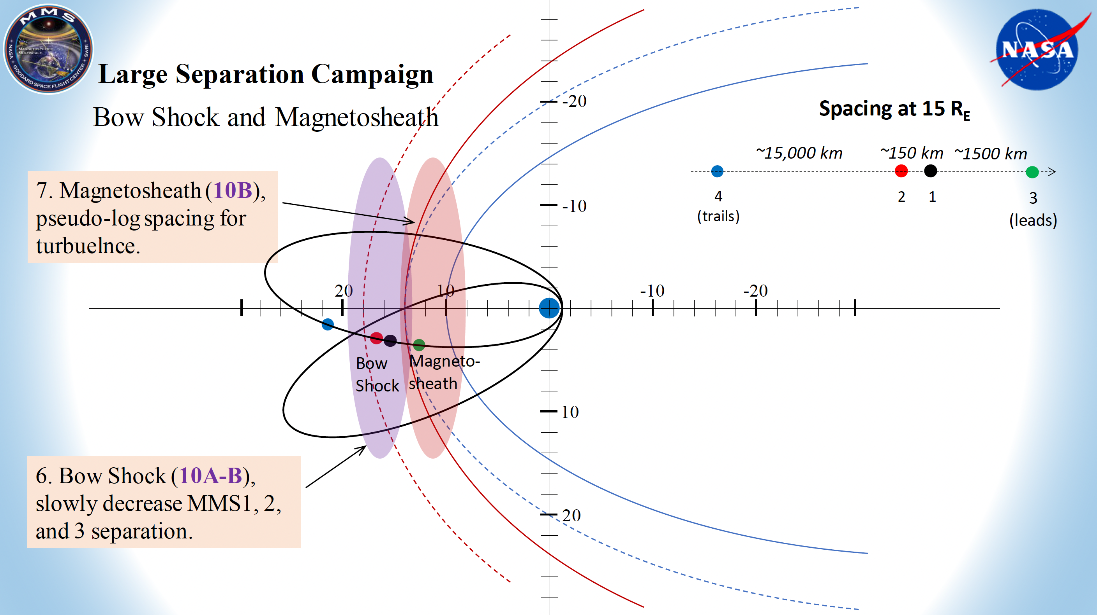
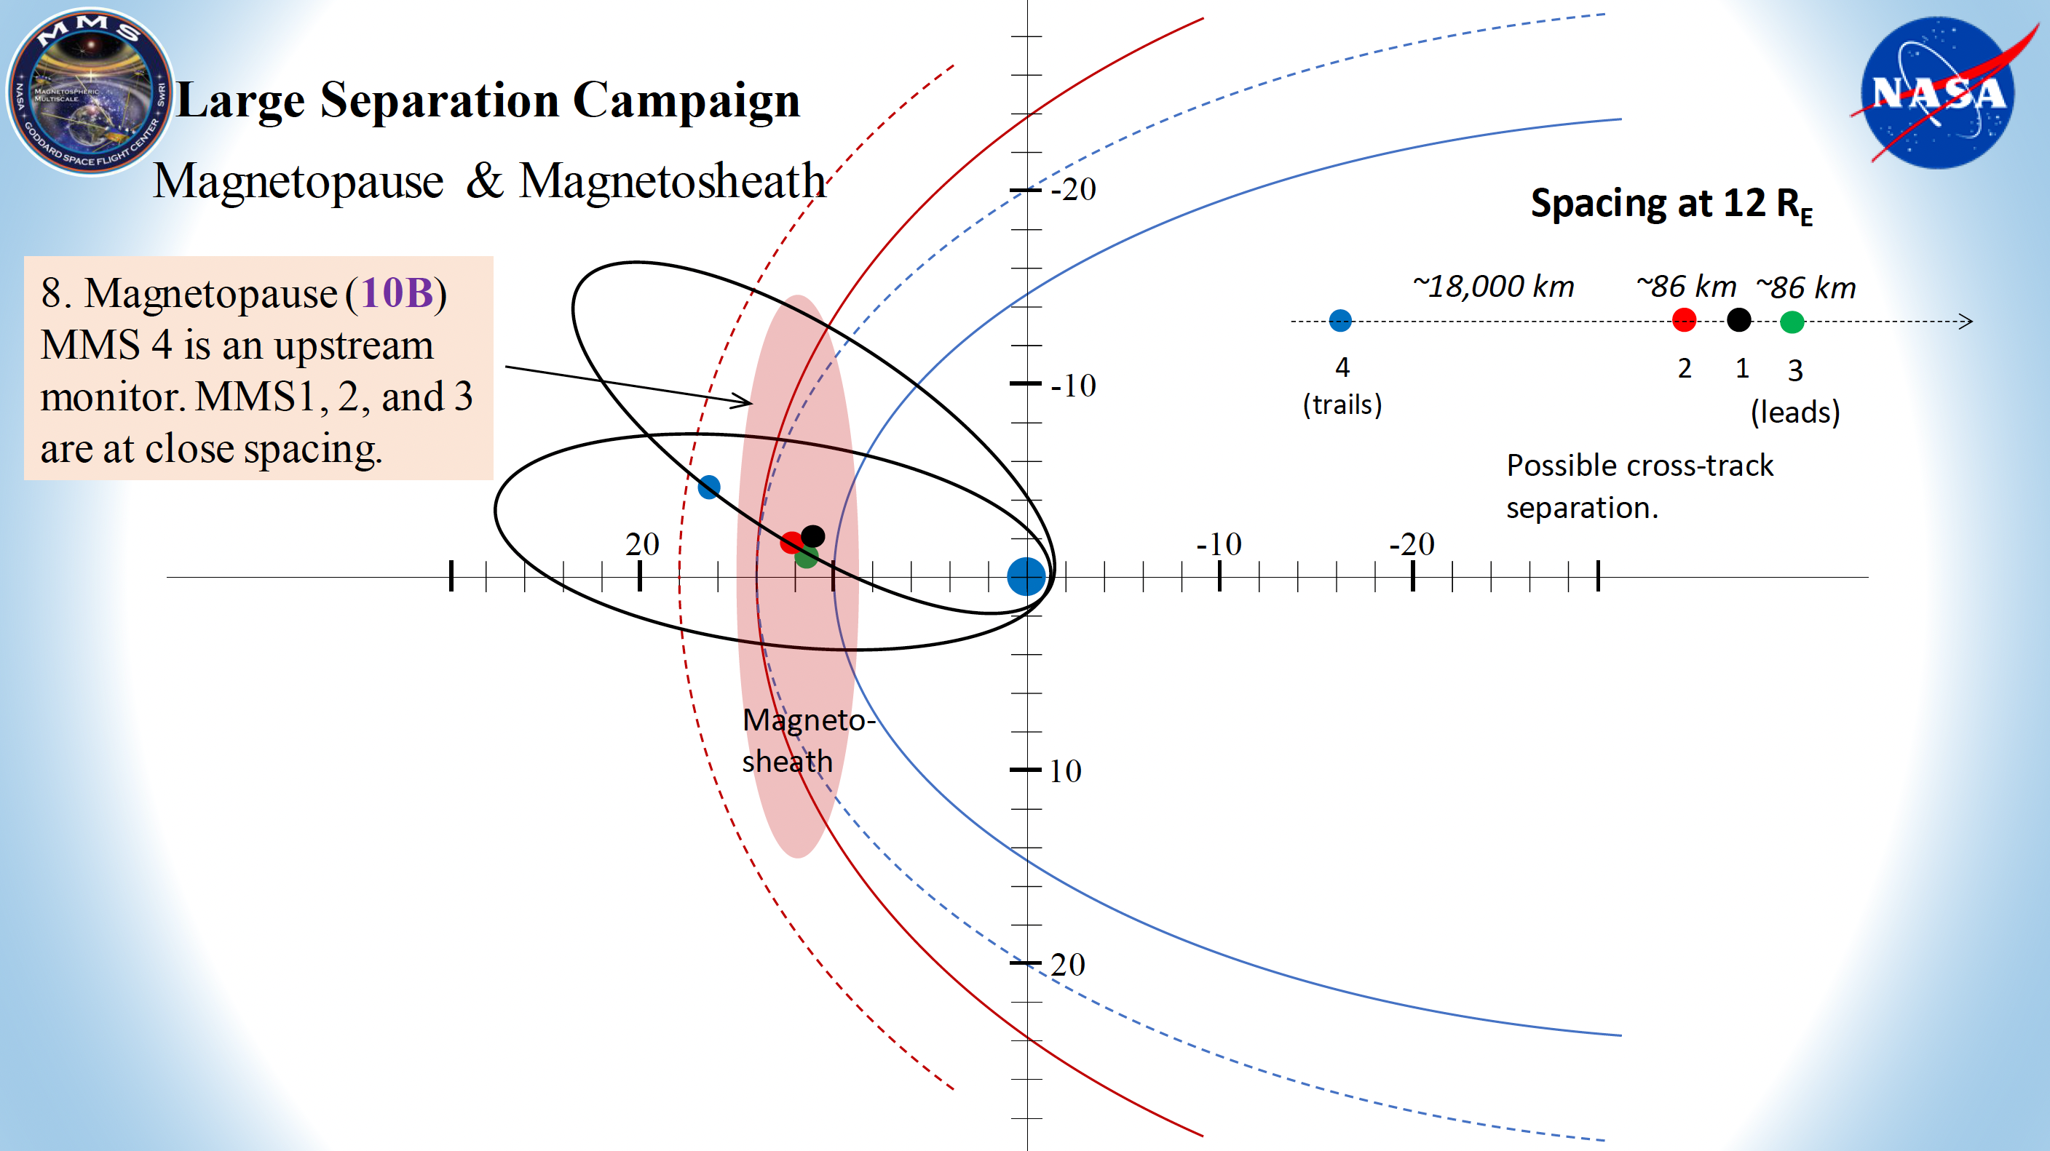
What we wished for?
String-of-pearls campaigns with variable separation:
1000s kms to investigate the effect of dayside transients on the magnetosphere
1-2 satellites upstream and 1-2 downstream to evaluate the transmission and potential effects for the shock
Magnetopause response (1000s km separation) while upstream SW/foreshock (several Re)
(A)
(B)

Slide 9
Why we need that ?
(i.e., test cases)

Slide 10
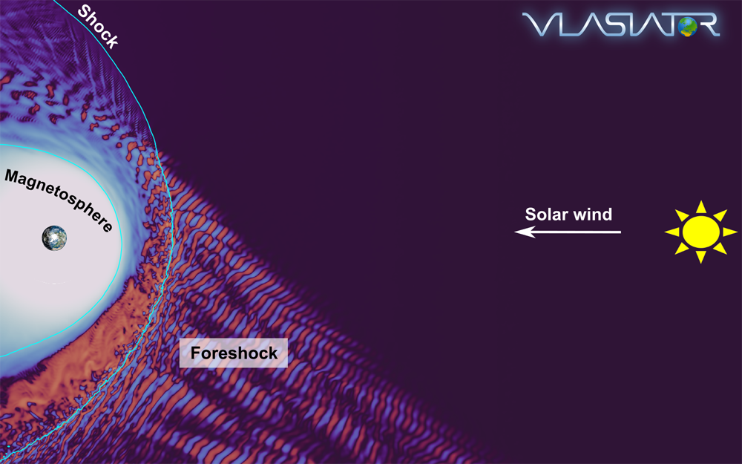
Credits: Lucille Turc / Vlasiator team

Slide 11
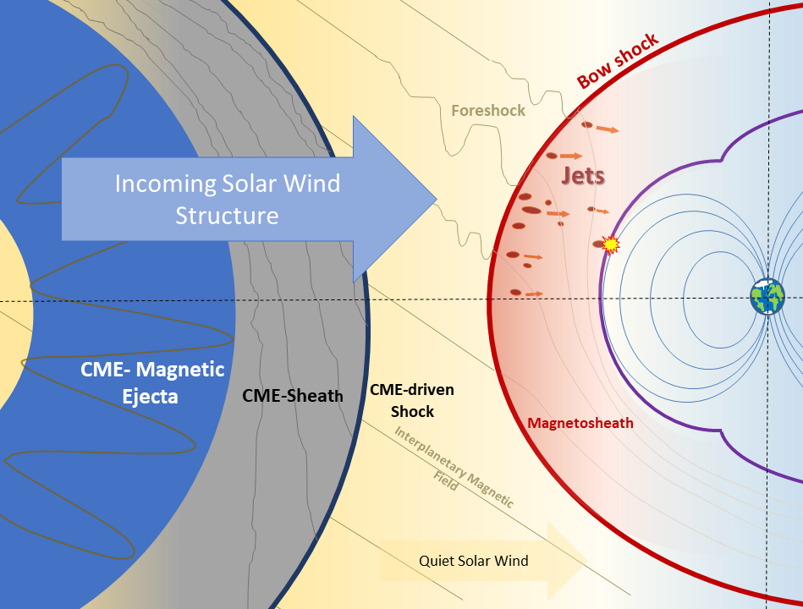
Credits: Florian Koller

Slide 12
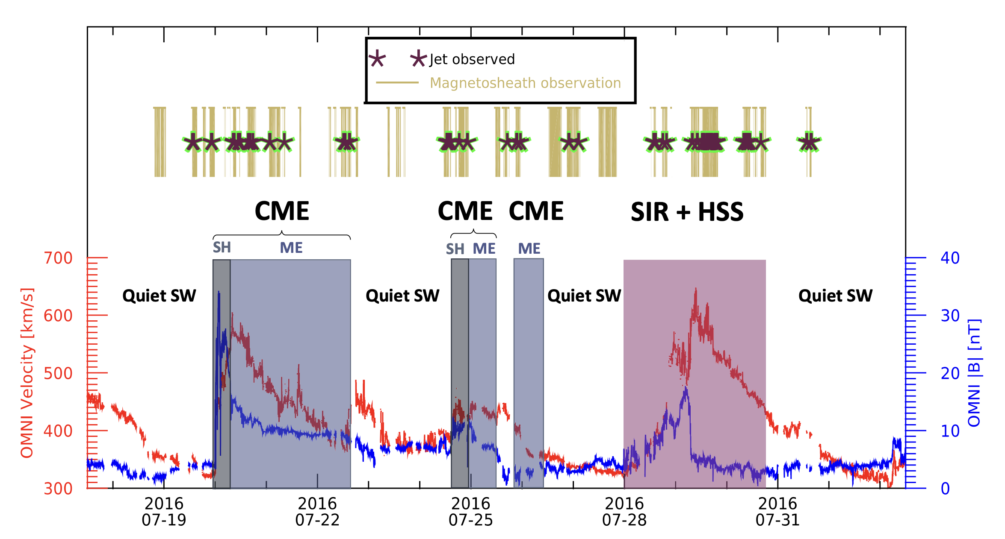
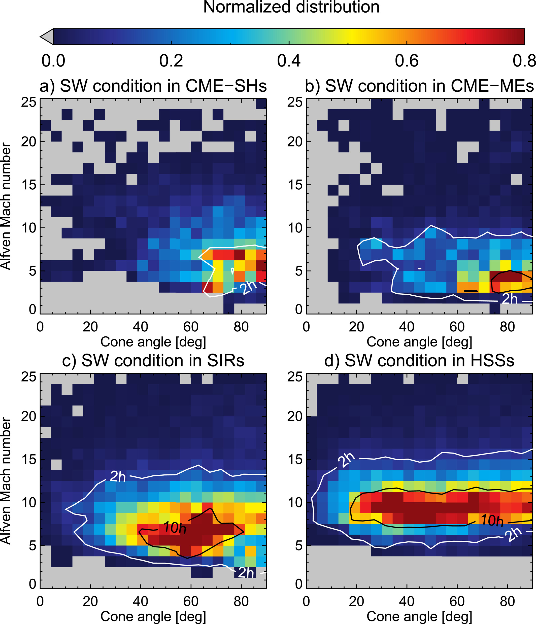

Jet formation – Solar Transients
Variable or extreme parameters modify the occurrence and properties of transients in the foreshock / magnetosheath
Magnetic Ejecta $↓$ #jets
SIR + HSS $↑$ # jets
Koller F., et al. 2022 | JGR
Koller F, et al,. 2023 | JGR

Slide 13
Open questions on Solar transients
How do close to shock conditions vary with the presence of SW transient phenomena (magnetic clouds, CMEs, high speed streamers etc.) ? (A)
How does the formation of foreshock and magnetosheath transient change when there are SW transients? (A)
What are the exact effects of the solar transients to the magnetopause (B)
(A)
(B)

Slide 14
Credits: Lucille Turc / Vlasiator team

Slide 15
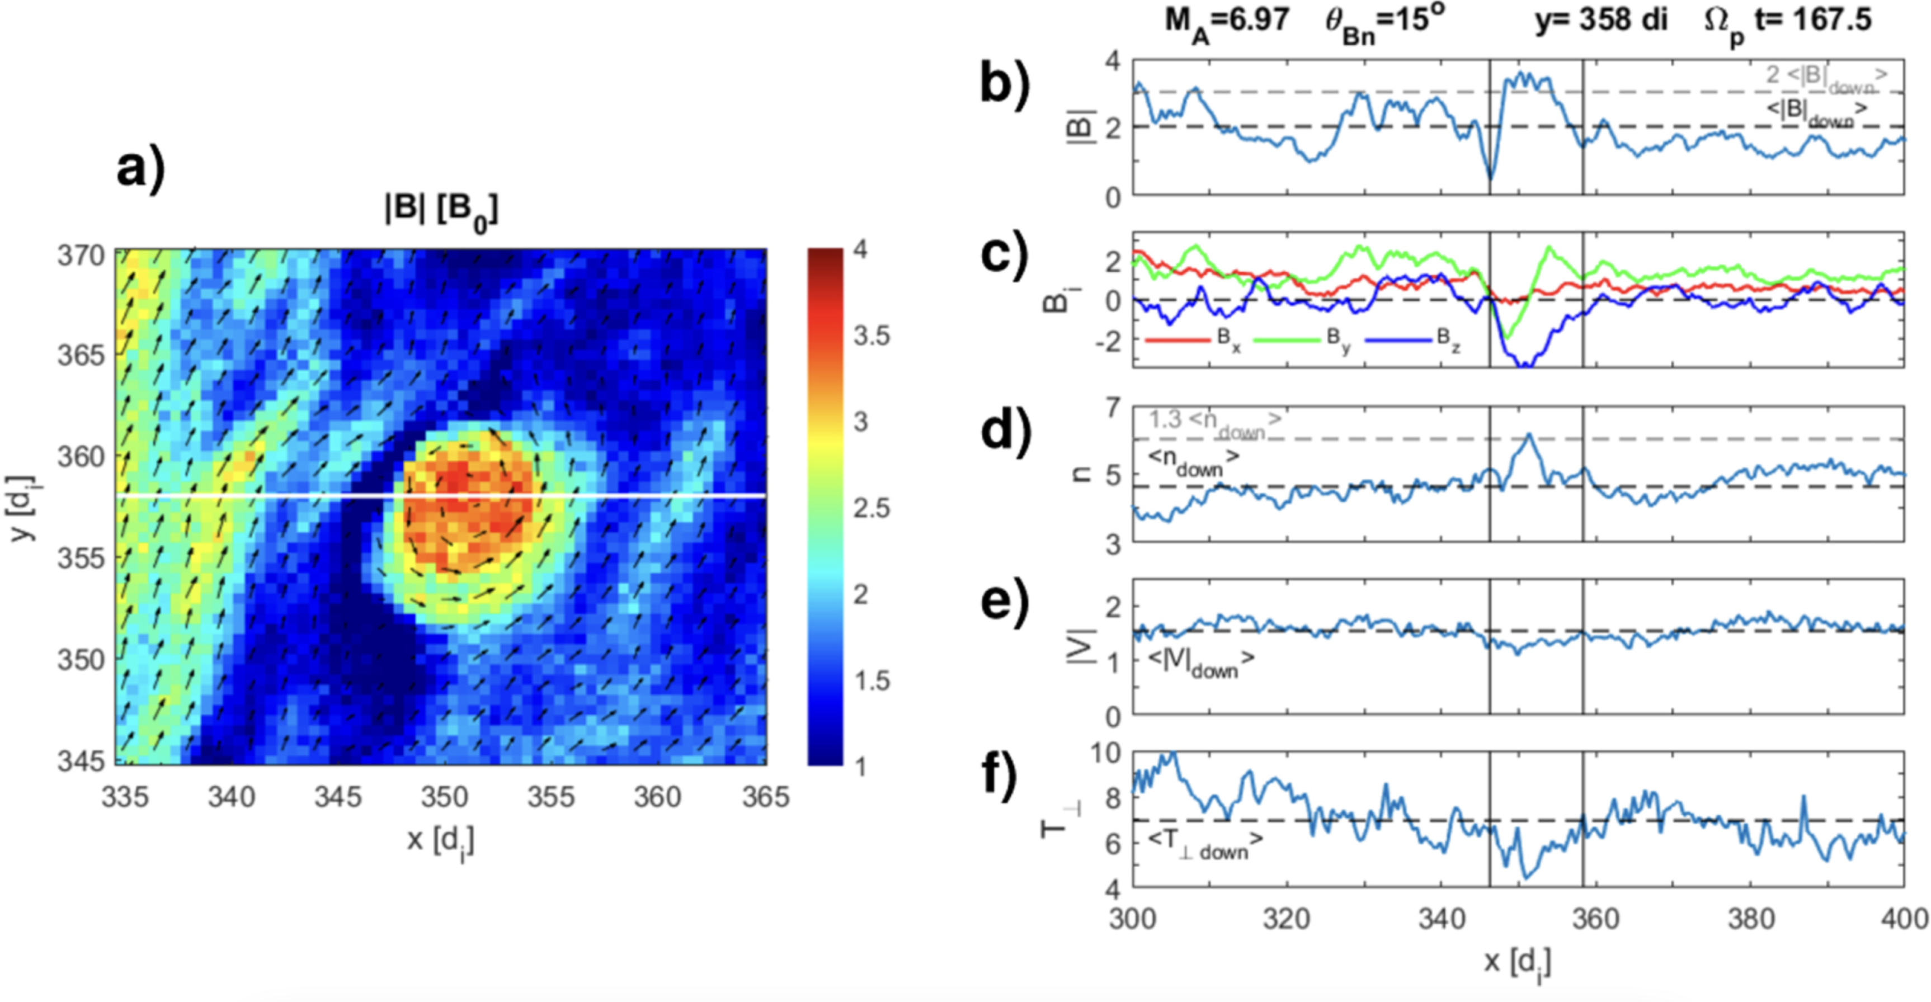
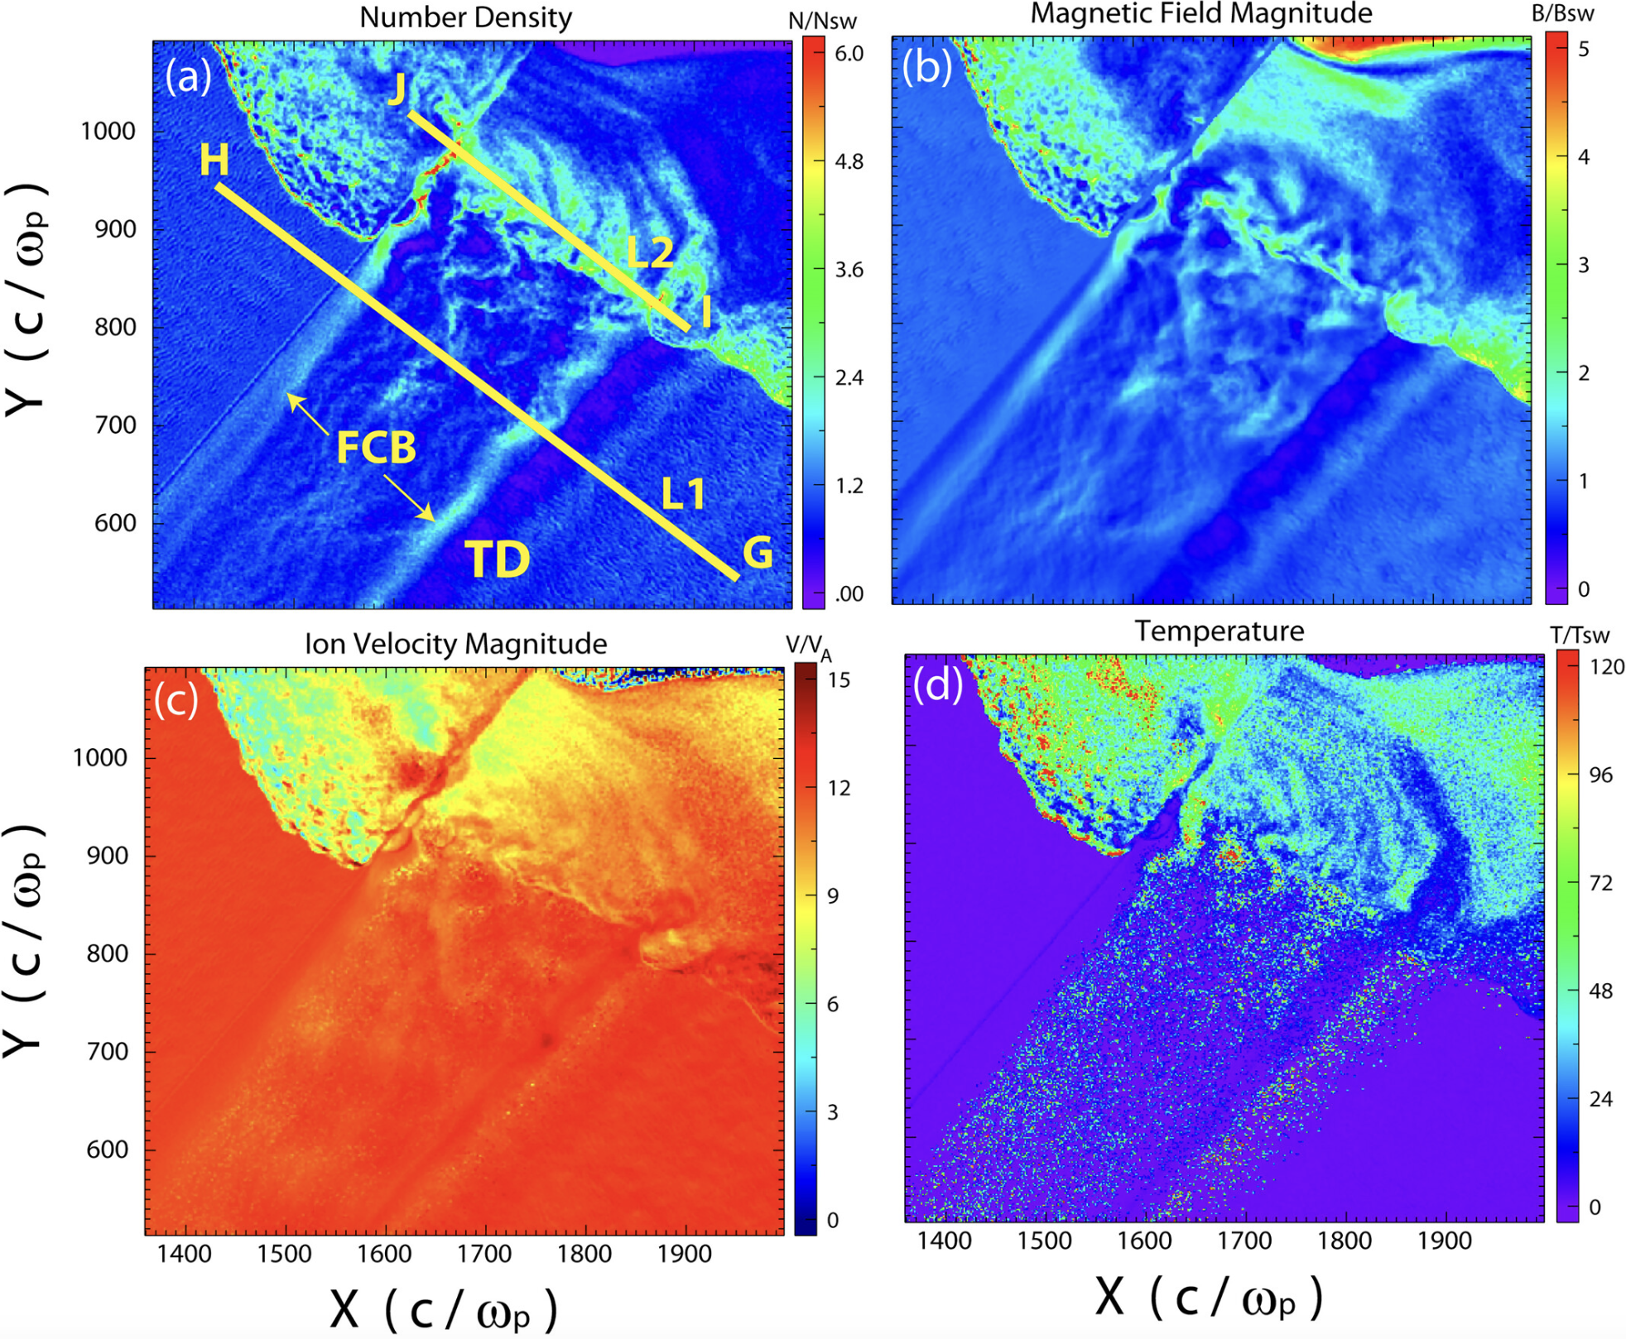
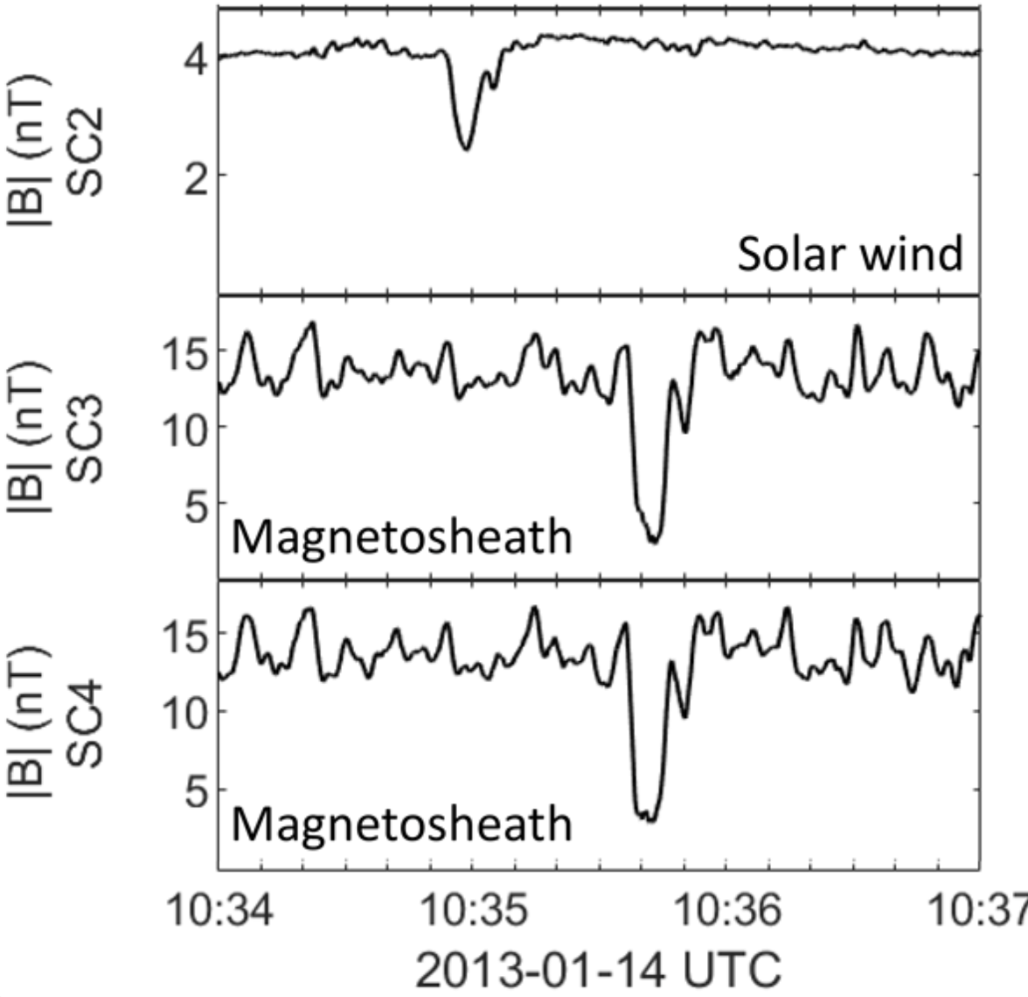
Transmission of Foreshock Transients
ULF waves are transmitted and so are the non-linear associated phenomena (Shocklets, SLAMS, etc.)
Transmission of FCB, FBs, HFAs, etc. has been shown in simulation and observations.
Preisser L., et al. 2020 | ApJL
Karlsson T., et al. 2022 | ANGEO
Sibeck D., et al. 2021 | JGR
Turc L., et al. 2023 | Nat. Physics
Raptis S., et al. 2022a | Nat. Commun
Kajdic P., et al. 2022 | JGR
Wang C-P., et al. 2023 | Frontiers
Eastwood J.P., et al. 2008 | JGR
Zhou Y., et al. 2023 | GRL

Slide 16
Open questions on Foreshock transients
What are the observational signatures of ULF (and associated phenomena) transmission ? How are the properties changing ? (A)
What effects can be caused in the magnetosheath plasma and in the magnetopause through the interaction of these structures with the ambient plasma (A, B)
(A)
(B)

Slide 17
Credits: Lucille Turc / Vlasiator team

Slide 18
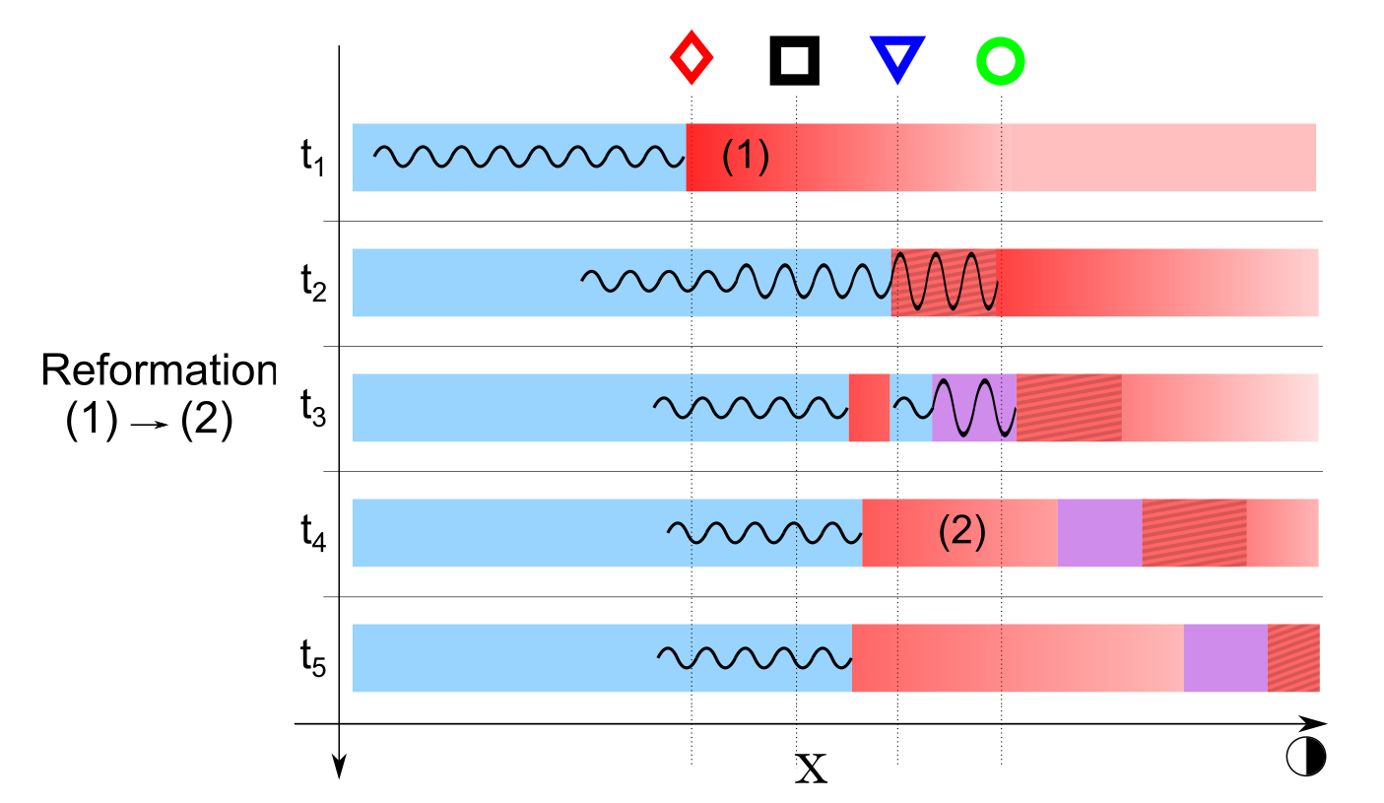
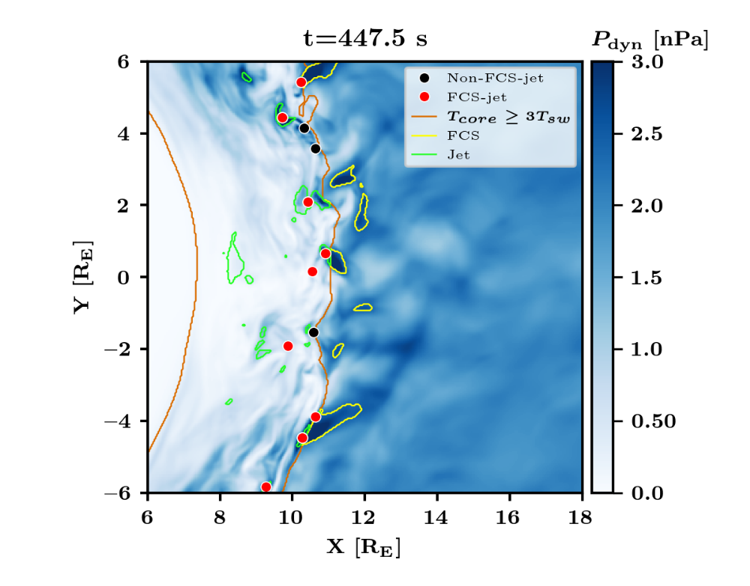
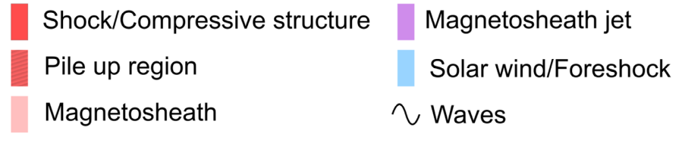
Jet formation
Jets forming from shock’s fundamental non-stationarity
75% of jets caused by Foreshock Compressive Structures
Turbulence Campaign 2019
Raptis S., et al. 2022a | Nat. Commun.
Suni J, et al,. 2021 | GRL

Slide 19
Open questions on formation
Is global shock reformation the answer to jets ? or maybe faster flows get dissipated and become part of the background population before reaching the MP ? (A)
How are close to the shock upstream conditions affecting the formation of downstream jets ? (A, B)
(A)
(B)

Slide 20
Credits: Lucille Turc / Vlasiator team

Slide 21
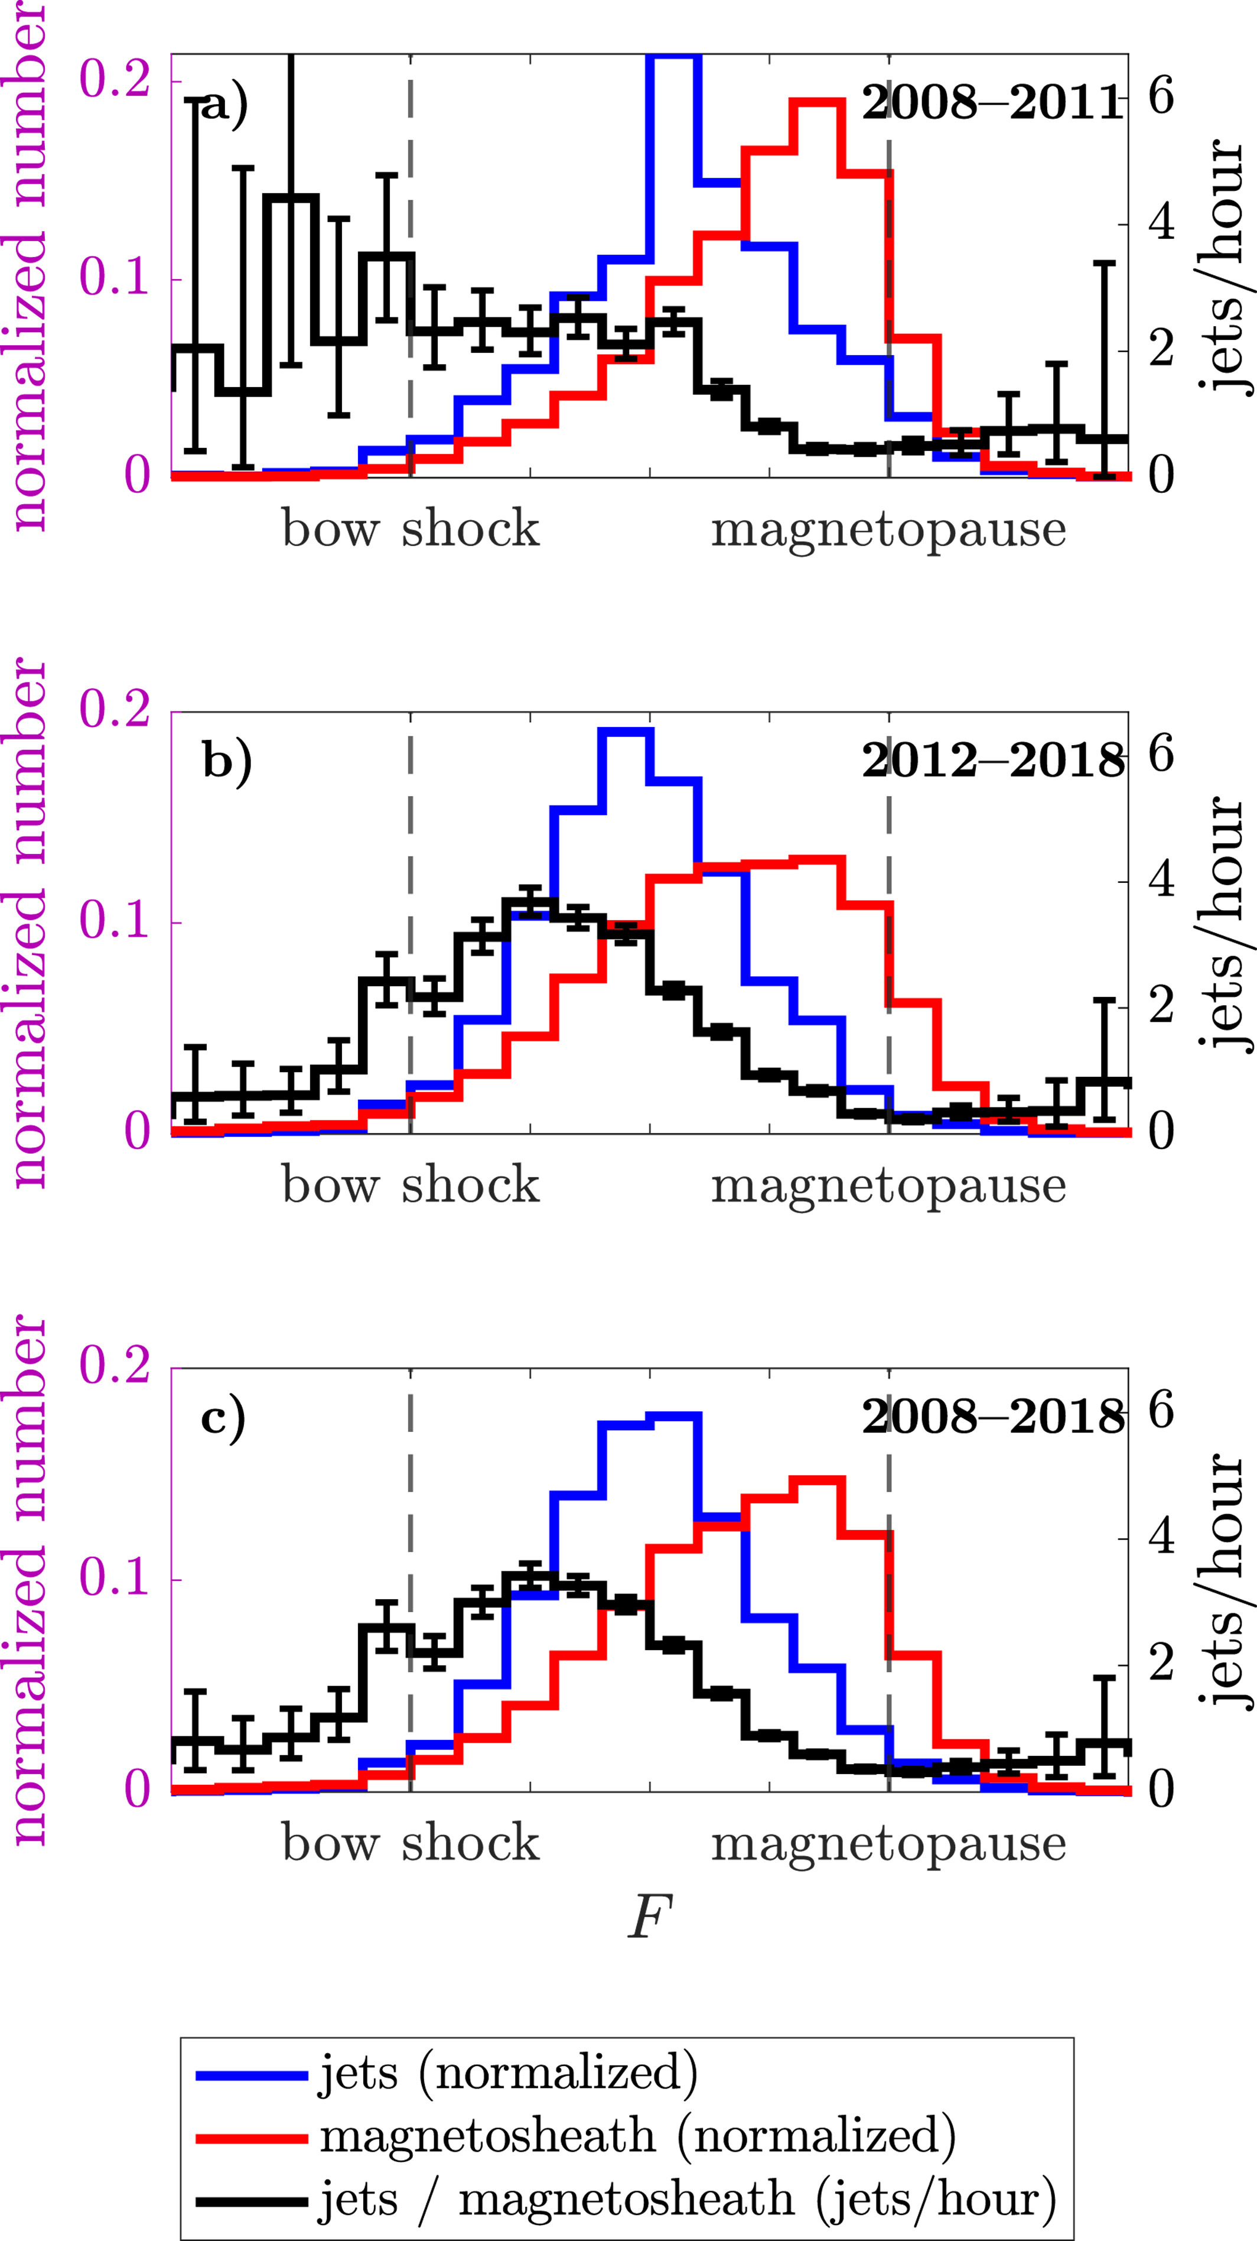
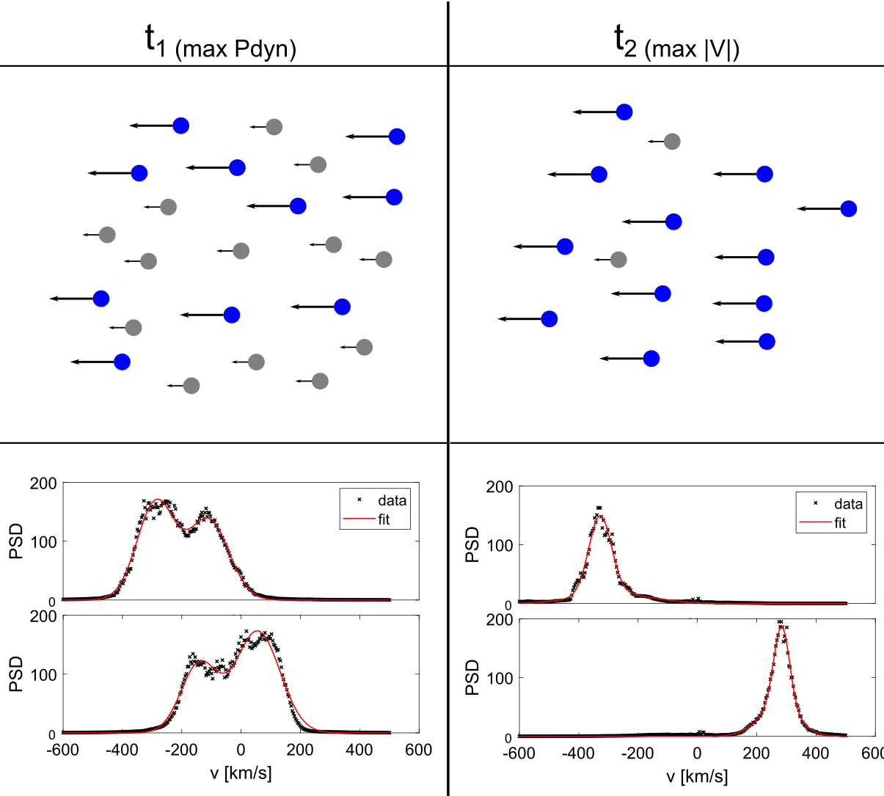
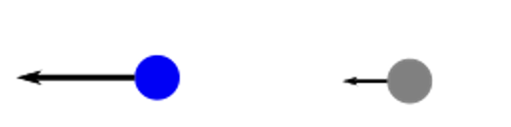
Jet evolution
When can a jet reach the MP ?
8 times more likely for high solar wind speed
17 more likely for low cone angles
Jets exhibiting 2+ populations = partial moments needed
= similar properties to upstream SW
Jets thermalize towards the magnetopause, the shape of the jets flatten and they are able to maintain their flow velocity and direction within the magnetosheath flow
Jet
BG/MSH
LaMoury A., et al. 2021 | JGR
Palmroth M, et al,. 2021 | ANGEO
Raptis S, et al,. 2022b | GRL

Slide 22
Open questions on Evolution
Do jets continue to show a clear double population? Does this change over time or closer to the MP ? (A)
How are the properties and the shape vary over distance from the bow shock/magnetopause? (A)
How do jets contribute to the generation of wave activity, turbulence and particle energization? (A)
(A)
(B)

Slide 23
Discussion
Foreshock & magnetosheath phenomena, in particular transient events = Interesting multi-scale physics, space weather effects, and overall unique environments to expand our understanding and test our codes.
MMS future campaigns: Opportunity to investigate different scales in high time-resolution, revealing previously unknown relationships between phenomena.
(Skipped): Effects on inner magnetosphere, excitation of ULF waves, etc.
(Skipped): Potential conjunctions with THEMIS/Cluster and other missions for investigating even larger scale evolution.

Slide 24
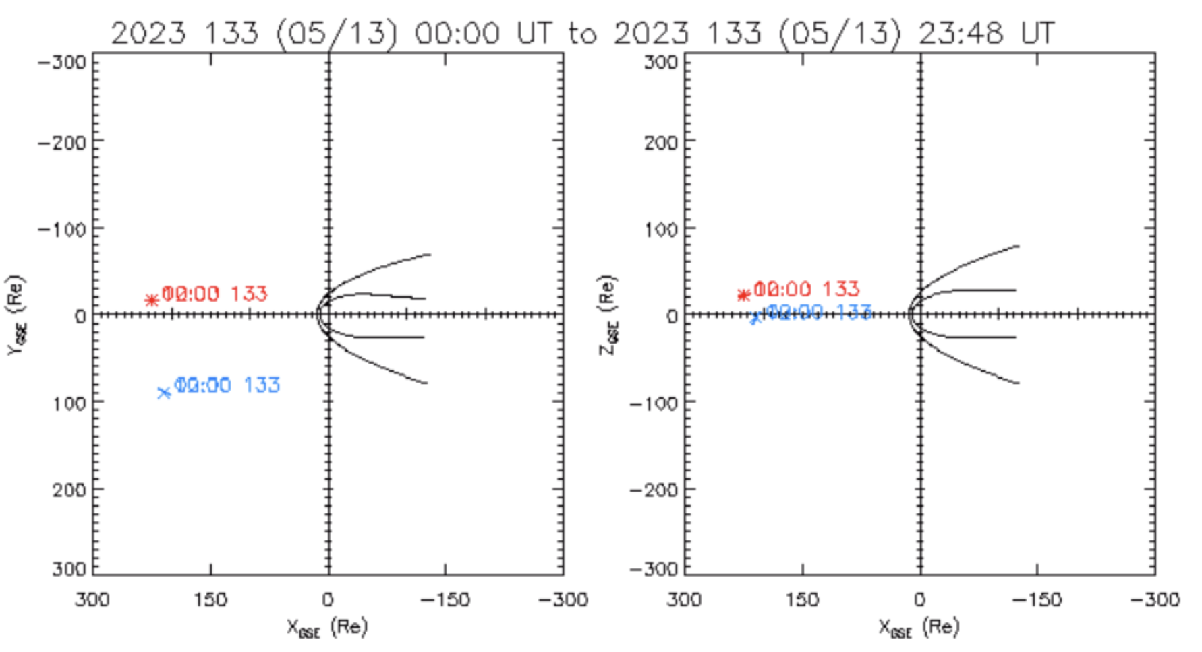
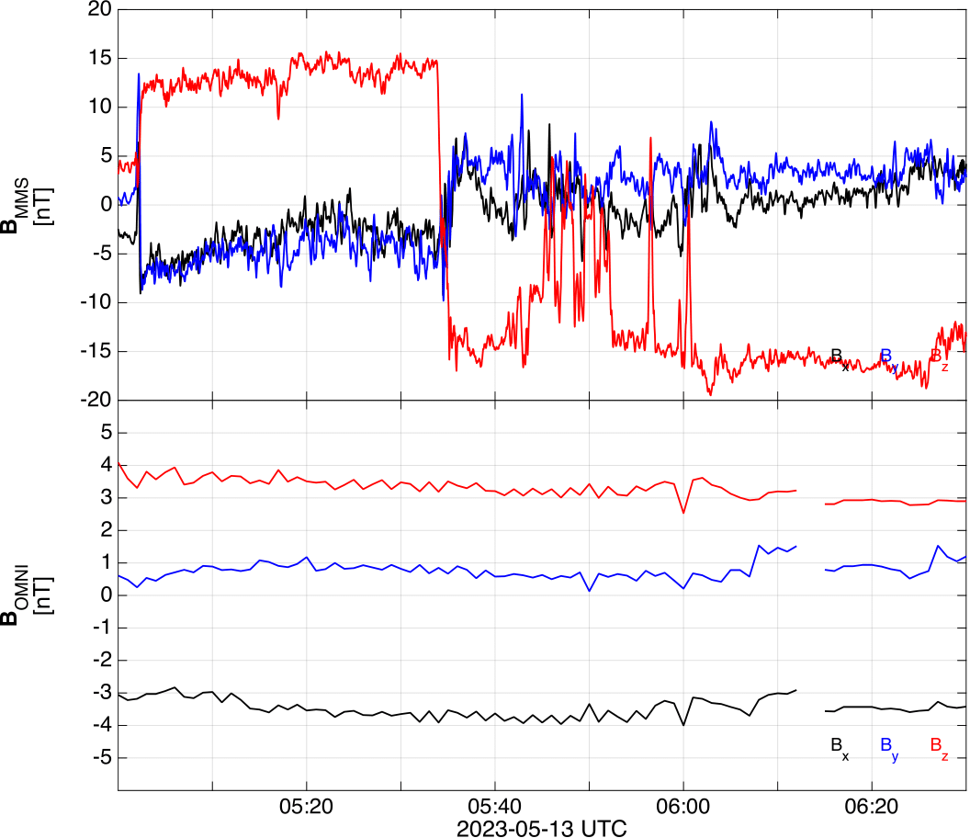
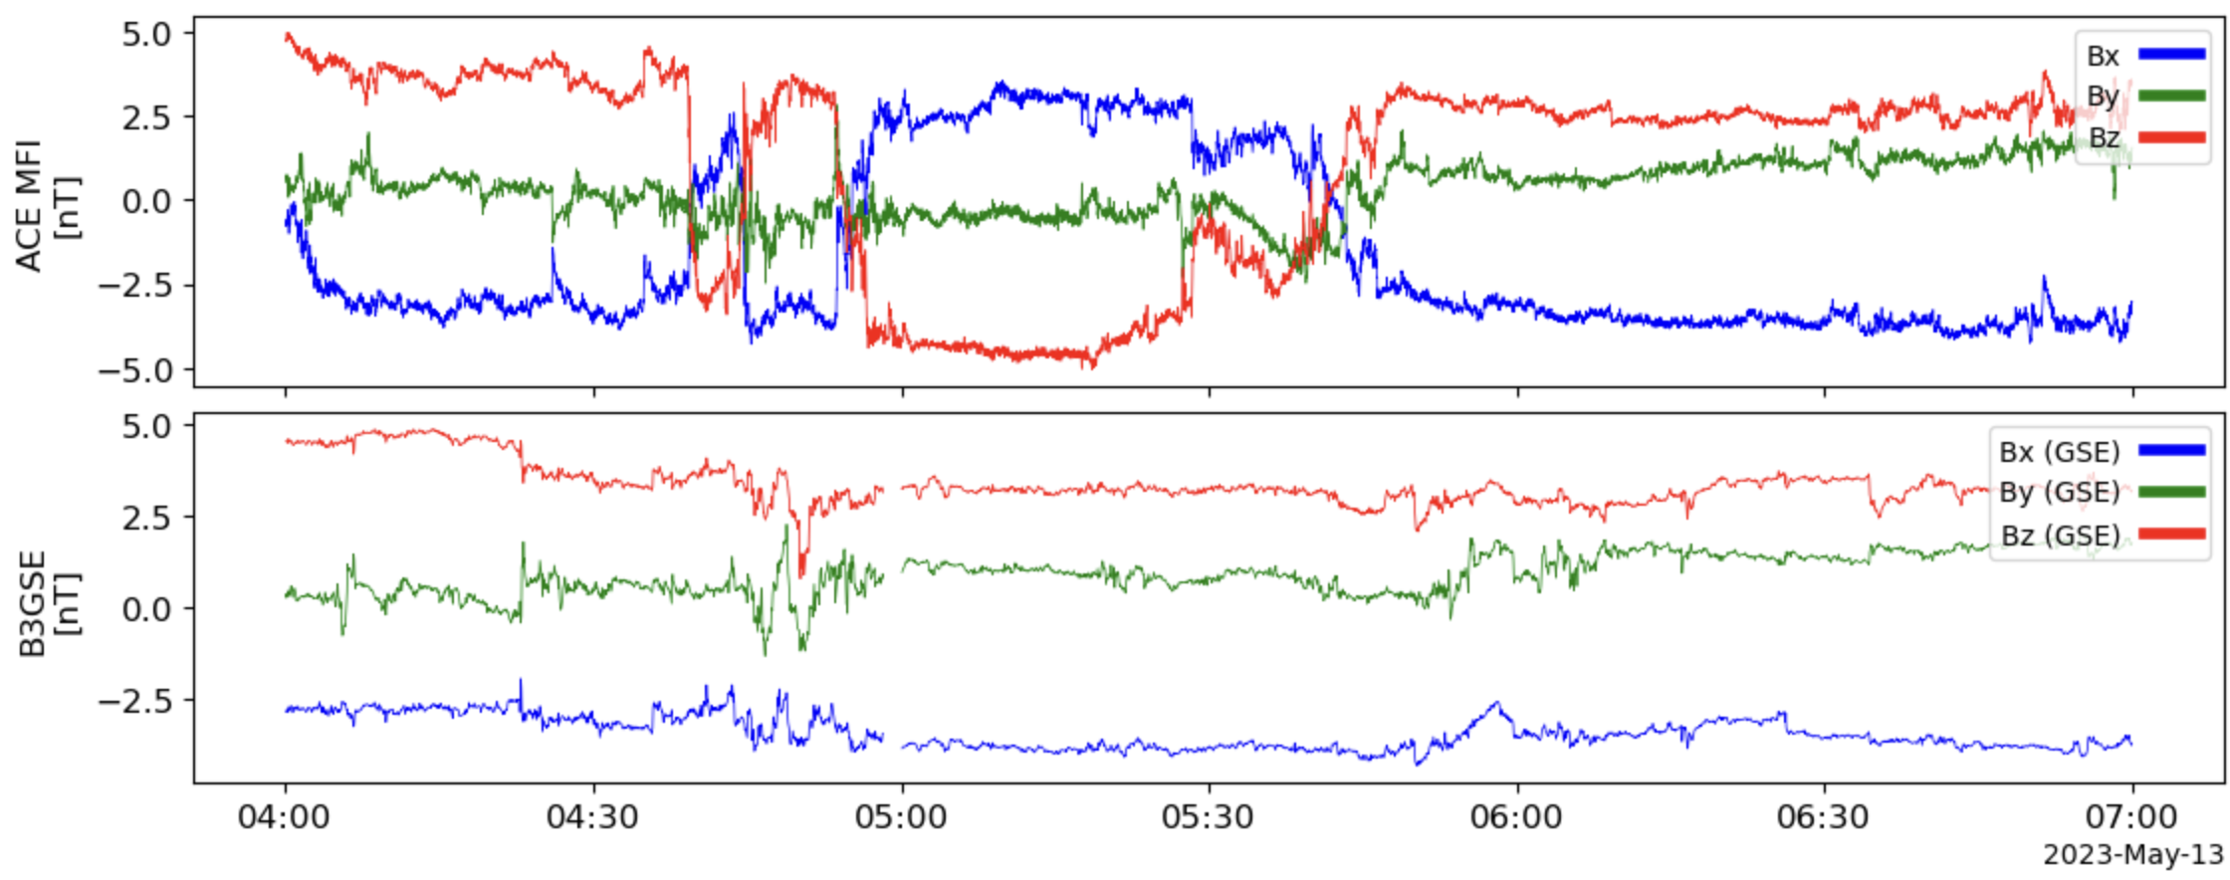
+1 bonus reason for the upstream monitor campaign
MMS at Magnetosheath
ACE
WIND
OMNI propagated to shock
ACE (GSE)
Key-point: Several minutes of Dt is typical, but cases like above are not rare either.
Be careful when using propagated values
WIND (GSE)

Slide 25
Extras
General

Slide 26
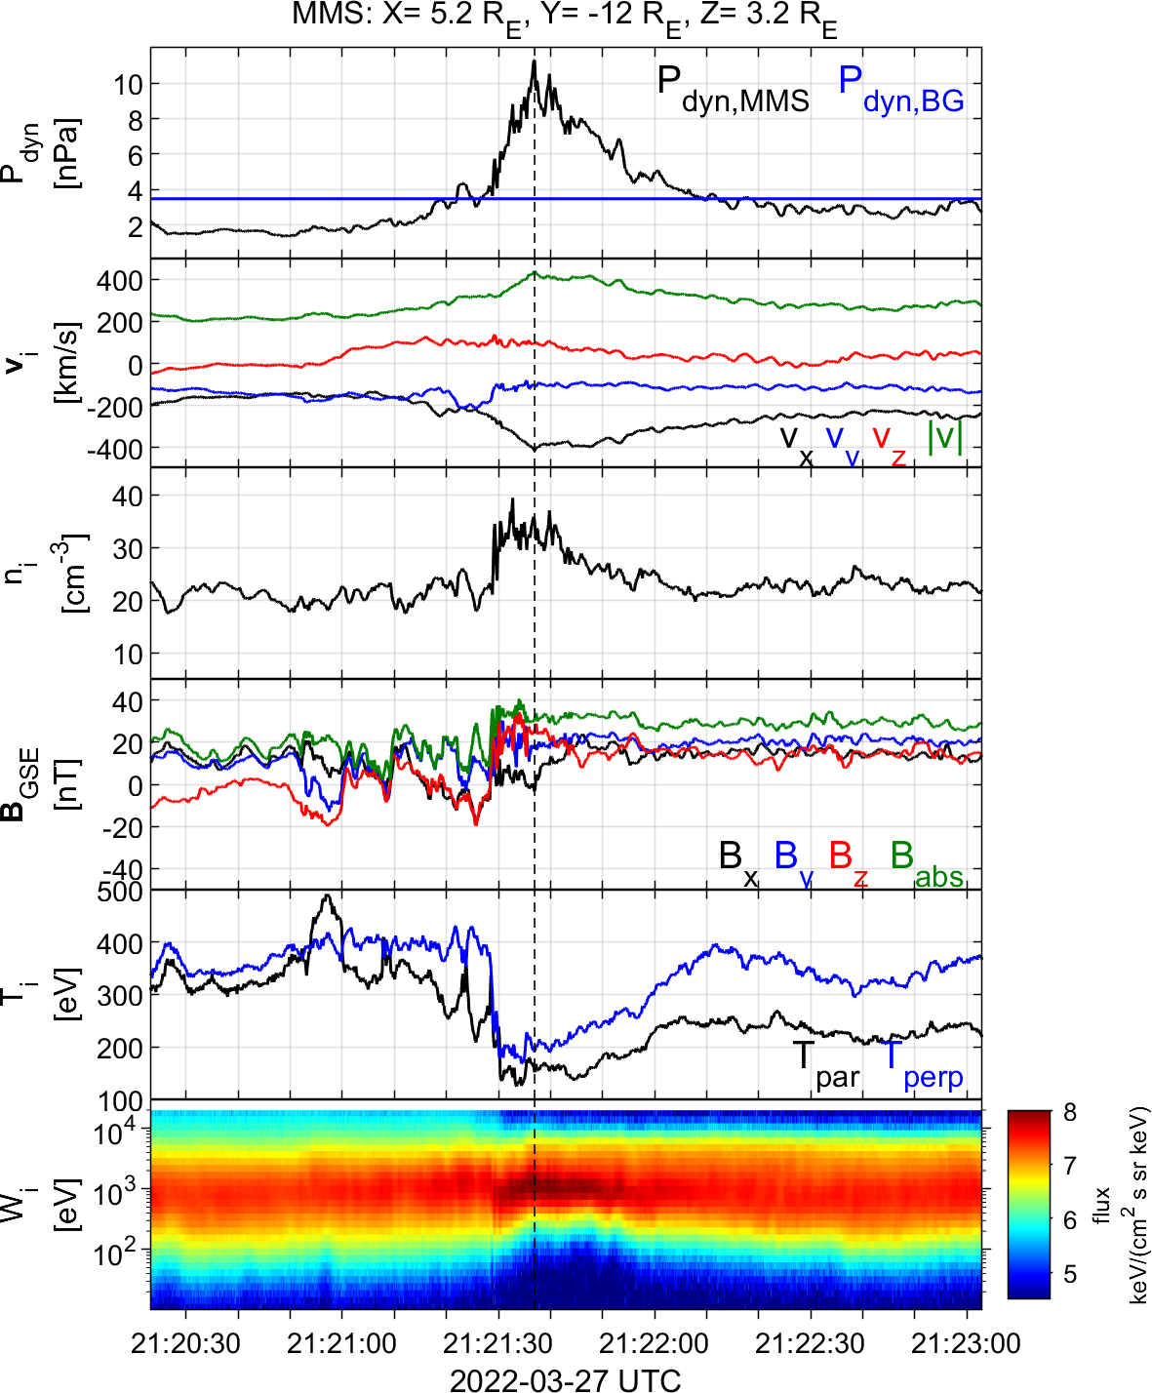
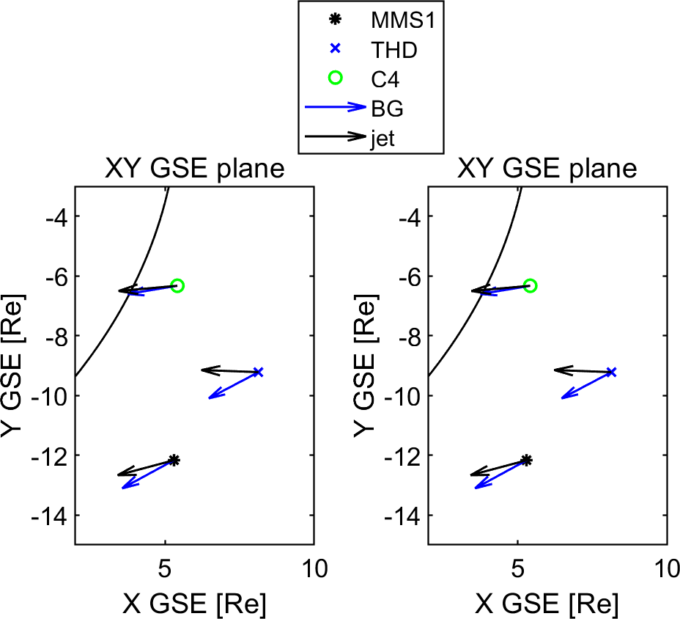
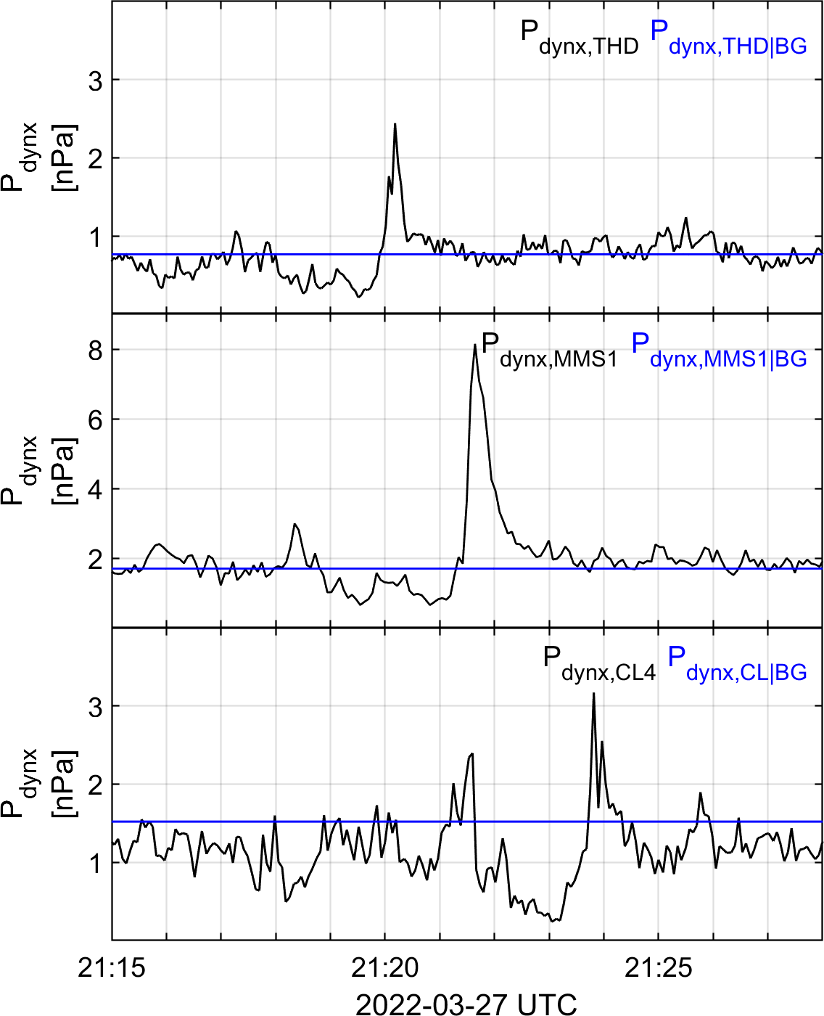
Example of a multi-SC Jet
?
?
?
(Ongoing work – TBD)

Slide 27
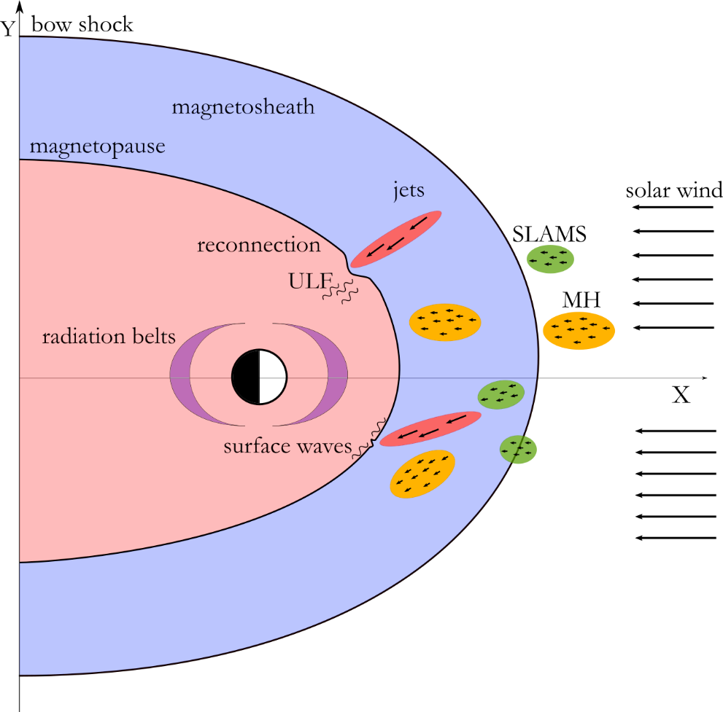
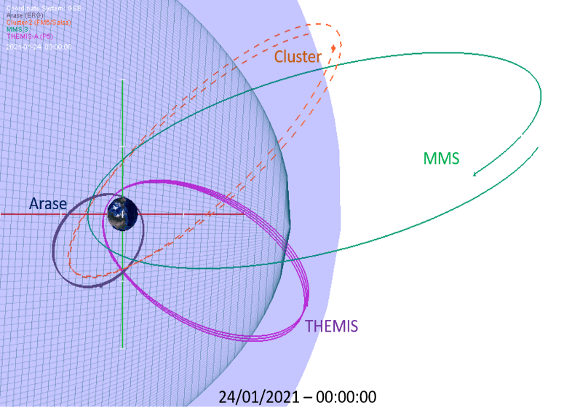
A lot of data are not fully used (conjunctions)

Slide 28
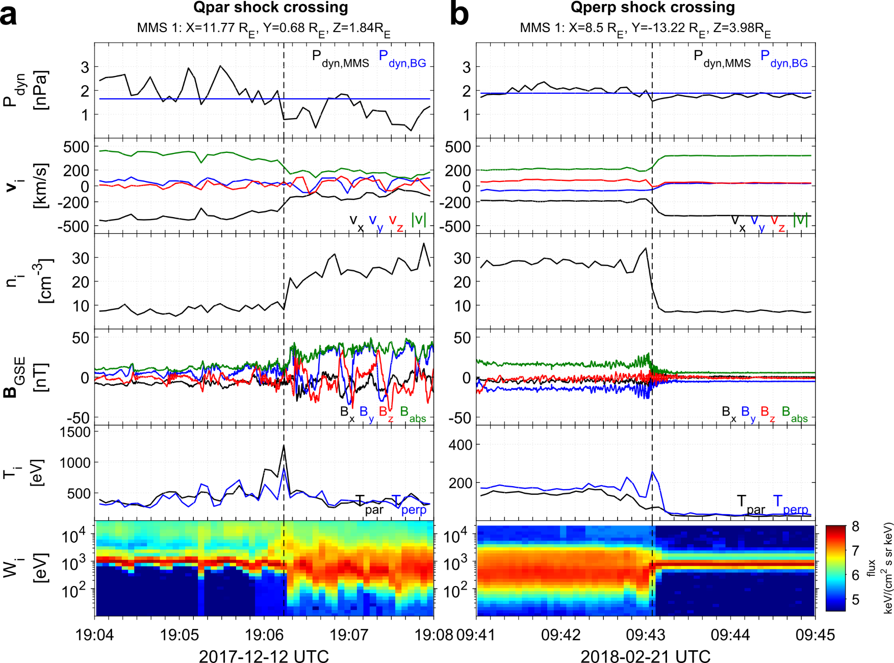
Qpar – Qperp crossings

Slide 29
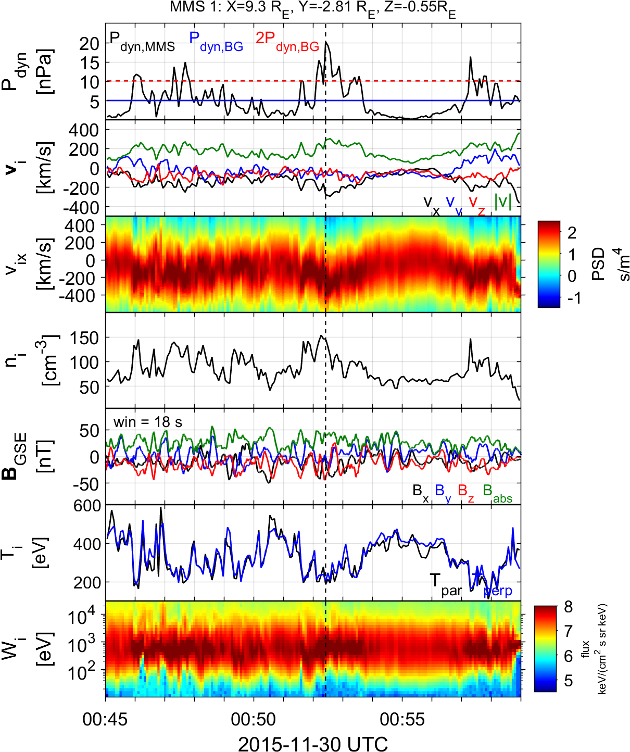
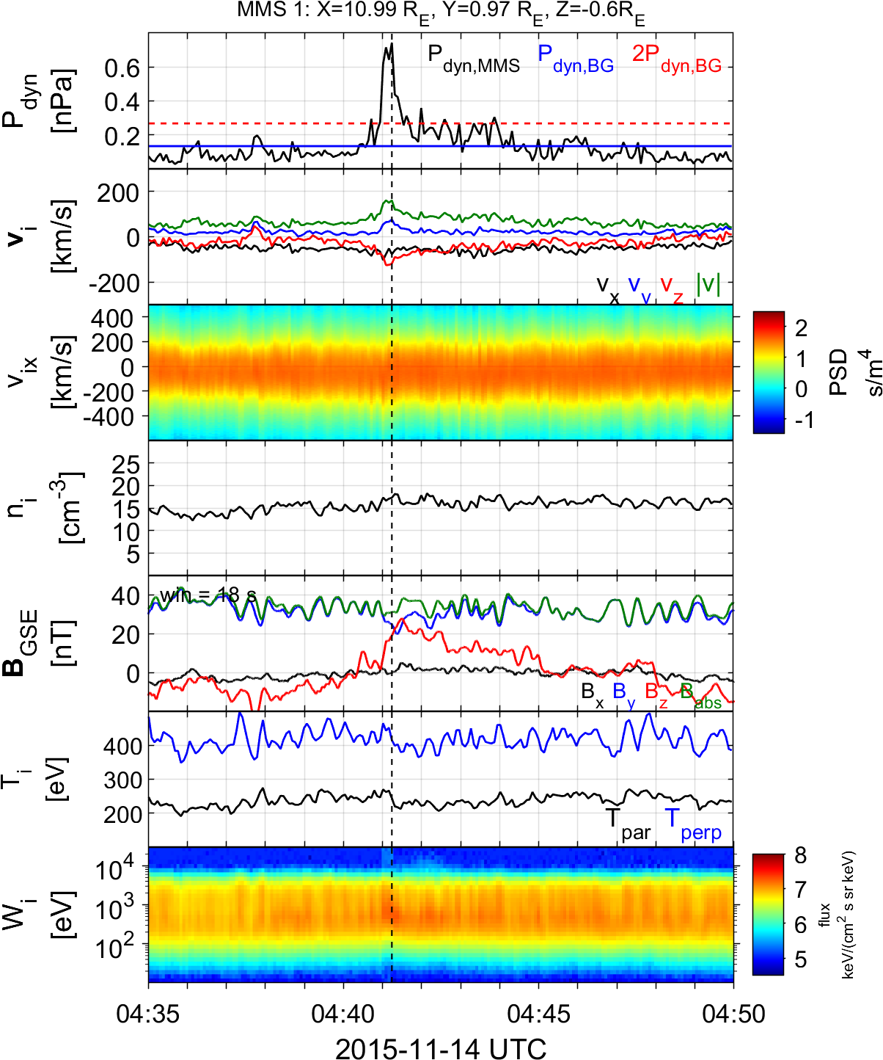
Qpar – Qperp Jets

Slide 30
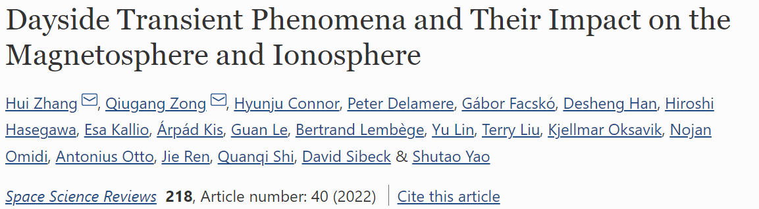
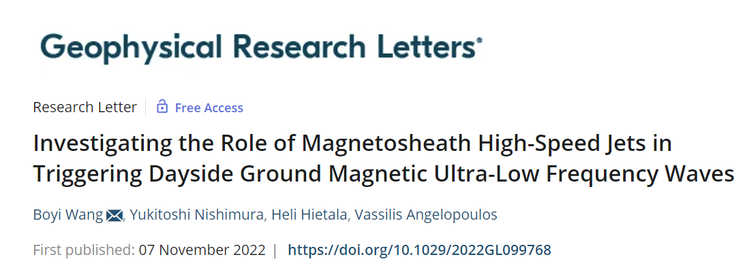
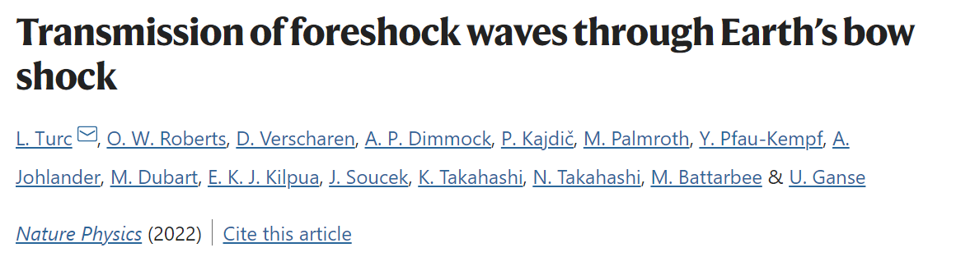
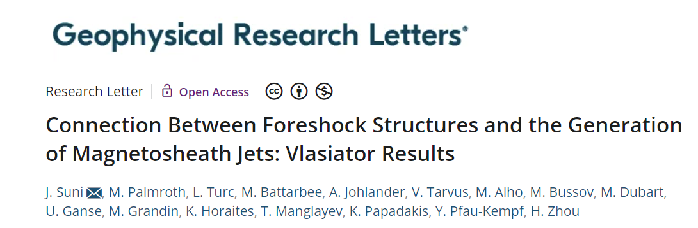
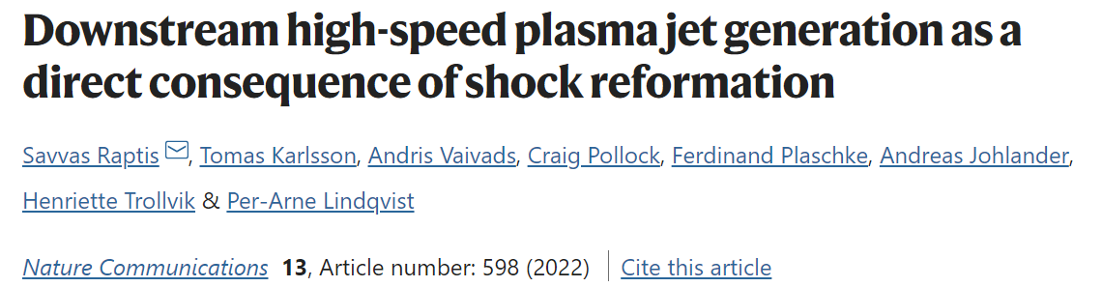

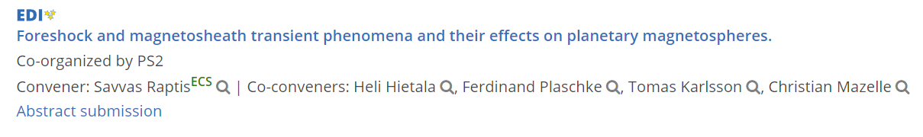
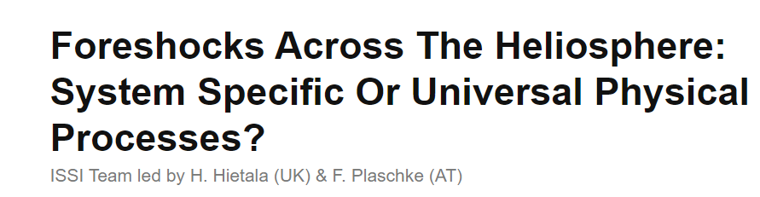

Why do we care? “big picture”

