Slide 1
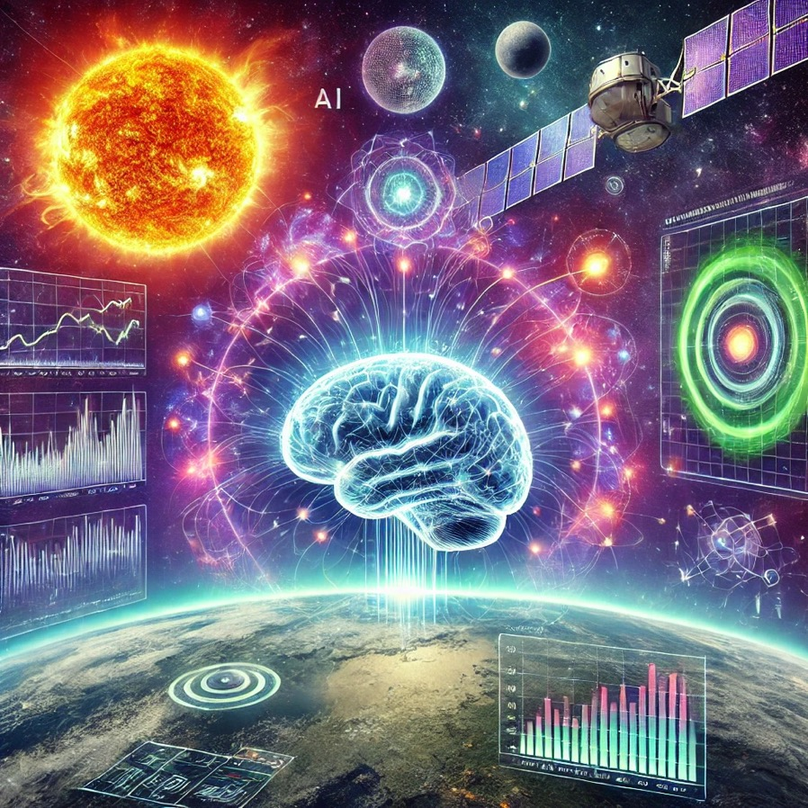
Advancements on
AI for Heliophysics and Space Weather
Savvas Raptis
Johns Hopkins University Applied Physics Laboratory (JHU/APL), Laurel, MD, USA
Thanks to my co-workers: Drew turner, Vicki Toy-Edens, George Clark, Jon Vandegriff, Manolis Georgoulis, Wenli Mo, Michail Sitnov, Harry Arnold, Matt Grey
Made with DALL-E 3
Special thanks to Giovanni Lapenta who introduced me to this topic when I was a master student.

Slide 2
High Level Intro

Slide 3
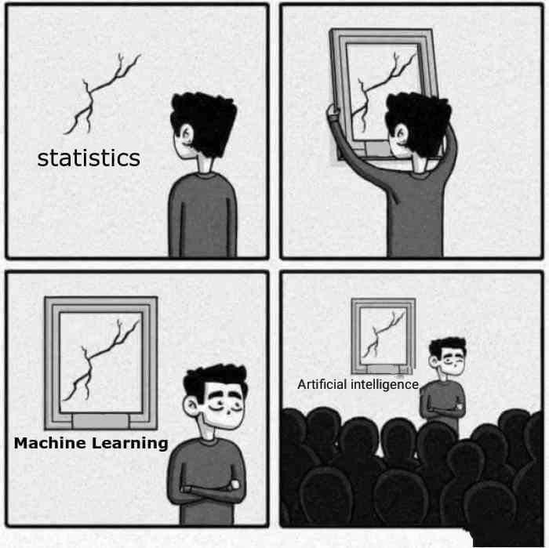
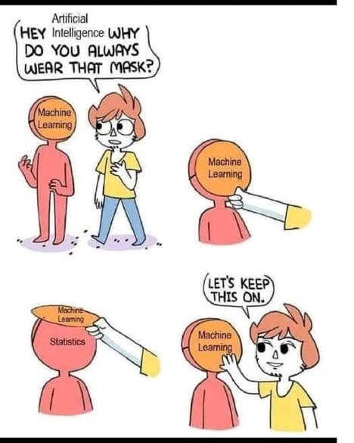
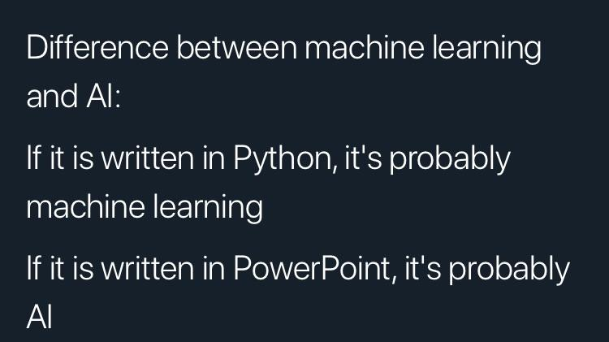
What is machine learning & A.I
AI (Artificial Intelligence) : A term often used to draw attention (at least for the moment).
ML (Machine Learning) : An algorithm designed to “learn” something based on rules and/or data.
My slide from 3 years ago doing a guest lecture on ML in space physics here at KTH…
Somehow we are already here

Slide 4
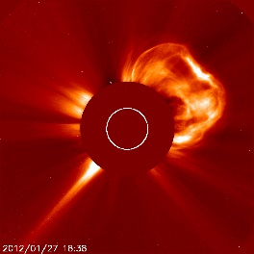
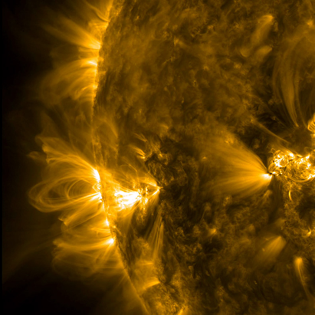
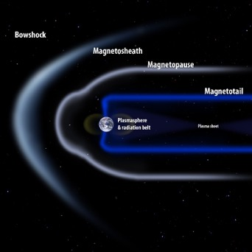
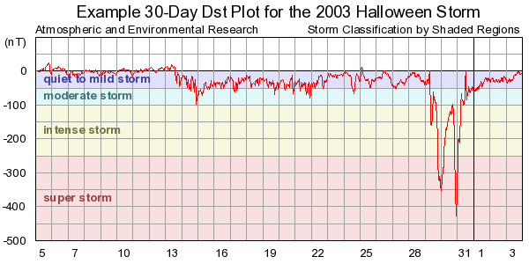
Relevance to Heliophysics and Space Weather
Can we predict CMEs?
Can we predict SEPs
(Solar Energetic Particles) ?
Can we predict Geomagnetic storms?
Can we classify plasma environments?
Another slide from back then…

Slide 5

Relevance to Heliophysics and Space Weather
Benella+2023, Nedal+2023, Ali+2024, Rotti+2024, Liu+2024
Li+2024, Chierichini+2024, Alobaid+2024, Ye+2024
Hu+2023, Zhang+2023, Liu+2023, Kervalishvili+2025
Toy‐Edens+2024,
Ekelund+2024,
Yeakel+2022, Nguyen+2022,
Lalti+ 2022
Many teams are actively
working on these

Slide 6
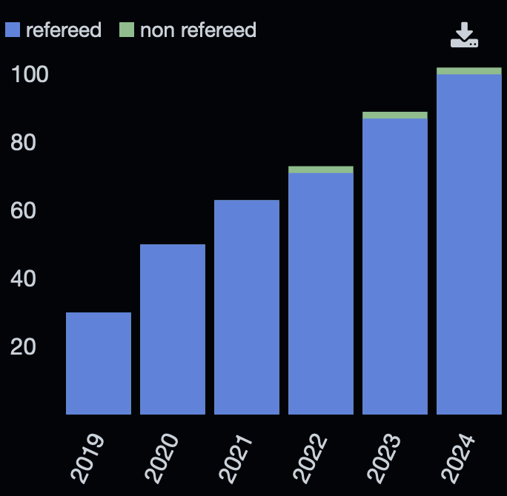
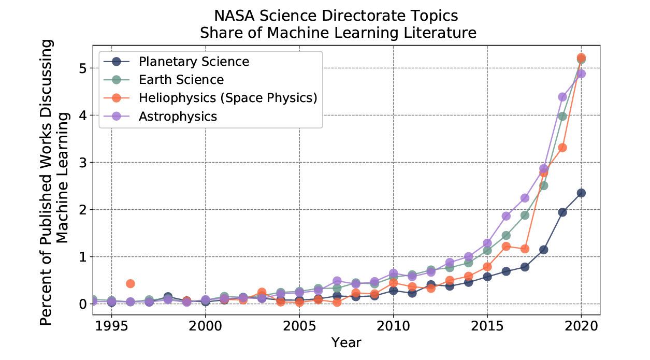
Machine Learning Publications in Heliophysics
Yearly initiatives connecting to industry - NASA FDL: https://fdl.ai
Abigail et al. (2020)
More and more publications are keep coming out!
Not the best query: ((("heliophysics" or"solar wind" or "magnetosphere") AND ("machine learning" OR "deep learning" OR "neural networks")) AND year:2019-2024)

Slide 7
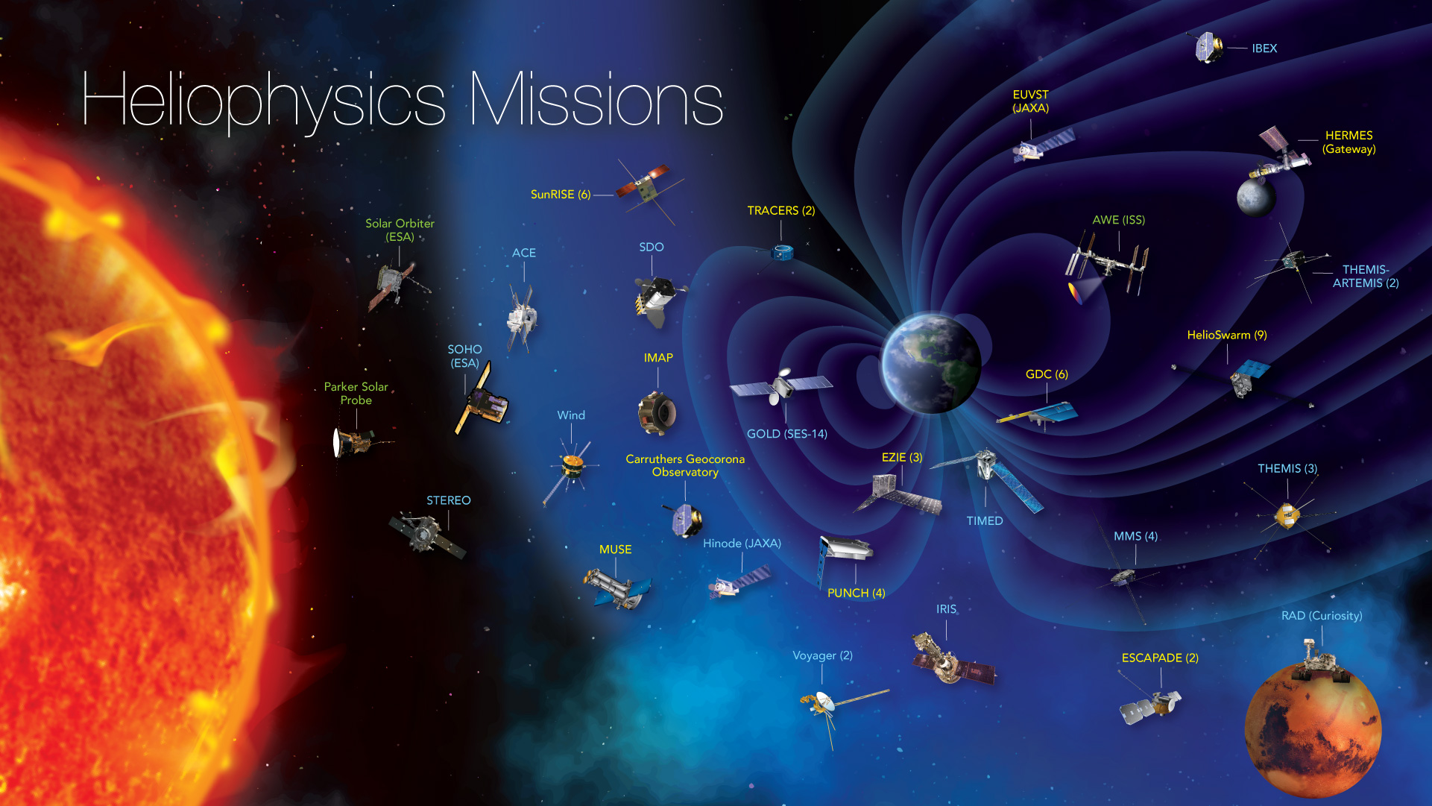

Slide 8
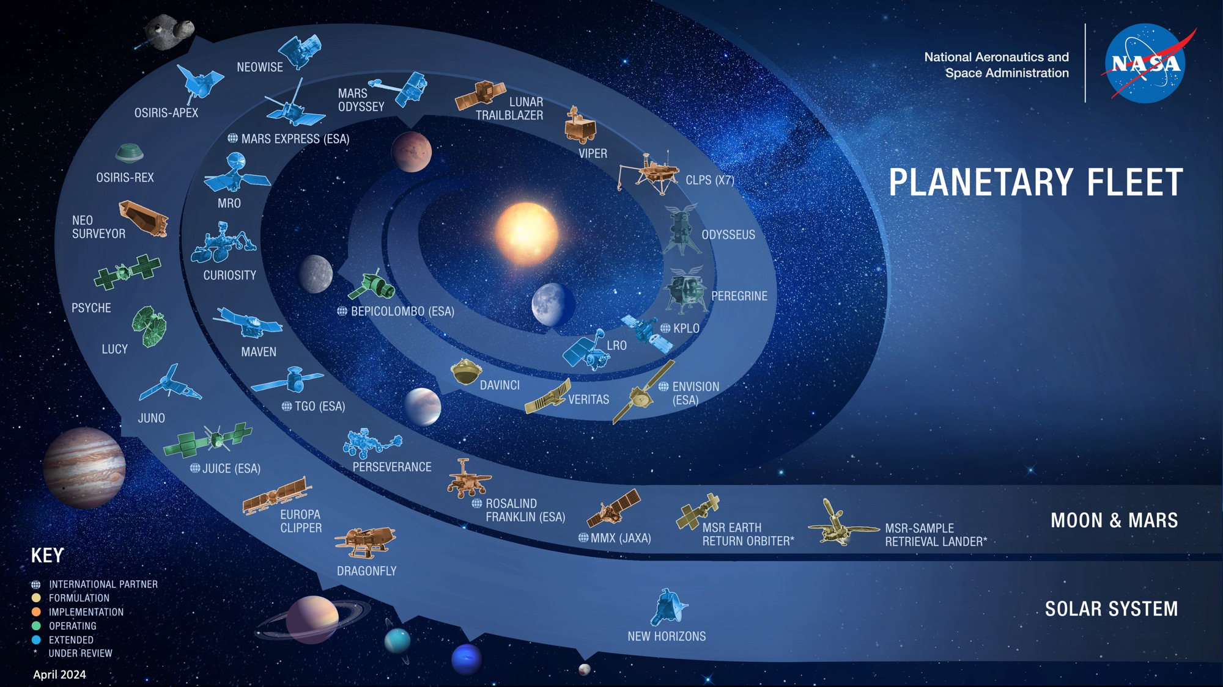

Slide 9
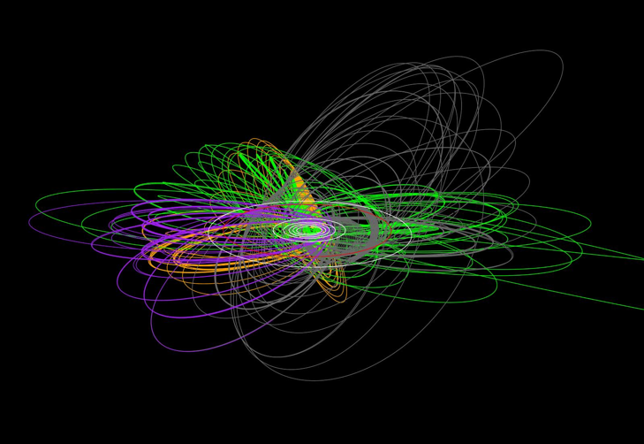
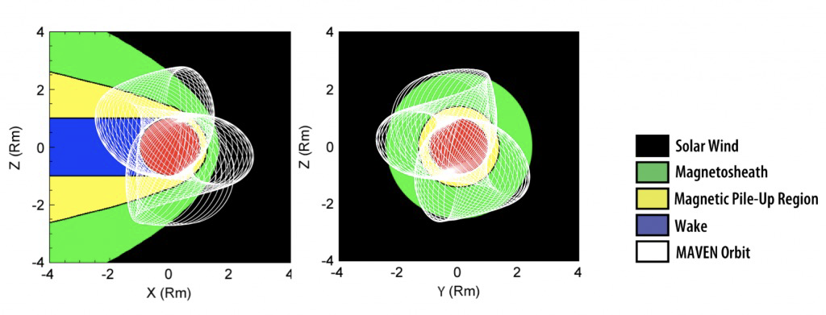
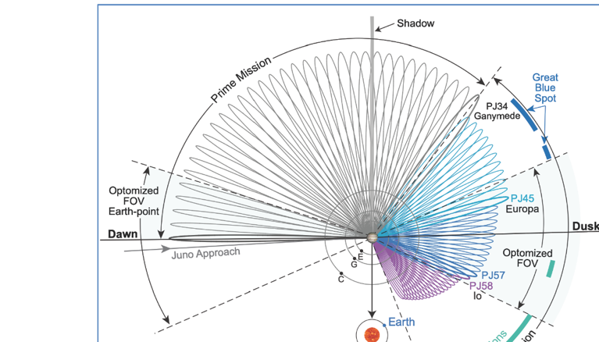
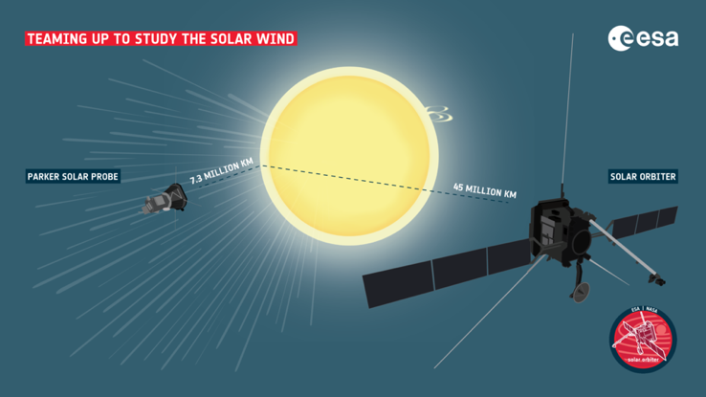
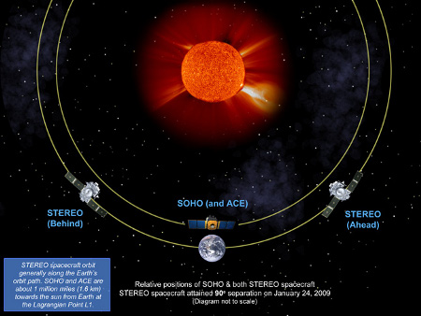
In other words: More than Earth
MAVEN at Mars
Cassini at Saturn
Juno at Jupiter
PSP/ Solar Orbiter, Stereo, SDO, ACE, Wind
Looking at the Sun and solar wind

Slide 10
Highlighting
Recent Results
Assumptions:
  Familiarity with ML concepts (e.g., supervised/unsupervised learning, neural networks, accuracy metrics, LSTMs etc.)
  Basic understanding of space and solar physics (Note: This might not be a smart choice, so I’ll try to keep it simple)
Space Weather: Energetic phenomena mostly from the Sun, affecting Earth and its technology.
Heliophysics: Study of the Sun and its effects on the solar system.
Plasma Environments Around Earth: Distinct regions shaped by Earth's magnetic field and solar wind
Note: I won’t show much on solar since the upcoming talks are going cover a significant part
Notes:
5

Slide 11
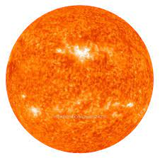








Problem: What are the near-earth solar wind conditions?
Bow Shock
Magnetopause
solar wind
$$\hat{B}$$
WIND
(L1)
MMS
Earth
200$R_{E}$
15$R_{E}$
10$R_{E}$
1$R_{E}$
Reminder: For space weather, we need to know what happened near-Earth, not at L1
$$R_{E}=6371.2 \left[km\right]$$
People typically use http://omniweb.gsfc.nasa.gov However, these are 1D with simple propagation

Slide 12
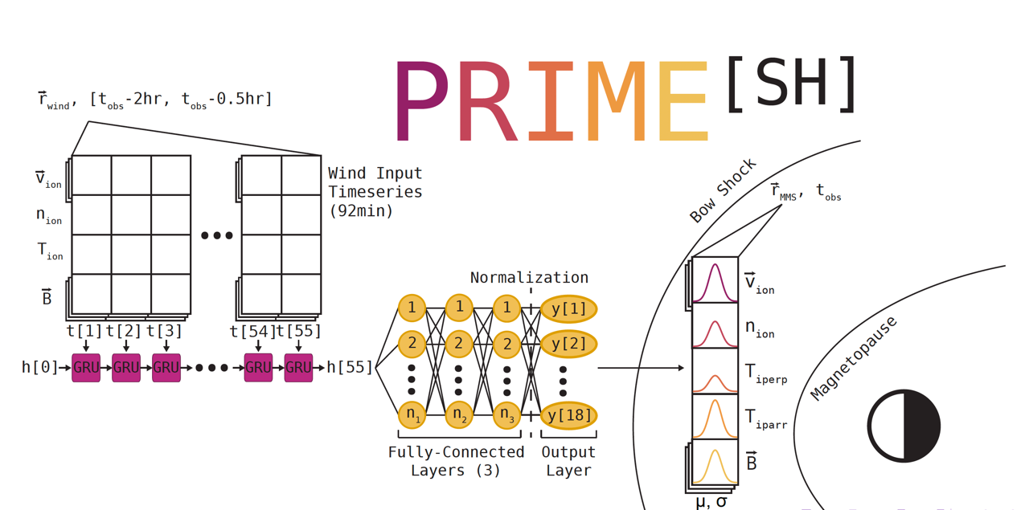
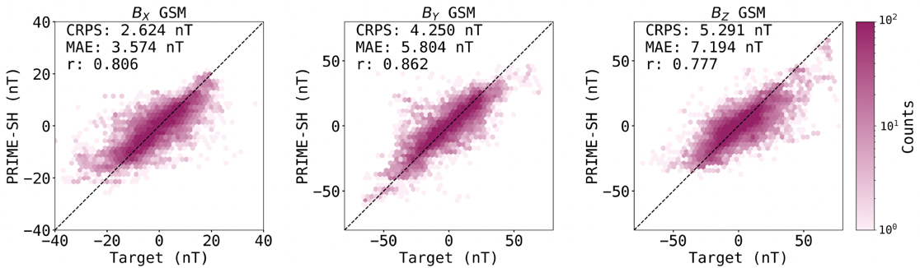
Solution: PRIME & PRIME-SH
Method:
Probabilistic Recurrent Neural Network
Input:
2-hour history of solar wind (SW) data
Outputs:
PRIME: Near Earth SW
PRIME-SH: Magnetosheath
Magnetosheath
Example output metric (B):
O’Brien+ 2023, 2024

Slide 13
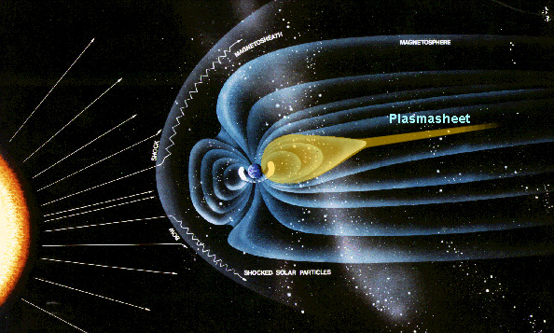
Problem: What are the plasmasheet conditions?
Why model the Plasma Sheet?
To understand geomagnetic storm dynamics
To improve space weather modeling
To gain insights into the inner magnetosphere

Slide 14
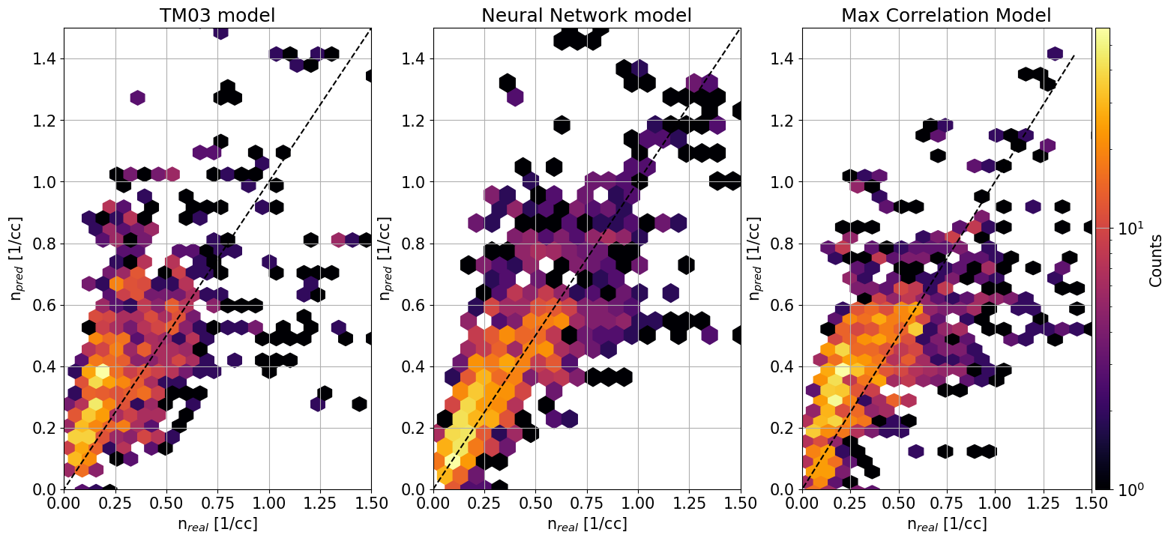
Solution: “PRIME-PS”
Input
Solar Wind (Wind)
>1 million points
Output
Geotail (1994 - 2022)
>1 million points
+
MMS (2015 – 2025)
~ 250k points
Even a simple neural network can outperform current models.
 | TM03 | NN | Base
R2 | 0.17 | 0.68 | 0.32
MAE | 0.19 | 0.11 | 0.18
RMSE | 0.27 | 0.2 | 0.27
r (cor) | 0.58 | 0.83 | 0.57
TM03: Tsyganenko & Mukai 2003 : https://agupubs.onlinelibrary.wiley.com/doi/full/10.1029/2002JA009707
Raptis+2025 (under prep)

Slide 15
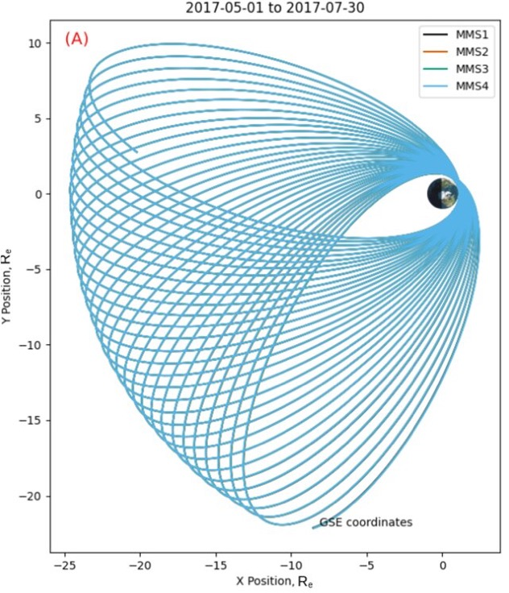
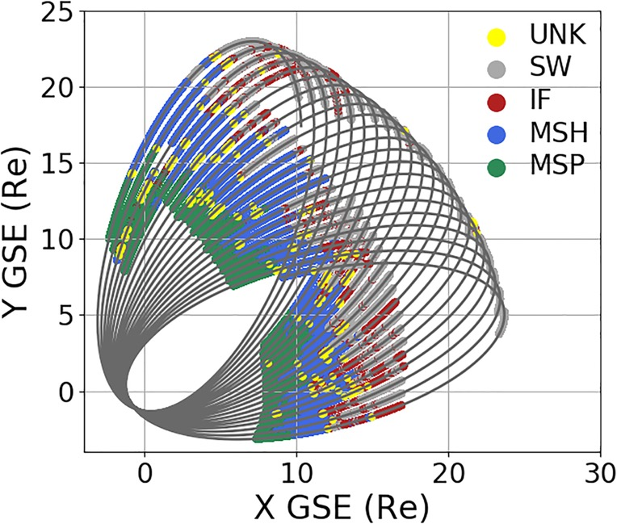
Problem: Where is the spacecraft located?
We know the orbit
But that’s not enough…
Bow Shock
SW
Magnetopause
MSH
MMS
MSP
Olshevsky+ 2021
These environments dynamically evolve with multiple temporal scales

Slide 16
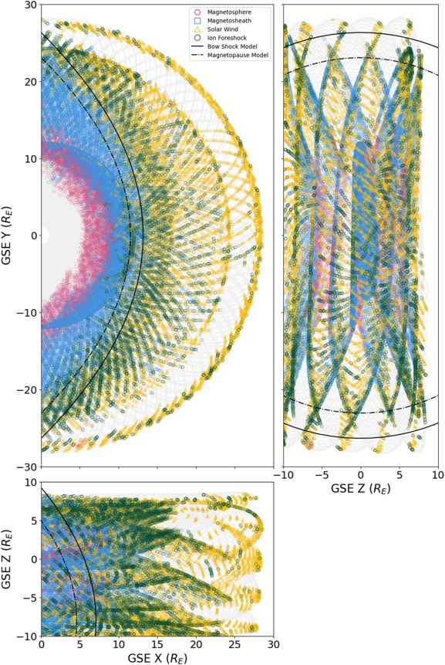
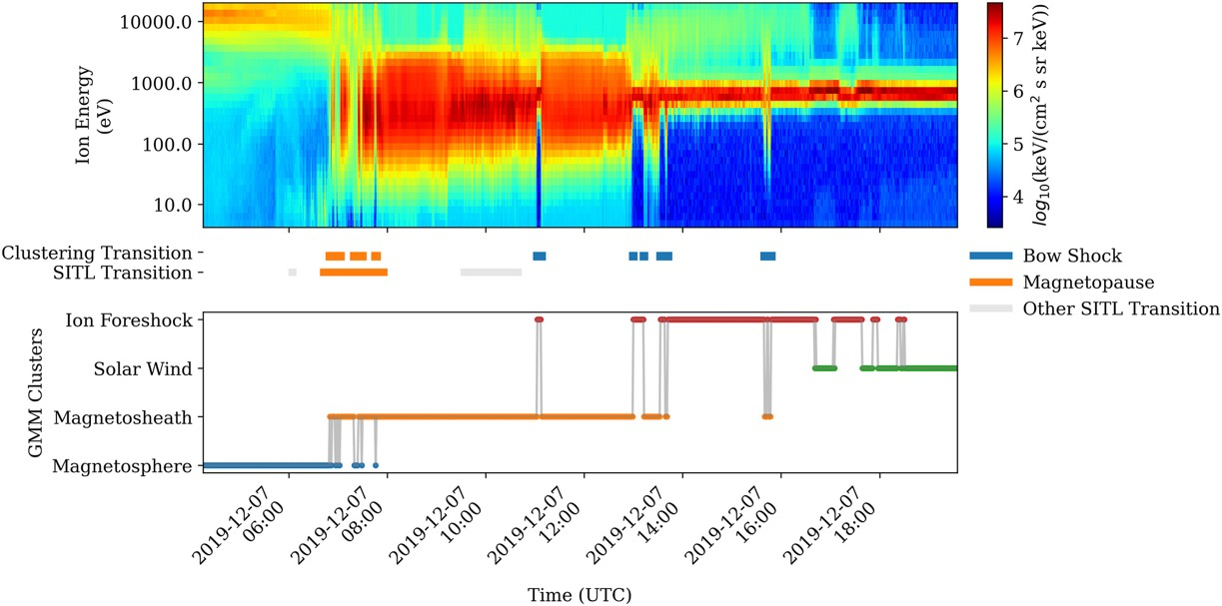
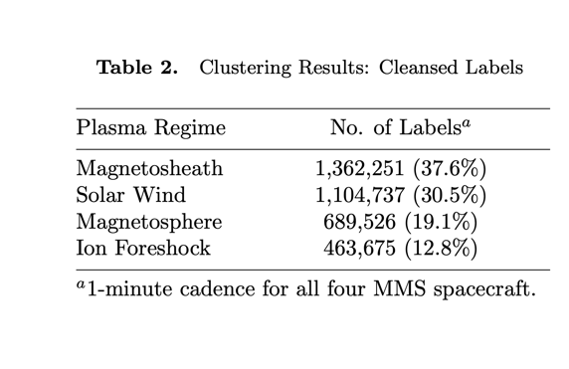
Solution: in-situ MMS classification
Key Questions:
Can we apply MMS feature space to other planets? Toy-Edens+2025 (under review)
Can we leverage these observations to synthetically generalized to astrophysics?... TBD
Lalti., et al. (2022) | JGR
Olshevsky., et al. (2021) | JGR
Breuillard et al. (2020) | Front. Astron. Space Sci.
Toy-Edens+ 2024

Slide 17
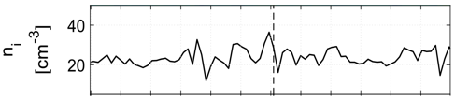
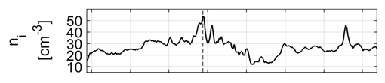
Problem: What data do we need in high-res?
(a)
Always available (low res)
Plot (b): Zoom-in on the red-shaded interval from (a).
Resolution Difference:
  Burst Data (b): 0.15 seconds (high resolution)
  Survey Data (a): 4.5 seconds
Challenge:
Downlinking everything is not feasible. Prioritization is key.
Solution:
Scientists-In-The-Loop (SITLs) handle prioritization manually.
(b)
<1% of dataset (high res)

Slide 18
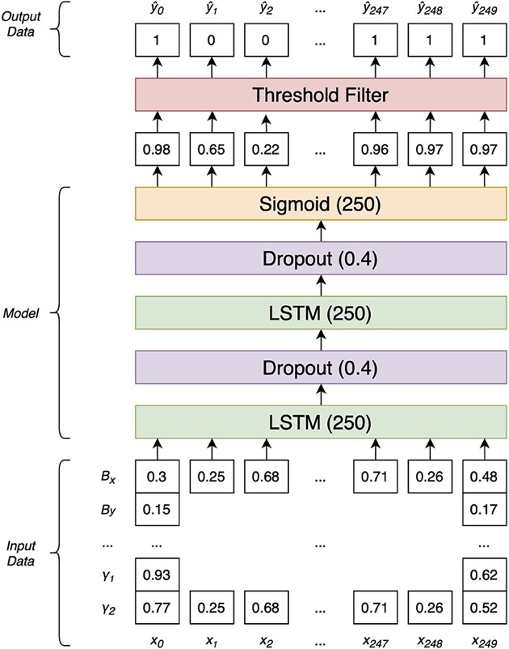
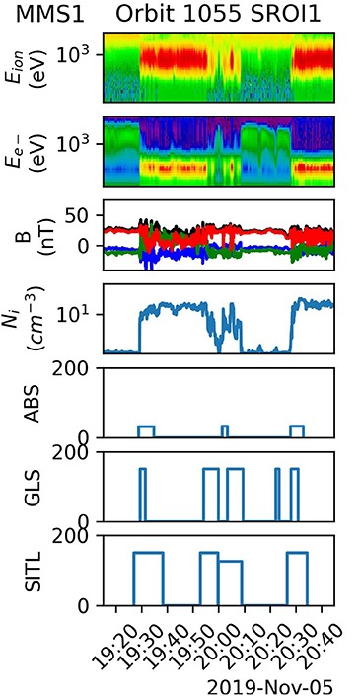
Solution: LSTM Burst data selection
Magnetosheath
Magnetosphere
LSTM model
Manual selection
GLS MP model has selected 78% of SITL-identified MP crossings
Argall+2020

Slide 19
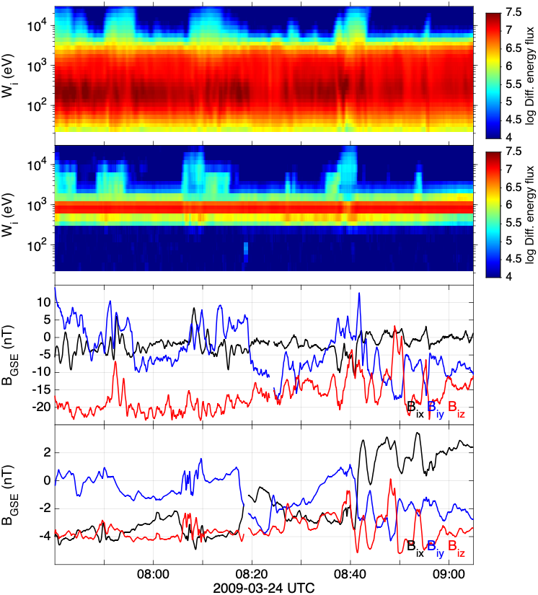
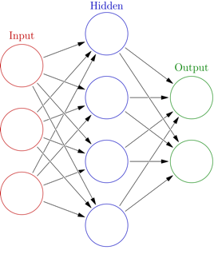
Problem: Can we create synthetic data from SC conjunctions?
Features not included in current physical theory
Bow Shock
SC2
Magnetopause
SC1
SW
MSH
Earth
SC2
Shock
SC1
SC1
SW
SC2
MSH
Raptis et al. (ongoing)

Slide 20
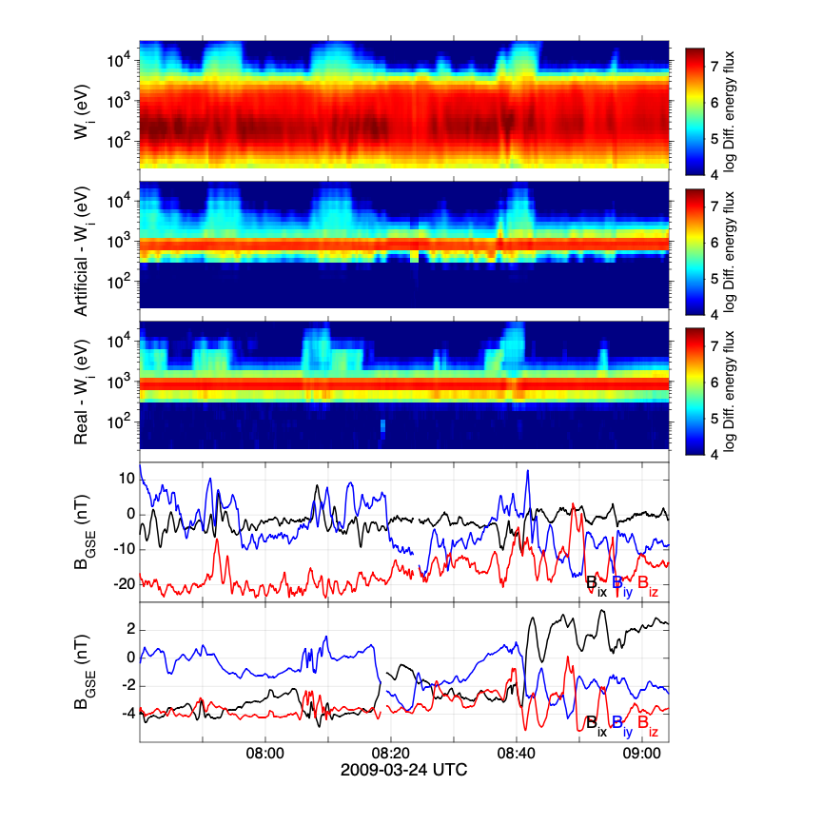
Solution: Synthetic data using CNNs and multiple SCs
SC2
Test Set Results:
NN was not trained on 2009 data.
Successfully captures upstream conditions.
Artifacts are present but can be smoothed.
Captures similar plasma moments:
  Real density: 3.8 [1/cc]
  Modeled density: 4.1 [1/cc]
Artificial
SC1
SC1
SC2
SC1
Raptis et al. (ongoing)

Slide 21
More recent results
Physics-Informed Neural Networks (PINNs) Modeling:
  Astrophysical shocks (Moscou+ 2023)
  Plasma space-time observations (Bard & Dorelli 2021, Dorelli+ 2023)
  Solar coronal magnetic field (Jarolim+ 2023)
Prediction/Forecasting:
  High-speed solar wind streams from SDO images (Collin+ 2025)
  Geoeffective events (Guastavino+ 2024, 2025)
Other Advances:
  Machine learning-ready datasets for decision-making (Angryk+ 2020, Georgoulis+ 2024)
  + many many more…

Slide 22
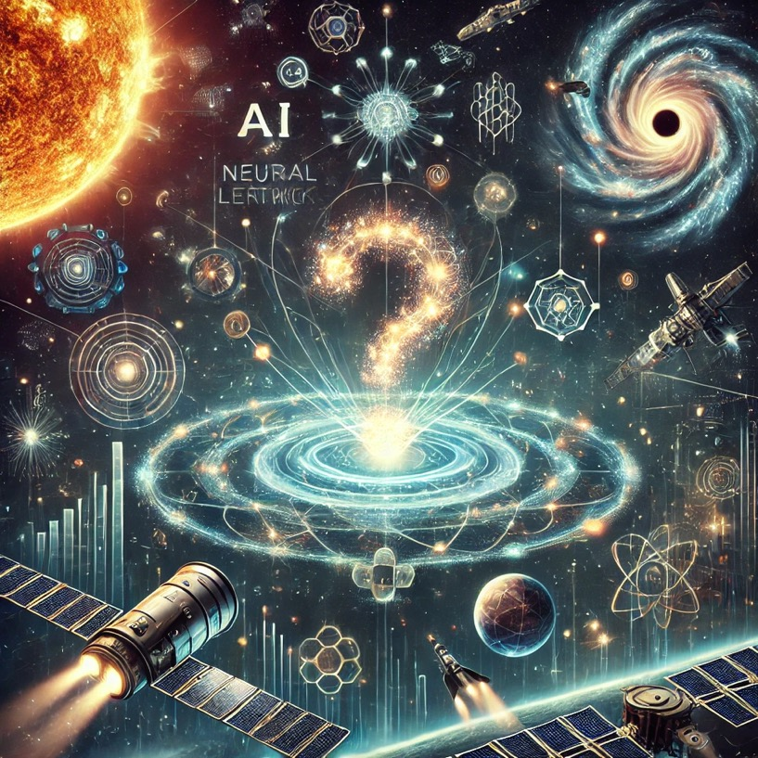
Main message:
Significant progress on various applications
Impossible to cover in one presentation
But what are we missing?
Made with DALL-E 3

Slide 23
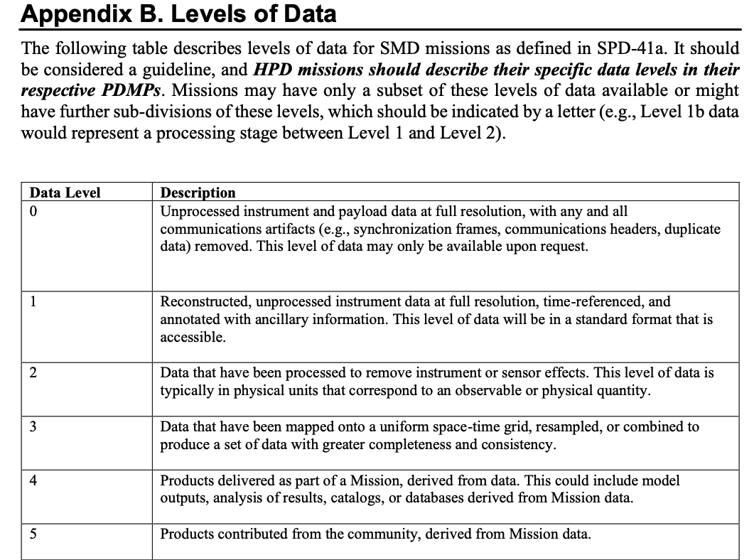


The problem with most applications for on-board?
What we should be working with
What we typically work with
What people promise they’ll make

Slide 24
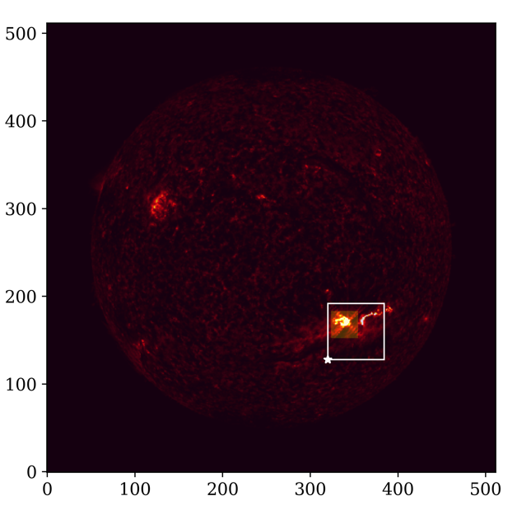
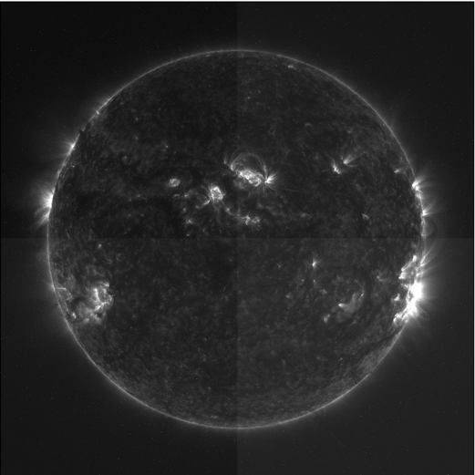
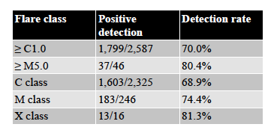
Example: Onset of Solar Flares with Onboard Instrument
SDO AIA level 0 data (courtesy of Meng Jin)
L0 Data from SDO
Determine Flare precursor signatures
70% detection rate 4 hours before the flare
Next talks will show you more on SDO driven machine learning projects
Other European relevant projects (e.g., DENSER https://swe.ssa.esa.int/machine-learning-in-support-of-space-weather-prediction)
Toy-Edens+ Ongoing

Slide 25
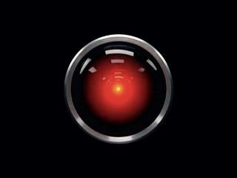
Onboard AI
Example of applications:
Onboard data processing
Automated instrument operations
Combining diverse datasets (e.g., from different missions) for decision making
Potential Issues:
Running an AI/ML solution in pytorch/tensorflow on your computer is easy, but translating that to on-board processing to operate using satellite and/or instrument data in real-time is not trivial
Running an onboard models with noisy, potentially uncalibrated/unvalidated real-time data inputs can be problematic
Most of current flight-proven hardware (e.g. MMS) does not have the processing power to handle complex AI/ML algorithms
This technology could be critical for future missions, particularly high-N constellations and deep-space missions (think Interstellar Probe… telemetry rates from 500 AU are very low)
We need to establish requirements and support efforts for next-gen processors
Image Copyright Metro-Goldwyn-Mayer, 2001: A Space Odyssey (1968)

Slide 26
Example case – MagCon Concept
Magnetospheric Constellation (MagCon)
  ≥ 30 scs in variety of Earth orbits
  Even determining/optimizing orbital coverage is a a challenge!
  Coupling in-situ and ground-based observations
MagCon + PARAGON = Links (26 SCs)
A mission highlighted in 2024 decadal survey!
Kepko+ 2018, 2024
Even SMEX/MIDEX missions (<120/180m) concepts: e.g., WEDGE (magnetotail) and MAKOS (bow shock) can benefit

Slide 27

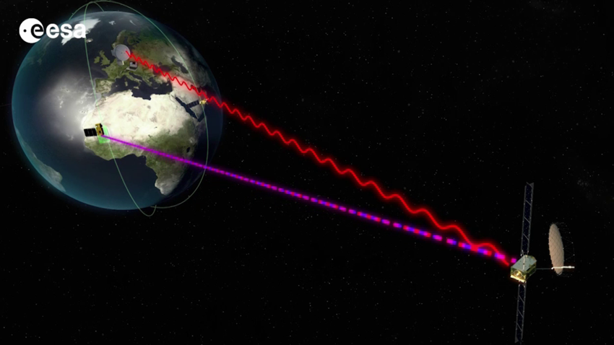
An alternative solution
For Spacecraft Close to Earth (Excludes Interstellar Probes)
Heliophysics missions with real-time (<5 min) ground transmission:
  Wind
  ACE
  VAP
  IMAP (Launching in SEP 2025)
In Other Words:
Real-time decision-making can be efficiently handled on the ground.
Key challenge: Ensuring fast communication to the ground and potentially SC to SC communication.
Credits: ESA

Slide 28
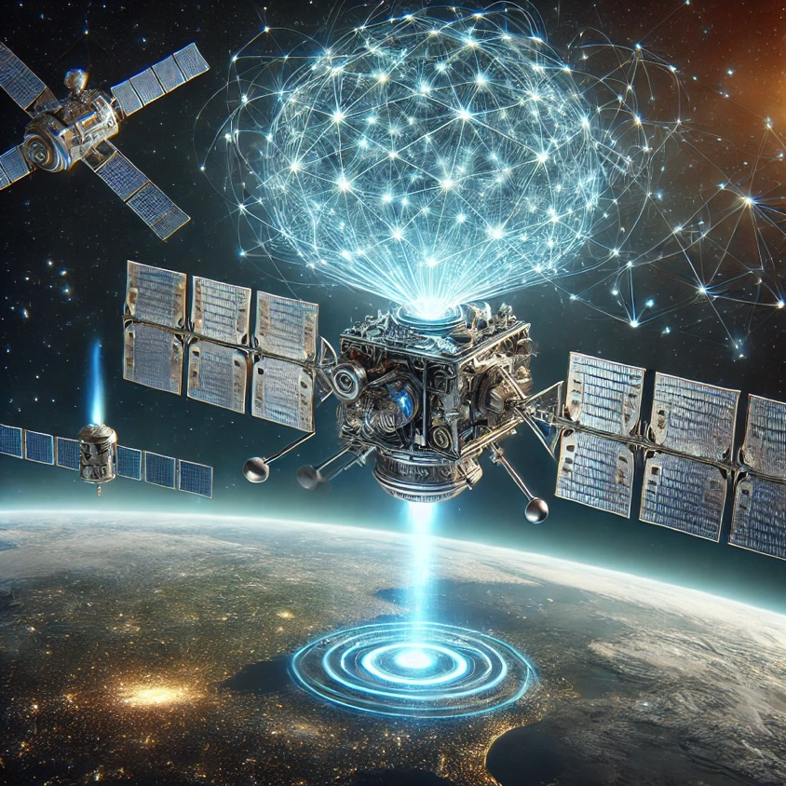
Final Words
Made with DALL-E 3
Amazing progress on ML/AI methods and on their applications in Heliophysics and Space Weather.
How can we use AI/ML for
  Data reduction and processing on board?
  Orbital and formation maneuvers? (Collision Avoidance?)
  Changing modes in instrumentation for different scientific and operational objectives?
How do we apply AI effectively to large constellations of SCs?
How do we design future missions to make AI methods more effective and increase science return?
How do we wrap models in the mission design?
Paraphrasing a SC engineer I talked with last week:
“If your AI/ML applications saves mass, power, volume, telemetry and/or cost then it can be pursued. Also, if your application enables new science! You just have to show/demonstrate it“
Notes:
We also didn’t talk about new techniques like PINNs
I also did not talk about LEO orbits and atmospheric effects, as I suspect people in the afternoon session will have more things to say there ☺

Slide 29
Appendix

Slide 30
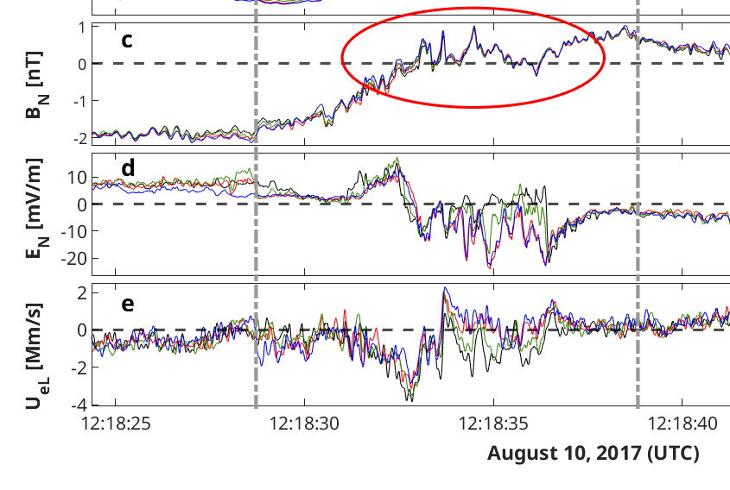
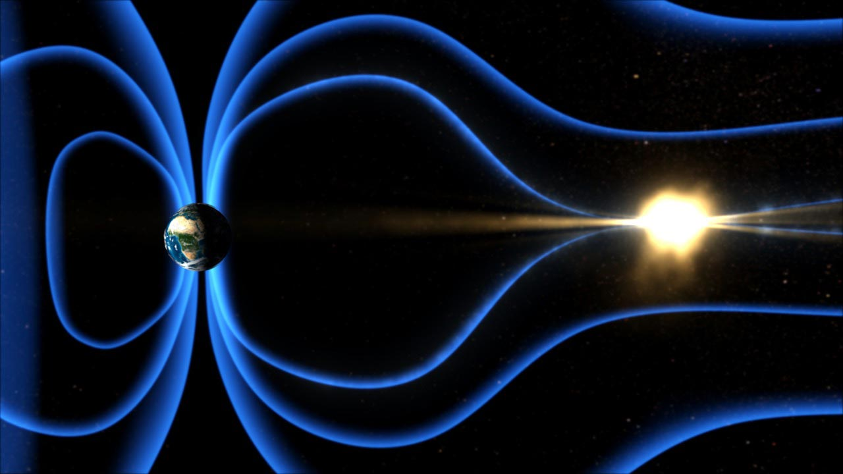
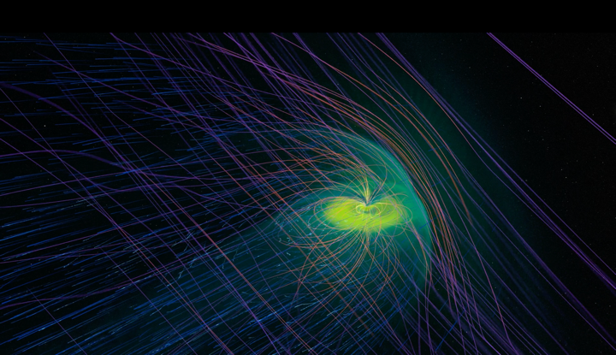
Problem: Where is magnetotail reconnection happening?
“Rare”
In-situ obs
Scroeder+2022
“Expensive”
Simulations
Credits: NASA
NASA's Scientific Visualization Studio

Slide 31
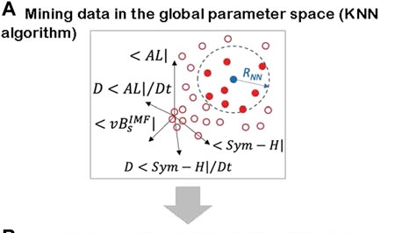
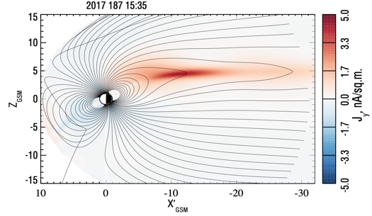
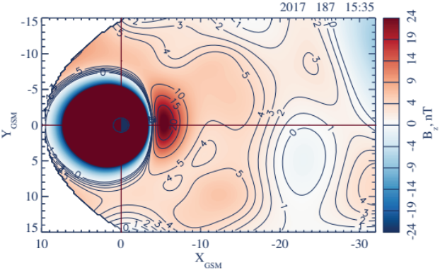
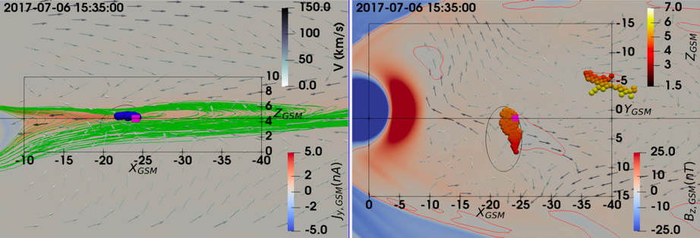
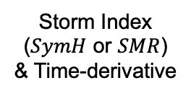

Solution: Data mining and multiple datsets
Motivation: Allow the data dictate the morphology and time evolution (not predefined functions)
Substorm Index ($AL$ or $SML$) & Time-derivative
Data Driven Modeling
Meridional
Equatorial
Solar wind electric field
Storm Index ($SymH$ or $SMR$) & Time-derivative
DM
X-Line
Physics Based Simulations
Meridional
Equatorial
DM
X-Line
Credits: Sitnov & Stephens (APL/JHU)
Credits: Arnold Harry (APL/JHU)
See also: Stephens et al., 2019; Sitnov et al., 2019

Slide 32

Physics Informed Machine Learning
Recent articles/advancements:
Kawaguchi+2019
Raissi+ 2020
Haghighat+ 2020
Jagtap+ 2020
Yang+2020
Rao+2020
Lu+2021
Karniadakis+2021
Markidis+2021
Kvachki+2023
Zhang+2024
Cao+2024
Raissi+ 2019

Slide 33






Method: Artificial Data reconstruction using multi-SC
Input
$$[x,y]$$
Convolution Neural Network
Feature Extraction
Dense Neural Network
Regression
Output
Flux $∀$ bin
Conv
Conv
Pool
Conv
Conv
$$\begin{matrix}F_{u,1} \\ ⋮ \\ F_{u,32}\end{matrix}$$
$$…$$
$$…$$
x
y
Raptis et al. (ongoing)

Slide 34

The dataset (i.e, output – Central Plasma Sheet)
Geotail (1994 - 2022)
>1 million points
(B) MMS (2015 – 2024)
~ 250k points
Output: plasma moments and magnetometer data.
Raptis+ 2024

Slide 35




Modeling Temperature Ratios | 2D Maps
Note: here that this dataset I used from MMS are (a) not classified properly (on purpose) (b) trained with little optimization and (c) not pre-processed. Still, NN provide reasonable results.
No extreme values
Neural Networks modeling
Empirical modeling (TM03/DSGR16)

Slide 36




Modeling Density | 2D Maps
N [1/cc]
N [1/cc]
Neural Networks modeling
Empirical modeling (TM03)
Raptis+ 2025 (ongoing)

Slide 37


OMNI Missmatches
1D propagation tools from L1 are not sufficient for Space Weather prediction
Example of time delay offset
Example of different conditions

Slide 38



Solar Wind is 3D
Borovsky 2017
Walsh et al. 2019

Slide 39

Problem: What data do we need in high-res?
Plot (b): Zoom-in on the yellow-shaded interval from (a).
Resolution Difference:
  Burst Data (b): 0.15 seconds (high resolution)
  Survey Data (a): 4.5 seconds
Challenge:
Downlinking everything is not feasible. Prioritization is key.
Solution:
Scientists-In-The-Loop (SITLs) handle prioritization manually.
Krämer+2025

