Slide 1

Machine Learning Modeling of Earth’s Plasma Sheet using Multi-Spacecraft Observations
Savvas Raptis¹, Connor O’Brien¹, Kareem Sorathia¹, Viacheslav Merkin¹, Shinichi Ohtani¹, Louis Richard², Anusree P. Devanandan³, Simon Wing¹
¹ APL/JHU, Laurel, MD, US
² Swedish Institute of Space Physics, Uppsala, Sweden
³ University of New Hampshire, NH, USA
Acknowledgments:
CGS NASA Drive Center
savvas.raptis@jhuapl.edu | https://savvasraptis.github.io

Slide 2
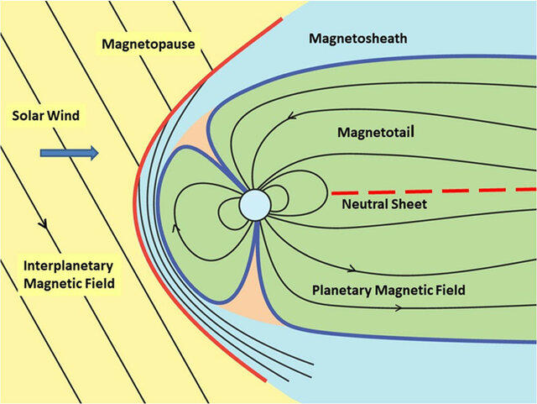
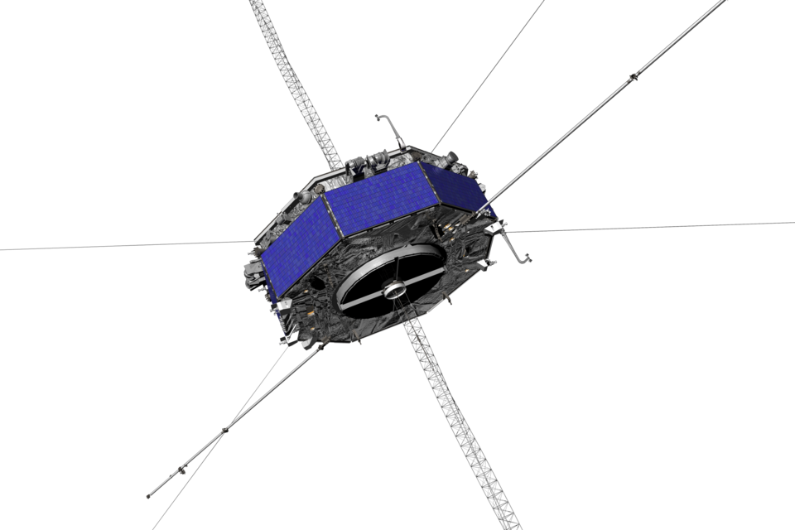
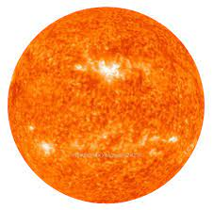


2
Where are we & what are we doing?
Credits: NASA
Input:
+Geomagnetic
e.g., ACE/WIND/DSCOVR
(L1)
200$R_{E}$
Output: In-situ properties from: MMS, Geotail, THEMIS
Goal: Model Plasmasheet properties based on driving (SW) and geomagnetic conditions
$$R_{E}=6371.2 \left[km\right]$$

Slide 3
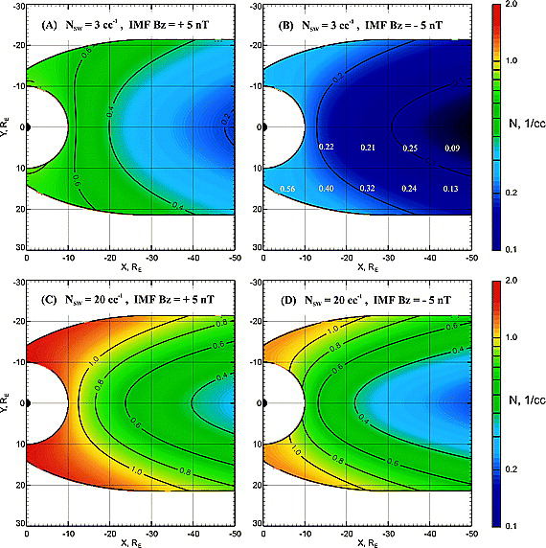
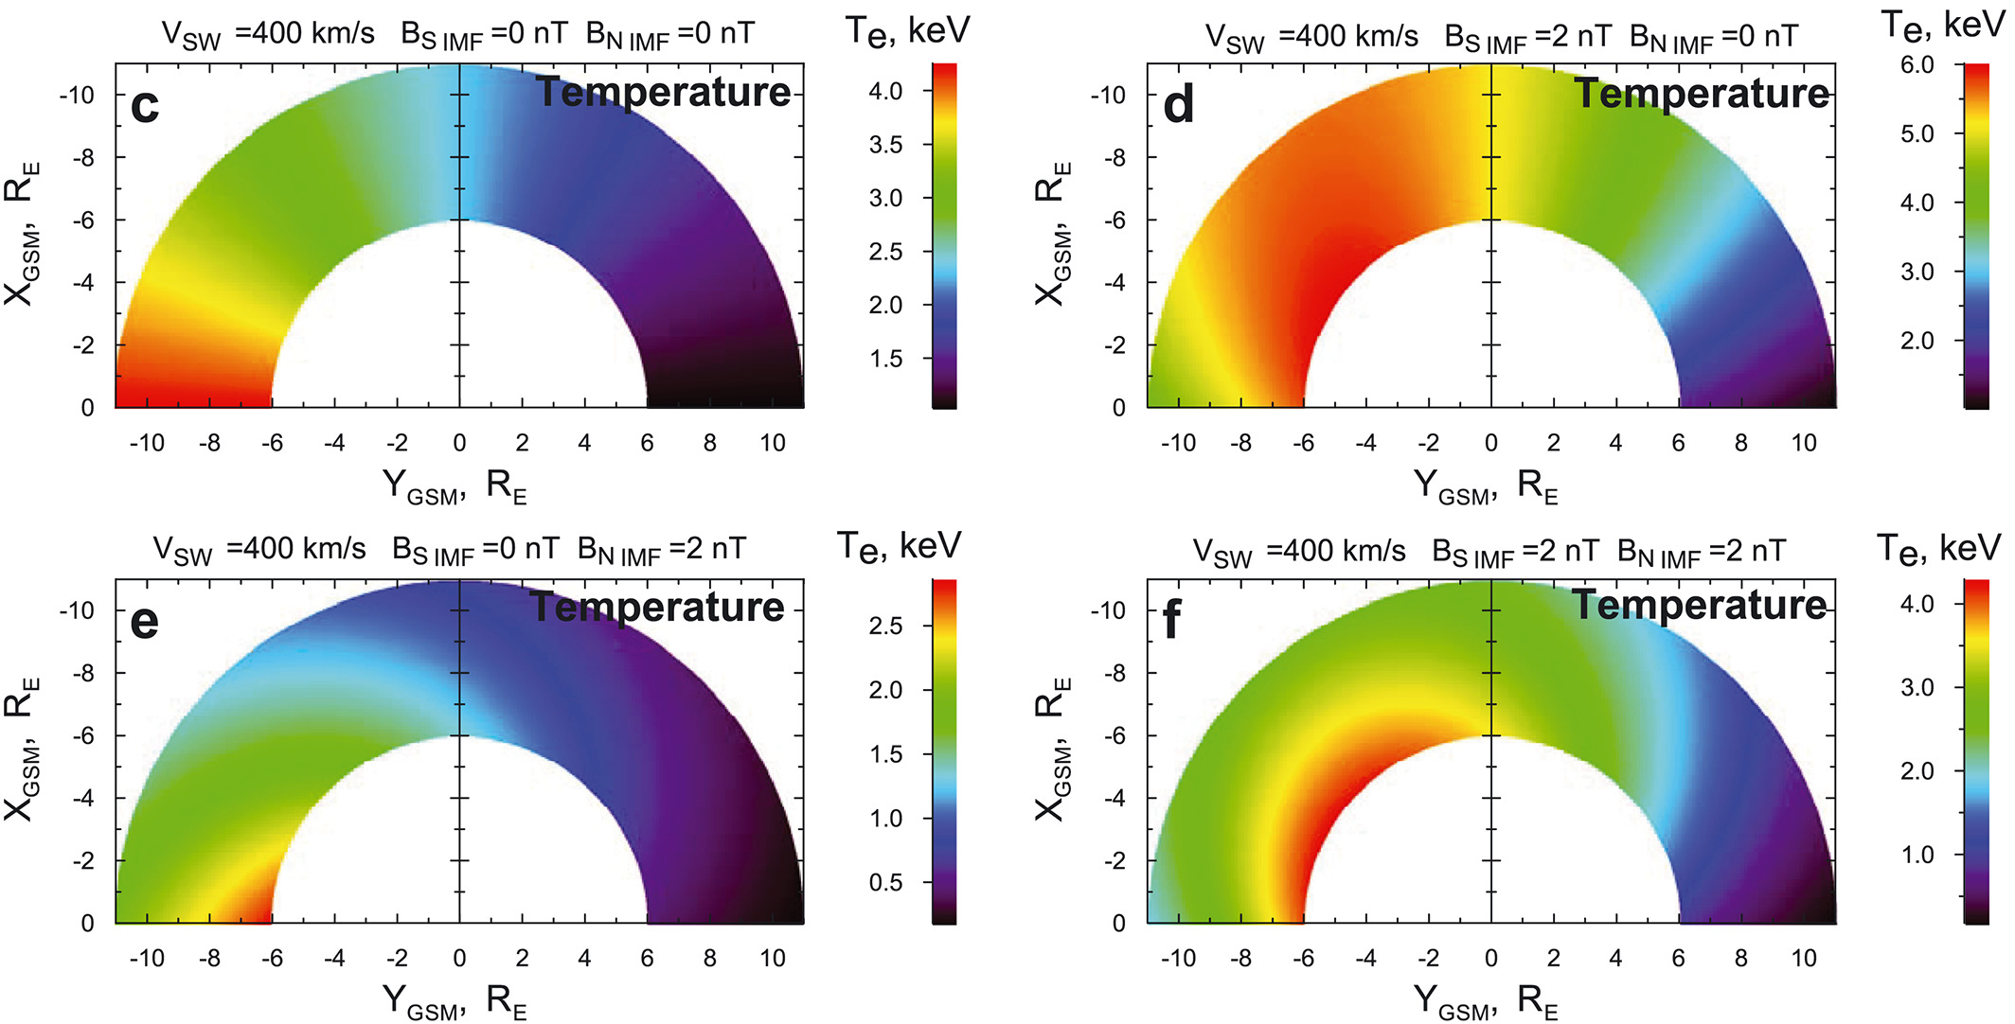
Baseline empirical models
Modelled with Geotail - symmetric
Modelled with THEMIS
Dubyagin+ 2016
Why then work on this?
Far more data, including unexplored MMS instrumentation
These models don’t include time history (e.g.., Borovsky+1998; Wing+2006)
Validate with modern and robust statistical/ML practices (i.e., train/test splits)
Tsyganenko & Mukai 2003
This presentation: Modeling of Ti, Te (MMS), and ni (Geotail)

Slide 4
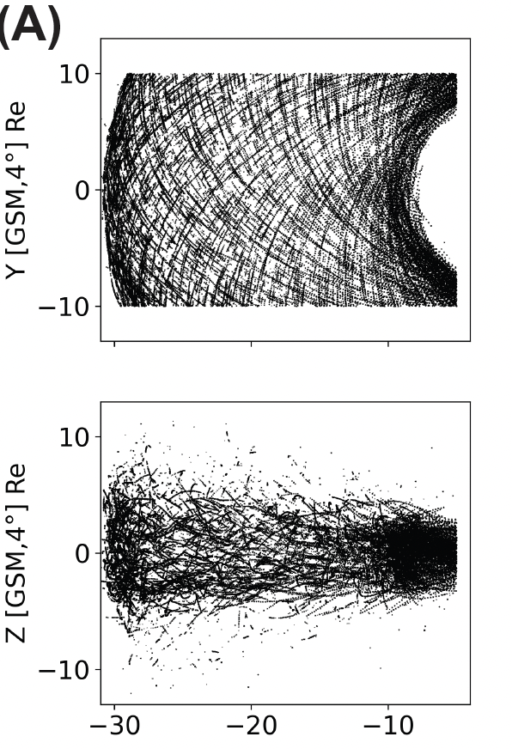
The dataset (output – Central Plasma Sheet)
Geotail (1994 - 2022)
>1 million points (~12s res)
(B) MMS (2015 – 2024)
~ 250k points (~12s res)
Output:
In principle, anything measured
(In this example plasma moments)
MMS moments: partial, not full
Integrated above ~1.5 keV (ions) / ~65 eV (electrons) to remove penetrating radiation and photoelectrons (Gershman et al., 2019).
Shifts mean Ti/Te by ~30%.
Raptis+ 2024 (GRL)

Slide 5
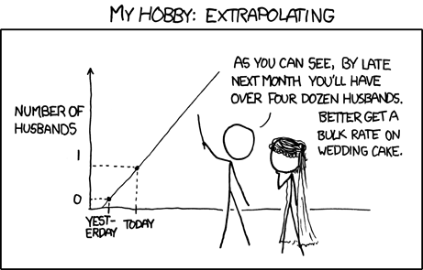
Results
https://xkcd.com

Slide 6
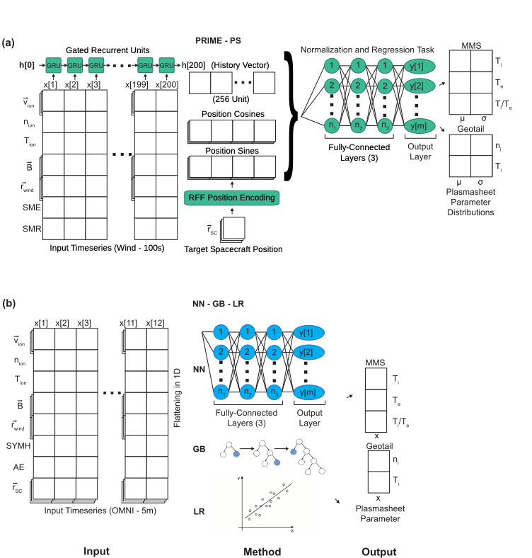
Methodologies & input space
Time History | Type of Input | Architectures
1-6h | Wind (L1) | Linear Reg
 | OMNIweb | Gradient Boosting
 |  | Neural Network
 |  | RNN/LSTM/GRU (PRIME-PS)
O’Brien et al. 2023, 2024
PRIME-PS: GRU encoder (5.5 h of Wind history) + Fourier-encoded spacecraft position → 3 dense layers → Gaussian (μ, σ) per target, trained on CRPS;
Advantages: Embedded uncertainty quantification and propagation from L1
Key Takeaway:
To quantify our method's impact, we tested multiple variations of the problem.
Raptis, O’Brien et al., 2026 (Submitted)

Slide 7
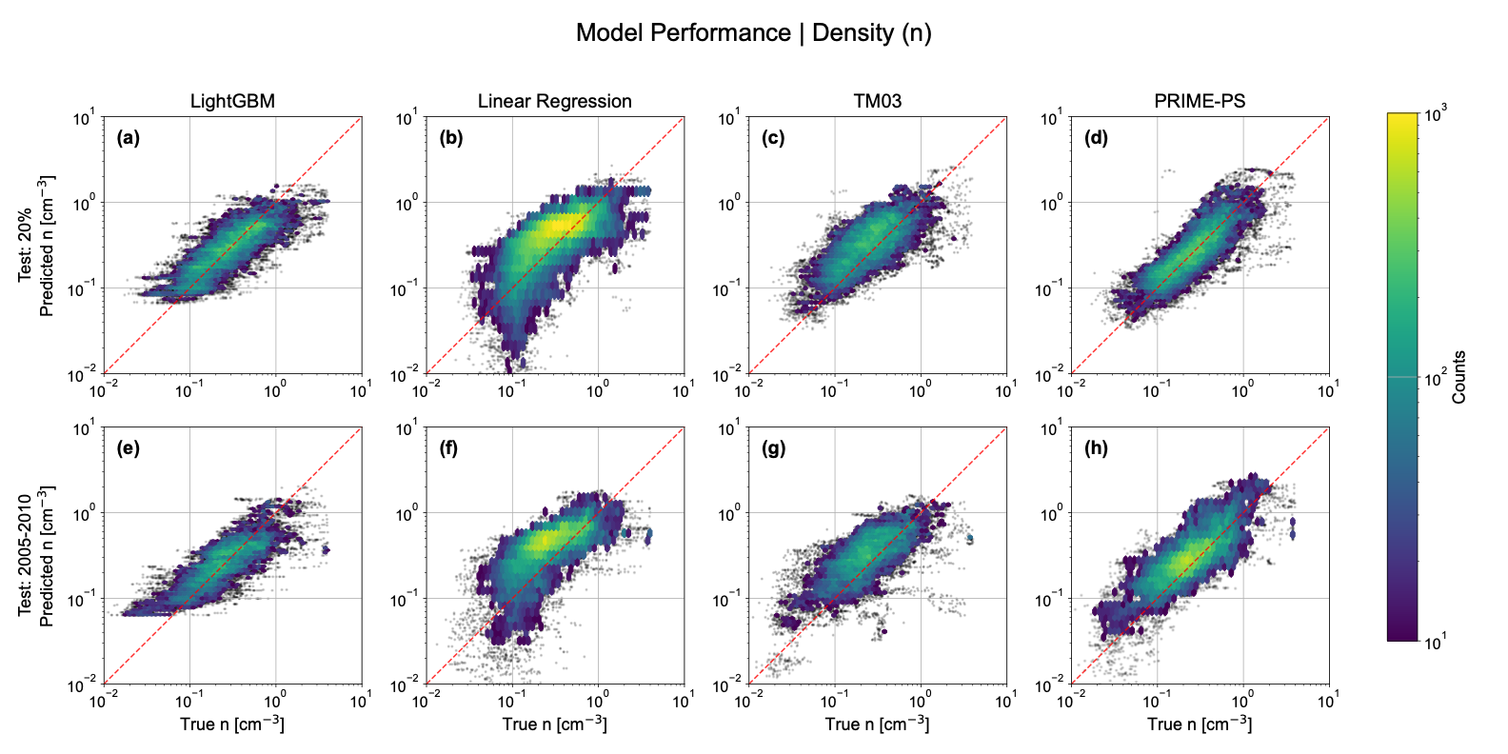
Modeling Density | Predictions vs Observations
Key Message: $PRIME>GB >Baseline ≈ TM03$
PRIME-PS had a lower MAE by:
~20% vs. LightGBM,
~25% vs. NN,
>30% vs. TM03/linear regression.
Consistent improvements all variables and in other metrics such as Rsquared and correlation.
Offsets
Raptis, O’Brien et al., 2026 (Submitted)
Reminder: Close to x=y → good

Slide 8
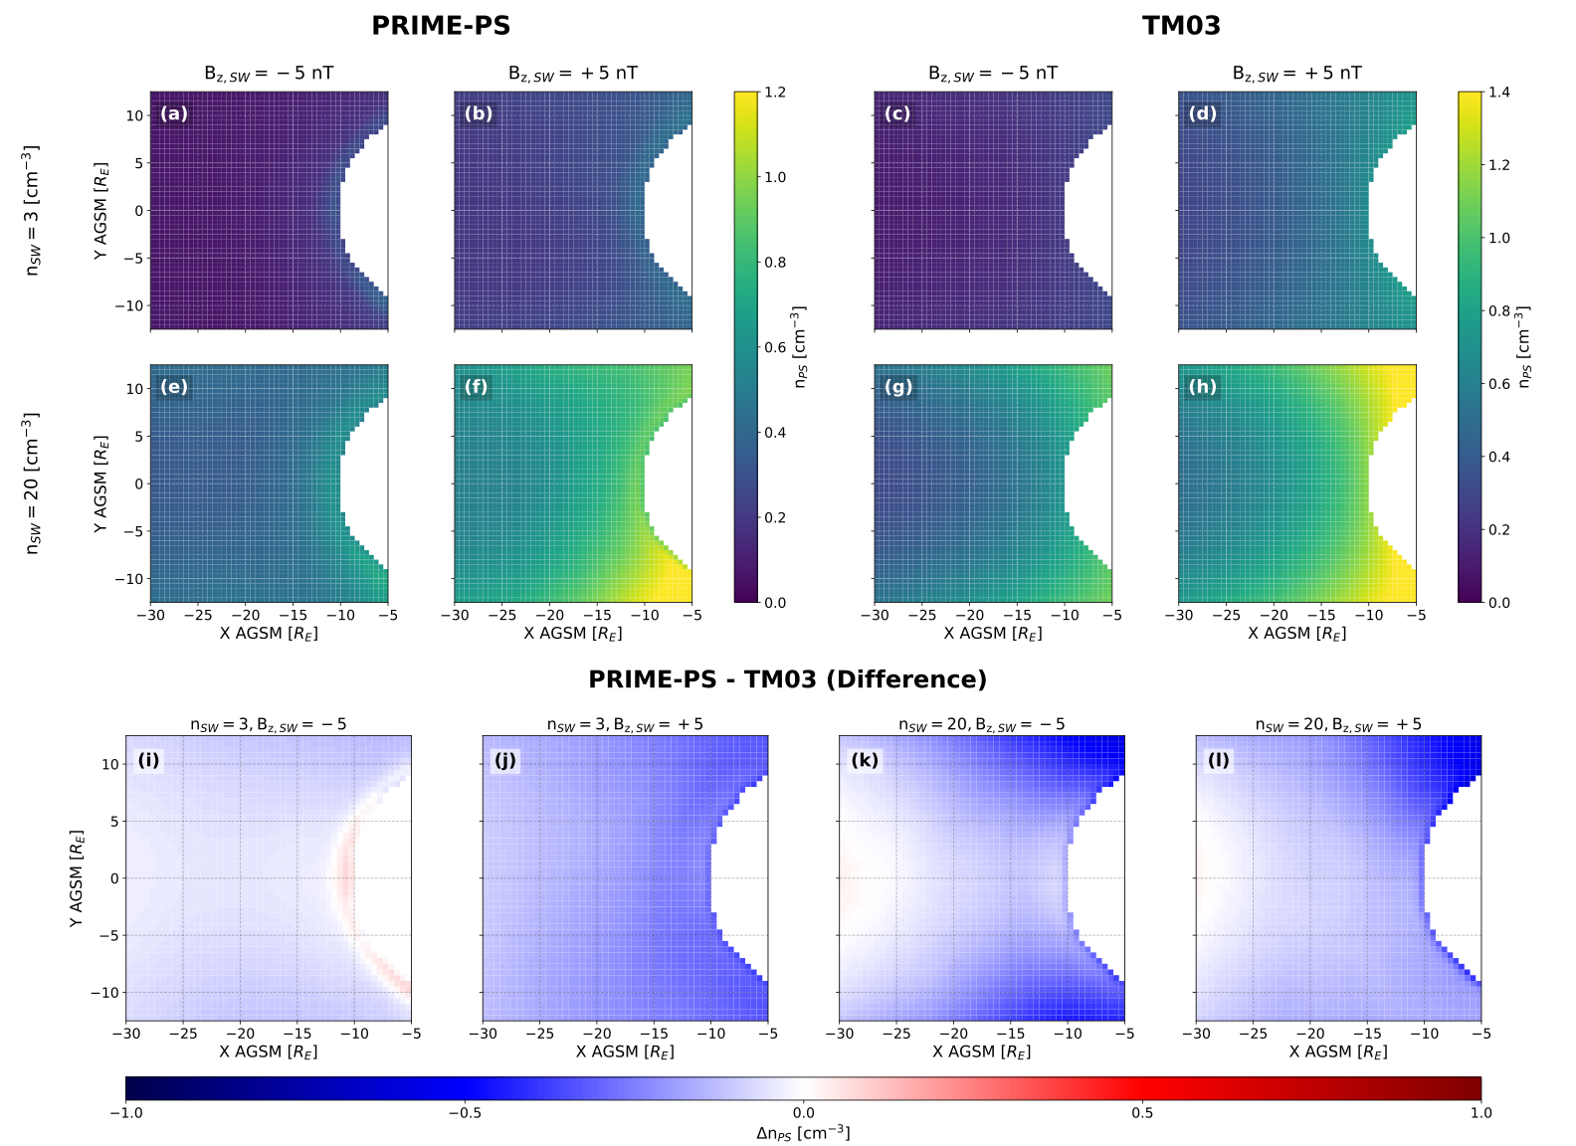
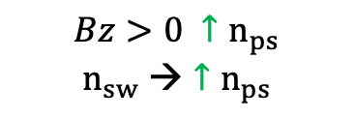
Modeling Density | 2D Maps (Synthetic input)
Asymmetries Introduced
$$Bz>0 {↑n}_{ps}$$
$$n_{sw} →{↑n}_{ps}$$
Neural Networks modeling
Empirical modeling (TM03)
Raptis, O’Brien et al., 2026 (Submitted)

Slide 9
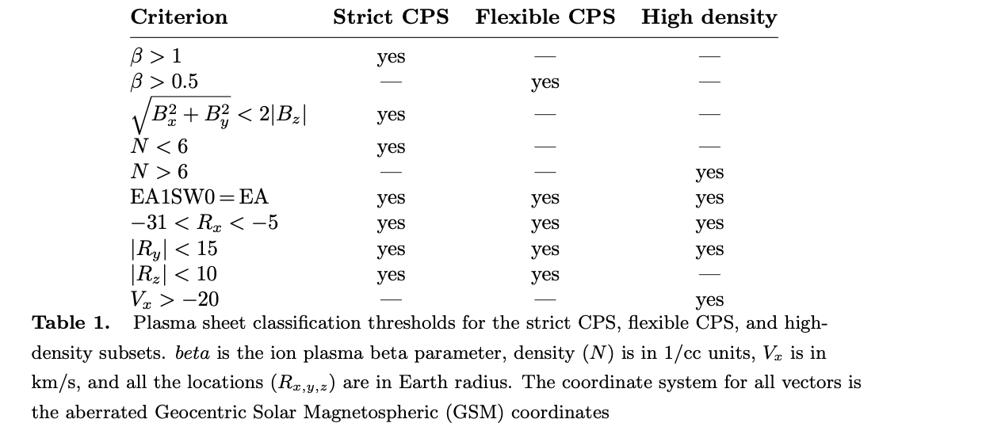
Storm Time & Extreme Events
The Problem: We use static thresholds for dynamic environments.
The Risk: We can mistakenly remove crucial "stormtime plasmasheet” datapoints.
The ”Fix": Manually find the missing data and add it to the dataset.
Strict CPS (e.g., Ohtani et al., 2008, Raptis et al., 2024) & Flexible CPS (e.g., Richard et al., 2022)

Slide 10
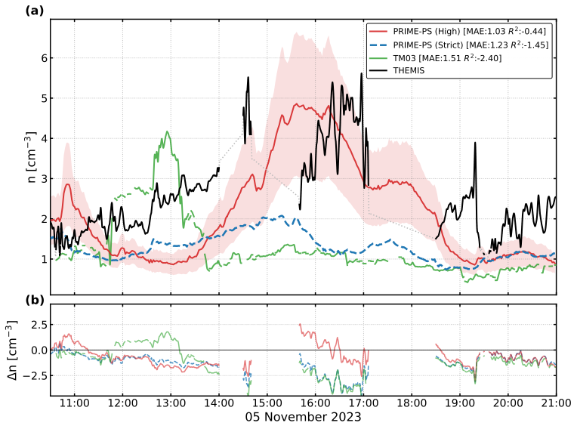
Test case of a storm (05 Nov 2023) - Density
Key Message: >30% improvement over TM03 during a storm
Process:
High: Includes manually picked high-density intervals from Geotail
Strict: Normal threshold-based classification of plasma sheet
Test:
THEMIS observations
Results
ML model (high dens): 1.03 [1/cc]
ML model (normal): 1.23 [1/cc]
TM03: 1.51 [1/cc]
Note: values <1 cm⁻³ are boundary layer transitions, gray shaded linear interpolation

Slide 11
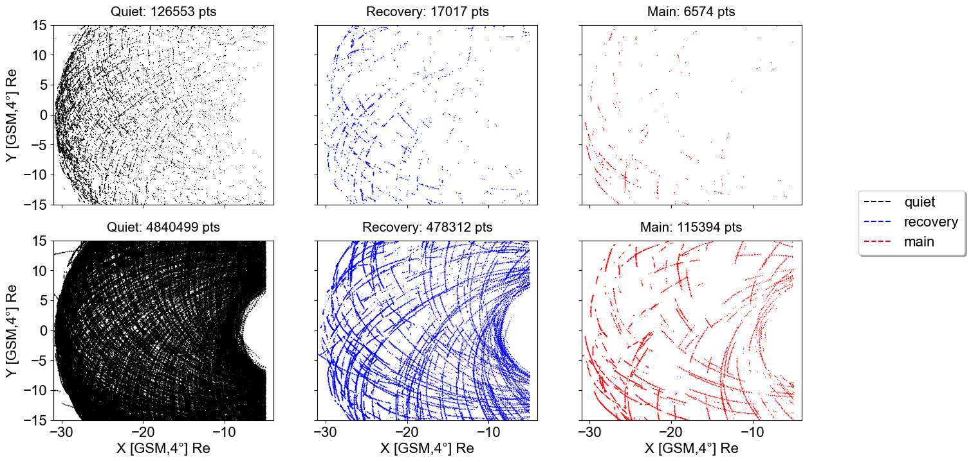
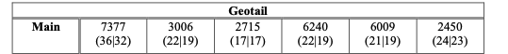
Community Reminder: Data Sparsity During Extreme Events
Geotail data (1994 – 2022), time resolution: 12 seconds
(#of unique days, # unique storms)
Note: This doesn’t show the incomplete driver (SW) distribution.
Keypoint: Number of data points can be misleading

Slide 12
Summary & Discussion
Results
Data-driven models reproduce dawn-dusk density, temperature, and Ti/Te asymmetries that previous analytical models miss
Dataset curation, namely plasma sheet classification and moment contamination correction, critically controls model performance
Training on high-density storm intervals reduces prediction error by ~25%, suggesting data sparsity is a primary bottleneck
Discussion Points/Opinions
Reminder GIGO applies to all data driven models https://en.wikipedia.org/wiki/Garbage_in,_garbage_out.The difference between partial vs. full moments for MMS alone can shift Ti/Te by ~30%
See our latest EOS article on Heliophysics and AI discussing data sparsity: https://eos.org/science-updates/vast-space-sparse-data-an-ai-answer-to-twin-space-weather-challenges
Raptis, O’Brien et al., 2026 (Submitted)

Slide 13

CGS Graduate Fellows
CGS will select up to 9 CGS Graduate Fellows who will receive support to enhance their current research projects
Eligibility: graduate students who are US Citizens
A list of CGS Team Members and their preferred topics will be advertised on the CGS website (will be available by August); Interested students must contact a CGS Team Member to discuss potential projects and level of support provided
Fellows will receive a stipend (~$10K-$12K) to be used for
  Travel to GEM or CEDAR in summer 2027 to present results
  Travel to CGS Workshop in August 2027
  Other expenses at the fellow’s discretion
Applications (due early October) will include:
  Form with general information
  2-page proposal describing project and how it relates to and enhances your current research
  1-page letter from research advisor recommending student and approval of project

Slide 14
Extras

Slide 15
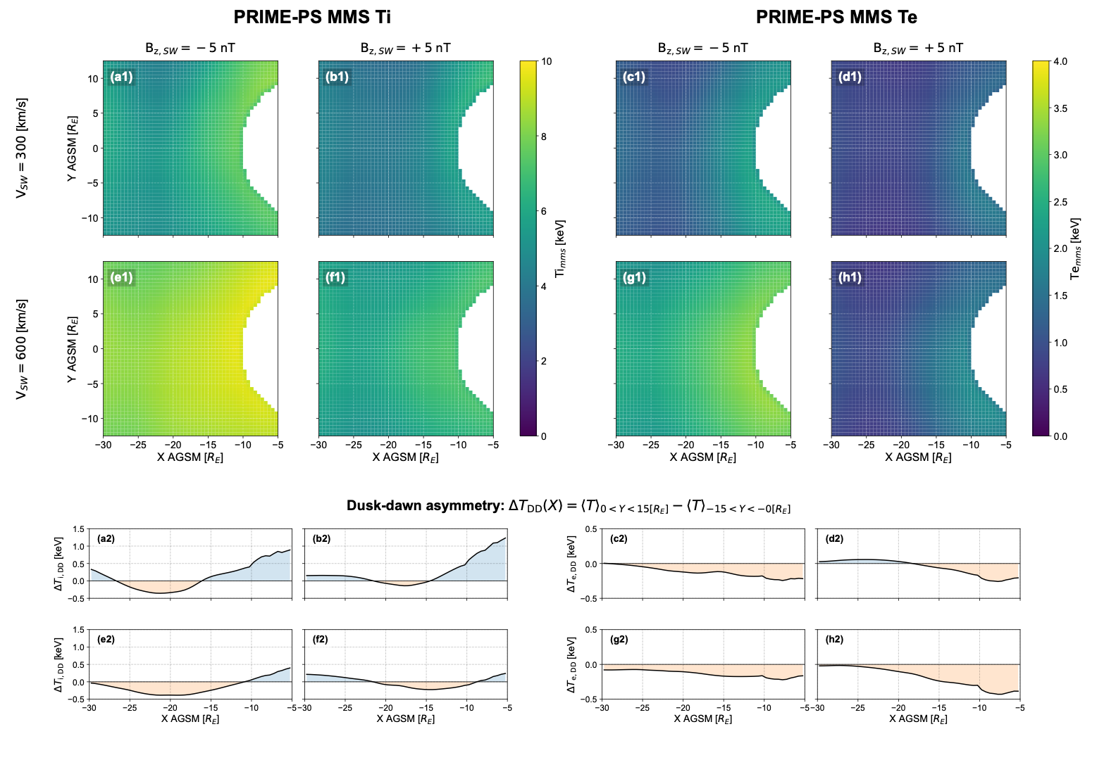
Modeling Temperatures with MMS | 2D Maps
Ti: increases with Vsw and peaks duskward
Te: weaker, opposite (dawnside) enhancement
Consistent with charge-dependent gradient-curvature drifts
Caveat: dawnside Ti feature (X ≈ -25 to -15 RE) may be a sampling artifact; the Geotail-trained model shows none
Blue: more dusk, Orange: more dawn

Slide 16
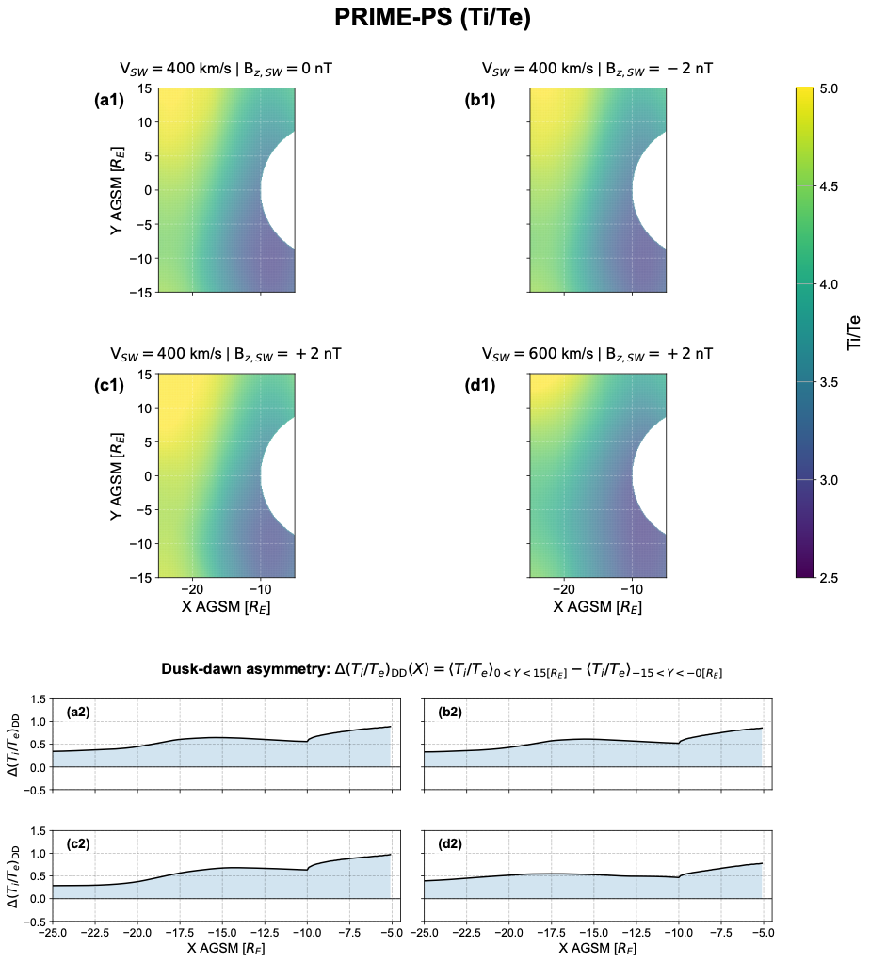
Modeling Temperature Ratios with MMS | 2D Maps
Note: Agreement Wang et al., 2010 with dusk Ti/Te higher than dawn (Using THEMIS)
Ti/Te rises from ~3 on the dawn side to ~5 on the dusk side
Duskward enhancement slightly stronger under northward IMF
Caveat: for northward IMF the asymmetry weakens as Vsw goes from 400 to 600 km/s, but fast-wind northward intervals are scarce in training, so this may reflect uneven sampling
Analytical alternative (TM03 ions + DGSR16 electrons) mixes spacecraft with non-overlapping domains and produces extreme values; ML gives a self-consistent ratio

Slide 17
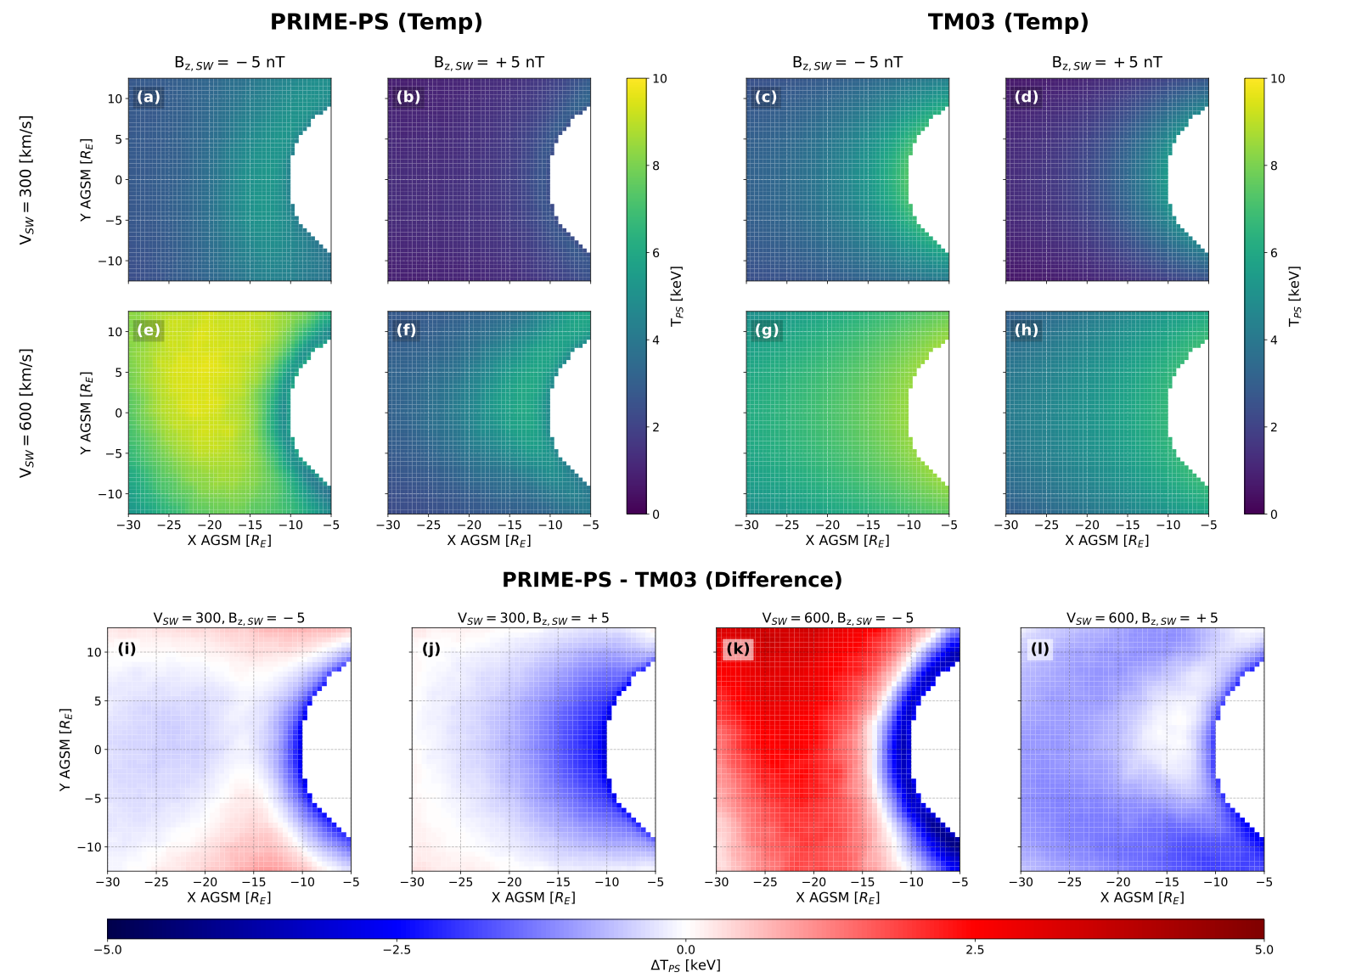
Modeling Ion Temperature with Geotail | 2D Maps

Slide 18
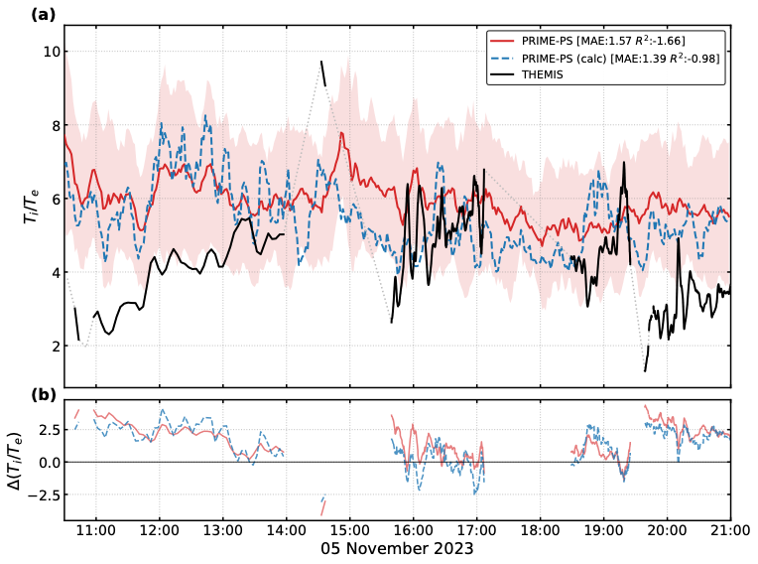
Test case of a storm (05 Nov 2023) – Ti/Te
Note: values <1 cm⁻³, are boundary layer transitions, gray shaded linear interpolation

Slide 19
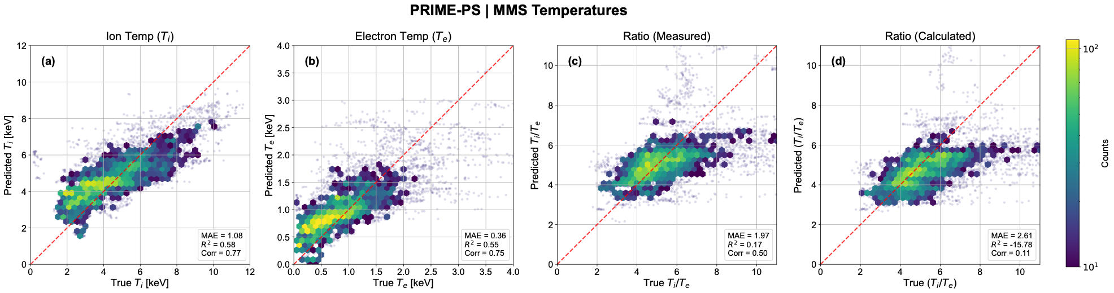
Temperature and Ti/Te MMS output

Slide 20
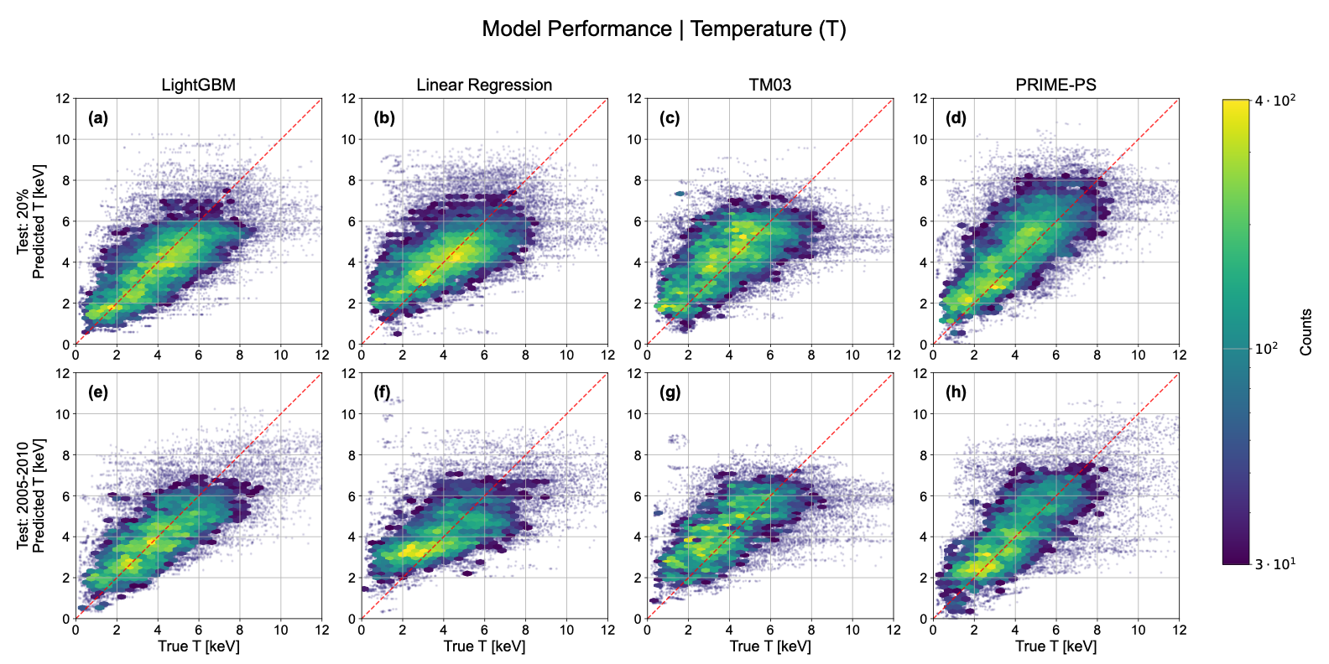
Modeling Temperature | Predictions vs Observations
Key Message: $PRIME−PS>GB >Baseline≥ TM03$
Raptis, O’Brien et al., 2026 (under prep.)

Slide 21
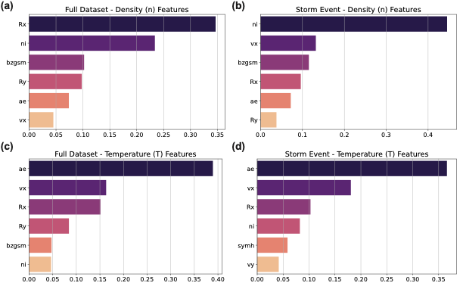
Feature Importance Analysis – Merged Time history
Quiet times
More internally driven
T is more external, maybe
Density is largely dictated by location
Storms:
More externally driven
Location matters less
Issues with this analysis:
Intercorrelation between variables is large (ae well correlated to vx)
Same with SW types (dense solar wind is typically slower)
Combines all time history (1h in this particular example)

Slide 22
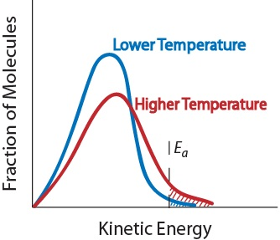
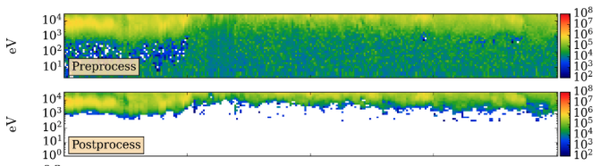
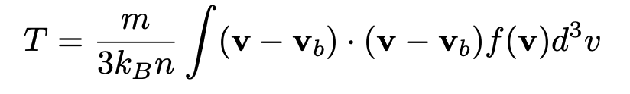
Community Reminder on Temperature
Temperature is the 2nd plasma moment
The higher the moment, the more uncertain because you rely more on the poorly sampled tails of the distribution.
So, 0 and 1st moment (Density and Velocity) are usually ok, but Temperature, we got to be careful
Ion Penetrating Radiation
Figure credits: Tien Vo
The temperature here was completely incorrect, and the velocity increased from about 200 km/s to over 1500 km/s.

Slide 23
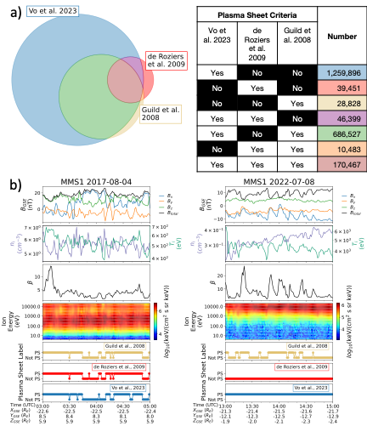
Classifying plasma sheet is not trivial
Note Vo+2023, had a multi-step process based on interval, this is just using the point-by-point classification

Slide 24
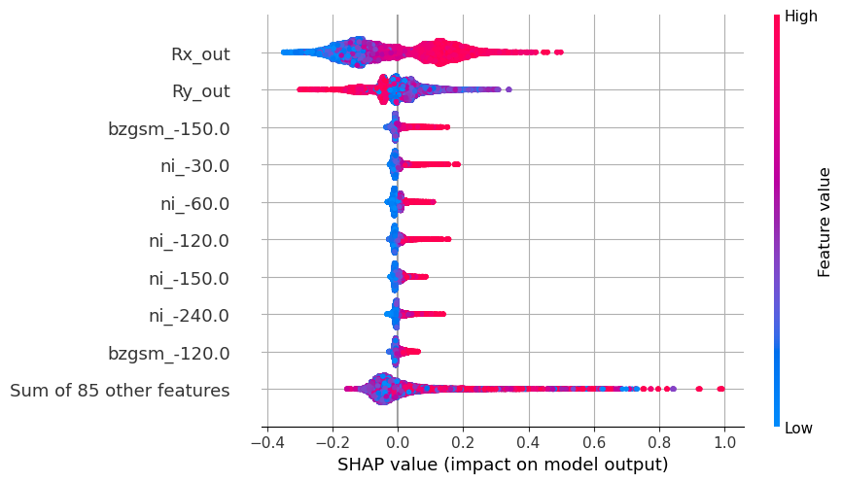
Feature Importance Analysis
Higher density close to earth and at dawn
X GSM
Y GSM
Answer: In most cases (statistically):
Model is predominantly driven by spacecraft location
Solar wind input has lower effect, although cumulative history is still important
Blue/Red: Input value
Left/Right: Output value
SHAP Values explain why a model made a specific prediction, by showing each feature's impact.

Slide 25
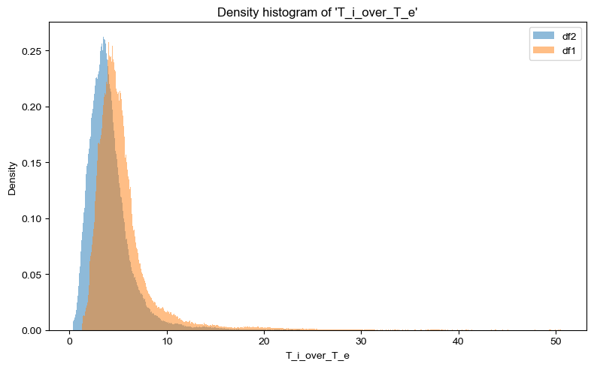
MMS Ti/Te plasmasheet ratio example (Full vs Partial moments)
mean df1 (full distribution moments): 5.5513
mean df2 (partial distribution moments): 4.0797
DF2 effectively removes the contribution from the penetrating radiation (Gershman+ 2019)
Key Message1: The mean differenced changed by 1.5 (>30%) simply by recalculating moments
Key Message2: A model with +30% is exciting, but we need to know if “ground truth” vary by the same magnitude

