Slide 1
Recent Advancements in Transient Processes and Particle Energization at Planetary Bow Shocks
Savvas Raptis
JHU/APL, Laurel, MD, USA
Thanks to collaborators and friends: Drew L. Turner, Ahmad Lalti, Martin Lindberg, Damiano Caprioli, George Clark, Terry Liu, Jamey R. Szalay, Lynn Wilson III, Imogen Gingell, Ying Zou, Ivan Vasko, Colby C. Haggerty, Yufei Zhou, David Sibeck, Primoz Kajdic, Adnane Osmane, Ian Cohen, Philippe Escoubet, and more
savvas.raptis@jhuapl.edu / https://savvasraptis.github.io

Slide 2
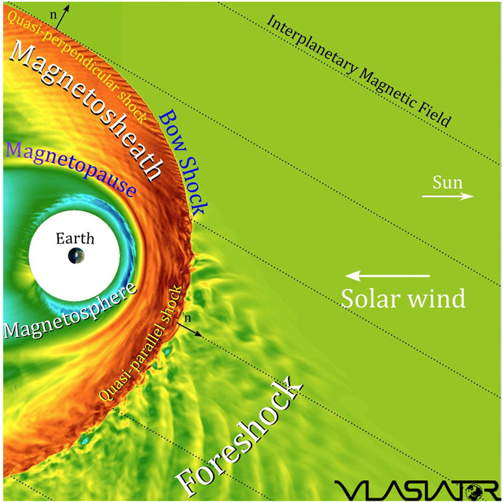
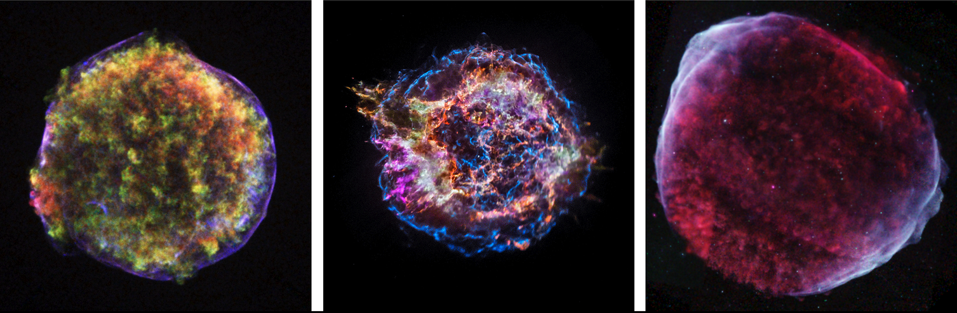
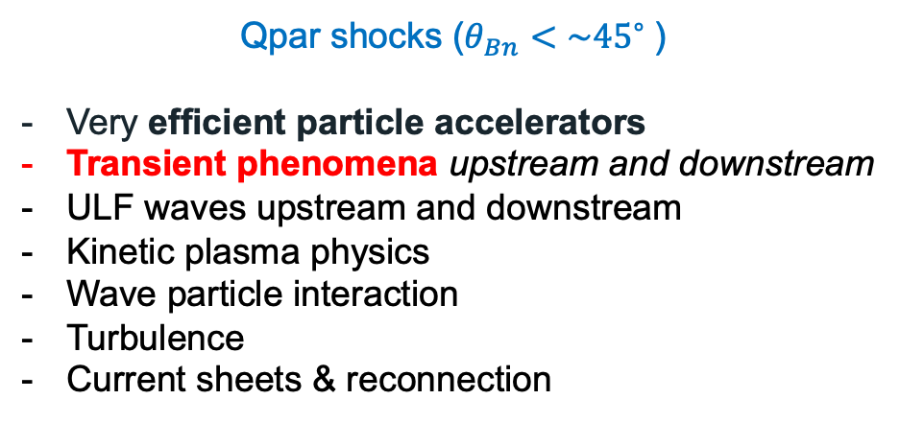
Earth’s Qpar bow shock and foreshock
Qpar shocks ($θ_{Bn}<\sim {45}^{∘}⁡$)
Very efficient particle accelerators
Transient phenomena upstream and downstream
ULF waves upstream and downstream
Kinetic plasma physics
Wave particle interaction
Turbulence
Current sheets & reconnection
*Astro references on Qpar importance for supernovas:
Caprioli+2014, Giuffrida+2022, Vink+2024, McGinness+2026

Slide 3
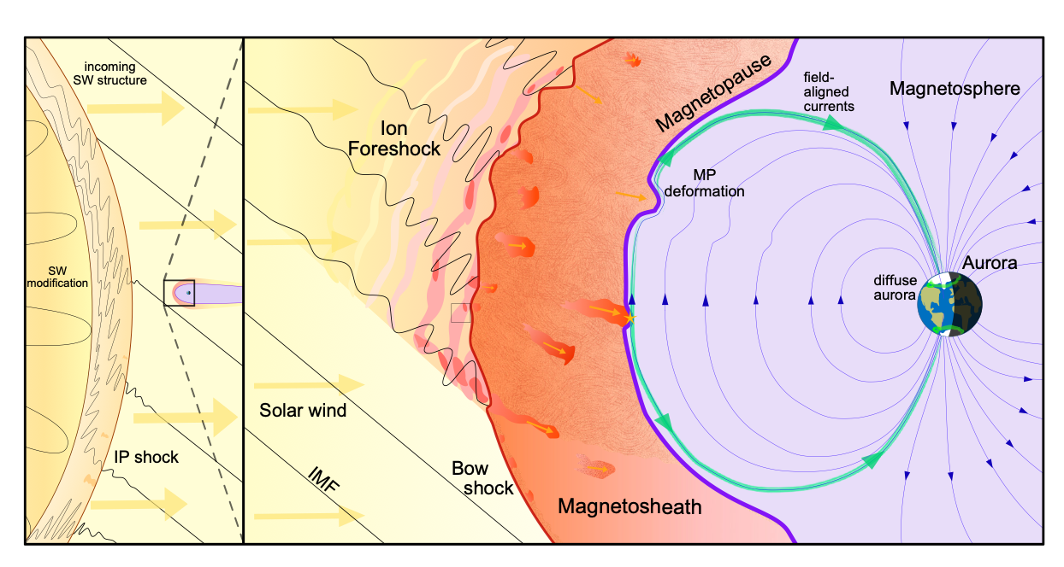
What is a Dayside Transient?
Transient phenomena are events that disrupt the steady-state plasma conditions, occurring temporarily and introducing dynamic changes to the physical system
Review of dayside transients: Zhang et al., 2022; Kajdic et al., 2024
Review of magnetosheath jets: Krämer et al., 2025
Global (Solar):
  Coronal Mass Ejection (CME)
  High-Speed Stream (HSS)
  Pressure Pulse / IP Shocks
Fluid scale:
  Flux Transfer Event (FTE)
  Magnetopause (bursty) Reconnection
Mesoscale:
  Hot Flow Anomalies (HFAs)
  Foreshock Bubbles (FBs)
  Magnetosheath High Speed Jets (HSJs)
Kinetic:
  ULF waves
  Shocklets
  SLAMS
Figure adapted from Krämer et al., 2025, Credits: Florian Koller
NOTE: Transients can be intrinsic (e.g., ULF waves) or driven (e.g., HFAs)
GEM FG: Multiscale Dayside Transients and their Effect on Earth's Magnetosphere
(2025 - 2029; Savvas Raptis, Ivan Vasko, Yuxi Chen, Gonzalo Cucho-Padin, Imogen Gingell, Terry Z. Liu, Ying Zou)
Notes:
Mesoscale → Foreshock ions referring 1000th of kilometers. Relative to solar wind ions they can be still considered fluid scales
Absolute scale of HFA/FB ~ FTEs reconnection

Slide 4
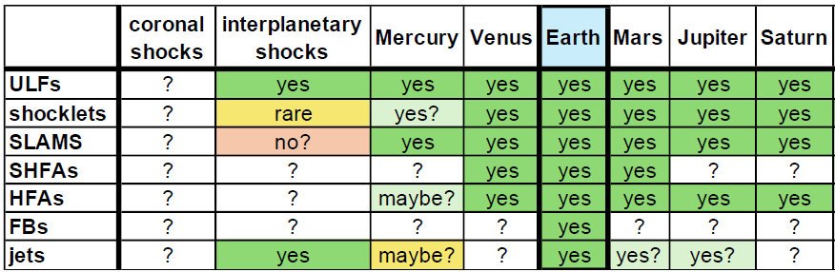
Universality of shock-generated transients
*
*
*
Hietala et al. ISSI 2019
Yes!*
Yes!*
Probably*?
Maybe?
*Omidi+2020, Gunell+ 2023, Madanian+2023, Zhou+ 2024, Mohammed-Amin+ 2025, Raptis+2026a

Slide 5
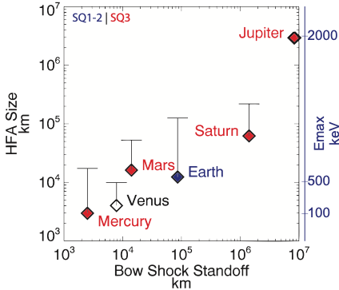
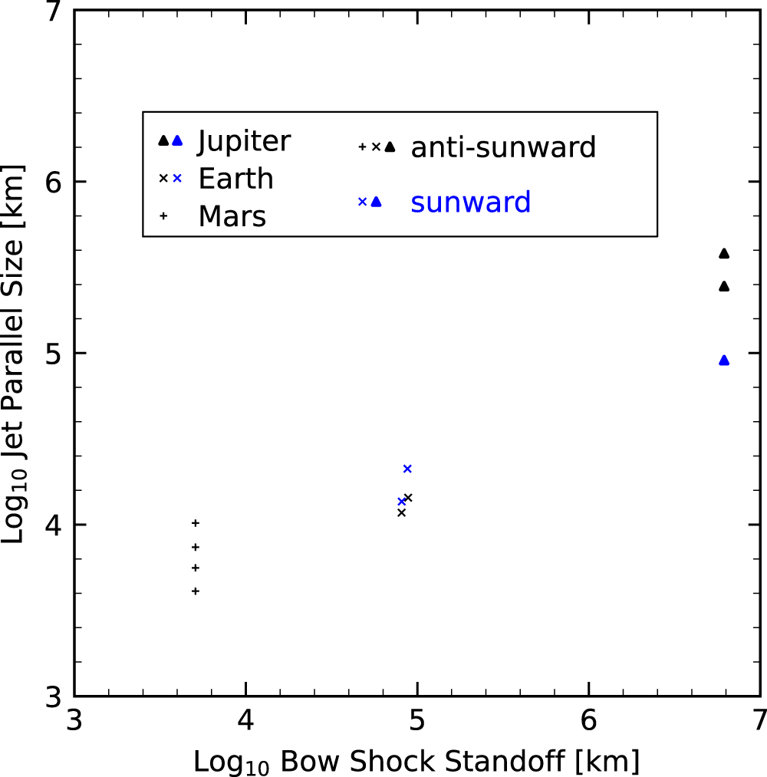
Transients Scaling Across Different Systems
Foreshock Transient Scaling
Downstream Jet Scaling
Zhou, et al. 2024
Adapted form Valek et al. (2017) | JGR
Important point to remember

Slide 6
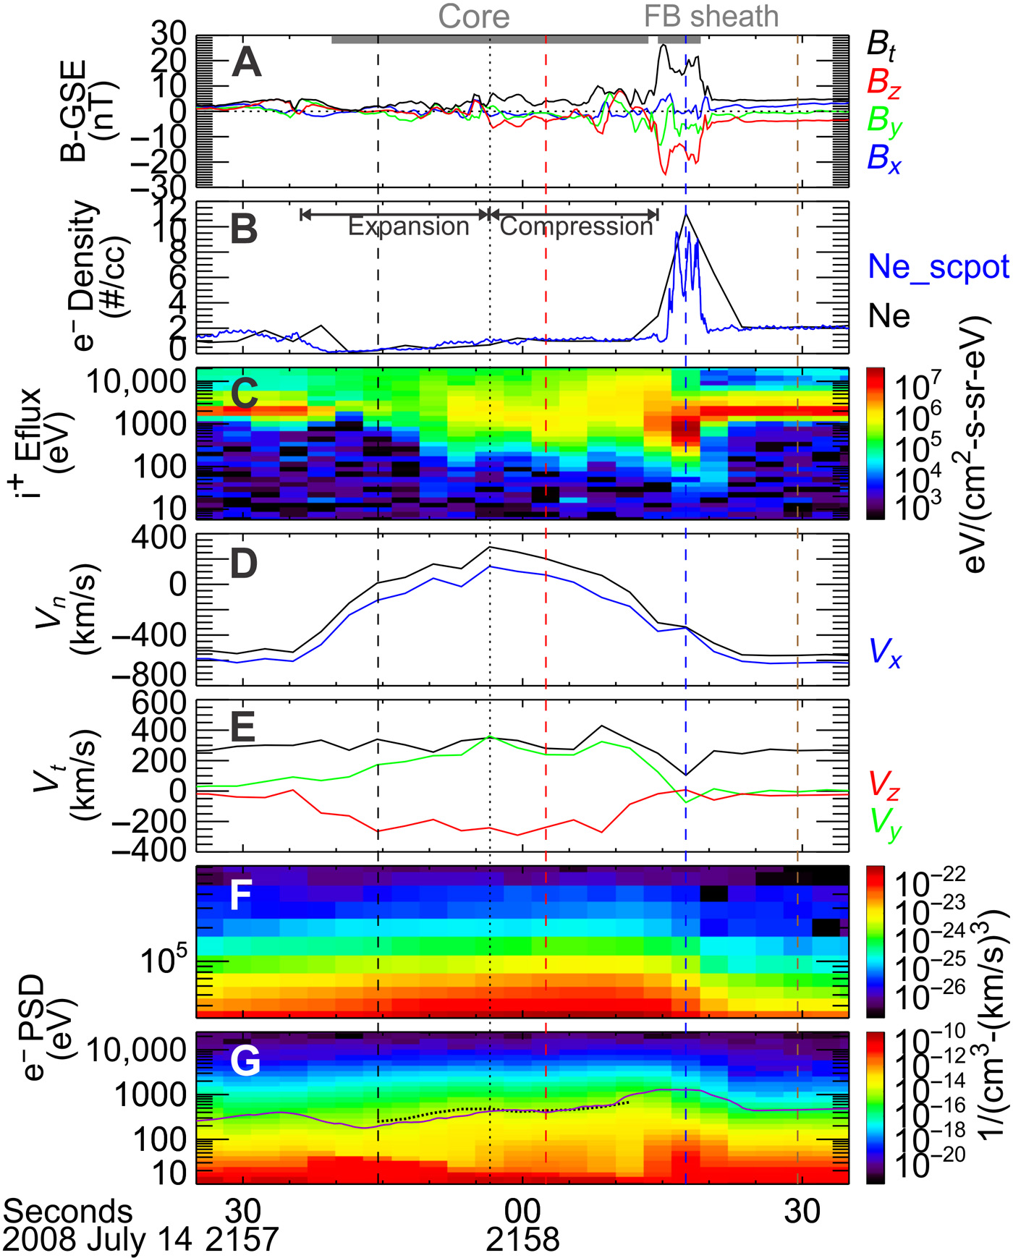
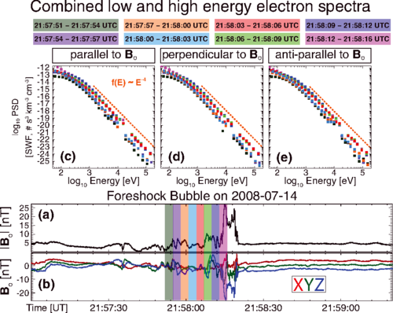
Foreshock Transients & Electron acceleration
See also: Turner et al. 2018; Liu et al. 2019; Shi et al. 2023,2025 ; Tonoian et al. 2023; Kamaletdinov et al. 2024; Li et al. 2025; Liu et al., 2026
~300 KeV electrons
Wilson III L. et al. 2016 | PRL
~200 KeV electrons
Liu T. et al. 2019 | Science Adv.
Notes:
Lynn Wilsson: Shock Drift Acceleration up to 300 KeV, non local acceleration that can then get even further accelerated at the shock
Terry Liu : Betatron acceleration on Foreshock transients = Making Qpar shock more effective in accelerating particles

Slide 7
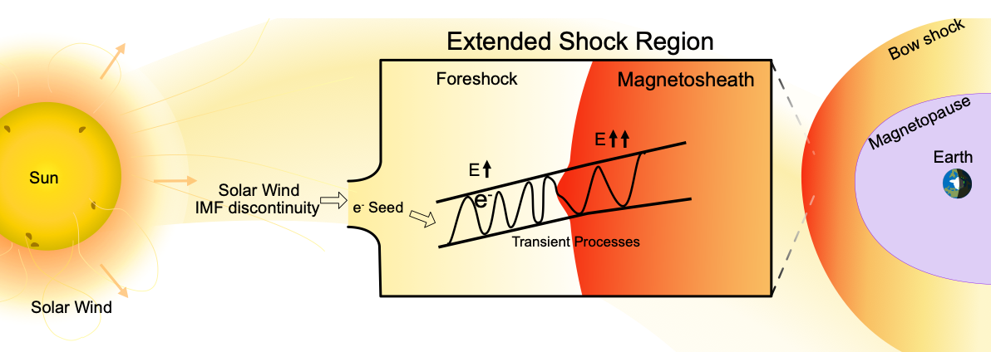
Mental Picture to Keep in Mind
Qpar Extended shock includes the foreshock, the magnetosheath and their transient processes
Sketch by Florian Koller

Slide 8



Latest Results
Transients & Particle Acceleration
Earth
Earth
Jupiter
Raptis et al.2025 | NatComm
Raptis et al.2025 | ApJL
Raptis et al.2026 | Nature

Slide 9
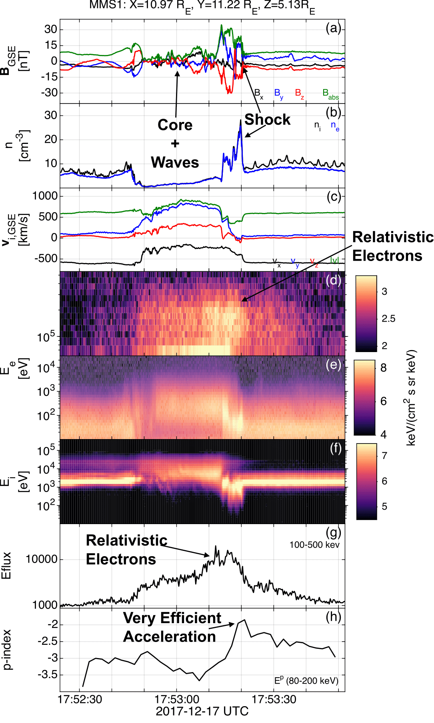
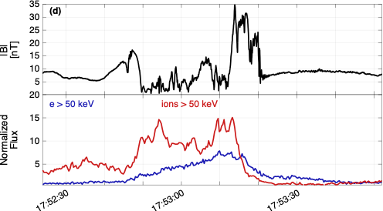


Transients & Relativistic Electrons with MMS
Typical properties of transient:
- Depleted Core (low B, n)
- Mature HFA (ΔΒ/B0 ~ 1-4)
- SW beam disrupted
- Strong density and magnetic field compressive boundaries
- Formation of a Qperp “shock”
- Flow anomaly (velocity decreasing)
Unique property
>500 keV electrons throughout the core and shock region
New plot, much easier to understand!
Compressive edges
Made for
PO yellow book
Core & Waves
With respect to upstream conditions (SW/FS):
Electron fluxes (>50 keV) up to x6
Ion fluxes (>50 keV) up to x15
Foreshock transient
Bow shock
Raptis et al.2025 | NatComm

Slide 10
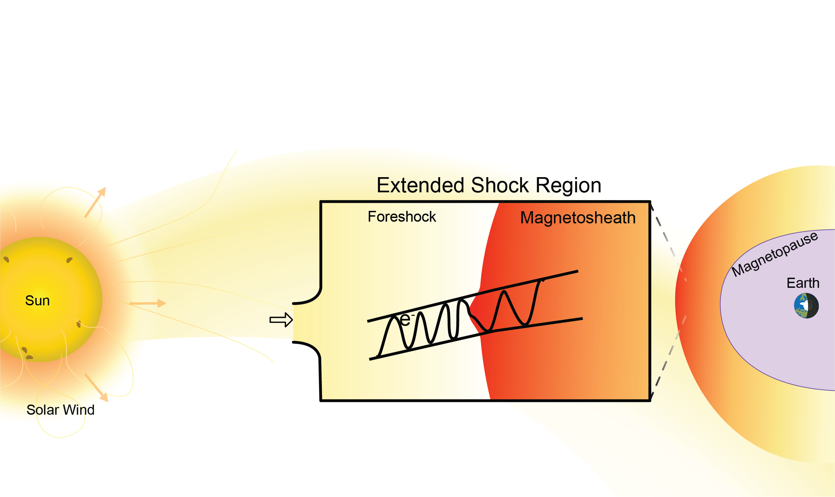
But let’s ask one more question
What do we expect to see when transients cross the bow shock and go downstream?
Transient
Sketch by Florian Koller

Slide 11
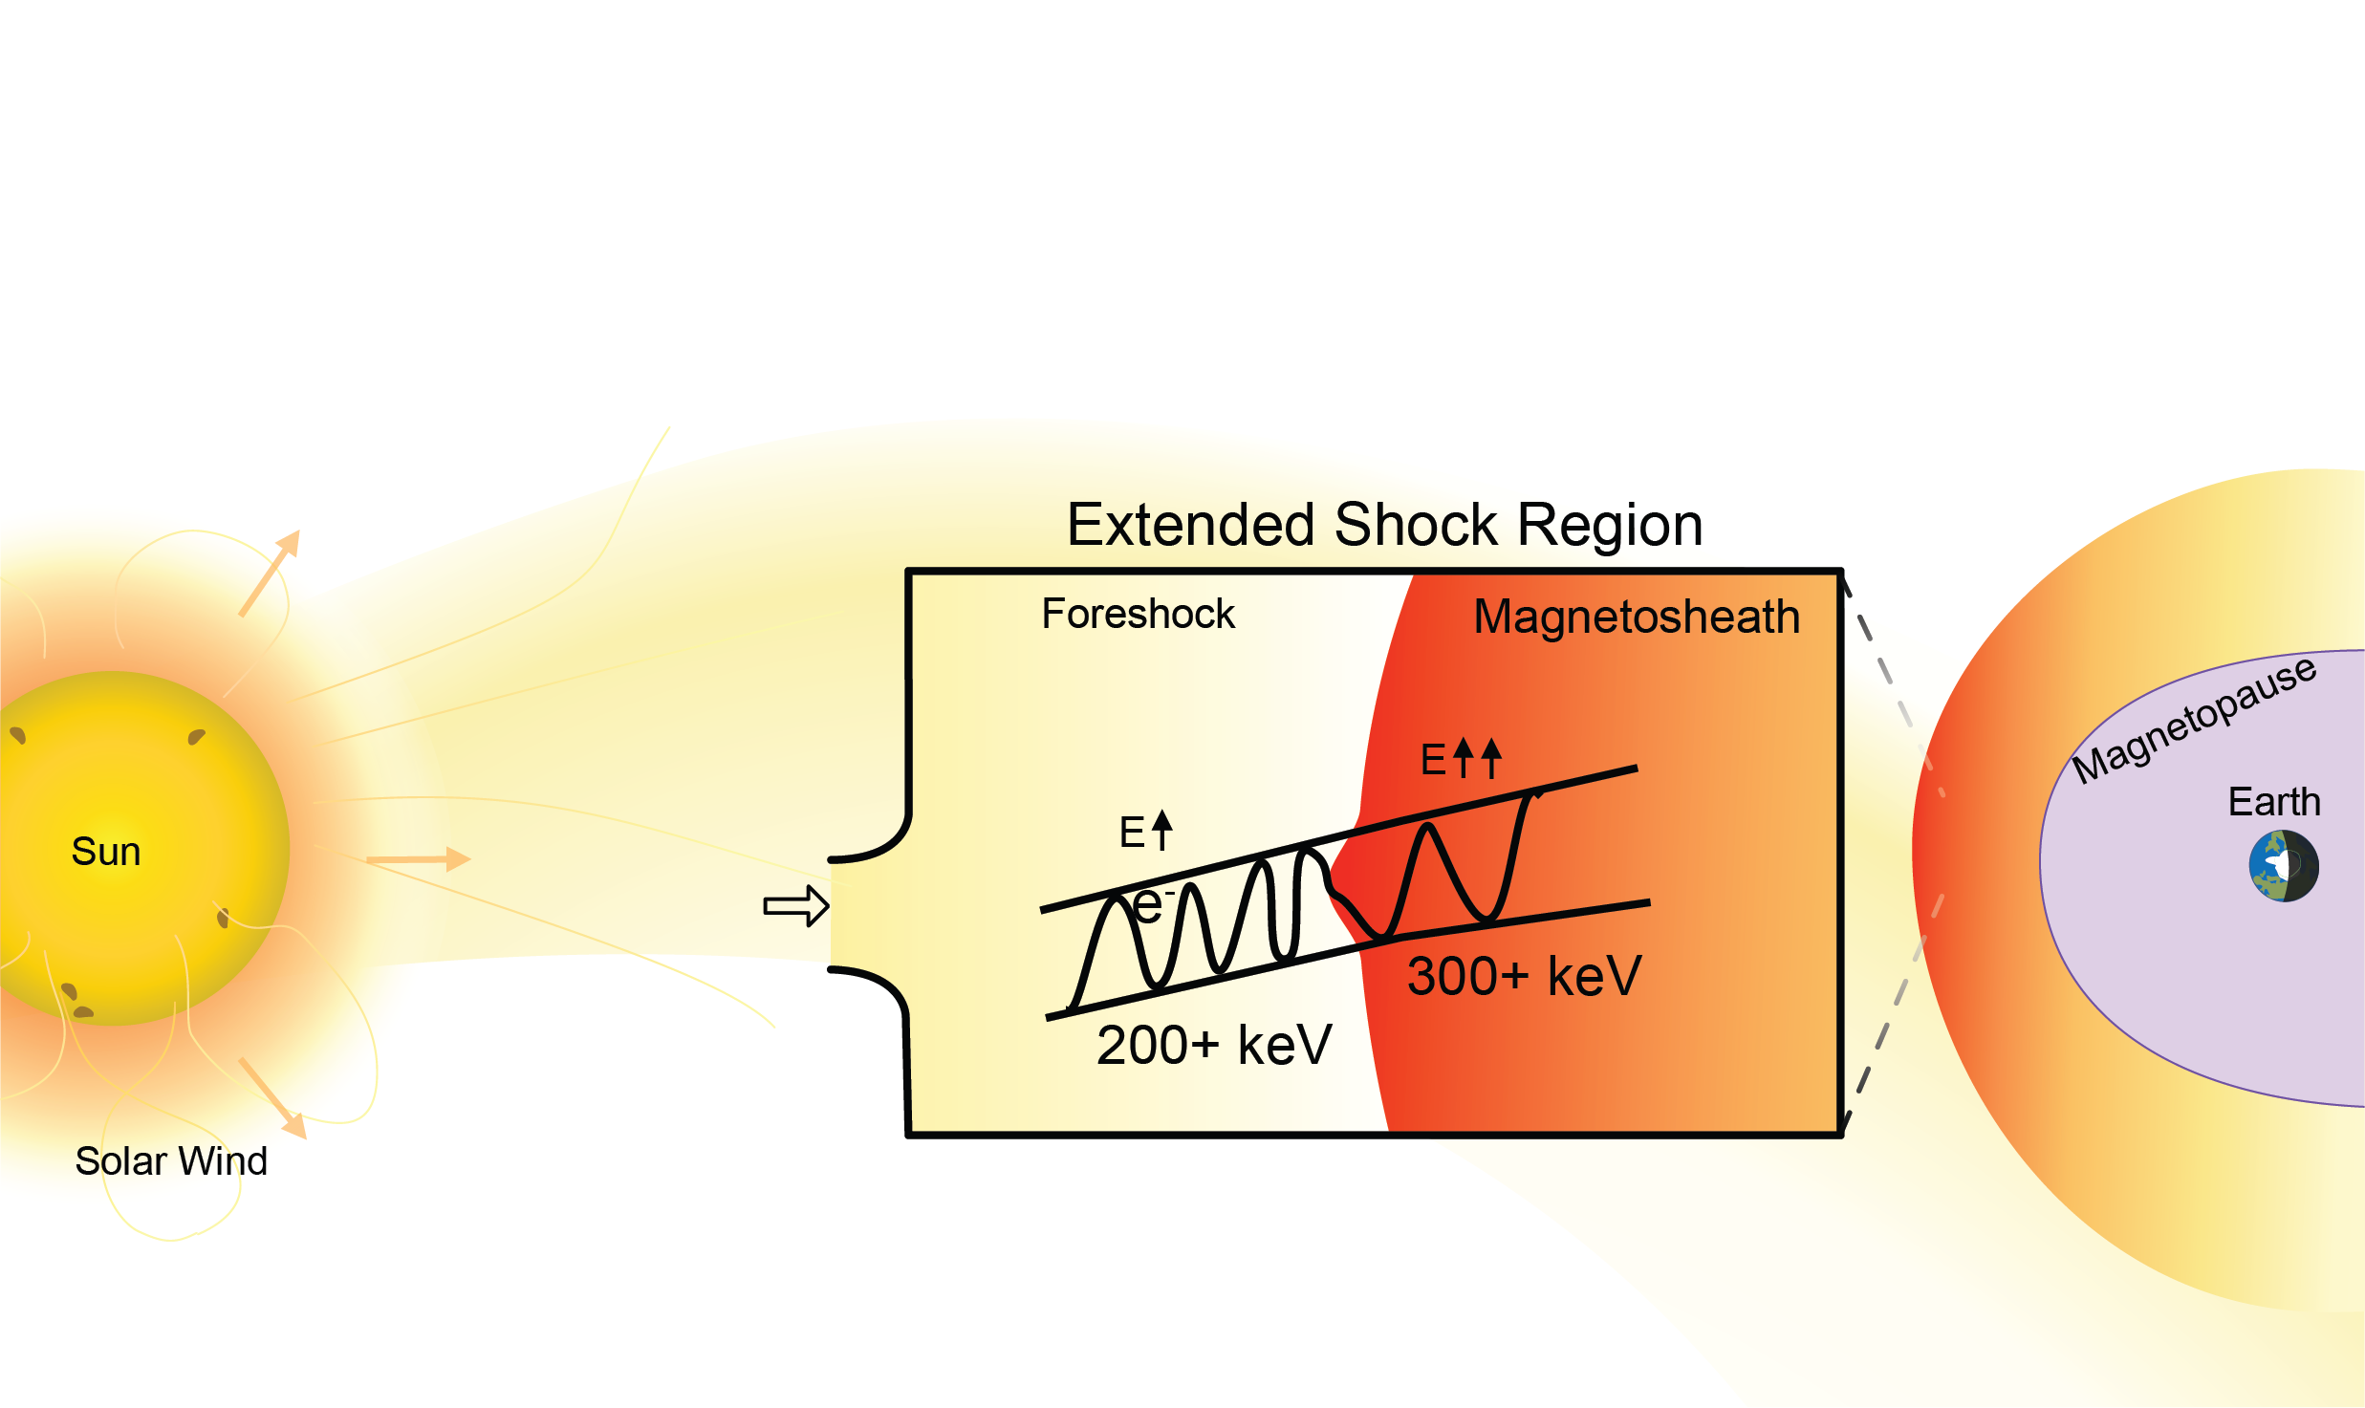
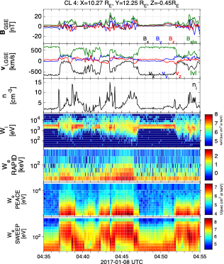
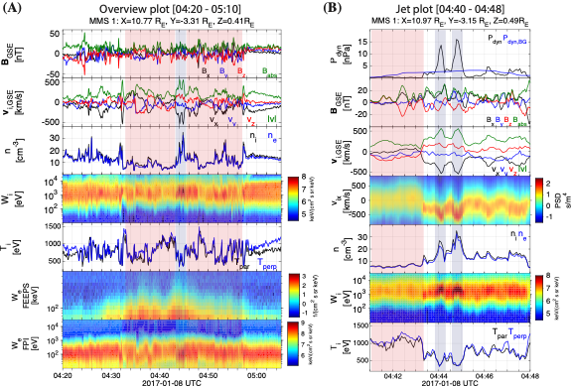
But let’s ask one more question
What do we expect to see when transients cross the bow shock and go downstream?
Cluster
MMS
Transient
Indeed, energization occurs
(+ We get localized magnetosheath jets)
Sketch by Florian Koller

Slide 12
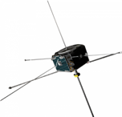



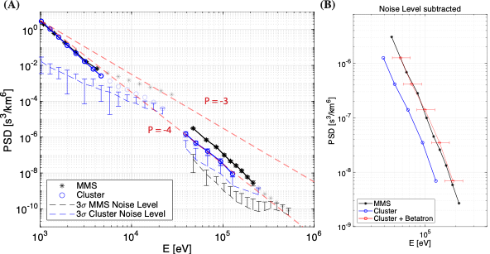
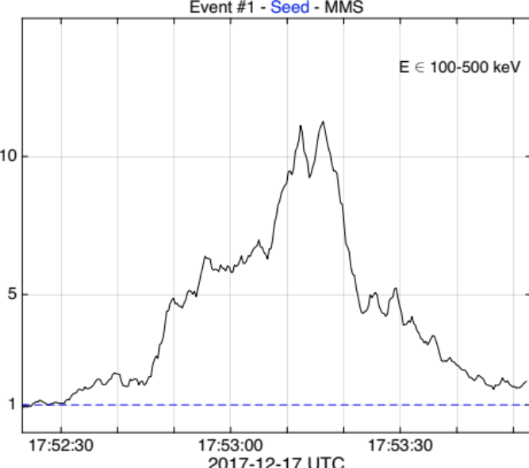
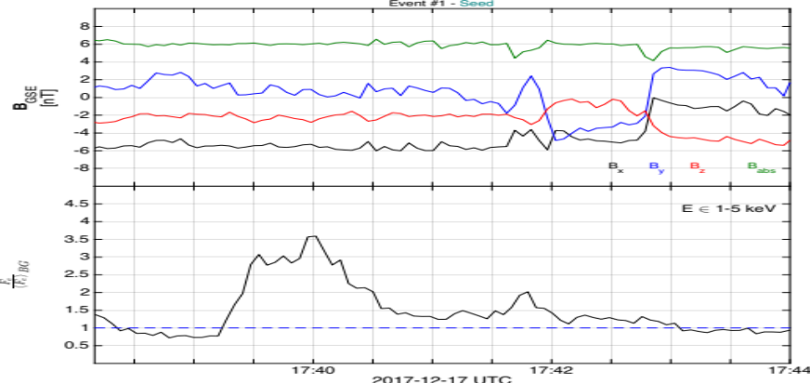
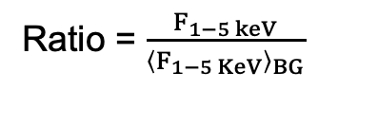
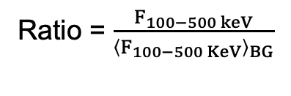

Reinforced Shock Acceleration (RSA): From Sun to Earth
(A)
?
Discontinuity (SW) ARTEMIS
Transient (FS) MMS
(B)
Transient (FS) Cluster
Transient (MSH) MMS
Coronal Hole SW
V> 400 km/s
X → X+100 keV
~1 keV
>100-500 keV
$${\left(\frac{B}{B0}\right)}^{2/3}$$
Ratio = $\frac{F_{100−500 keV}}{{\left\langle F_{100−500 KeV}\right\rangle }_{BG}}$
Ratio = $\frac{F_{1−5 keV}}{{\left\langle F_{1−5 KeV}\right\rangle }_{BG}}$
Max flux ratio
Max flux ratio
SW – ARTEMIS/THEMIS
Foreshock - MMS
Note: Framework is consistent with other studies (e.g., Wilson+2016, Liu+2019, Shi+2025)
Magnetosheath – CL/MMS
Fast SW seeding ~1 keV particles
: Raptis+ 2025 (NatComm) - Revealing an Unexpectedly Low Electron Injection Threshold via Reinforced Shock Acceleration
: Raptis+ 2025 (ApJL) - Multi-Mission Observations of Relativistic Electrons and High-Speed Jets Linked to Shock Generated Transients

Slide 13
The question now is:
What about other planetary shocks?
Raptis et al.2026

Slide 14
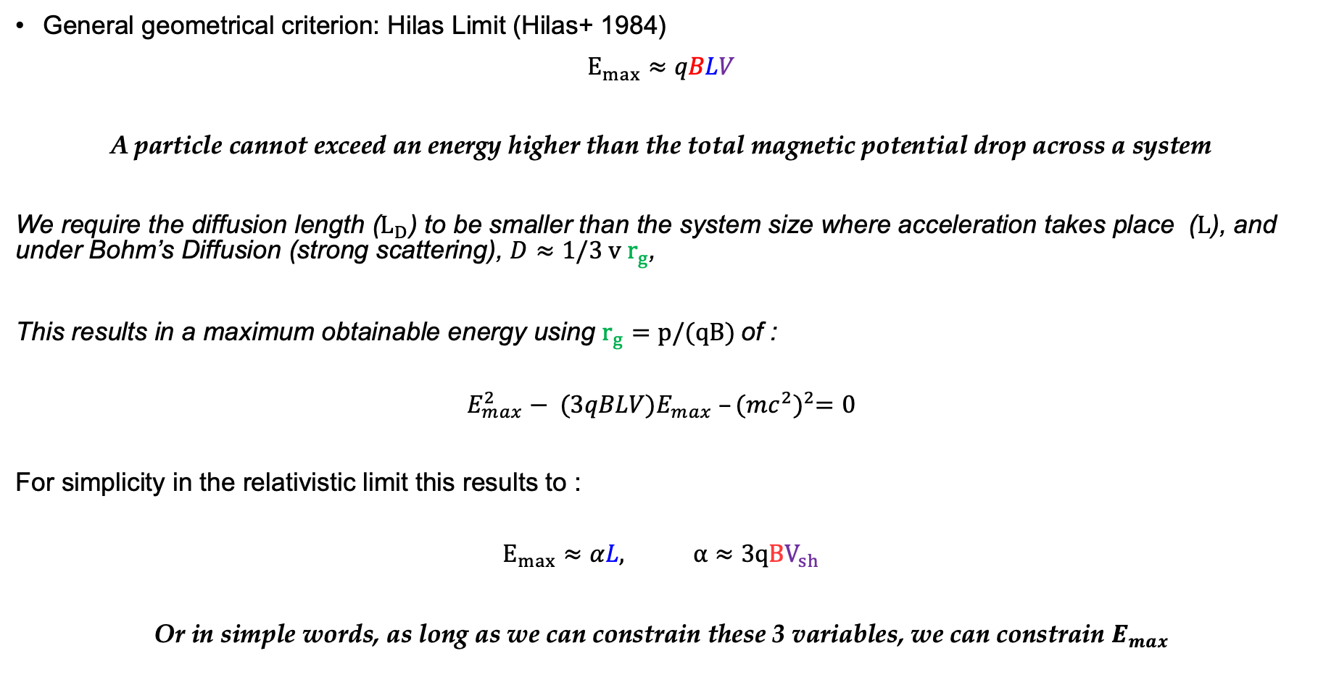
Particle Acceleration: Hilas Criterion and Scales
General geometrical criterion: Hilas Limit (Hilas+ 1984)
$E_{max}≈qBLV$
A particle cannot exceed an energy higher than the total magnetic potential drop across a system
We require the diffusion length ($L_{D}$) to be smaller than the system size where acceleration takes place ($L$), and under Bohm’s Diffusion (strong scattering), $D≈1/3 v r_{g}$,
This results in a maximum obtainable energy using $r_{g}=p/(qB)$of :
$$E_{max}^{2}− (3qBLV)E_{max} –{(mc^{2})}^{2}=0$$
For simplicity in the relativistic limit this results to :
$$E_{max}≈αL, α≈3qBV_{sh}$$
Or in simple words, as long as we can constrain these 3 variables, we can constrain $E_{max}$
Full derivation: Oka et al. 2025; Raptis et al. 2026 (Methods)

Slide 15
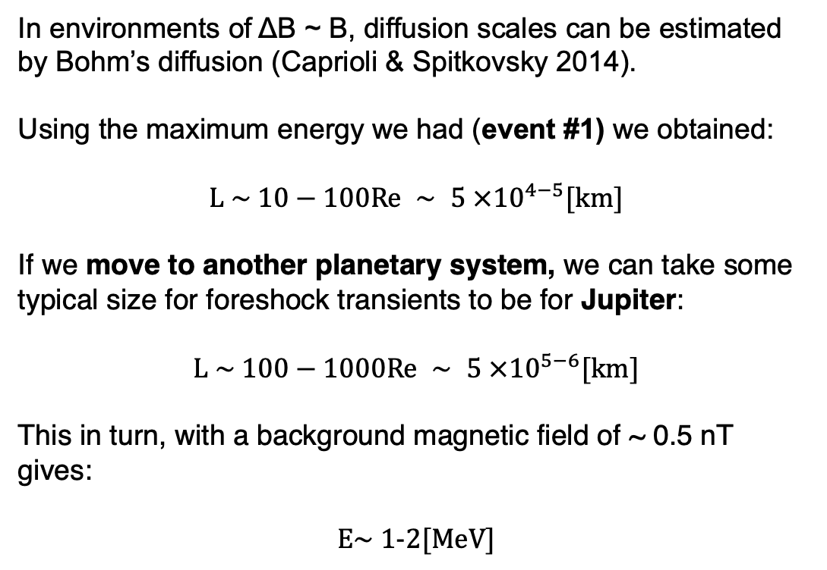
Electron Acceleration in other planets
Adapted from Valek + 2017
Re
In environments of ΔB ~ B, diffusion scales can be estimated by Bohm’s diffusion (Caprioli & Spitkovsky 2014).
Using the maximum energy we had (event #1) we obtained:
$$L \sim 10−100Re ∼ 5 ×{10}^{4−5}[km]$$
If we move to another planetary system, we can take some typical size for foreshock transients to be for Jupiter:
$$L \sim 100−1000Re ∼ 5 ×{10}^{5−6}[km]$$
This in turn, with a background magnetic field of ~ 0.5 nT gives:
$$E\sim 1−2[MeV]$$
Unpublished figure, adapted from Valek et al., 2017

Slide 16
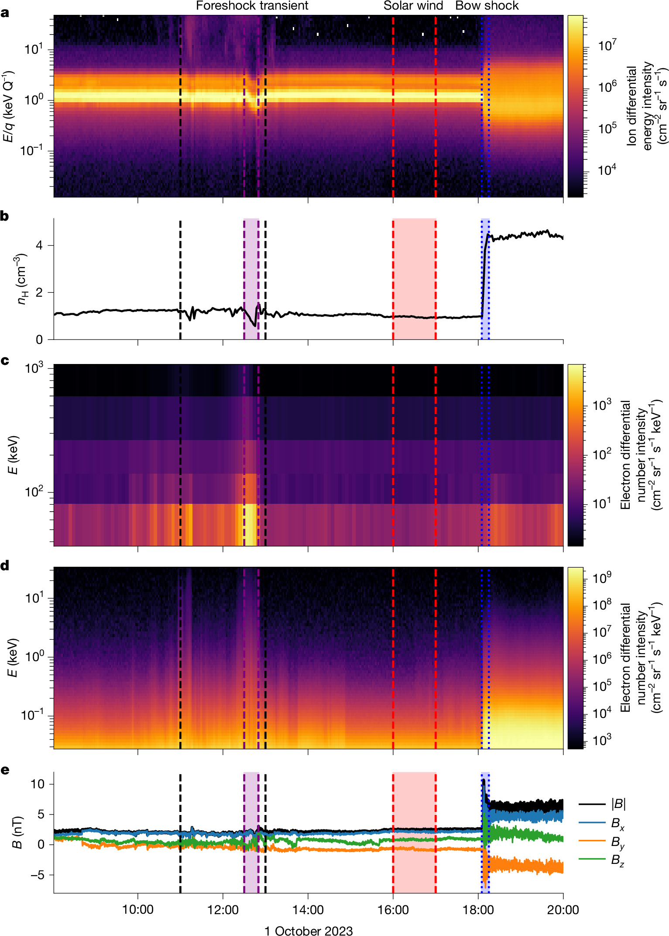
Juno Observations – Jovian Bow Shock Crossing
Ion spectrum
Foreshock Transient (HFA):
Energetic electrons up to 1 MeV
Disrupted solar wind beam
Localized depletion of n and B
Solar wind (SW):
Typical SW:~ 1-2/cc, 2.5 nT
No energetic electrons
Quasi-perpendicular geometry
Bow shock (BS):
Duskward Flanks Crossing [+12.9, +60.5, −59.3] Rj)
Typical compression of ~2 for B and n
suprathermal electrons present but minimal energetic electrons only up to 10ish KeV
Ion density
Electron
Spectra
JADE + JEDI
Magnetic
field
Raptis et al. 2026

Slide 17
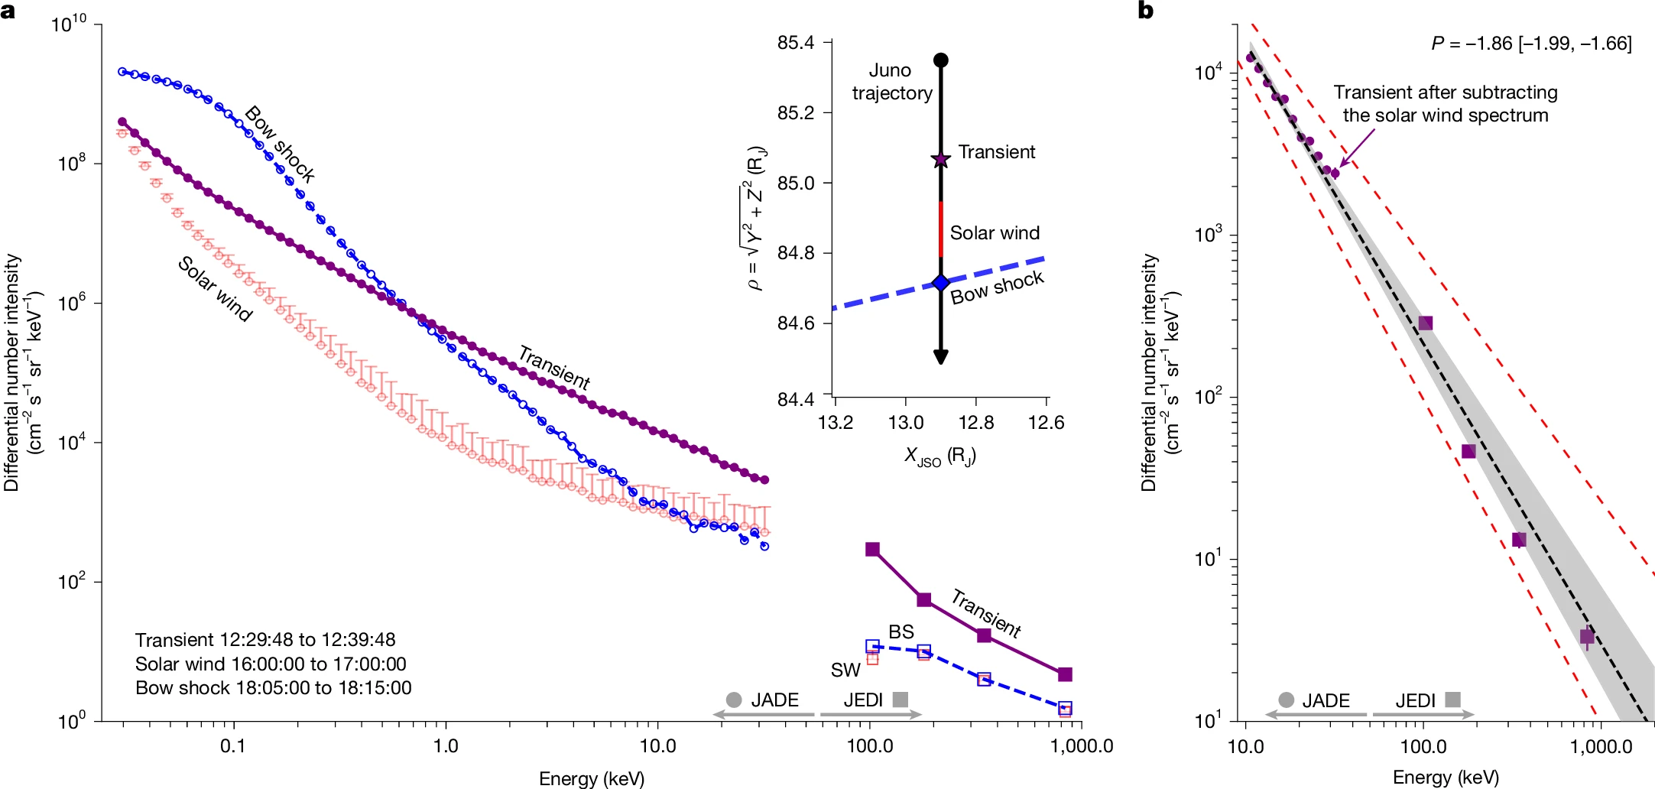
Reinforced Shock Acceleration at Jupiter
DSA (rel) ~2
DSA (non-rel) ~1.5
Most efficient acceleration happens at the foreshock. The bow shock crossing only up to <10 keV
Raptis et al. 2026

Slide 18
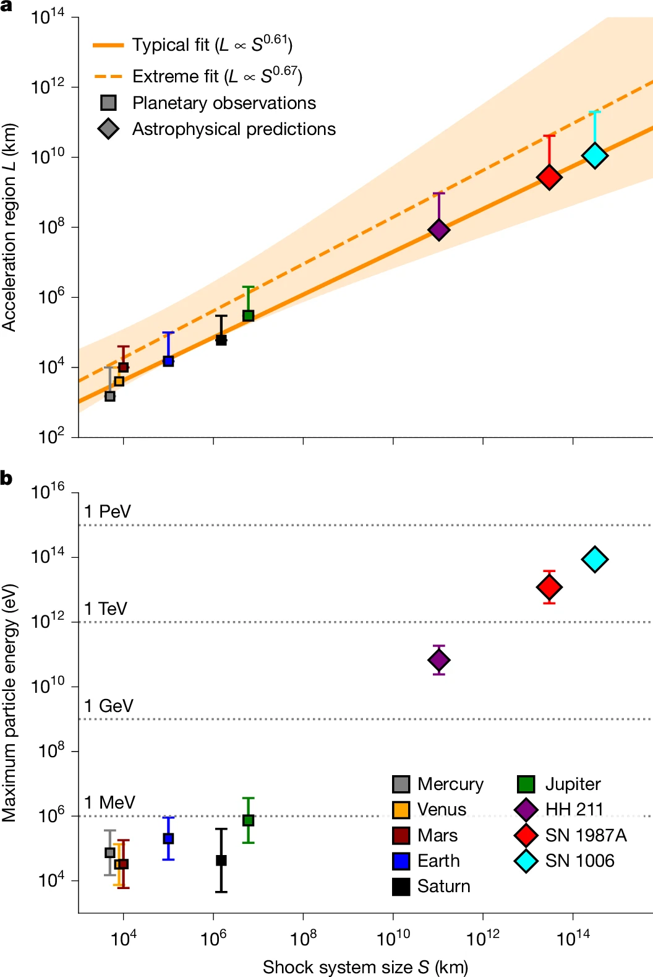
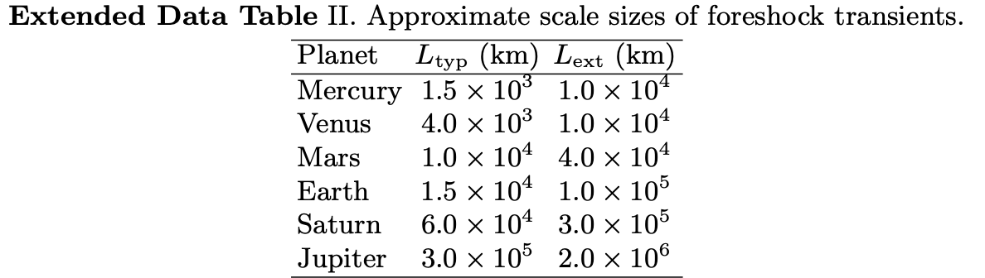
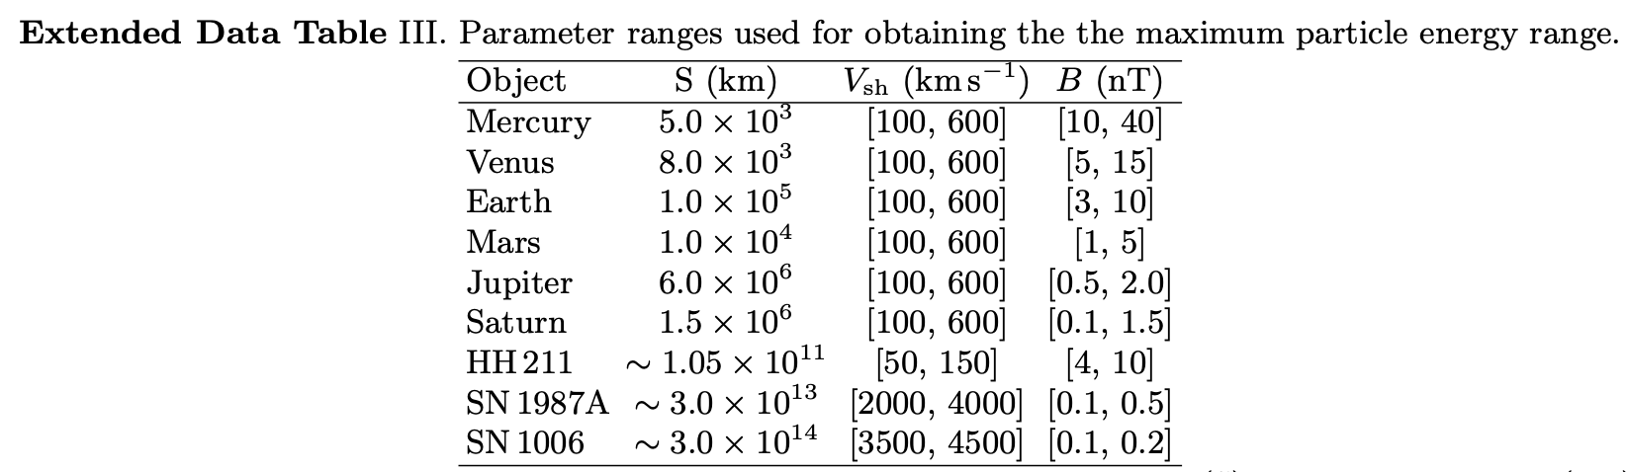
Can we extrapolate to astrophysical shocks?
$$E_{max}\sim BV_{sh}L$$
Inputs: in situ planetary data
Caveats & Assumptions:
An extrapolation beyond any in situ test
Assumes quasi-parallel geometry and transient formation at these shocks
Bohm diffusion (dB/B₀ ≫ 1) is conservative: these are lower bounds (Malkov & Diamond 2005)
Upstream field coherence may cap L in some systems
Why trust it:
The L(S) scaling is anchored in decades of in situ planetary data and produce reasonable values
The SN 1006 prediction (≲100 TeV) matches independantly observed maximum (Giuffrida et al., 2022)
At Earth and Jupiter, the transient outperforms the shock front itself and the limits match observations made from in-situ missions
fit
extrapolation
From three observables to E_{max}
B and V_{sh}: taken from each system (tables above).
L: fit planetary data to a power law linking transient size to shock standoff distance S.
Extrapolate: apply the upper prediction interval of the fit to HH 211, SN 1987A and SN 1006.
Bound: the Hillas limit turns each L into a maximum energy.
Raptis et al. 2026
Inspired by Uritsky et al., 2014 & Valek et al., 2017

Slide 19
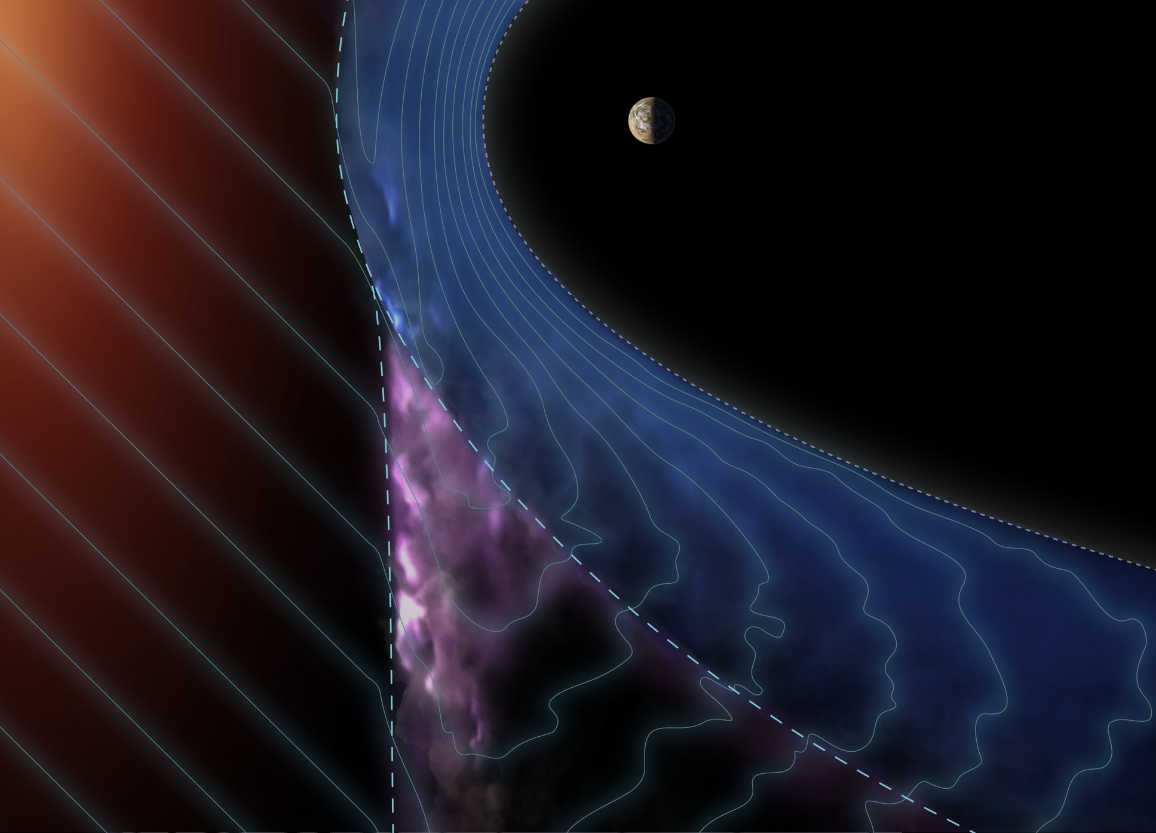
Illustration of the process in an arbitrary planet
Raptis et al. 2026

Slide 20

Illustration of the process in an arbitrary planet
Raptis et al. 2026

Slide 21
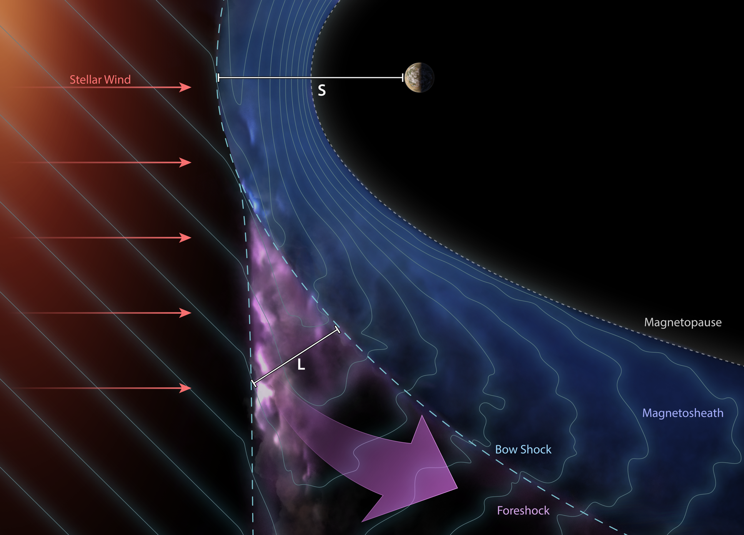
Illustration of the process in an arbitrary planet
Raptis et al. 2026

Slide 22
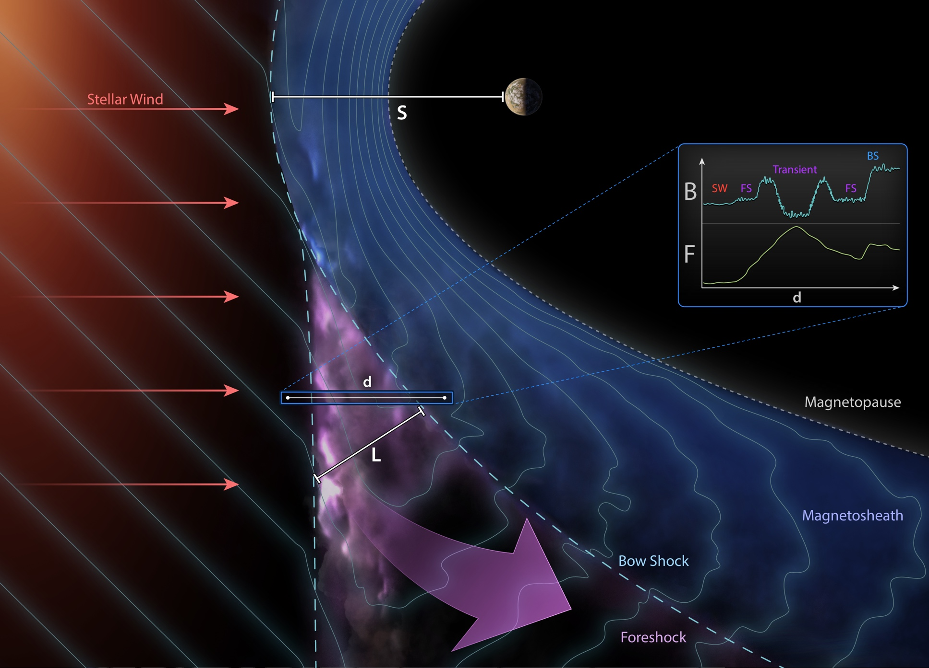
Illustration of the process in an arbitrary planet
Raptis et al. 2026

Slide 23
Summary & Future Work
Transient Processes at Quasi-Parallel shocks may be more important than previously realized! relativistic particles, localized compressive edges/shocks operating multiple temporal and spatial scales all interacting with each other.
Recent results:
Seeding and Max Energy: Identified a systematic suprathermal seeding (~1–5 keV) intrinsic to fast solar wind. Localized transients act as the primary driver to energize these these electrons to high energies (100s of keV). (Raptis et al., 2025a)
A Two-Step Mechanism: Particles get more energized when larger transients (i.e., HFAs/FBs) cross the bow shock. For energetic particles, additional acceleration can be modeled by compression (betatron) and strong scattering. (Raptis et al., 2025b)
Broader Implications: We expanded this model to test its universality at other planetary boundaries (e.g., Jupiter – 1 MeV electrons) and fundamental astrophysical shocks. This model predicts ~10-100 TeV particles in in supernova shocks (e.g., SN 1006) consistent with cosmic ray observations. (Raptis et al., 2026)
Future steps:
Formulate a physical first-principle model: We know foreshock transients form, but we are not sure about the details, so extrapolation to other systems is speculative and needs to be grounded.
Energy transfer & wave particle interaction is still unclear. We need to look at electron scales for formulating the connection from thermal to suprathermal energies and to uncover the processes of pre-seeding

Slide 24
Appendix

Slide 25
Reinforced Shock Acceleration of Electrons
RSA of Electrons
Shock Acceleration
Wave particle interactions
Ratio = $\frac{F_{100−500 KeV}}{{\left\langle F_{100−500 KeV}\right\rangle }_{BG}}$
“Seeding”
Seed & DC from
fast solar wind
(~1keV)
+
Max flux ratio
Efficient through PA scattering & confinement:
- Whistler waves (Shock Transition)
- Wavefield of HFA’s core (ΔB>>B)
- ”Magnetic bottle” between HFA’s edges and bow shock (i.e., Fermi acceleration)
- Betatron (elec. temperature anisotropy)
Note: Framework is consistent with all other studies (e.g., Wilson+2016, Liu+2019, Shi+2025)
Key-point:
Seed + Foreshock’s Shock + Waves + Efficiency factors = ~100s KeV electrons before reaching the bow shock.
Raptis et al.2025 | NatComm

Slide 26
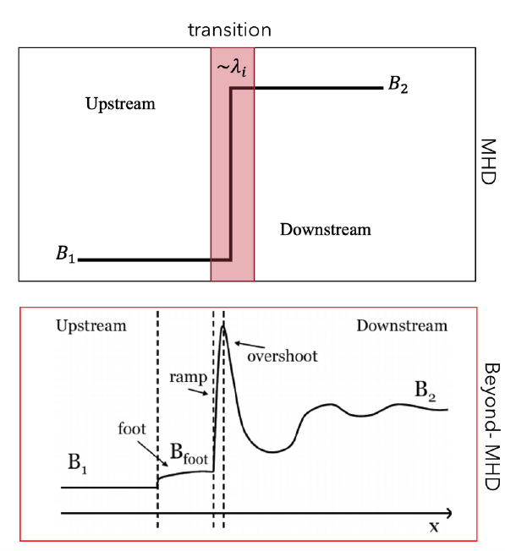
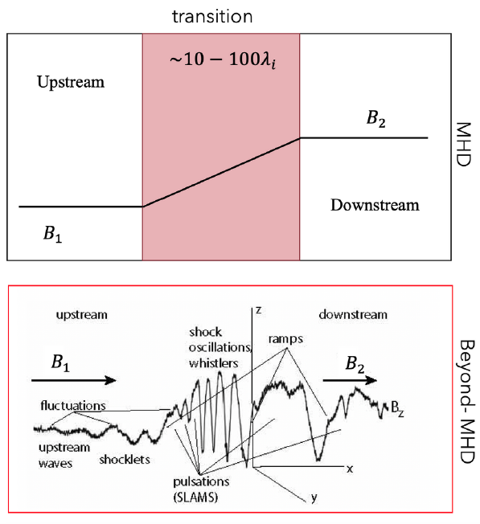
Quasi-parallel and Quasi-perpendicular shocks
Qperp
Qpar

Slide 27
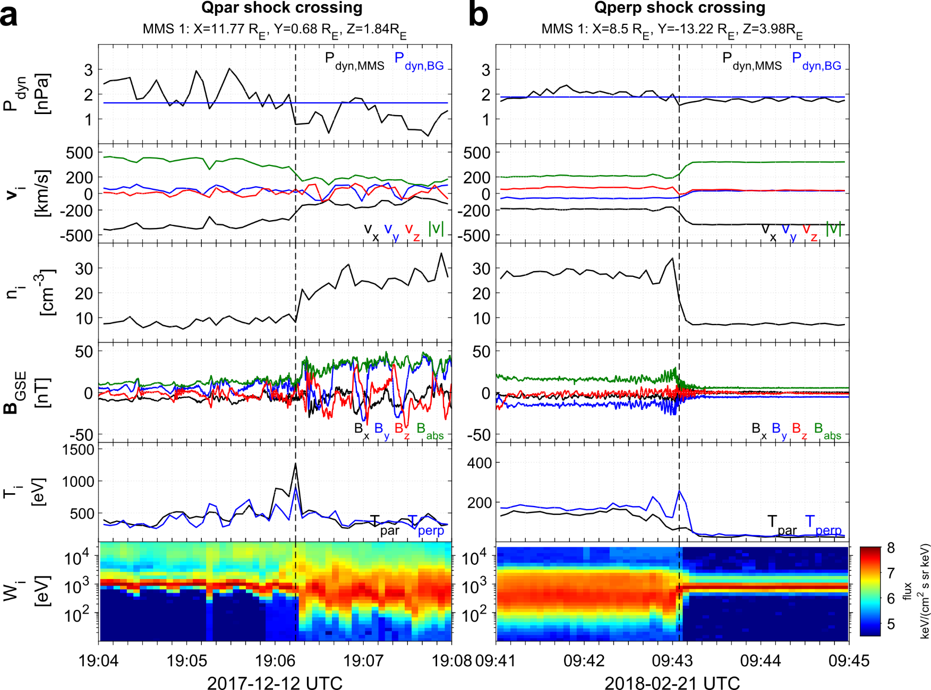

Community Reminder: Qpar – Qperp Shocks
Qpar shocks and downstream plasma:
Presence of foreshock
Magnetic field fluctuations ↑
High energy ions ↑
Temperature anisotropy ↓
Upstream
Upstream
Downstream
Downstream
(2)
(4)
See our new MMS citizen science project: “Shock Detectives”:
https://www.zooniverse.org/projects/vickitoyedens/shock-detectives
(1)
(3)
MMS, Cluster, THEMIS, MMS
Raptis+(2020), Karlsson+(2021), Koller+(2024), Svenningsson+(2024), Raptis+(2026, Ongoing)
Figure taken from PhD Thesis (Raptis 2022)

Slide 28
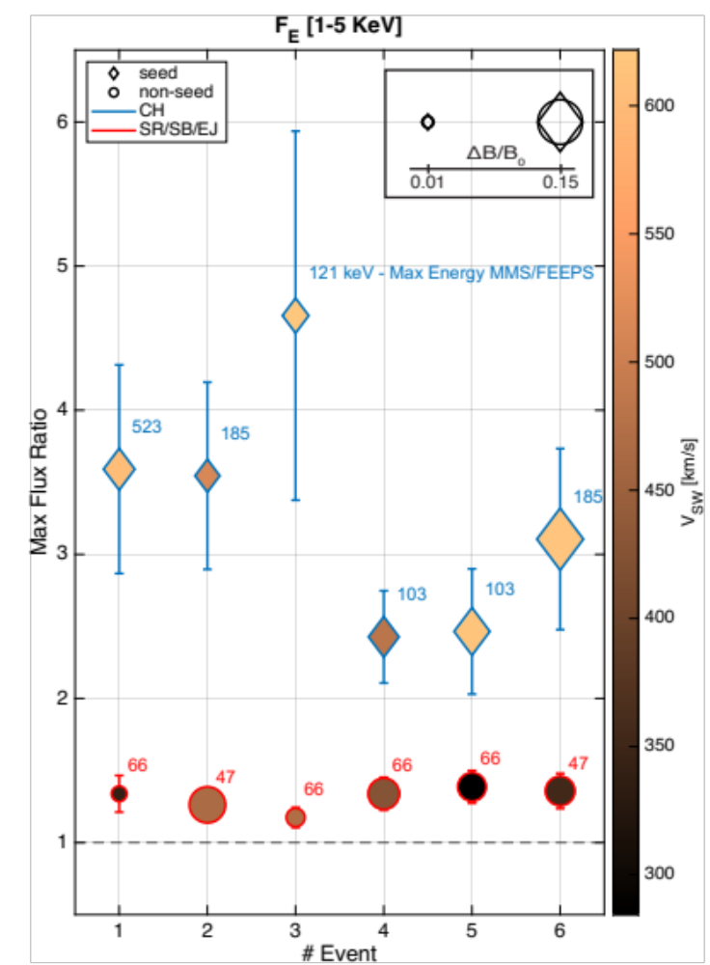
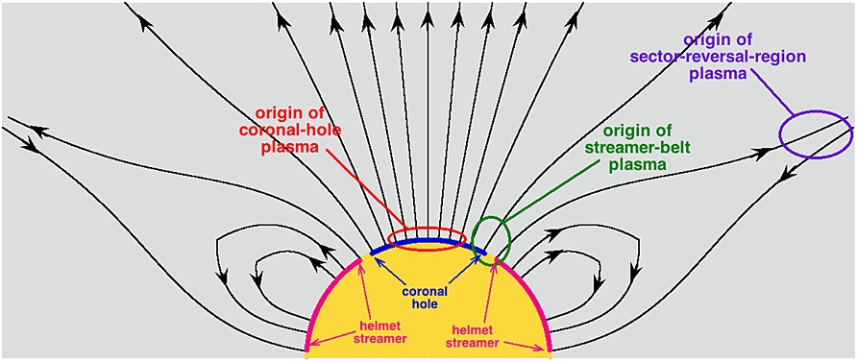
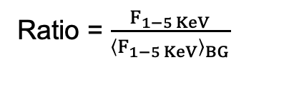
Seeding and particle acceleration
Seed events (FEEPS > 100 KeV)
CH (78%), CH (40%), CH(79%), CH (39%), CH (77%), CH (79%)
No-seed (FEEPS = Noise)
SB (80%), SB(42%), EJ (55%) SB (44%), SR(63%), SB (46%)
Using: [Xu and Borosvky 2014, Camporeale+ 2017] methodology
Ratio = $\frac{F_{1−5 KeV}}{{\left\langle F_{1−5 KeV}\right\rangle }_{BG}}$
Raptis et al.2025 NatComm
Terry Liu+ ( 2017) noticed similar trends

Slide 29
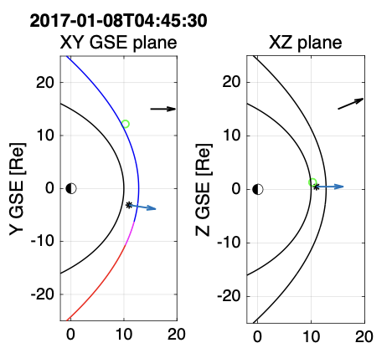
Cluster: Upstream showing HFAs
700 km/s Solar Wind!
Fast coronal hole plasma consistent with our previous work ✓
Hot Flow Anomalies
Disturbed SW beam
~200 keV electrons
Typical properties:
Compressive edges ✓
Flow anomaly ✓
Hot core ✓
Particle energization ✓
Raptis et al.2025 ApJL

Slide 30
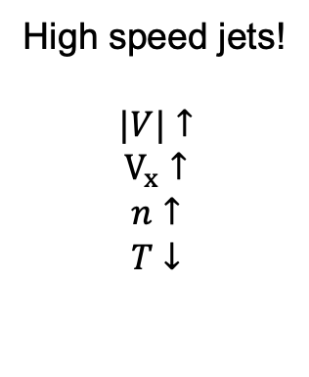
MMS: Downstream HFAs and jets
High speed jets!
$$|V|↑$$
$$V_{x}↑$$
$$n↑$$
$$T↓$$
Zoom-in
Hot Flow Anomalies
Localized compressions
~300 keV electrons
20+min interval
Raptis et al.2025 ApJL

Slide 31
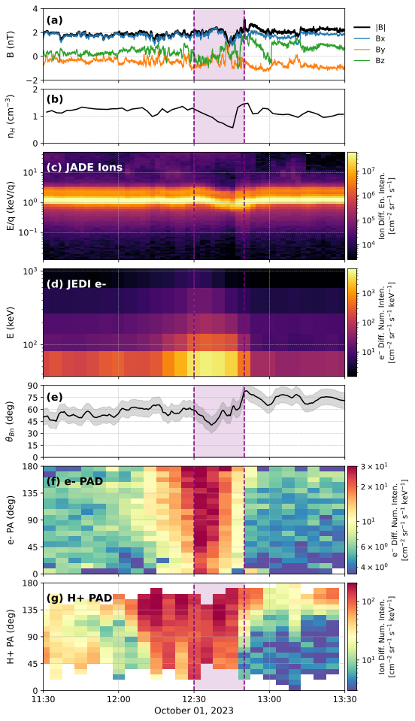
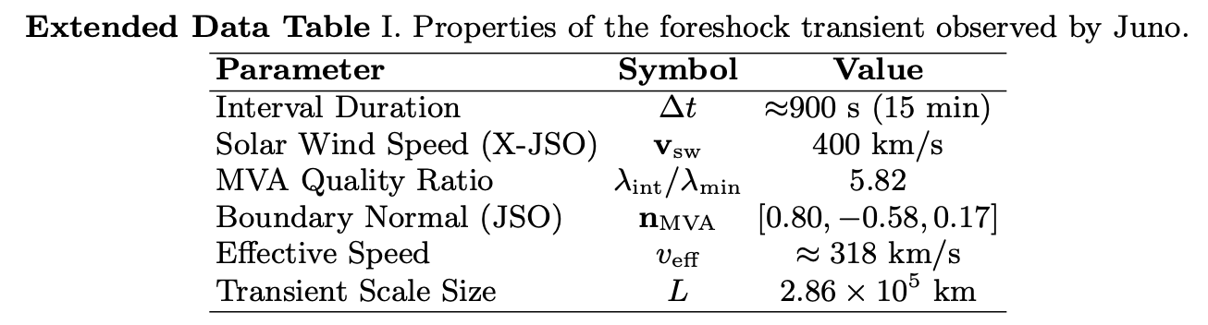
Zoomed-in timeseries of Transient
Foreshock Transient (HFA):
High energy electrons up to 1 MeV (agreement with Raptis+2025a,b)
Disrupted solar wind beam
Localized depletion of n and B
Global Geometry:
Using bow shock model (Joy+ 2002), local angle changes from ~40 to ~75 degrees
Pitch Angle Distributions (PADs):
Isotropic distribution, strong scattering
No trapped population
Localized within the ~15min interval
Magnetic Field
Ion density
JADE
Ion Spectrum
JEDI
Electron Spectra
ΘBn
Electron PAD
Ion PAD
Raptis et al. 2026

Slide 32
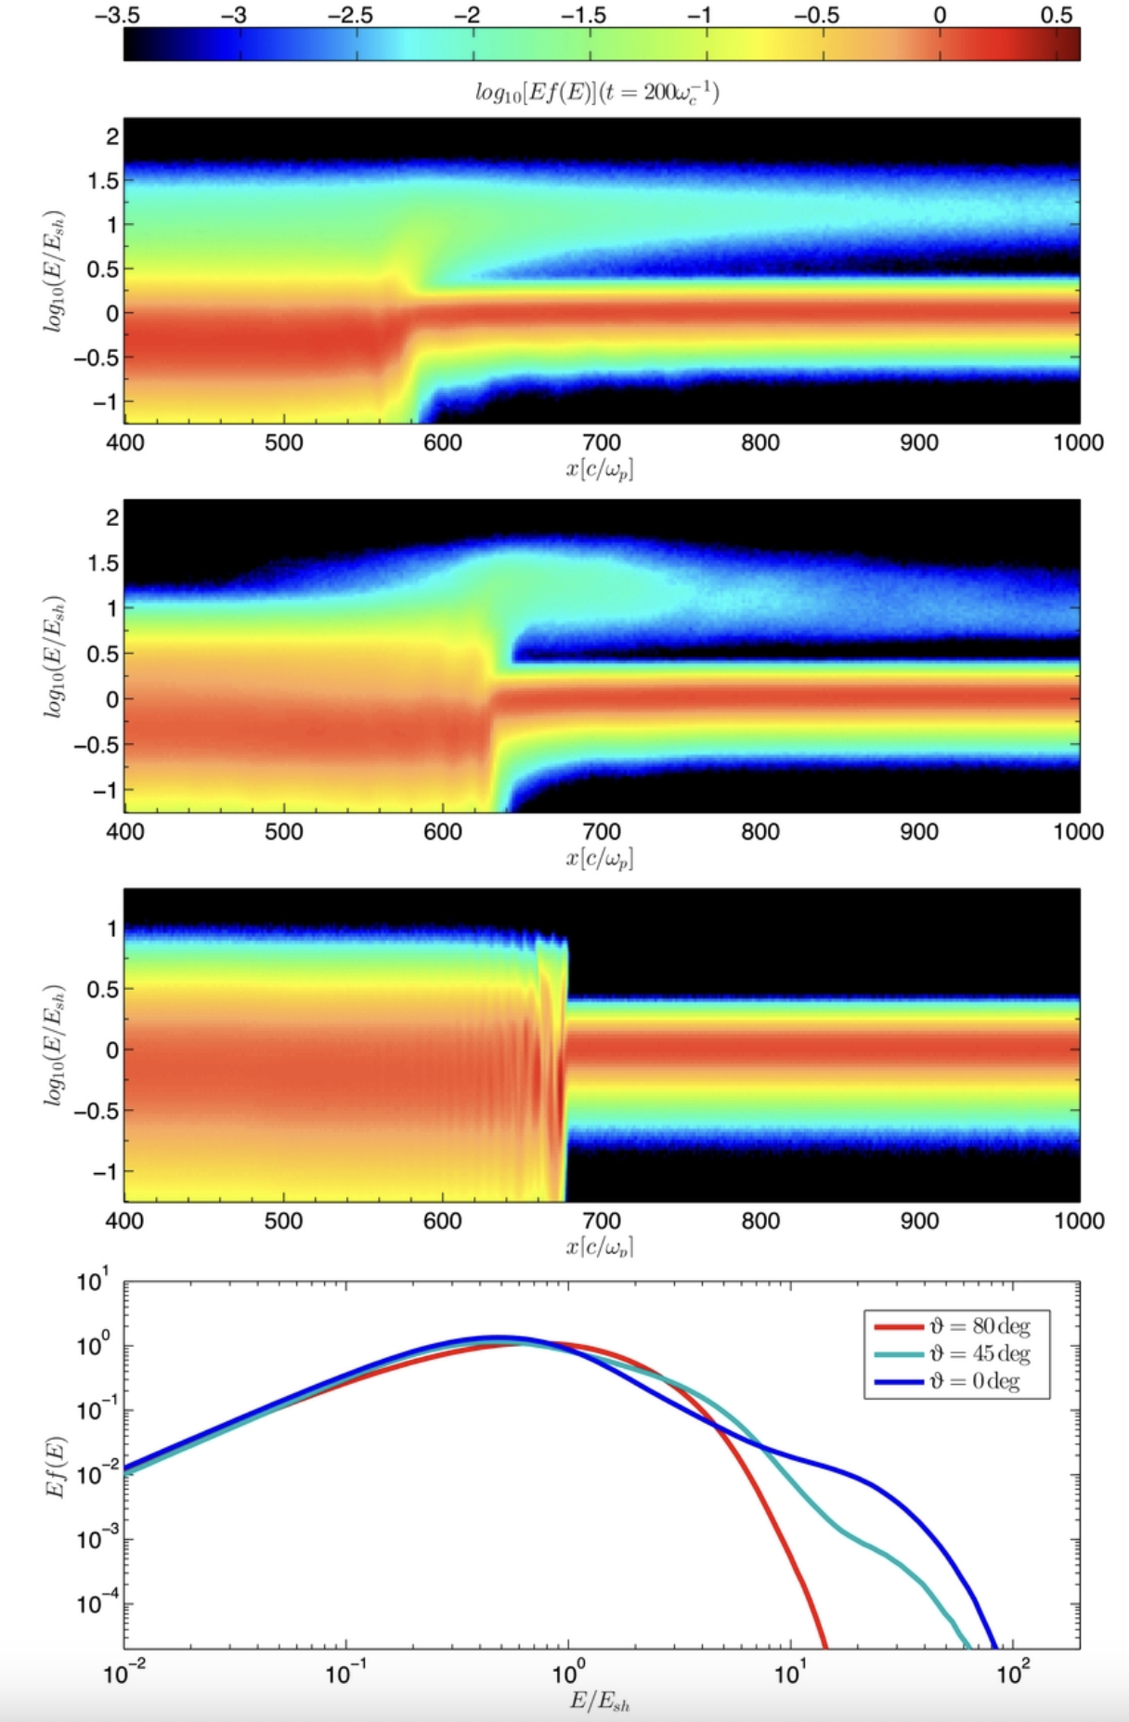
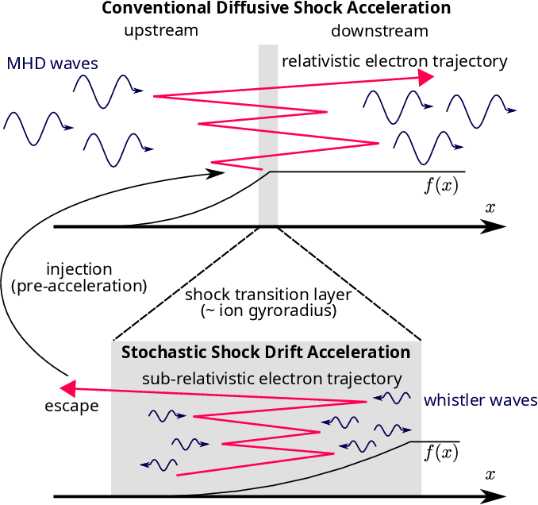
Acceleration at Qpar and Qperp shocks
Qpar shock (DSA)
Oblique shock
Qperp shock
(SDA/SSDA)
ions
Caprioli and Spitkovsky 2014
Amano et al. 2020 | PRL
Notes:
Shock Drift Acceleration = Not enough to get relativistic
Diffusive Shock Acceleration = Good, but requires injection.
SSDA tried to solve this by introducing whistler activity

Slide 33

Shock-generated transients are amazing particle accelerators
Solar wind
Jets forming
Core
$$n_{BG}$$
Magnetosheath
Relativistic electrons
Transients get transmitted
Accelerating particles in the process
restructuring the sheath & forming jets
Raptis et al.2025 NatComm
Raptis et al.2025 ApJL

Slide 34
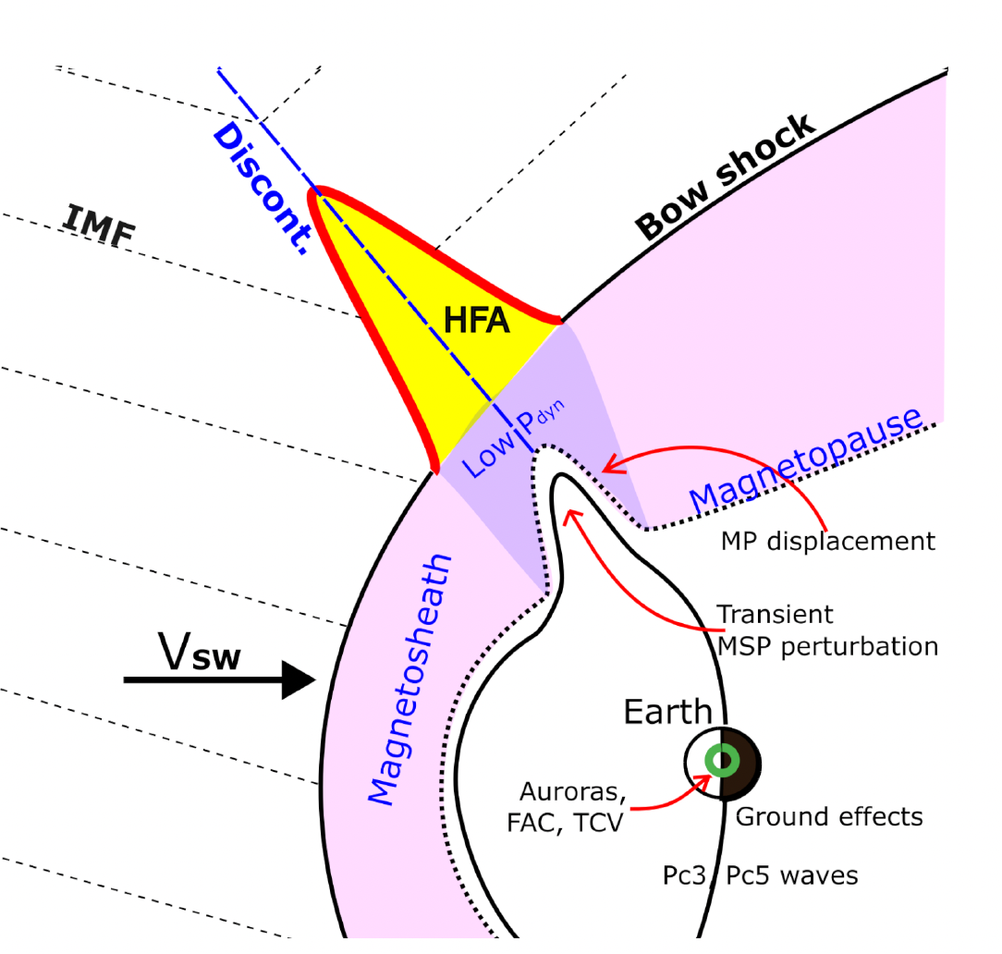
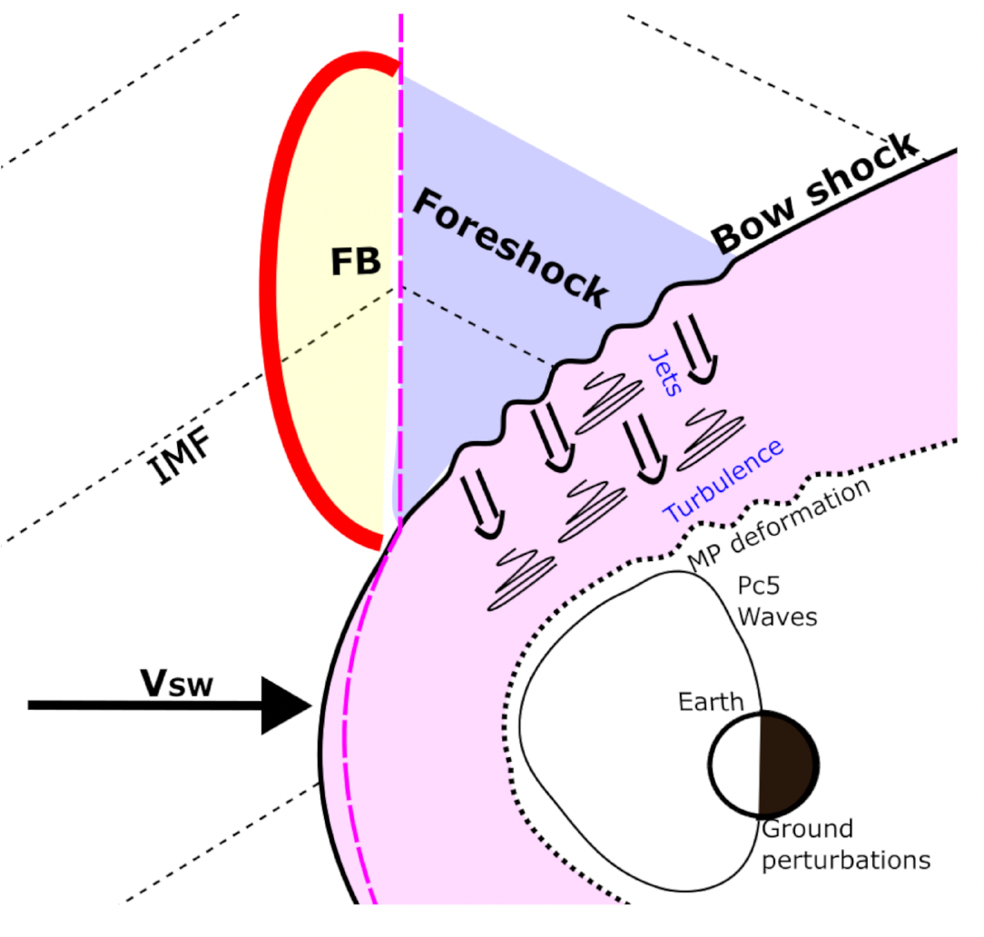
Transients with most notable impact
How many: ~several per day!
How big: up to ~10s of Re
HFAs
Discontinuities intersects BS and E (-V X B) points towards the sheet, ions pile up and thermalized
FBs
Discontinuity & foreshock backstream ions concentrate and create a bubble that expands into the SW
Zhang et al., (2022)
Hot Flow Anomalies (HFAs)
Foreshock Bubbles(FBs)
Primož K. et al. (2024)
TUMS (Transient Upstream Mesoscale Structures)

Slide 35
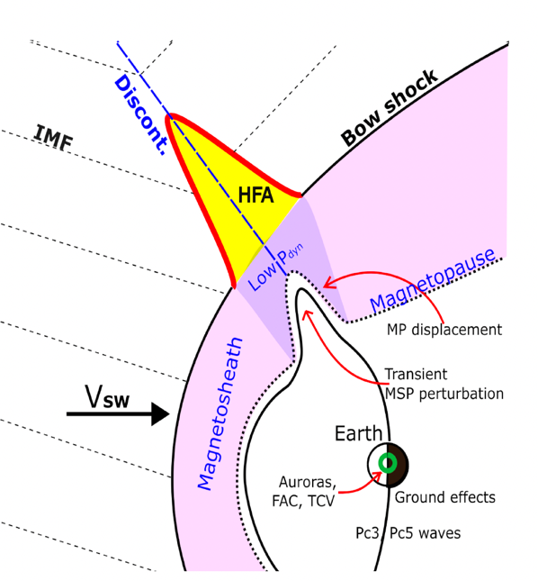
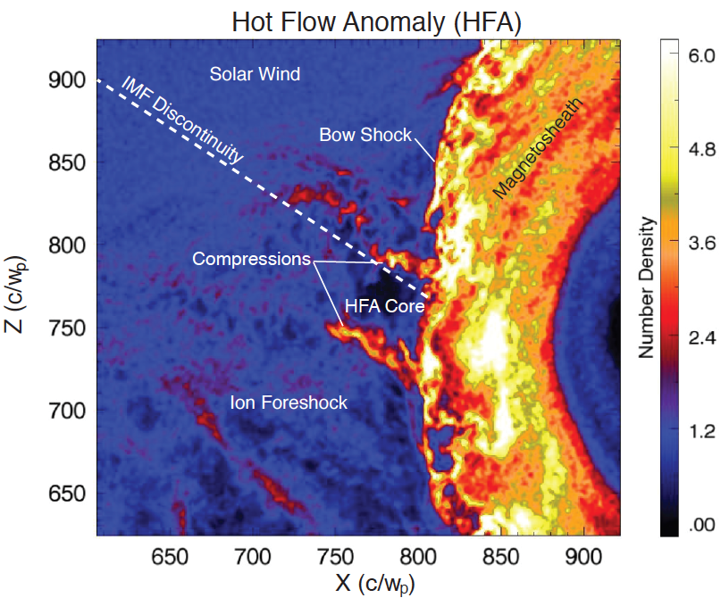
The anatomy of an HFA
Effect on Magnetosphere e.g.,: Shen+2018, Wang+ 2021, Yang+2023, Guo+ 2023, Xu+ 2024, Sibeck+2025
How many: ~several per day!
How big: ~up to 10s of Re
Crater-like B-field and IMF discontinuity
Upstream
shock
Solar wind beam disrupted
Density compressions and cavity
Upstream
shock
Strong plasma flow
deflections in core
Hot Flow Anomalies (HFA)
Figure by Nick Omidi
Kajdič+ (2024)
Superheated core plasma
How do they form?
Discontinuity intersects the bow shock and the convection electric field
(−VxB) points towards the sheet on at least one side.
Figure by Drew Turner

Slide 36
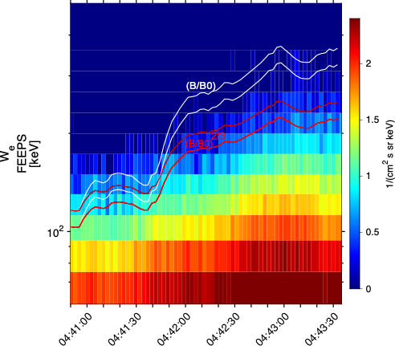
Why Stochastic Betatron Acceleration? Better agreement

Slide 37
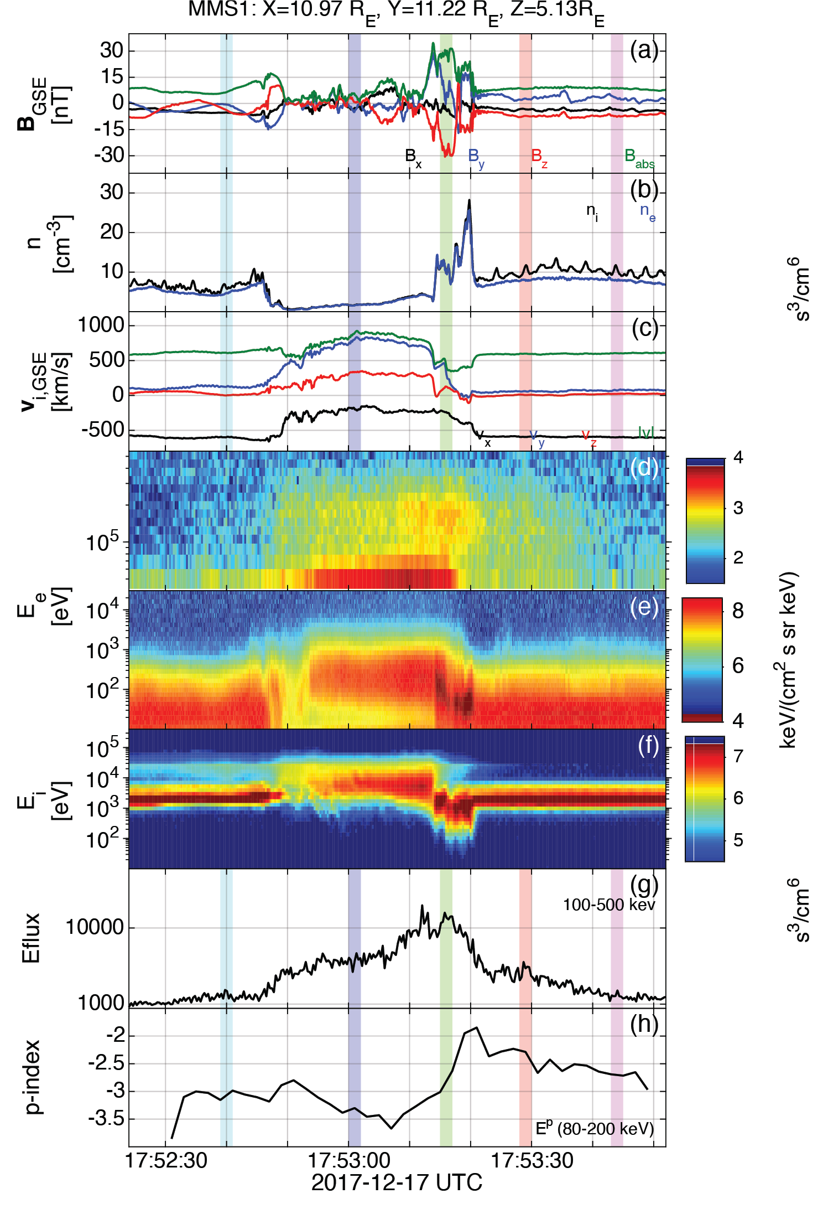



Reinforced Shock Acceleration of Relativistic Electrons
Most energetic electrons observed (500+keV) at foreshock observed by MMS obtained by:
Seed population from fast coronal hole solar wind at suprathermal energy range (~1-5 KeV)
Shock acceleration (SDA/Betatron/Fermi) + Wave particle interaction
Efficiency factors (Trapping and scattering – geometry with bow shock)
Ratio = $\frac{F_{100−500 keV}}{{\left\langle F_{100−500 KeV}\right\rangle }_{BG}}$
Ratio = $\frac{F_{1−5 keV}}{{\left\langle F_{1−5 KeV}\right\rangle }_{BG}}$
Max flux ratio
Max flux ratio
Discontinuity ARTEMIS
Key-point:
Seed + Foreshock’s Shock + Waves + Efficiency factors = ~MeV electrons before reaching the bow shock.
Transient MMS
Earth
~ 30 Re
Raptis+ 2025 Nat.Comm

Slide 38


Is seed from the foreshock? – Maybe partially
(A), (B) → Seeded events – partial mode
(C) → Seeded event full mode
(D) → Non-seeded event – partial mode
3/6 seeded and 2/6 non seeded connected to foreshock
Raptis+ 2025 Nat.Comm

Slide 39

Shocks as particle accelerators
Different shock geometries and particles have different acceleration mechanisms invoked but all can accelerate particles
Astrophysics: Supernova remnants, cosmic rays
Solar Physics: SEP acceleration, fast shock at reconnection
Shock wave
SN-1006 Supernova Remnant
Image from NASA APOD
Courtesy of Li-Jen Chen, GSFC
Desai & Giacalone (2016)

Slide 40

Expectation & Reality
*
*
*
*
https://xkcd.com
*In our case typically it is models, mechanisms, frameworks etc.

Slide 41



Simple Simplistic Picture to remember
❌
✓
How do relativistic electrons form at shocks? “Behind The paper” https://communities.springernature.com/posts/shocks-acceleration-electrons-from-sun-to-earth

Slide 42

Diffusive Shock Acceleration (DSA)
1st Order Fermi, head-on collisions guaranteed (quasi-para shocks):
<ΔE/E> ~ 4/3 β
β = V_{c-s}/c < 1
Simplified explanation
Waves + turbulence downstream = Scatter particles back to the shock
Some of the particles get to very high energies.
Injection Problem
What is the energy threshold needed to kick start this process and how do we reach that?

