Slide 1



Forecasting CMEs using Image Processing & Neural Networks
Savvas Raptis
KTH - Department of Space and Plasma Physics
SpaceCoffee 43
Wednesday 19/12/2018 - 16.00

Slide 2
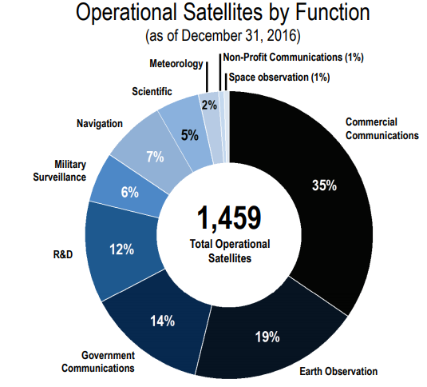
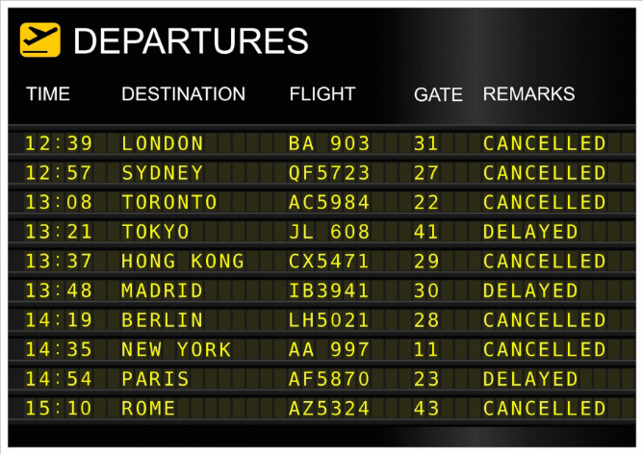

Preventing a disaster
If Satellites Stop:
No Telecommunications
No Military surveillance
No Weather forecast
No GPS
*Figure Courtesy: SIA (Satelite Industry Association)

Slide 3
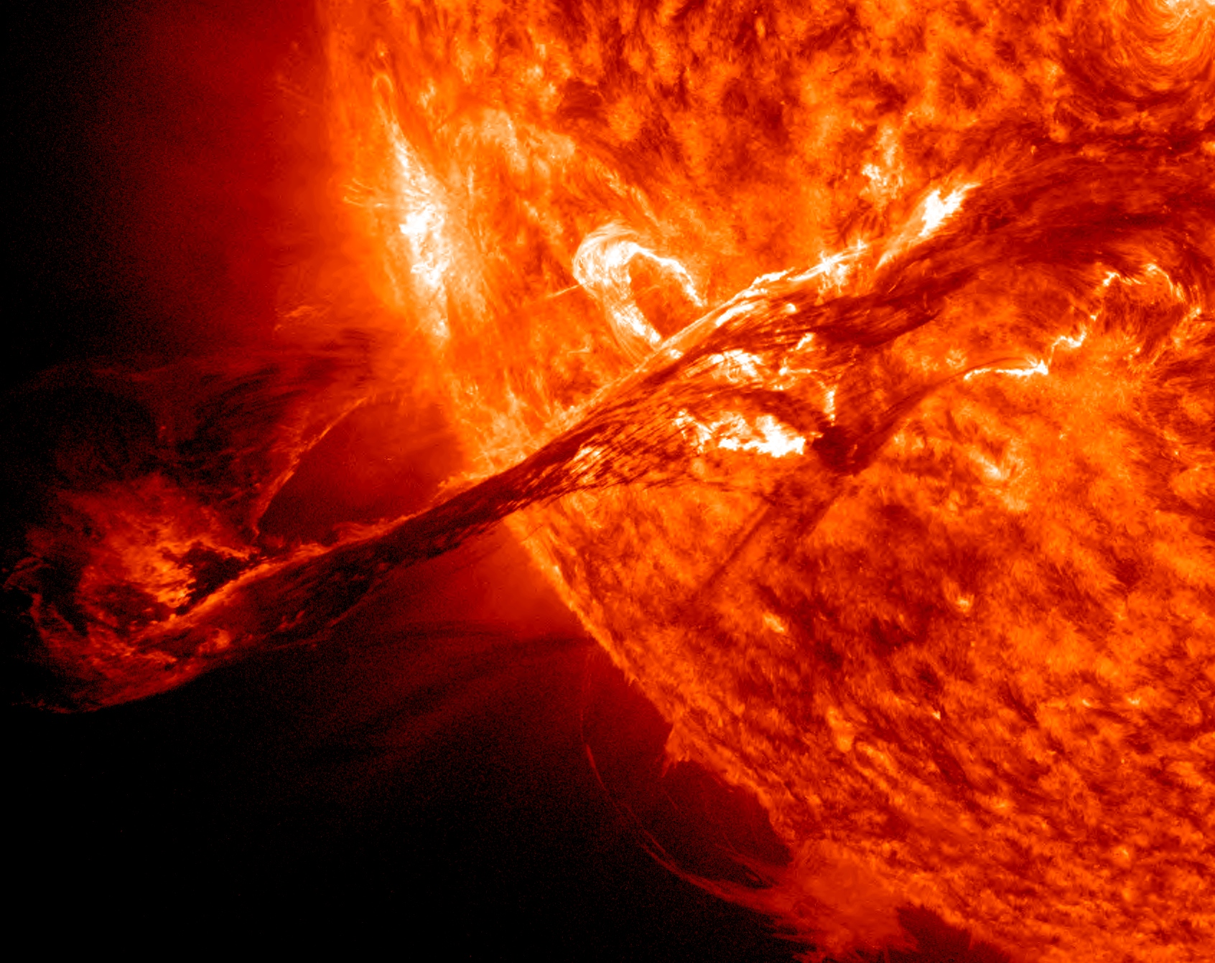
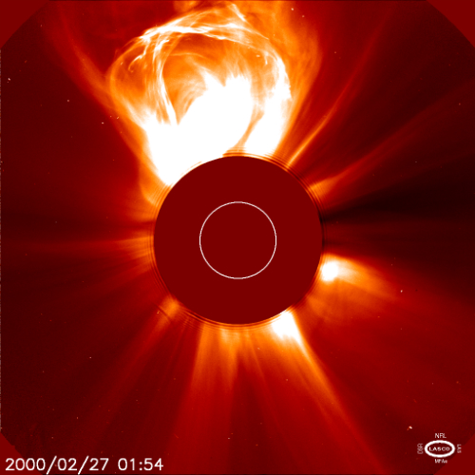
What can cause these problems?
Coronal Mass Ejections (CMEs)
*Figure Courtesy: NASA/ESA, SDO and SOHO satellites

Slide 4
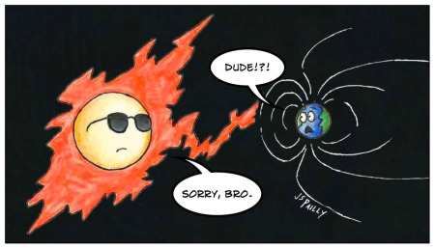
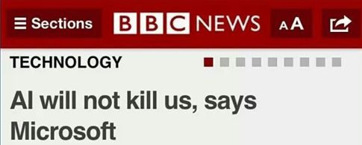
Theory
*Figure Courtesy: https://planetpailly.com/

Slide 5
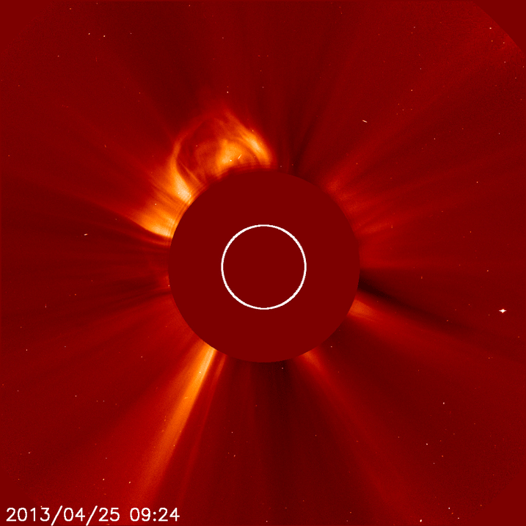
Coronal Mass Ejections – CMEs
CMEs
Energetic events from the Sun
Particles in space
+
Disturbances to Earth’s magnetic field
Problems in Satellites/Communications/Grids/infrastructures etc.
*Figure Courtesy: NASA/ESA, SOHO satellite

Slide 6
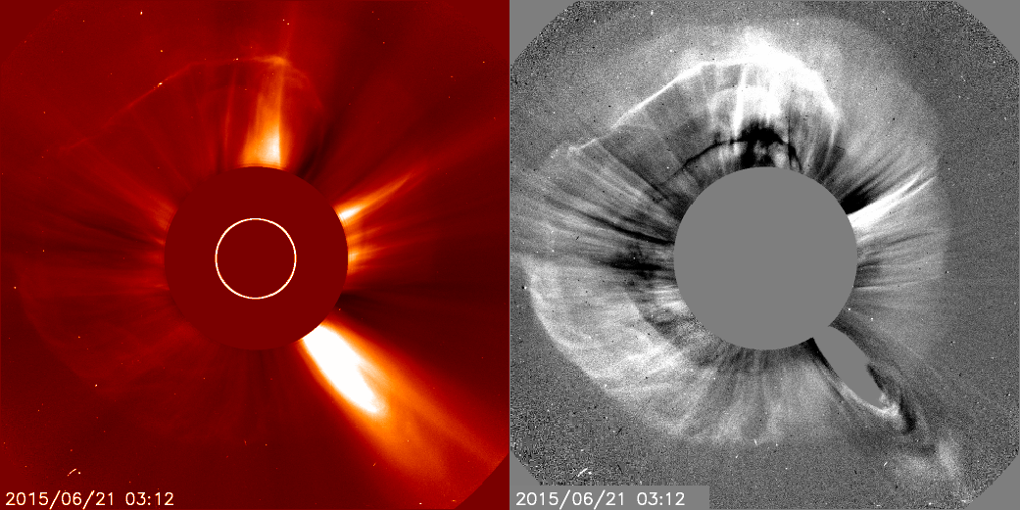
Halo CMEs
Halo CMEs
Earth-directed CMEs. Can be seen from coronagraph.
Why important?
Going to Earth
More effects on mankind
*Figure Courtesy: NASA/ESA, SOHO satellite

Slide 7
What is machine learning & A.I ?
Making the computer “learn” from data without being explicitly programmed

Slide 8
Neural Networks

Slide 9
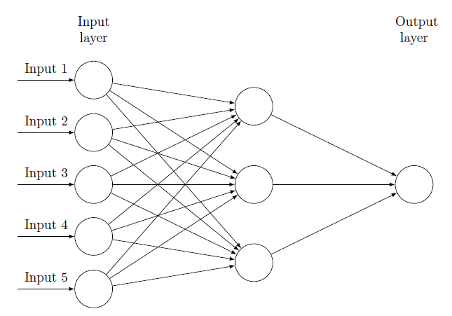
Neural Networks
Let’s see what happens here!!
Output

Slide 10
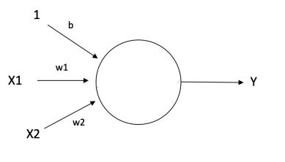
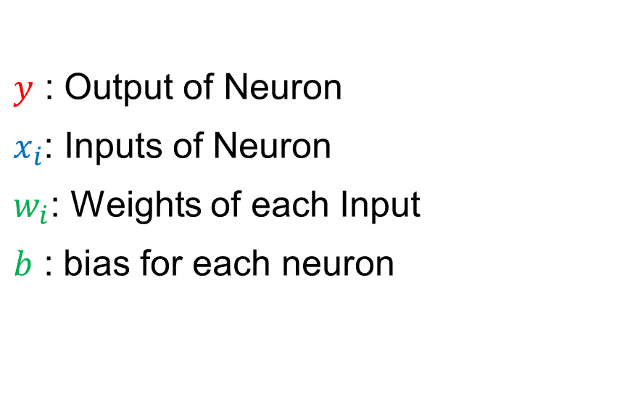

A Neural Network Input and Output
$y$ : Output of Neuron
$x_{i}$: Inputs of Neuron
$w_{i}$: Weights of each Input
$b$ : bias for each neuron
$$y=f\left(x_{1}w_{1}+x_{2}w_{2}+…+x_{n}w_{n}+b\right)$$
Random Numbers
Magic happens here

Slide 11
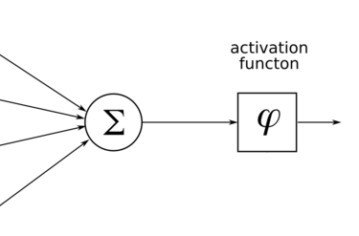
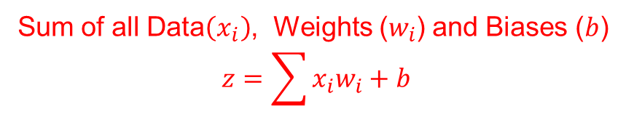




Activation Function
$$b$$
$$w_{1}$$
$$w_{2}$$
$$w_{n}$$
Sum of all Data$\left(x_{i}\right)$, Weights ($w_{i}$) and Biases ($b$)
$$z=\sum{x_{i}w_{i}+b}$$

Slide 12

Activation Function
$$b$$
$$w_{1}$$
$$w_{2}$$
$$w_{n}$$
Apply $f\left(z\right)$ depending on goal

Slide 13
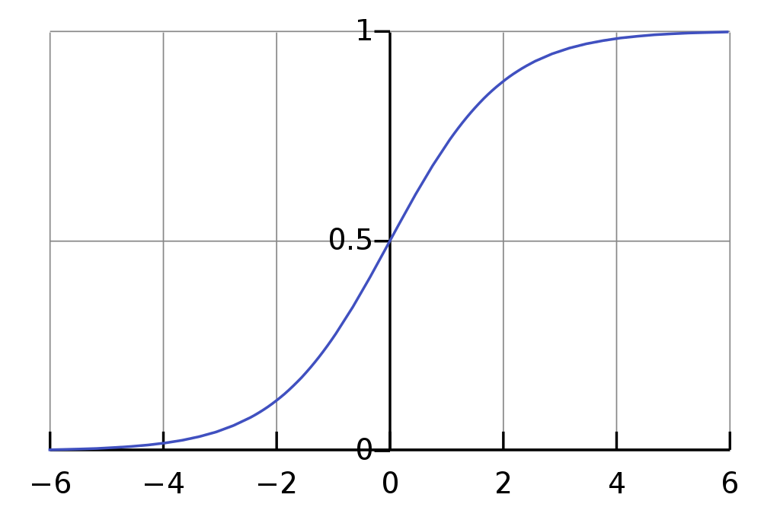
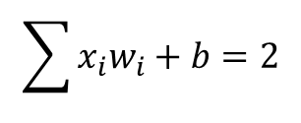

Activation function Examples
Goal: Classification
$$\sum{x_{i}w_{i}+b}=2$$
$$y=0.8 →Class 1$$

Slide 14
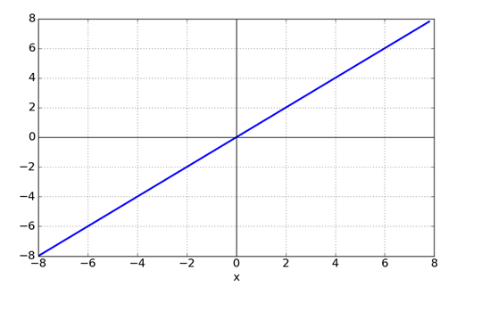

Activation function Examples
Goal: Regression
$$\sum{x_{i}w_{i}+b}=2$$
$$y=2$$

Slide 15
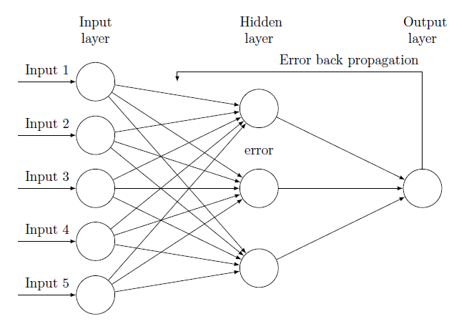
Neural Networks & Backpropagation
Output

Slide 16
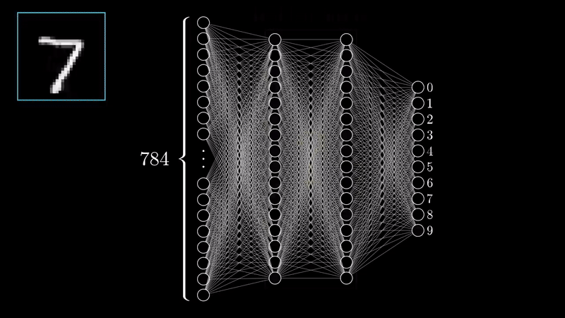
A Trained Neural Network
*Video Courtesy: 3Blue1Brown (Check him on YouTube!)

Slide 17
Neural Networks in Practice
Problem: Predict DST Index
Idea: Quantities are correlated with DST index
(Dynamic Pressure, Magnetic field etc.)
Correlation
Machine Learning
Prediction

Slide 18
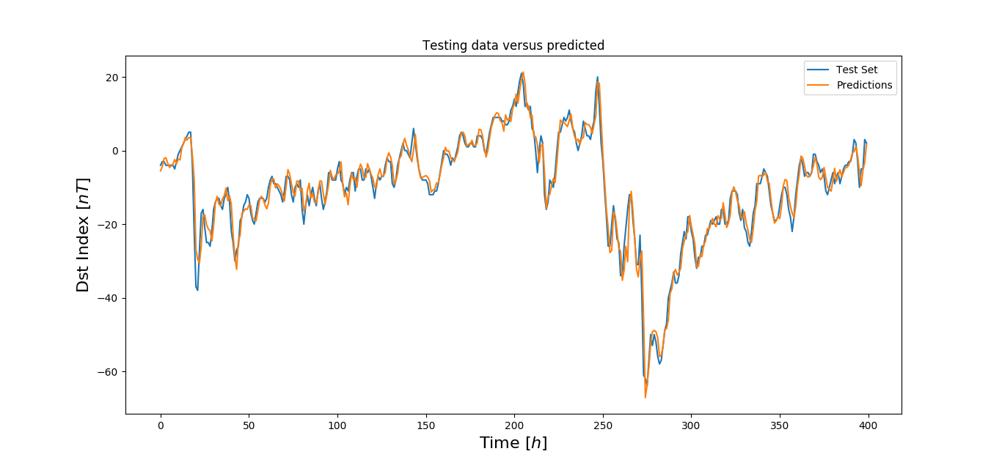
Example: Neural Networks on DST
Output: DST index
(1 Hour later)
Input: Quantities from satellite ACE
4 Layers of (20, 10, 5, 1) Neurons
500 Epochs

Slide 19
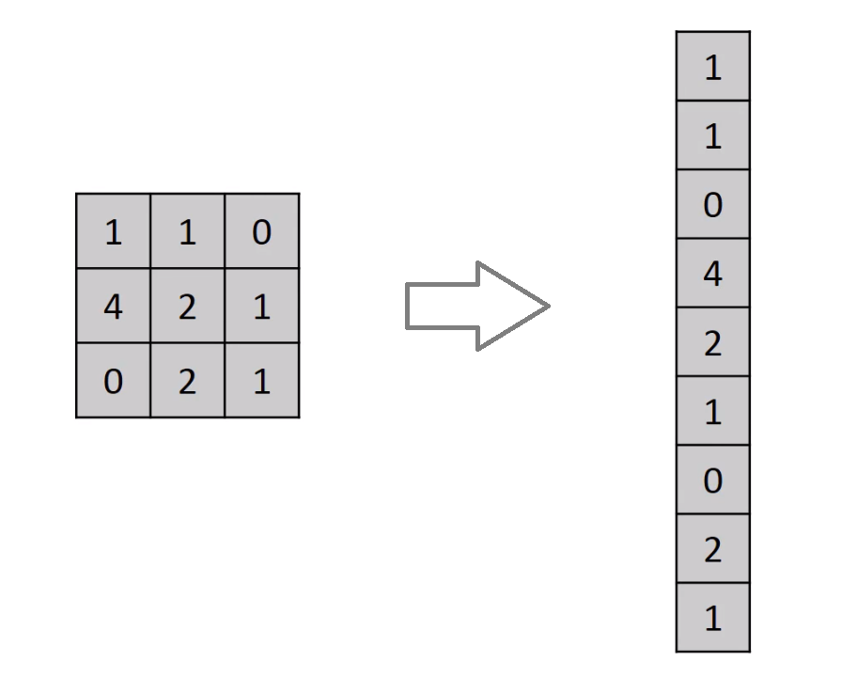
Neural Networks with Images

Slide 20

Neural Networks with Images – Dog example

Slide 21
Convolution Neural Networks

Slide 22
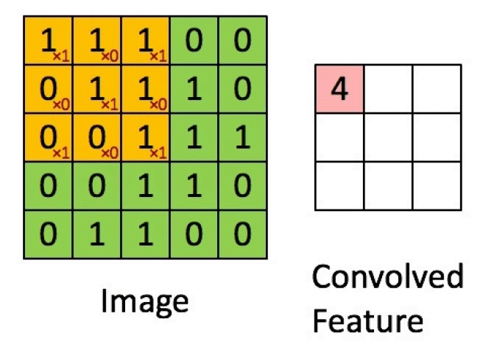
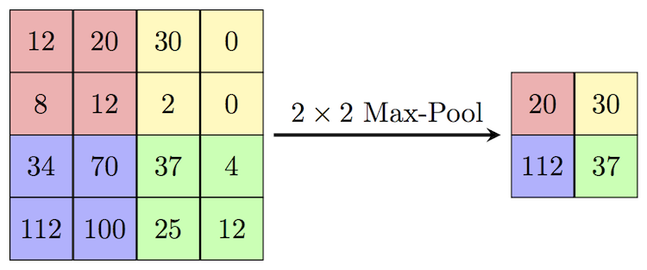
Convolution Neural Network (CNN) Layers
Convolution
Extract features & Keep spatial relationship
Pooling/Subsampling
Reduce dimensionality & retain information
*Figure Courtesy: Erik Reppel
*Figure Courtesy: Cambridge Spark Ltd
Notes:
συνελικτικό νευρωνικό δίκτυο,

Slide 23
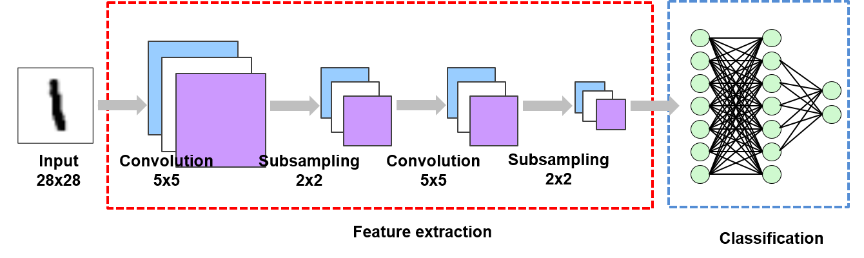
Example of CNN
*Figure Courtesy: Suhyun Kim iSystems Design Labs

Slide 24
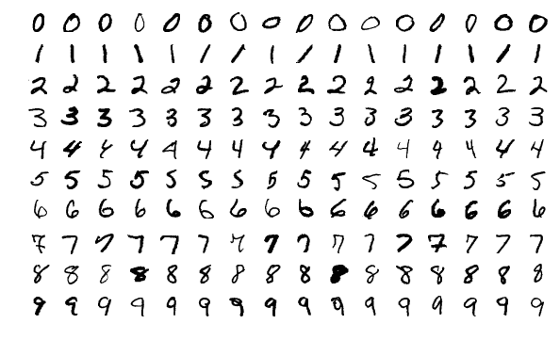
NN vs CNN
Input: MNIST database
Neural Network Result:
97.3%
Convolution Neural Network Result:
99.07%

Slide 25
Analysis

Slide 26
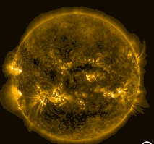
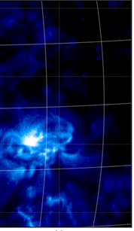
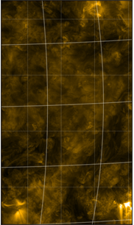
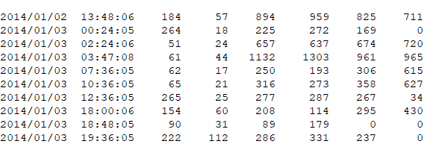
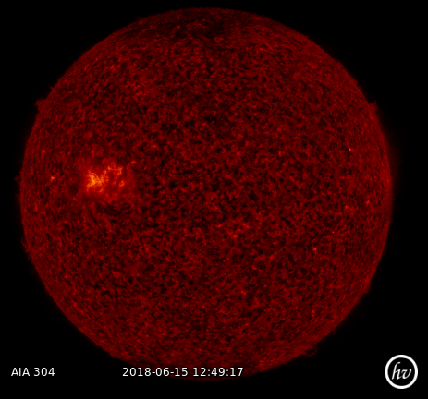
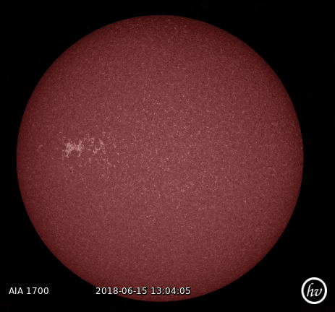
Main Goal
Forecast the emerged CMEs using solar images taken from SDO and CNN
Input
SDO Images during 2014
Output
LASCO/CACTUS Catalogs
Date
Characteristics

Slide 27
1st Part
2nd Part
3rd Part
Data Enhancement
CNN implementation
Pre-processing Tool & History Maps
Machine Learning Project
Improving Input Project

Slide 28
1st Part
2nd Part
3rd Part
Data Reduction
CNN implementation
Pre-processing Tool & History Maps

Slide 29

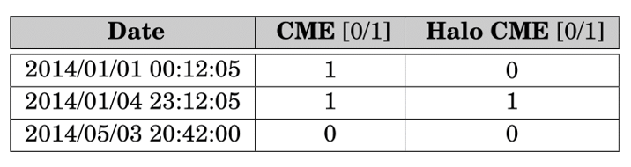


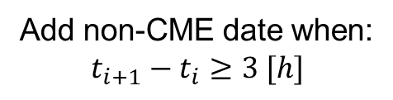

The Data Reduction Project
Add non-CME date when:
$$t_{i+1}−t_{i}≥3 [h]$$
$$θ>90\text{°}$$

Slide 30
1st Part
2nd Part
3rd Part
Data Enhancement
CNN implementation
Pre-processing Tool & History Maps

Slide 31
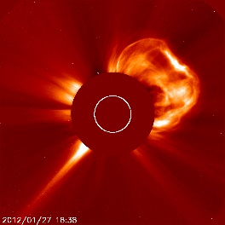

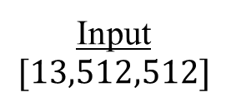

The Machine Learning Project
Input
$$[13,512,512]$$
Convolution Neural Network
Feature Extraction
Dense Neural Network
Classification
Output
CME / No CME
Conv
Conv
Conv
Pool
Conv
Conv
Conv
CME
$$…$$
$$…$$
No CME
Input = 13 SDO images, 2 [h] history before the event.
Output = 1/0

Slide 32
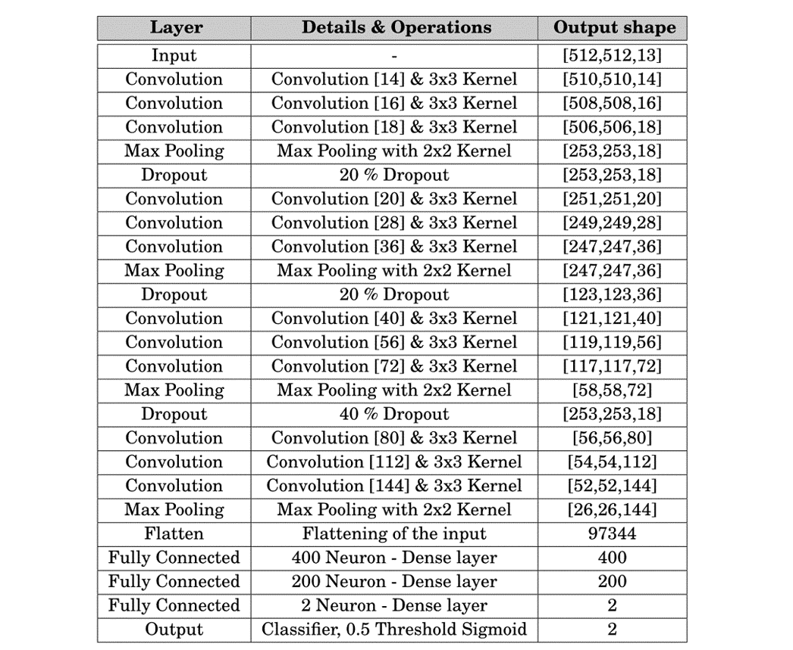
Final CNN architecture
CME
No CME

Slide 33
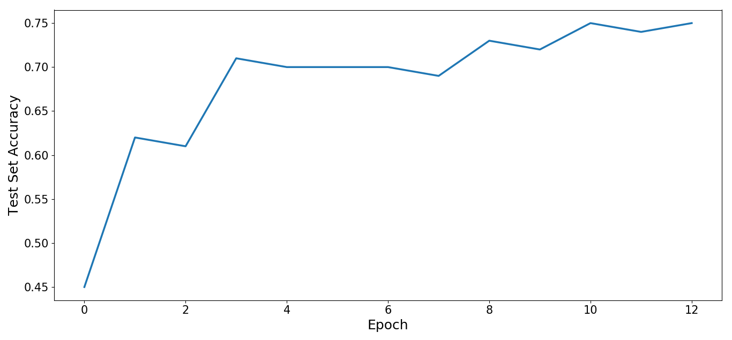
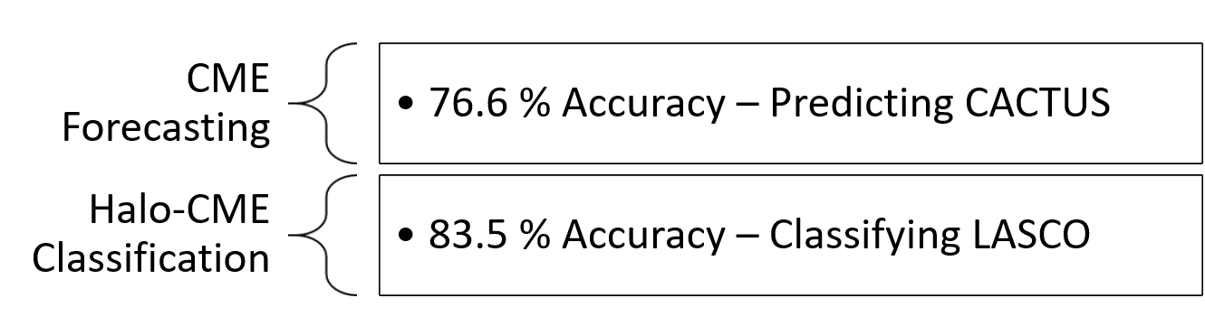
Result of CNN

Slide 34
1st Part
2nd Part
3rd Part
Data Enhancement
CNN implementation
Pre-processing Tool & History Maps

Slide 35
Pre-processing Tool – Motivation
Previous input
(+) Promising results.
(-) Expensive computationally and memory wise.
Using the pre-processing tool
(+) New input → less computational time & memory consumption.
(?) Better results.

Slide 36
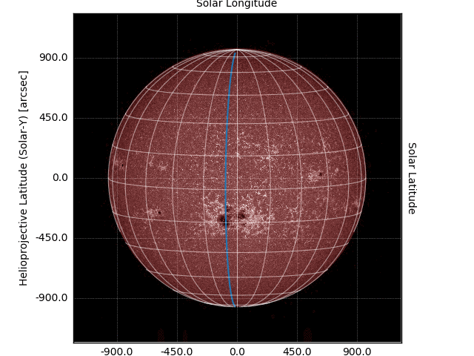
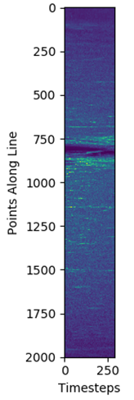
History Map (HM) – Single Line Example
HM
Same blue line, different representation
Notes:
Γεωγραφικό μήκος

Slide 37
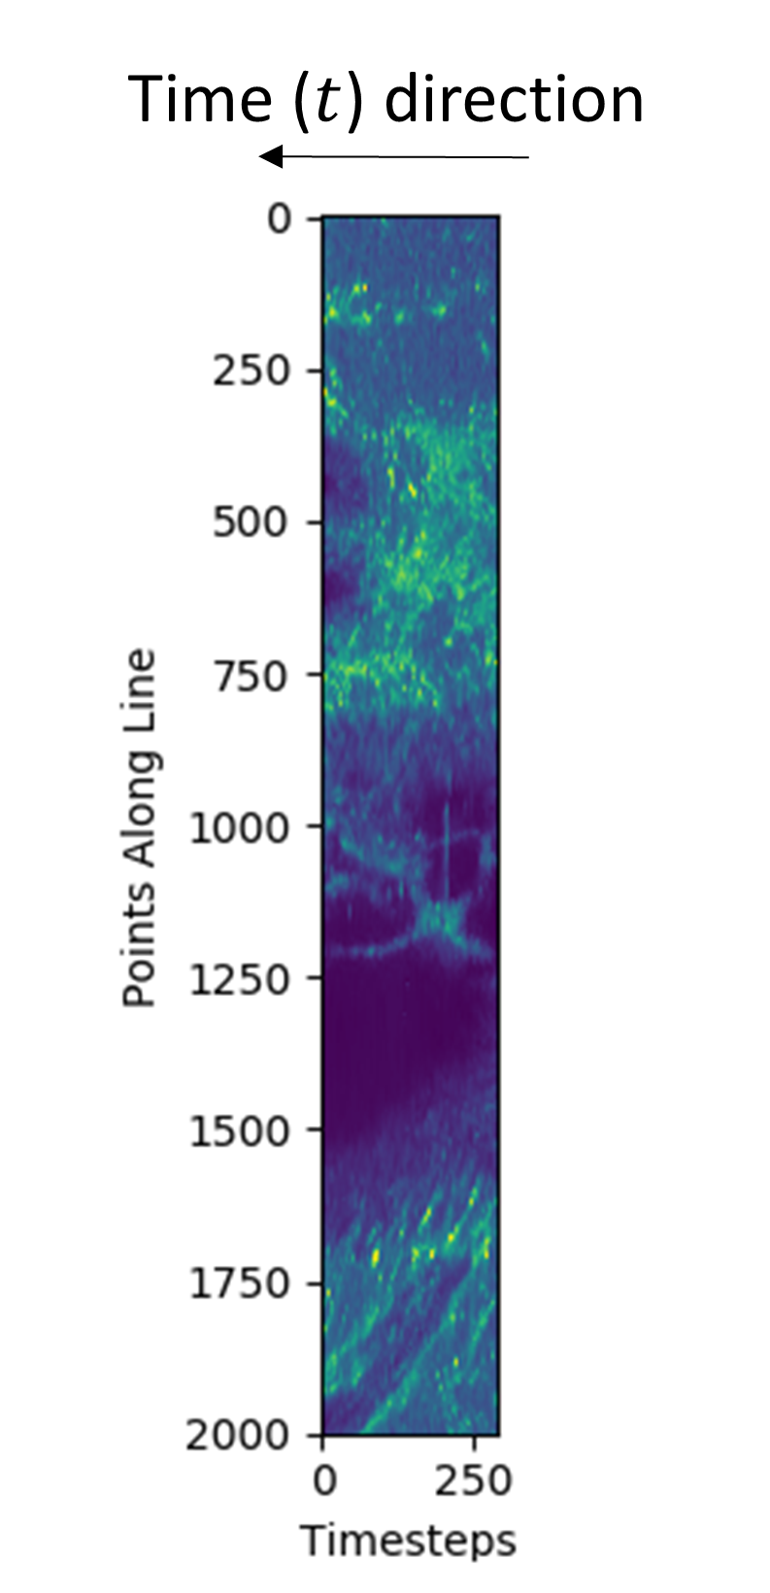
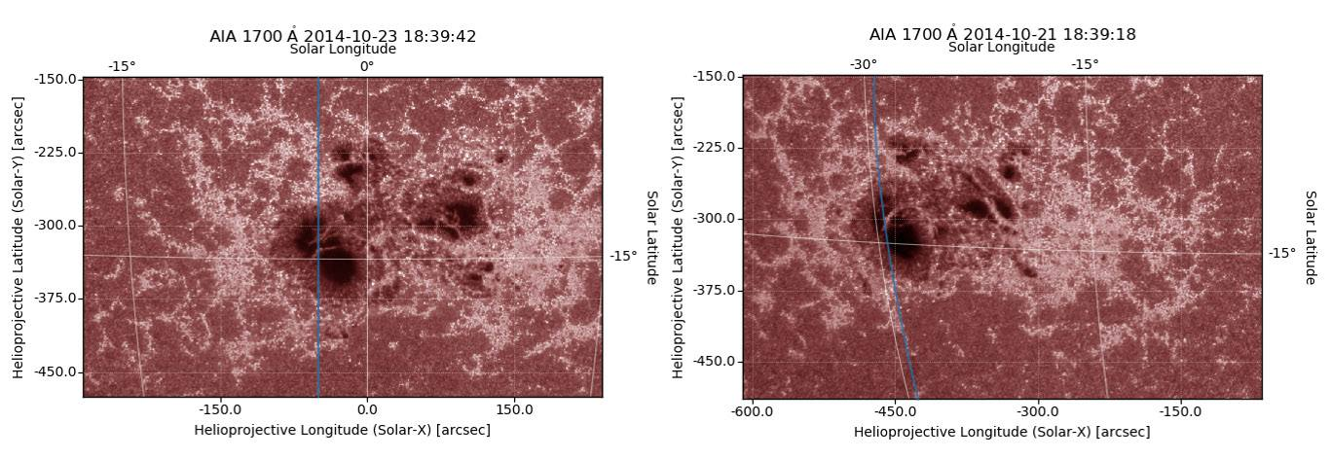
Pre-processing Tool – Sunspot

Slide 38
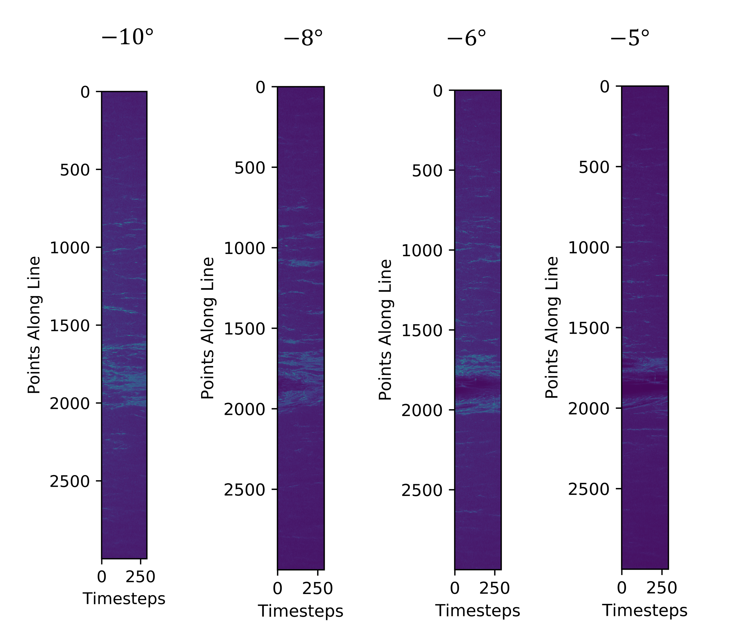
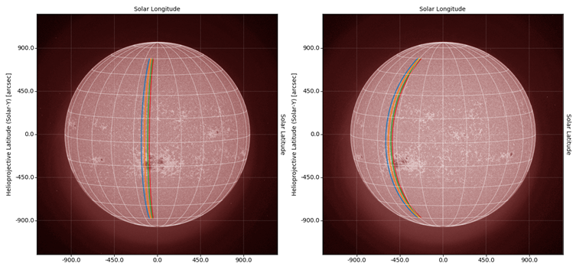
History Map – Multi Line Example

Slide 39
Why History Maps ?
Substantial decrease of data and computational time.
Structures are shown in a frame that is co-moving → time evolution is shown.
Possibly useful for forecasting other phenomena such as Solar flares or Sunspots (Adaptable time scale).

Slide 40
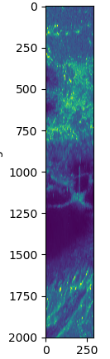

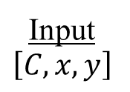

Possible Future Project (?)
Input
$$\left[C,x,y\right]$$
Convolution Neural Network
Feature Extraction
Dense Neural Network
Classification
Output
CME / No CME
History maps
Conv
Conv
Conv
Pool
Conv
Conv
Conv
CME
$$…$$
$$…$$
No CME

Slide 41
Conclusion

Slide 42
Summary
Enhanced, clean and processed SDO data and CACTUS/LASCO catalogs
Created multiple CNN models, with the best obtaining 76.6% prediction on CMEs and 83.5% classification between CME and halo-CME.
Created a pre-processing tool that derives “History Maps” (HM). Possibly useful in future Machine learning research and Solar data analysis.

Slide 43
Machine Learning & A.I. in Solar & Space
An active community, many PhD and Postdoc positions currently around Europe (Italy, Belgium) – AIDA Project (https://aida-space.blogspot.com/)
New specialized conferences (https://event.cwi.nl/ml-helio-2019/)
Machine Learning in Heliophysics
16 - 20 September 2019 – Amsterdam
New internship programs Nasa Frontier Lab (https://frontierdevelopmentlab.org/) for PhDs and Postdocs

Slide 44
Extras

Slide 45
Pre-processing Tool – Procedure & Output
Procedure
Download data
Track Sun’s differential rotation for every longitude line
Go to next date on Catalog
Repeat
Output
Database file (.sql)
Scientific images (.FITS)
History maps (.png)
NN input (.npy)
Animation (.gif)

Slide 46

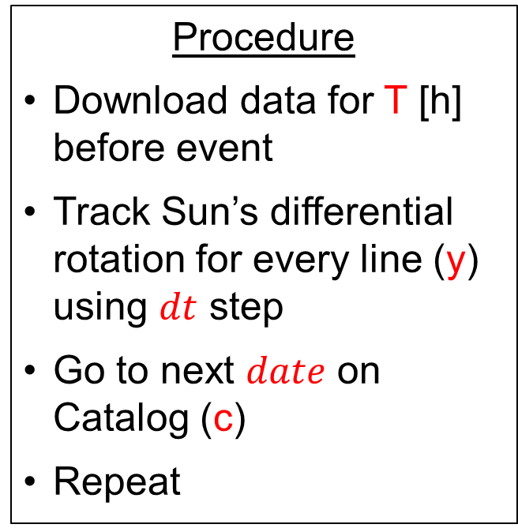
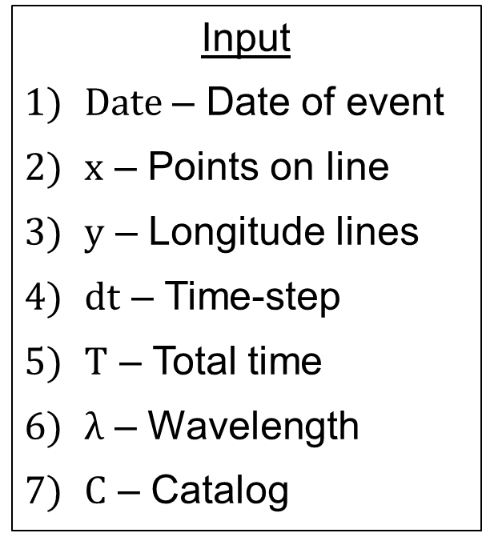
Pre-processing Tool – Design
Input
$Date$ – Date of event
$x$ – Points on line
$y$ – Longitude lines
$dt$ – Time-step
$T$ – Total time
$λ$ – Wavelength
$C$ – Catalog
Procedure
Download data for T [h] before event
Track Sun’s differential rotation for every line (y) using $dt$ step
Go to next $date$ on Catalog (c)
Repeat
Output
Database file (.sql)
Scientific images (.FITS)
History maps (.png)
NN input (.npy)
Animation (.gif)

Slide 47
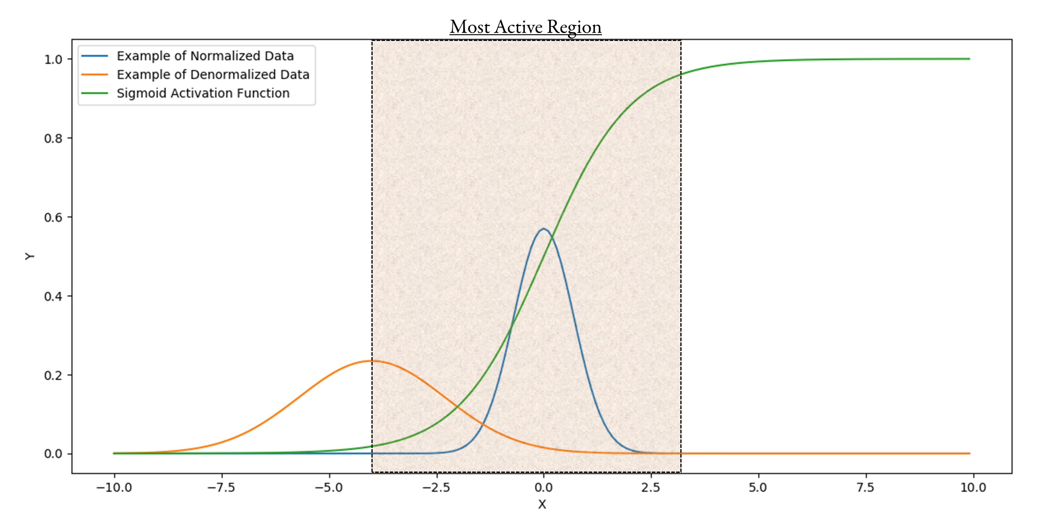
Why normalization is vital?

Slide 48
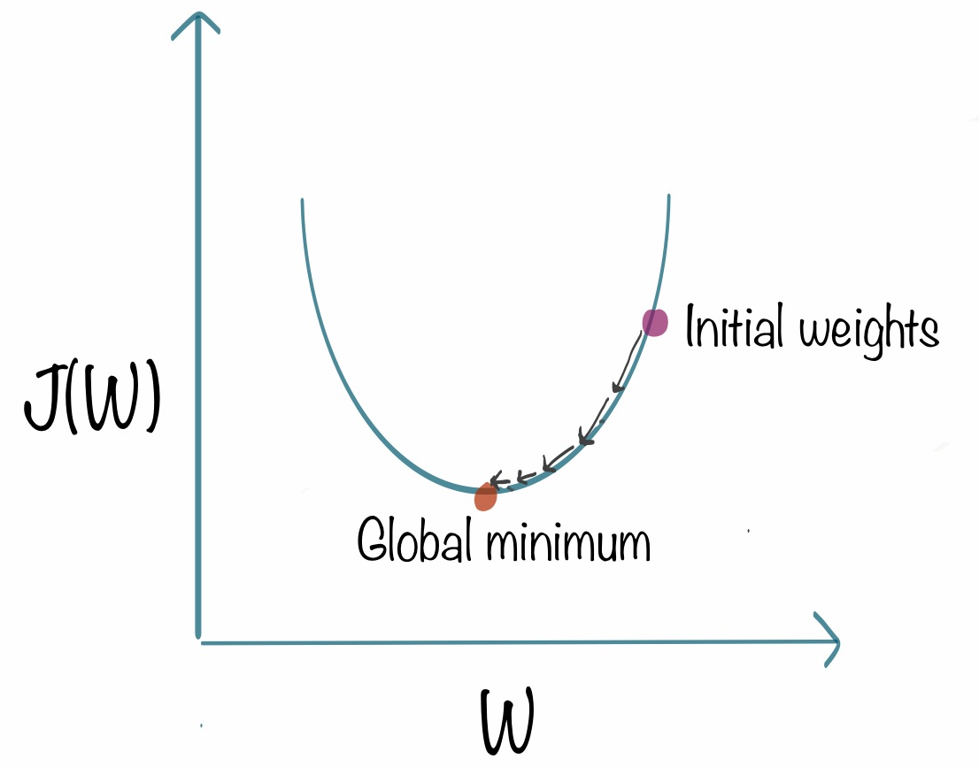
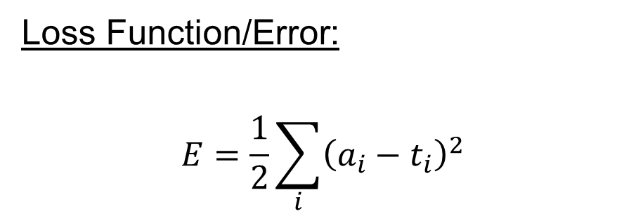
Gradient Descent - Training
Loss Function/Error:
$$E=\frac{1}{2}\sum_{i}{{\left(a_{i}−t_{i}\right)}^{2}}$$

Slide 49

Advanced Activation functions
Goal → Complexity
Non-linear activations (Hidden Layers)

Slide 50

Type of Machine Learning Problems

Slide 51



Differential Rotation Models
Allen Howard Snodgrass

