Slide 1

Classifying Magnetosheath Jets Using MMS:
Quasi – parallel &
Quasi – perpendicular Jets
Savvas Raptis, Tomas Karlsson &
Per-Arne Lindqvist
KTH - Department of Space and Plasma Physics
Vlasiator Hackathon
21/08/2019, Helsinki

Slide 2
Introduction

Slide 3
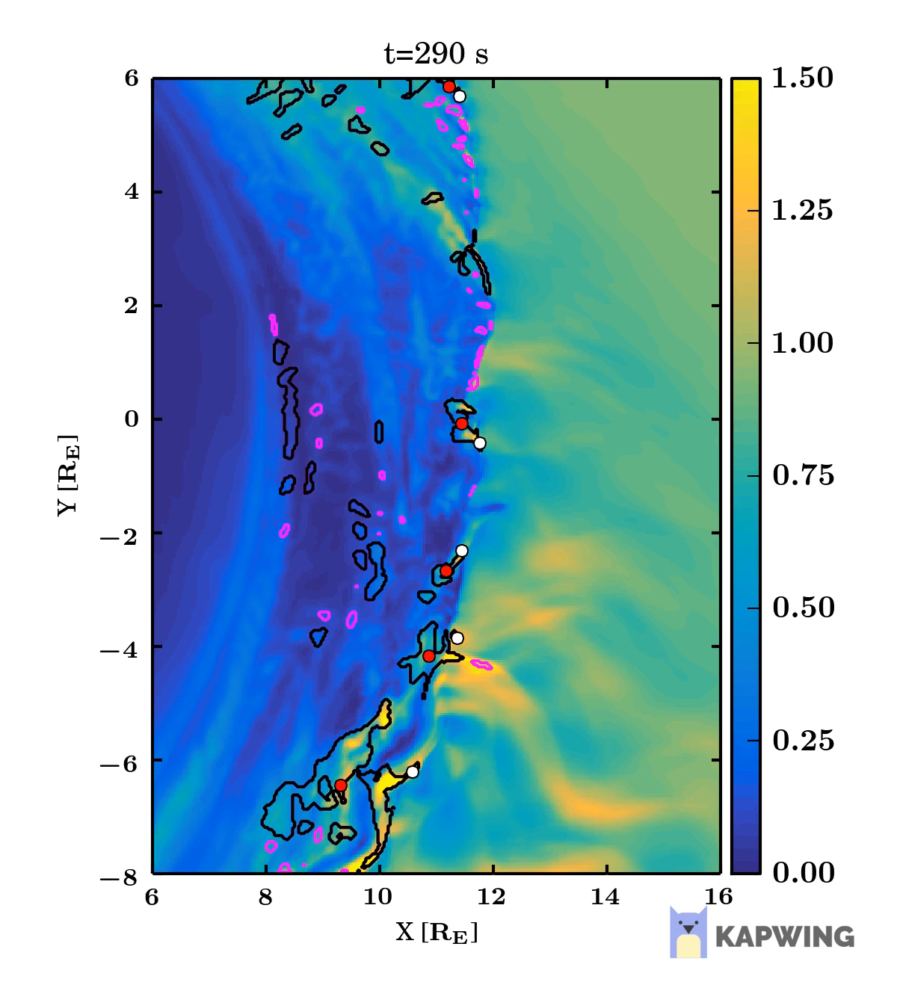
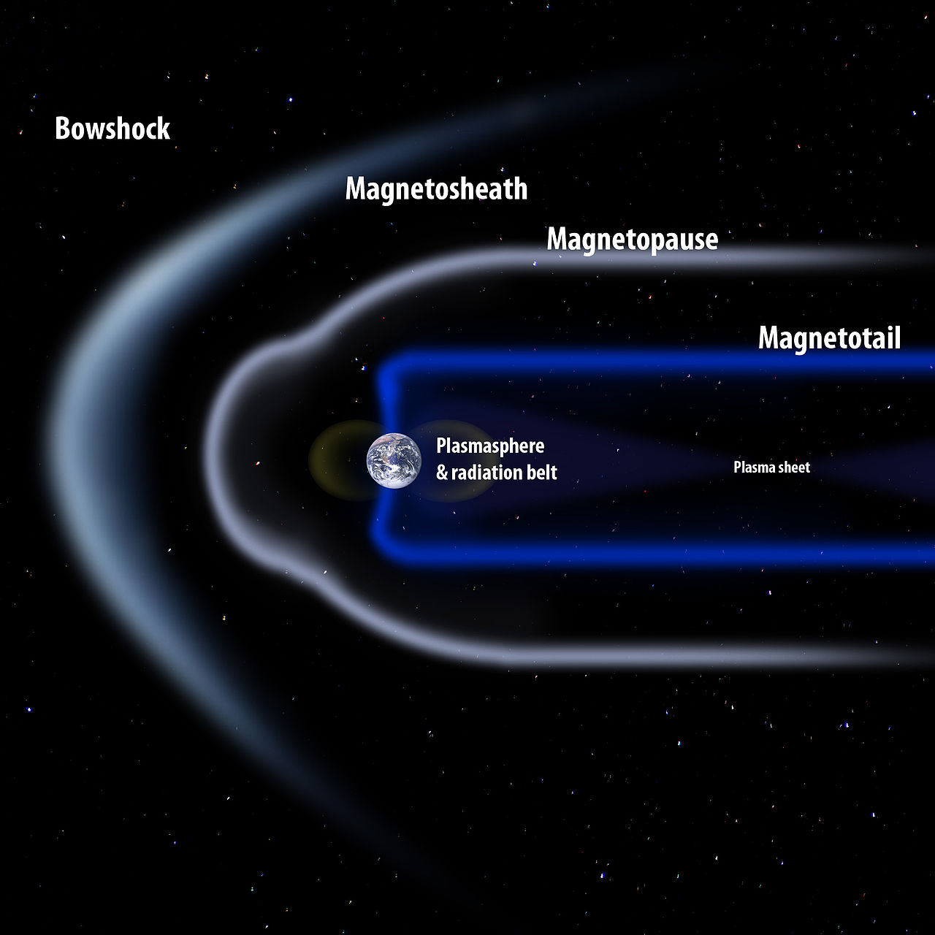
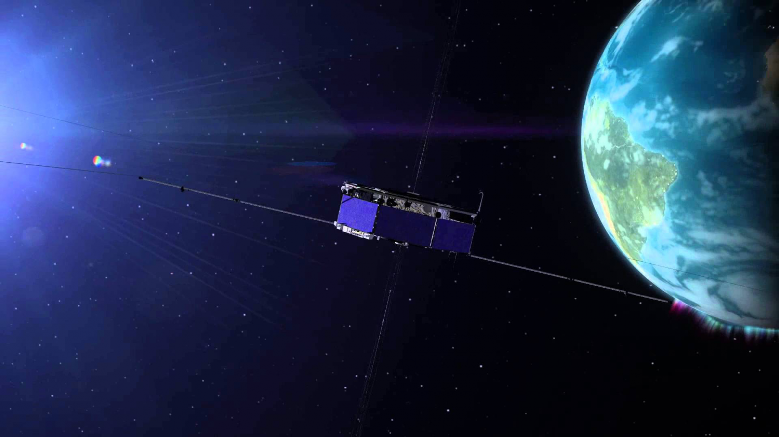
Magnetosheath Jets
What: Enhancements of dynamic pressure above the general fluctuations level
Where: Magnetosheath
Data: MMS (Magnetospheric Multiscale Mission)
Why: Interaction of SW & Magnetosphere, magnetopause reconnection, radiation belts, auroral features…
Palmroth Minna et al. (2018)

Slide 4
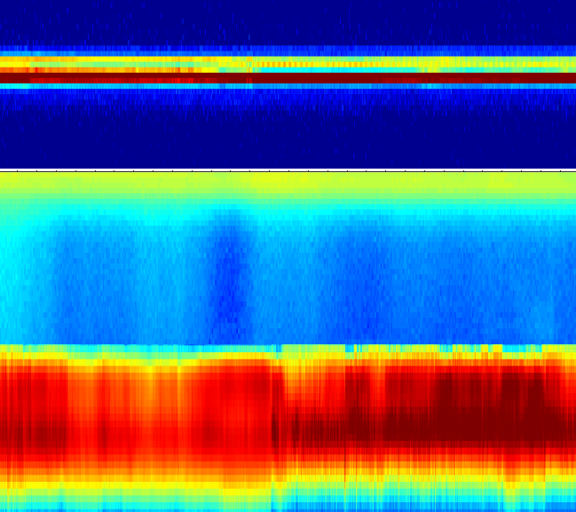
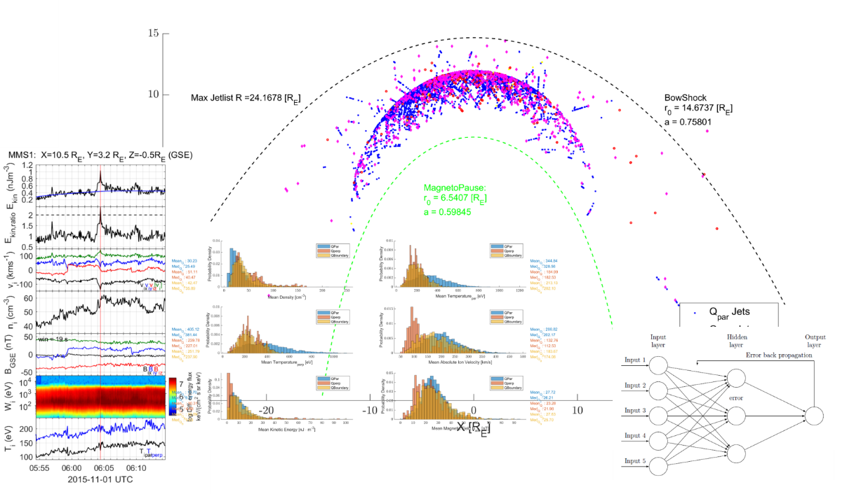
Searching for Jets
Loading MMS data
Classify regions (MS/SW/PSH)
Search for Magnetosheath Jets on MS
Save Area and Jet Values ($v,P_{dyn},ρ,P,Β,Ε, T,θ$...)
Save Area and Jet Values (v,𝑃_𝑑𝑦𝑛,𝜌,𝑃,Β,Ε, T,θ...)
Jet Classification
Statistics – Jet Comparison
Find patterns & Possible origin and generation mechanism
TBD …
SW
PSH
MS

Slide 5
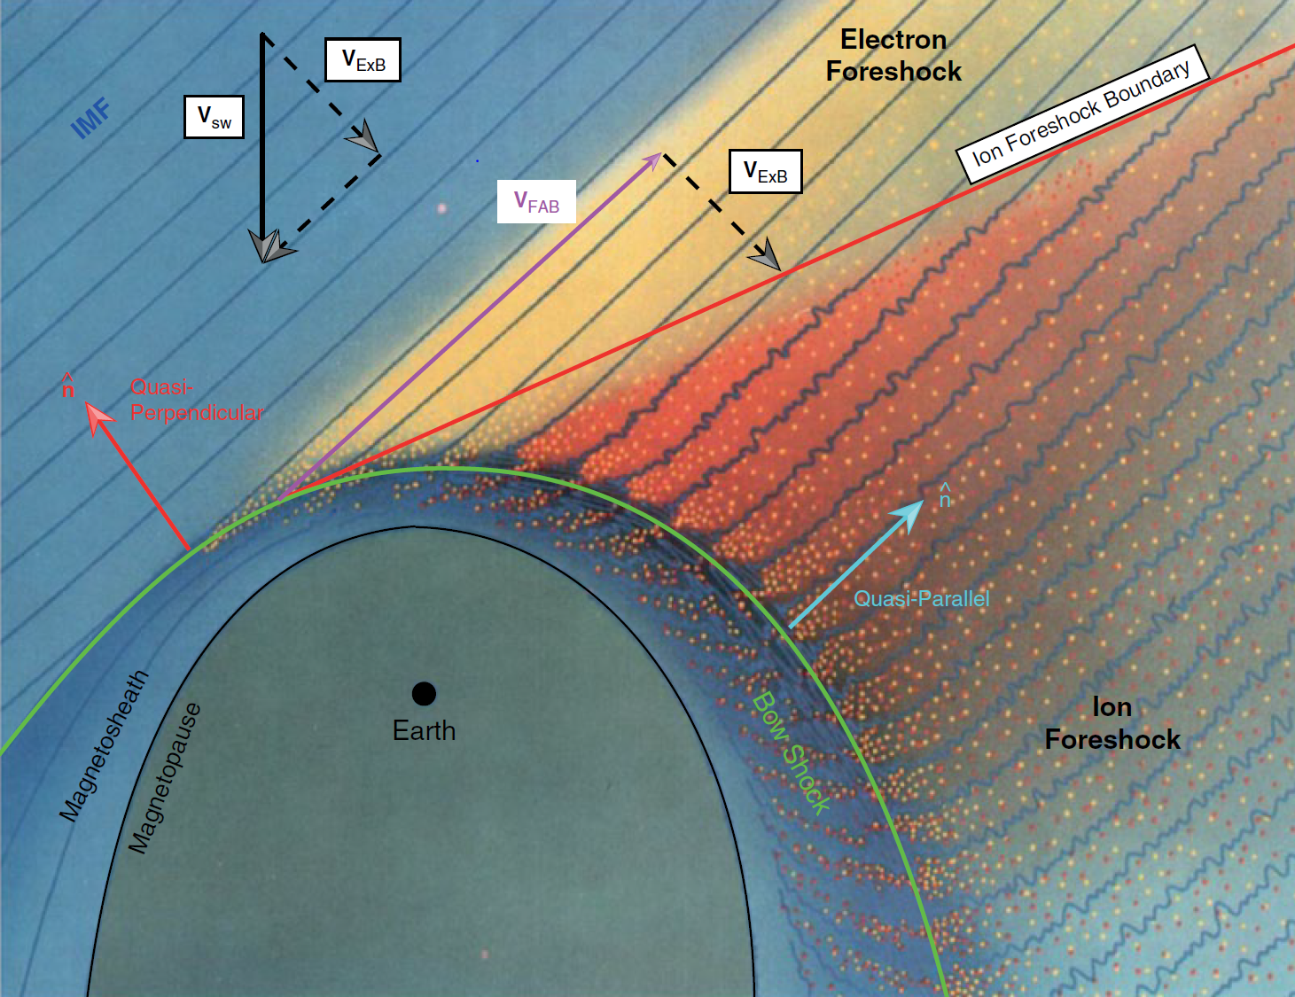
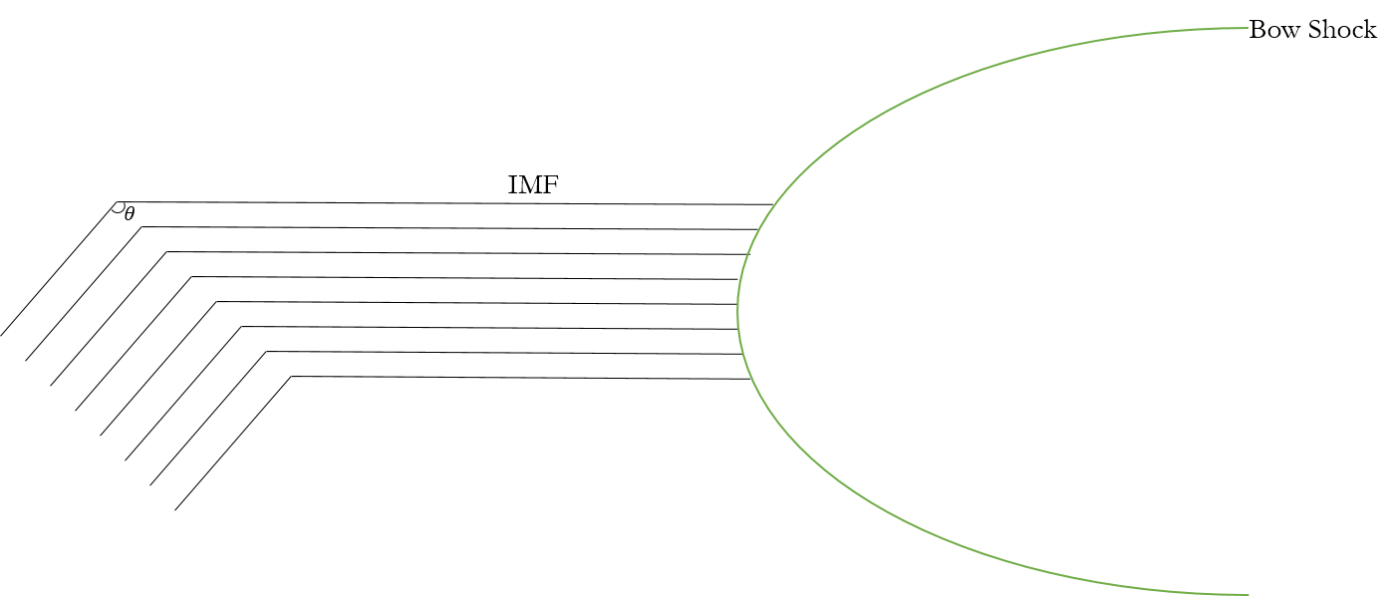
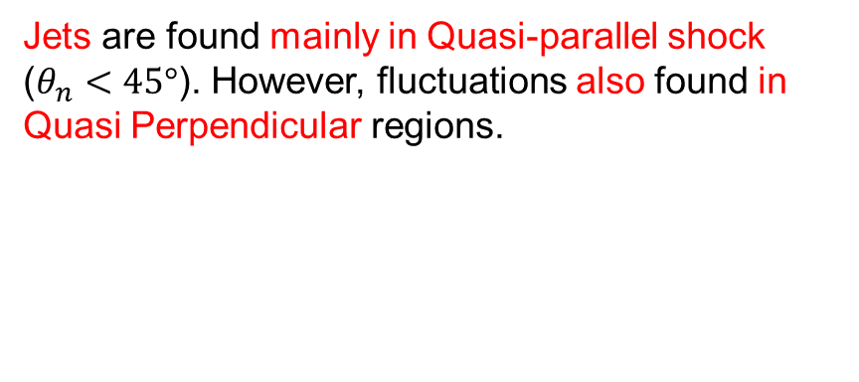

Motivation – Main Subcategories
Jets are found mainly in Quasi-parallel shock ($θ_{n}<45°$). However, fluctuations also found in Quasi Perpendicular regions.
$$Q_{par}$$ | $$Q_{per}$$ | $$Boundary$$
L. B. Wilson (2016)

Slide 6
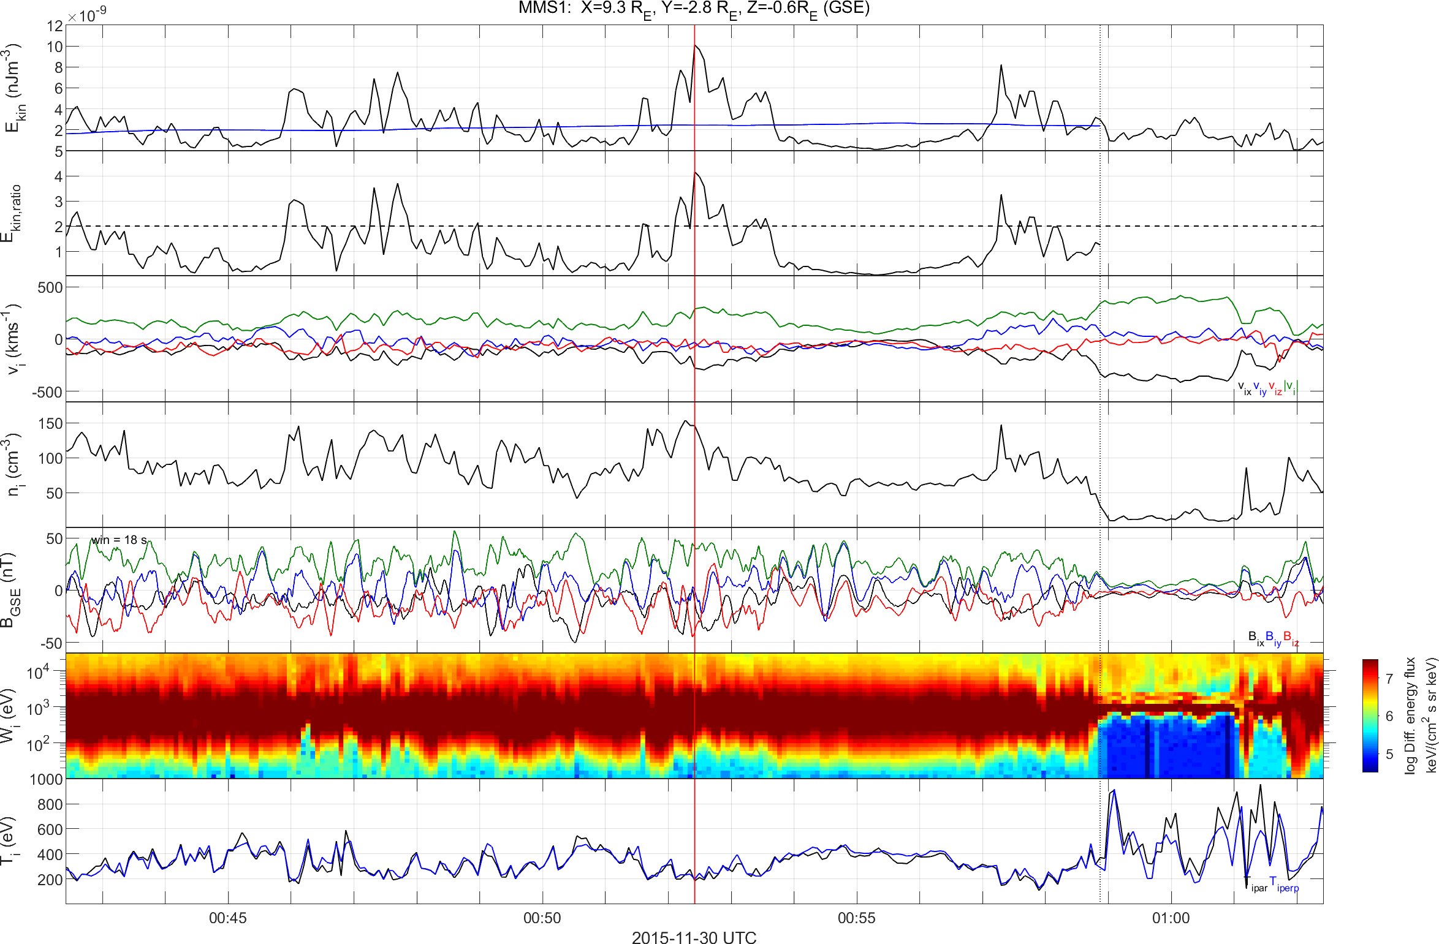
How Jet look like – Quasi Parallel
High $B$ Variance, High Energetic Particles, Low Anisotropy
Kinetic Energy Density
Kinetic Energy Density Ratio
Velocity
Density
Magnetic Field
Ion Energy Spectrum
Temperature

Slide 7
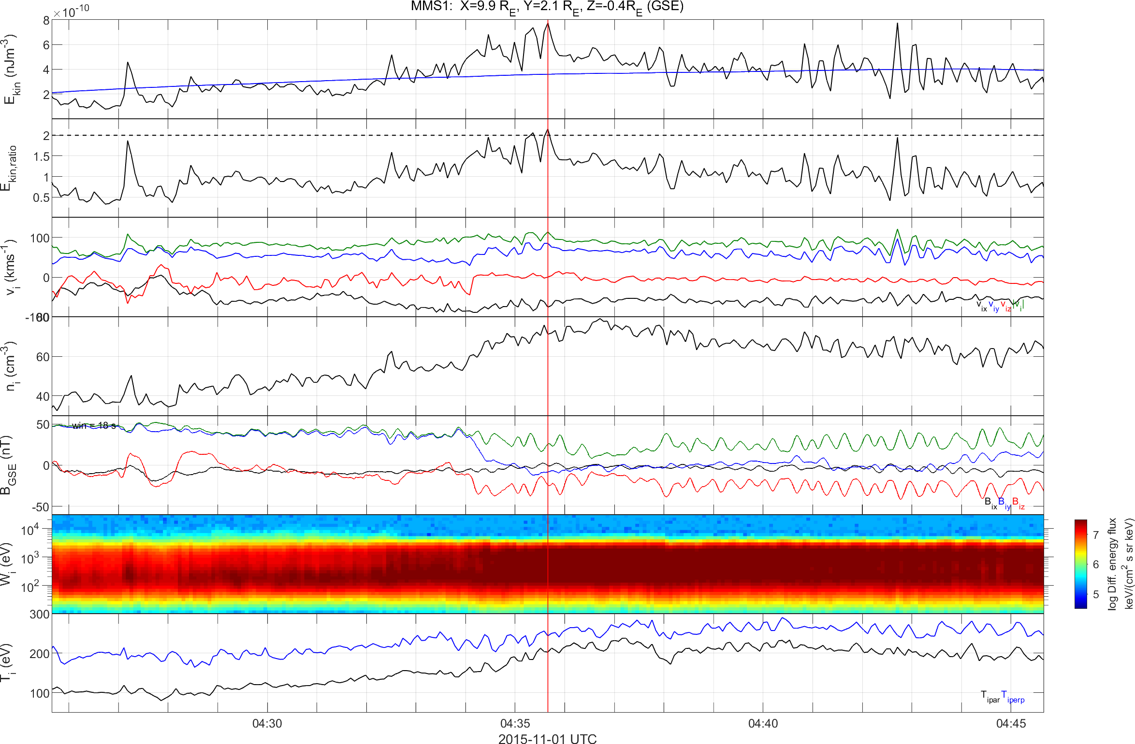
How Jet look like – Quasi Perpendicular
Low $B$ Variance, Low Energetic Particles, High Anisotropy
Kinetic Energy Density
Kinetic Energy Density Ratio
Velocity
Density
Magnetic Field
Ion Energy Spectrum
Temperature

Slide 8
See the differences?
High Variance, High Energetic Particles, Low Anisotropy
Low Variance, No Energetic Particles, High Anisotropy
Quasi – Parallel Jet
Quasi – Perpendicular

Slide 9
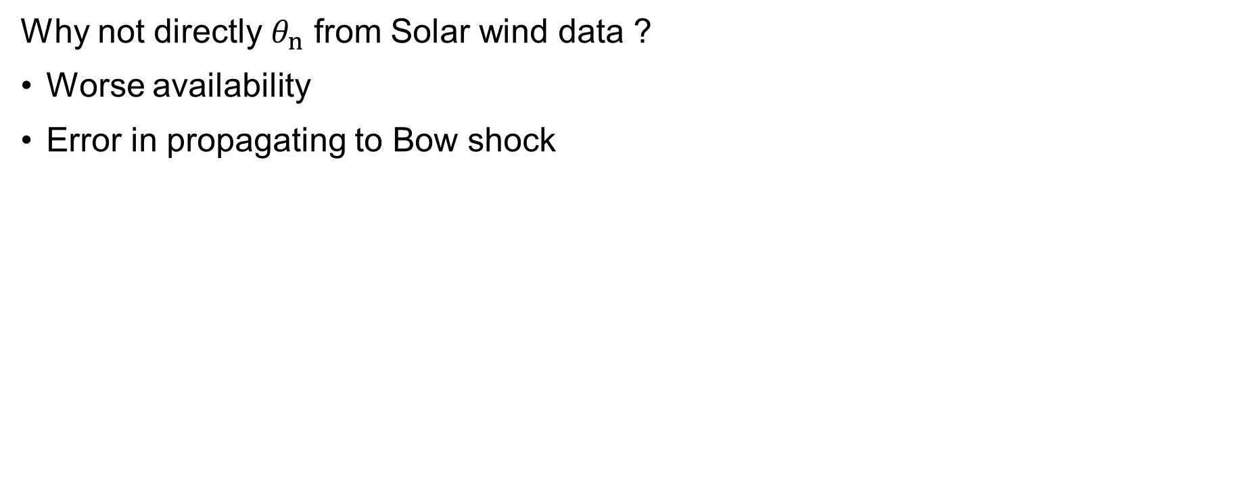

Angle & Bow shock configuration
Why not directly $θ_{n}$ from Solar wind data ?
Worse availability
Error in propagating to Bow shock
Bow Shock
Magnetopause
$$ACE$$
ΗRO Data (1 min average)
Jets
MMS

Slide 10
Angle & Bow shock Verification

Slide 11
Angle & Bow shock Verification
Q-par region
Q-perp region

Slide 12
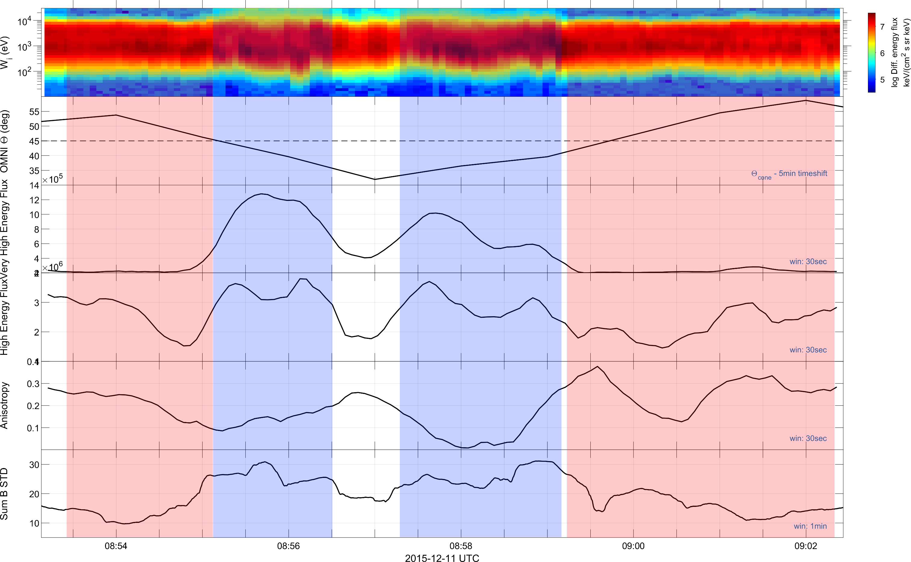

More Verification
Ion Spectrum (1:32)
Cone Angle (SW)
Very High Flux (30:32)
High Flux (27:29)
Temperature Anisotropy
$$\sum_{i}{σ\left(B_{i}\right)}$$

Slide 13
Main Categories
Qpar Jet
Qperp Jet
Boundary Jet
Encapsulated Jet

Slide 14
Results

Slide 15

Classification in progress!
Ion Spectrum (1:32)
High Flux (27:29)
Very High Flux (30:32)
$$\sum_{i}{σ\left(B_{i}\right)}$$
Temperature Anisotropy

Slide 16
Classification in progress!
Ion Spectrum (1:32)
High Flux (27:29)
Very High Flux (30:32)
$$\sum_{i}{σ\left(B_{i}\right)}$$
Temperature Anisotropy

Slide 17


Classification in progress!
Ion Spectrum (1:32)
High Flux (27:29)
Very High Flux (30:32)
Level I
$$\sum_{i}{σ\left(B_{i}\right)}$$
Temperature Anisotropy
Level II

Slide 18
Where are they?

Slide 19
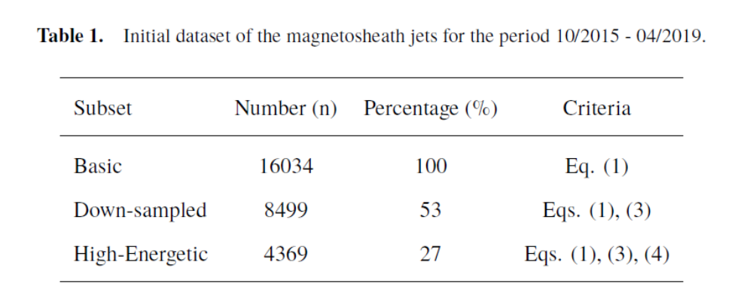

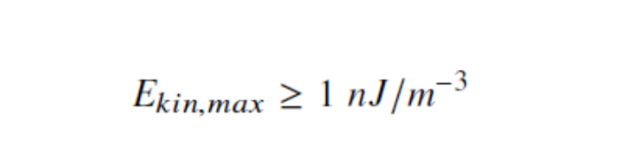


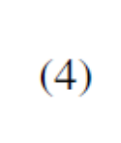

Jets criteria & database

Slide 20
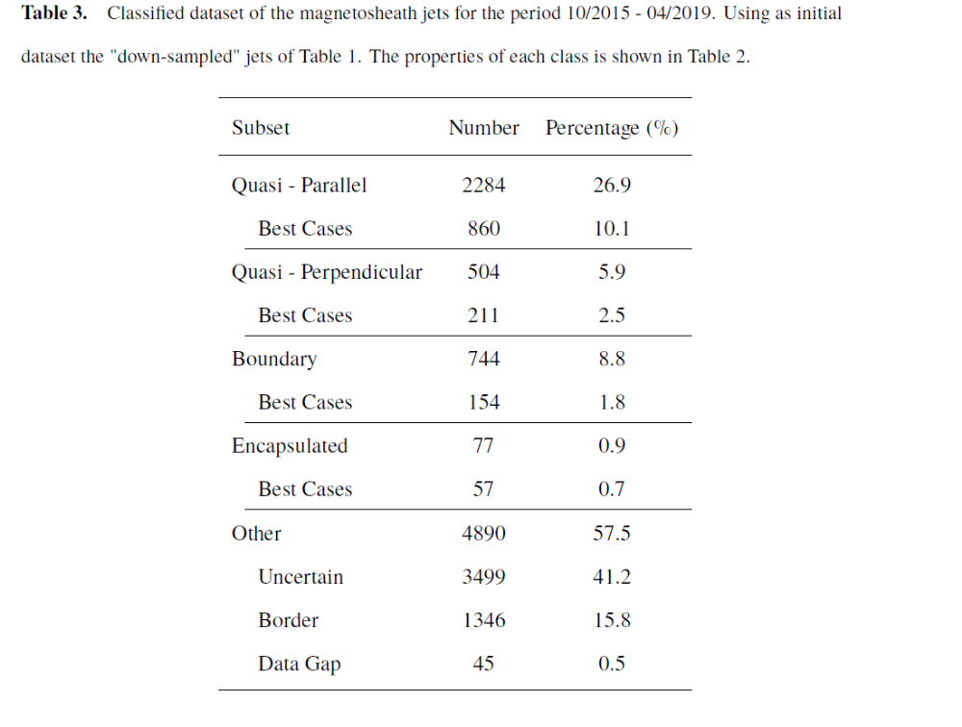
Database Jet - Classified

Slide 28
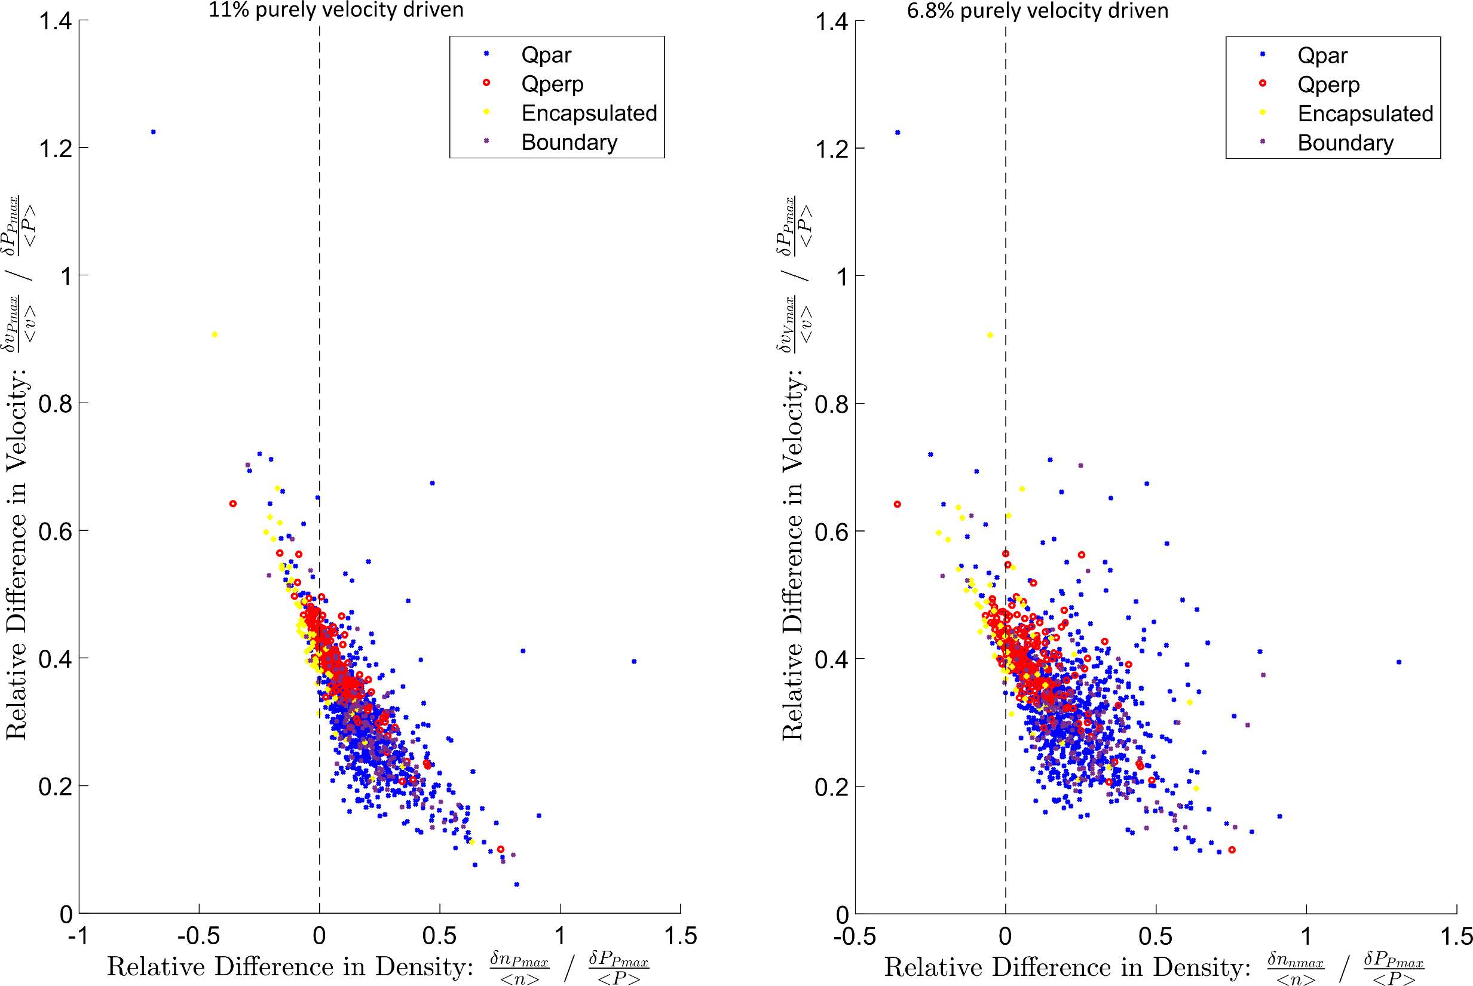

Slide 29

BS ripples (?)
SLAMS (?)
$$Δx=x_{Jet} − {\left\langle x\right\rangle }_{±5 min}$$

Slide 30
Conclusion
Summary
Obtained a vast database of Magnetosheath Jets (~10.000) using all available MMS data.
Successfully classified jets into several different categories showing different attributes.
Analyzed their characteristics and found interesting similarities & differences compared to earlier results.
Possible connections to other associated mechanisms such as SLAMS & Bow shock ripples.

Slide 31
Extras

Slide 34
“Extra” Categories
Border Jets
Unclassified Jets

Slide 35
Multistage Classification – Simplified Scheme
Stages
Pre-jet-post
Categories
Quasi – Par.
Quasi – Perp.
Boundary
Encapsulated
Unknown
Quality Check
Criteria Number
Level I – III

Slide 36
Multistage Classification – Simplified Scheme
Stages
Pre-jet-post
(2) Adjust times & Values
(a) Jet Period
(b) Pre/post Period
Categories
Quasi – Par.
Quasi – Perp.
Boundary
Encapsulated
Unknown
Quality Check
Criteria Number
Level I – III
Tries Required
1 – 5 / stage

Slide 37
Multistage Classification – Simplified Scheme
Stages
Pre-jet-post
(2) Adjust times & Values
(a) Jet Period
(b) Pre/post Period
Categories
Quasi – Par.
Quasi – Perp.
Boundary
Encapsulated
Unknown
Quality Check
Criteria Number
Level I – III
Tries Required
1 – 5 / stage

Slide 38
Multistage Classification – Simplified Scheme
Stages
Pre-jet-post
(2) Adjust times & Values
(a) Jet Period
(b) Pre/post Period
(3) Normalizing
Categories
Quasi – Par.
Quasi – Perp.
Boundary
Encapsulated
Unknown
Quality Check
Criteria Number
Level I – III
Tries Required
1 – 5 / stage

Slide 39
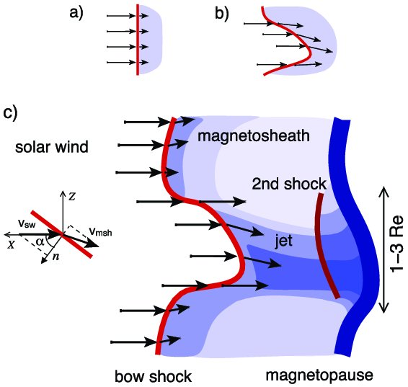
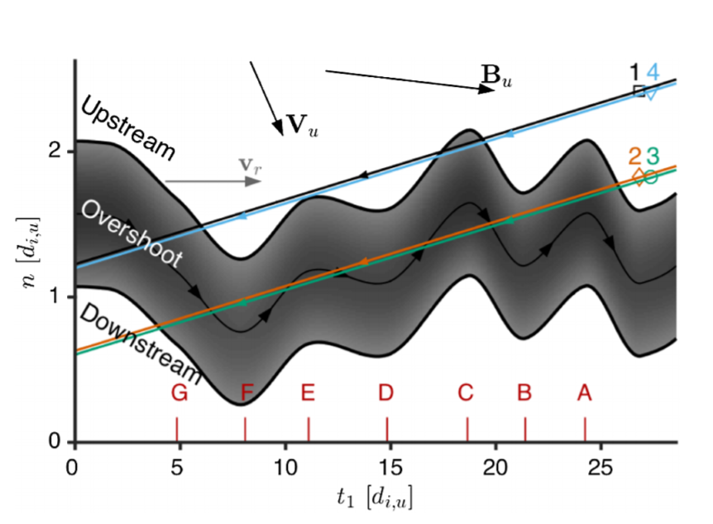
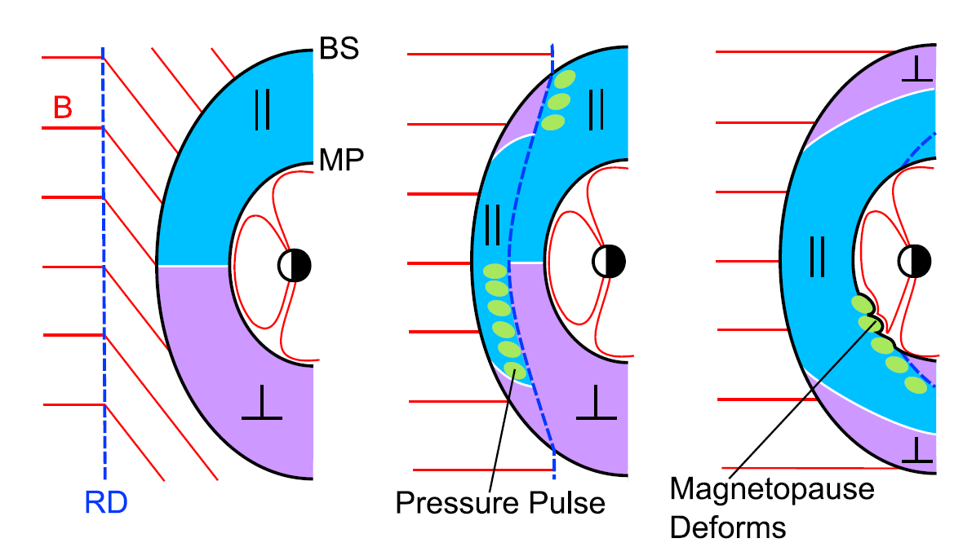
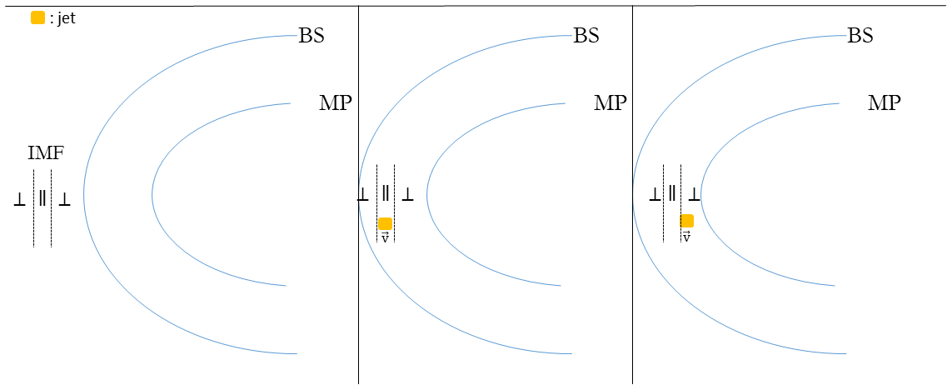
Mechanisms ideas for each jets
Quasi – Parallel
Quasi – Perpendicular
Hietala et al. (2012)
Johlander et al. (2016)
Boundary
Encapsulated
Archer et al. (2012)

