Slide 1

Magnetosheath Jets: Simulations, Data Analysis & Machine Learning
Savvas Raptis
Space and Plasma Physics, School of Electrical Engineering and Computer Science, KTH Royal Institute of Technology, Sweden
Collaboration with: Tomas Karlsson, Minna Palmroth, Ferdinand Plaschke, Sigiava Aminalragia-Giamini, Anita Kullen, Per-arne Lindqvist et al.
Athens, 29/01/2020

Slide 2
Introduction

Slide 3
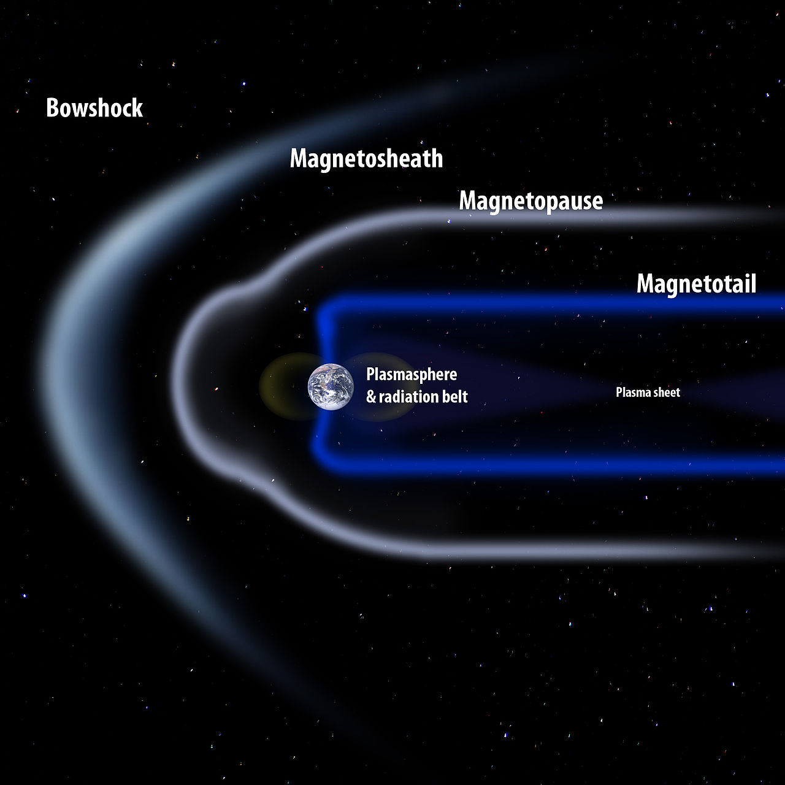
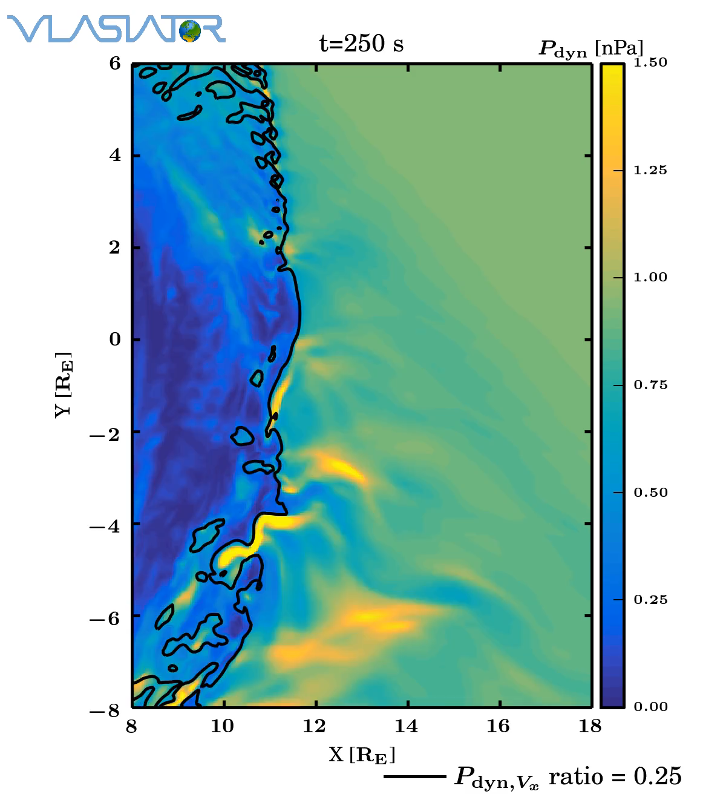
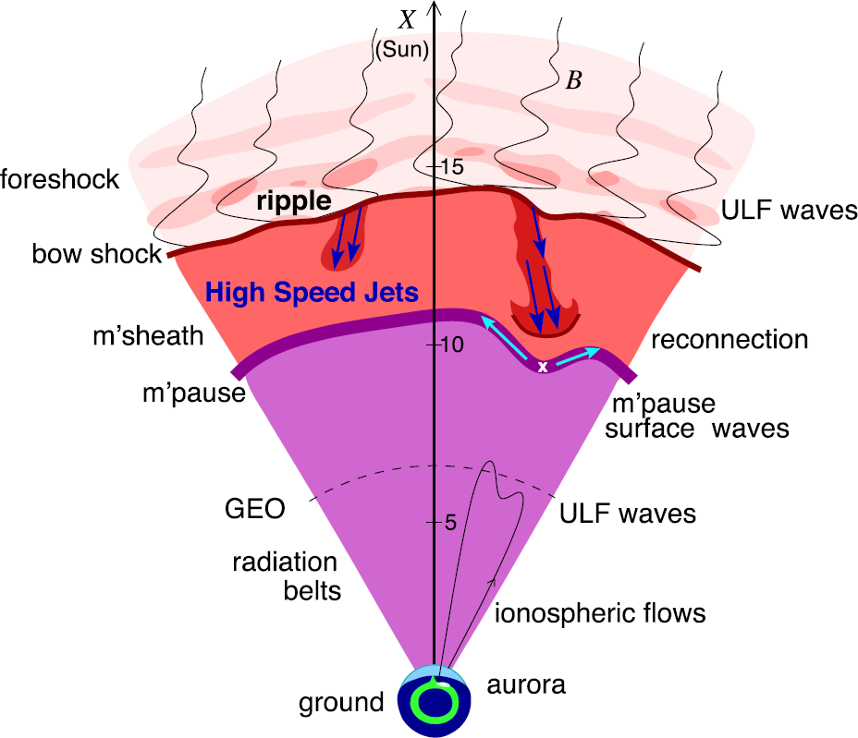
Magnetosheath Jets
Where: Magnetosheath
What: Enhancements of dynamic pressure above the general fluctuation level
Why: Interaction of SW & Magnetosphere, magnetopause reconnection, radiation belts, auroral features…
Palmroth Minna et al. (2018)
Plaschke F. et al. (2018)

Slide 4
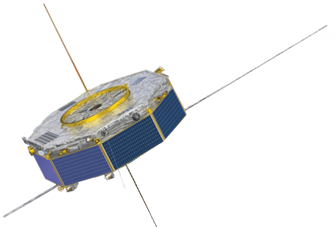
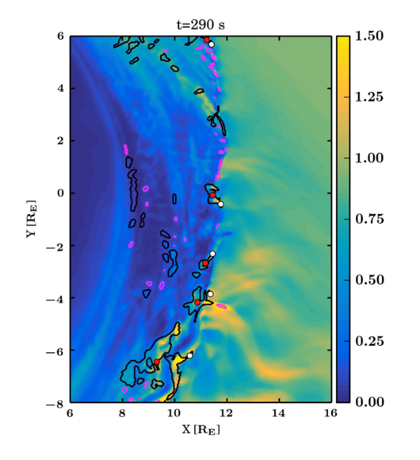
Overview
Data vs Simulations | Classification (Data Analysis) | Classification (Machine Learning)
Question: How well can we model magnetosheath jets? Can we verify simulations and then generalize from their result? | Question: Can Jets happen in Quasi-perpendicular bow shocks? What are the different type of jets? Do they have different properties? Different generation mechanism? | Question: Can we verify somehow our previous classification? Can Machine learning outperform physical modeling? What is the solar wind doing when jets are happening?
VS

Slide 5
Overview
Data vs Simulations | Classification (Data Analysis) | Classification (Machine Learning)
Question: How well can we model magnetosheath jets? Can we verify simulations and then generalize from their result? | Question: Can Jets happen in Quasi-perpendicular bow shocks? What are the different type of jets? Do they have different properties? Different generation mechanism? | Question: Can we verify somehow our previous classification? Can Machine learning outperform physical modeling? What is the solar wind doing when jets are happening?

Slide 6
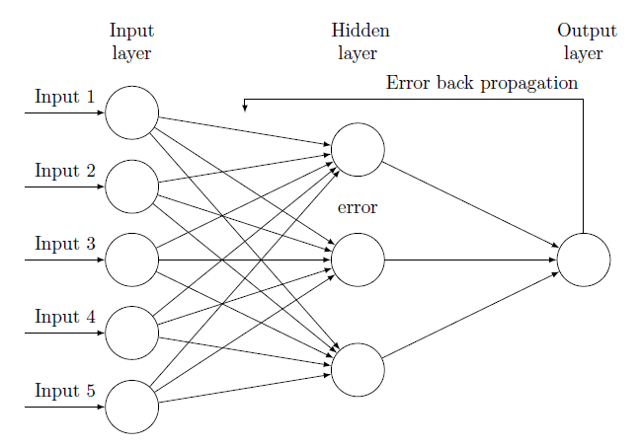
Overview
Data vs Simulations | Classification (Data Analysis) | Classification (Machine Learning)
Question: How well can we model magnetosheath jets? Can we verify simulations and then generalize from their result? | Question: Can Jets happen in Quasi-perpendicular bow shocks? What are the different type of jets? Do they have different properties? Different generation mechanism? | Question: Can we verify somehow our previous classification? Can Machine learning outperform physical modeling? What is the solar wind doing when jets are happening?

Slide 7
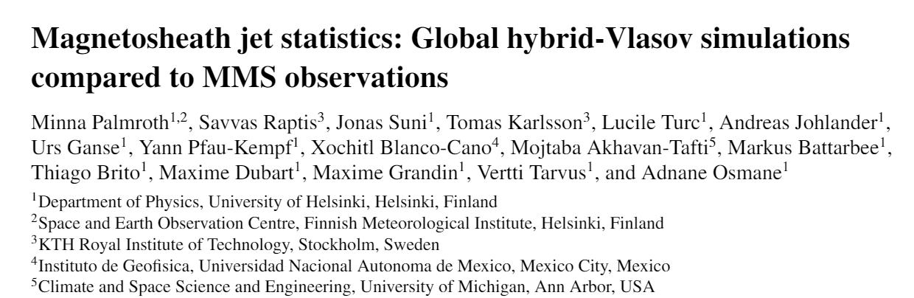
Part 1:
Simulations
VS
Measurements
Ongoing (Q1 2020)

Slide 8


Jets with Measurements – MMS
$$p_{dyn}=m_{p}n_{i}V_{i}^{2}$$
MMS
Database 2015 – 2018 (8499)
Data gaps (- 45)
Unstable SW conditions (- 2357)
Total:
6142
$$p_{dyn}>2{\left\langle p_{dyn}\right\rangle }_{10}$$
Dynamic Pressure
Dynamic Pressure Ratio
Velocity
Density
Magnetic Field
Ion Energy
Spectrum
Temperature
Notes:
$$\max\left(SD\left(Θ_{IMF}\right)\right)<45$$
Particle distribution functions that are not at thermal equilibrium and depart from Maxwellians are frequently observed in space and astrophysical collisionless plasmas.

Slide 9
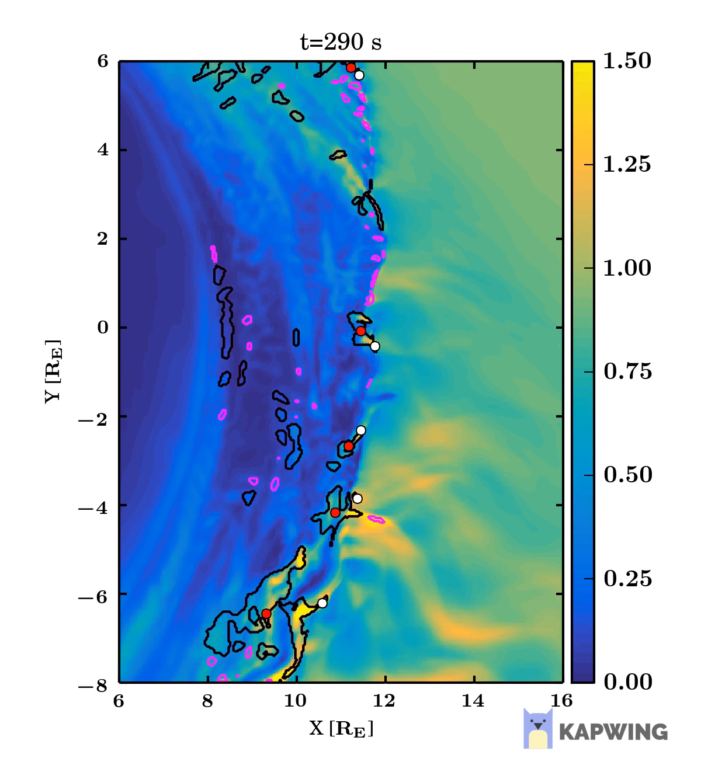
Jets with Simulations – Vlasiator
Vlasiator
Global hybrid-Vlasov
Protons = Distribution functions
Electrons = Massless fluid
2D3V simulations (Although 3D possible)
Number of Jets: 273
Notes:
The protons are propagated using the Vlasov equation,
and the velocity space is coupled to real space, where electromagnetic fields are
solved using Maxwell’s equations and complemented by the Ohm’s law including the Hall term.
227 km resolution and 30 km/s in velocity
5 R_E magnetosheath, 10 R_E whole thing

Slide 10
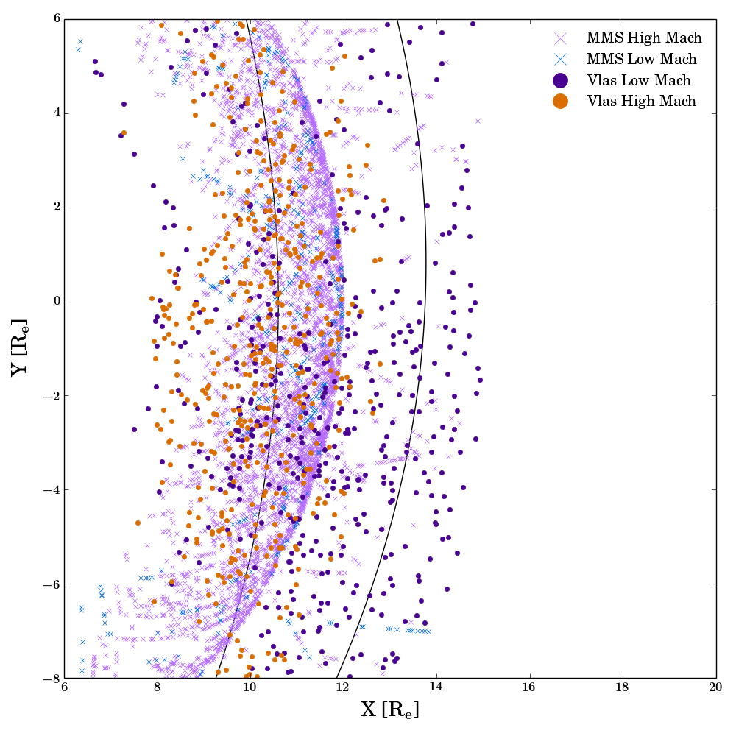
Magnetosheath Jets – Full Dataset

Slide 11
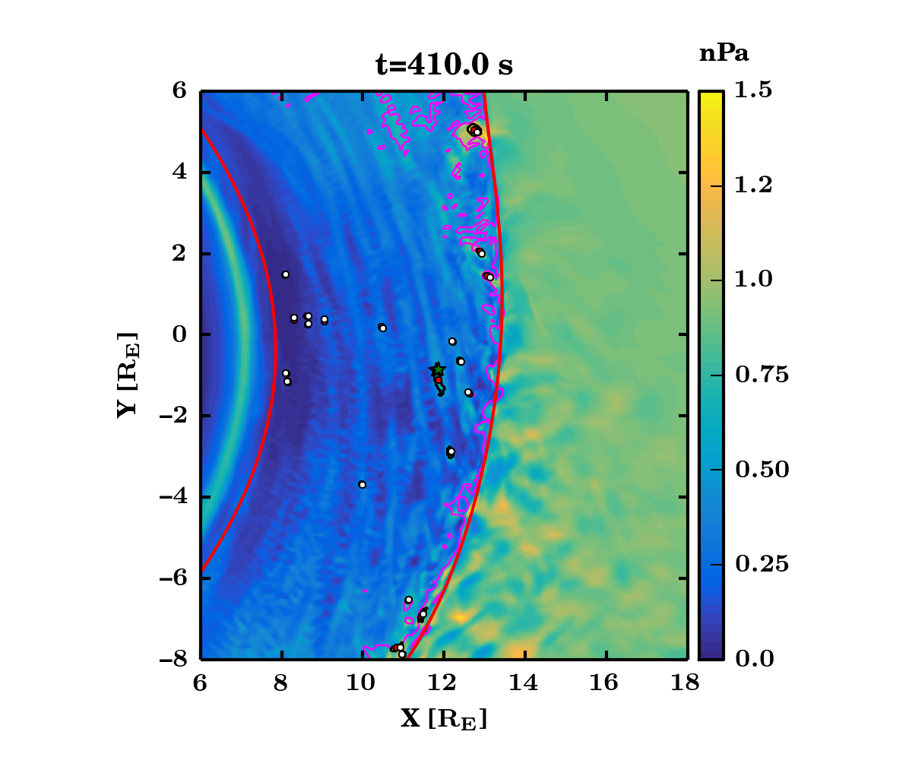
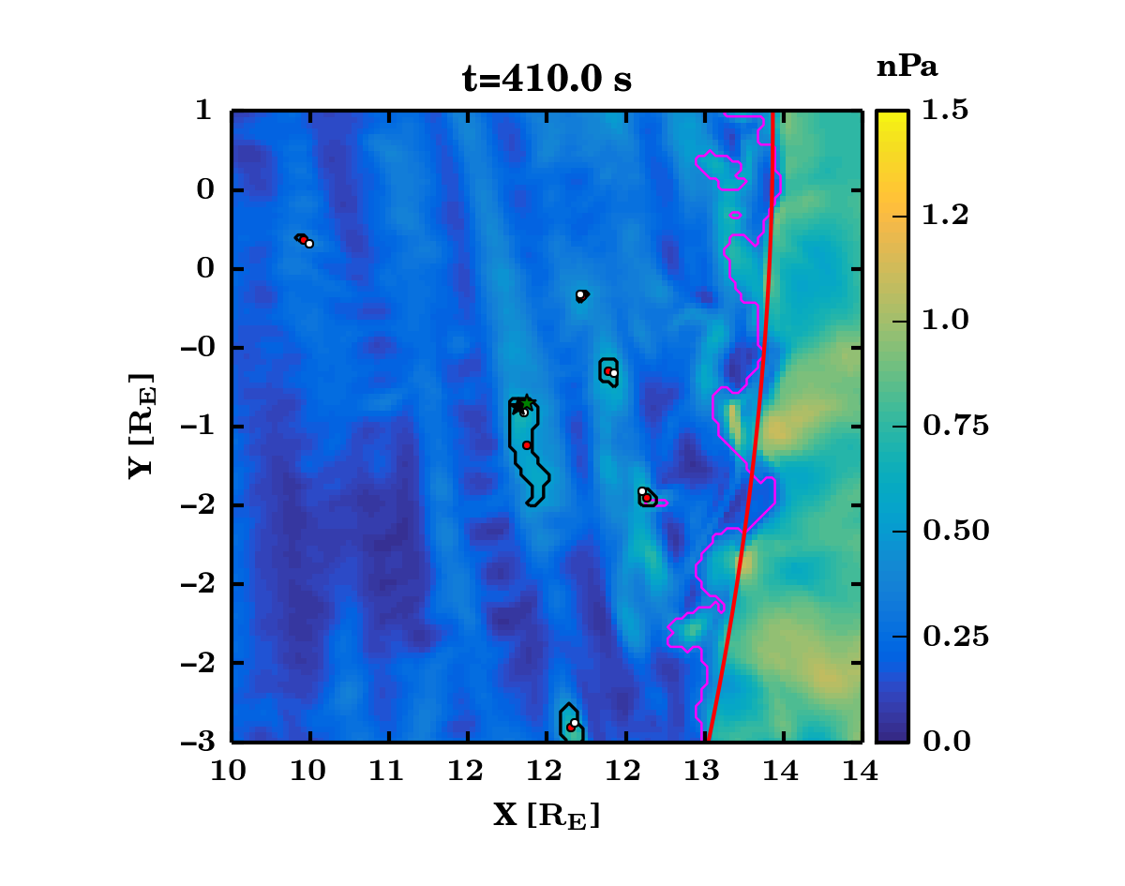
Main Results – Case Comparison
Notes:
The white dots indicate the locations of the
largest velocity within the jet. Figure

Slide 12
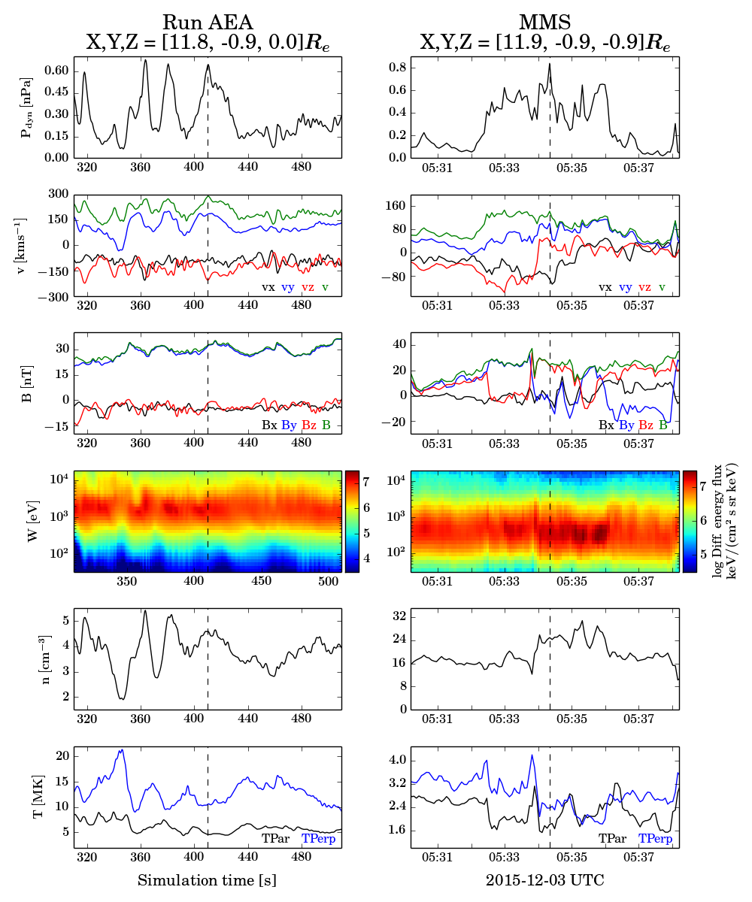
Main Results – Case Comparison
Dynamic Pressure
Velocity
Magnetic Field
Ion Energy Spectrum
Density
Temperature

Slide 13
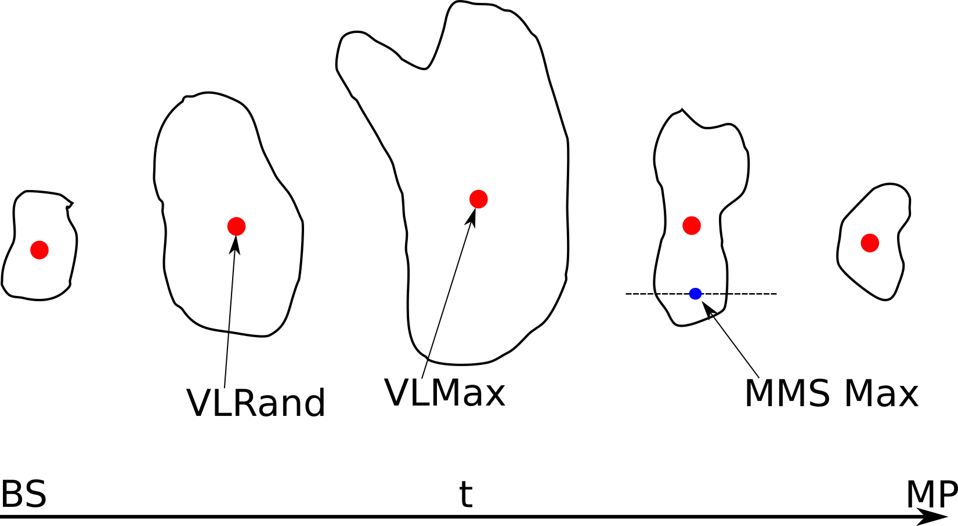
Main Difference between MMS & Vlasiator
Notes:
Another difference = Solar Wind Conditions
Constant in time conditions in Vlasiator, not happening in real life.
Also extremely hot temperature (because Vlasiator initialized like that their simulation)

Slide 14
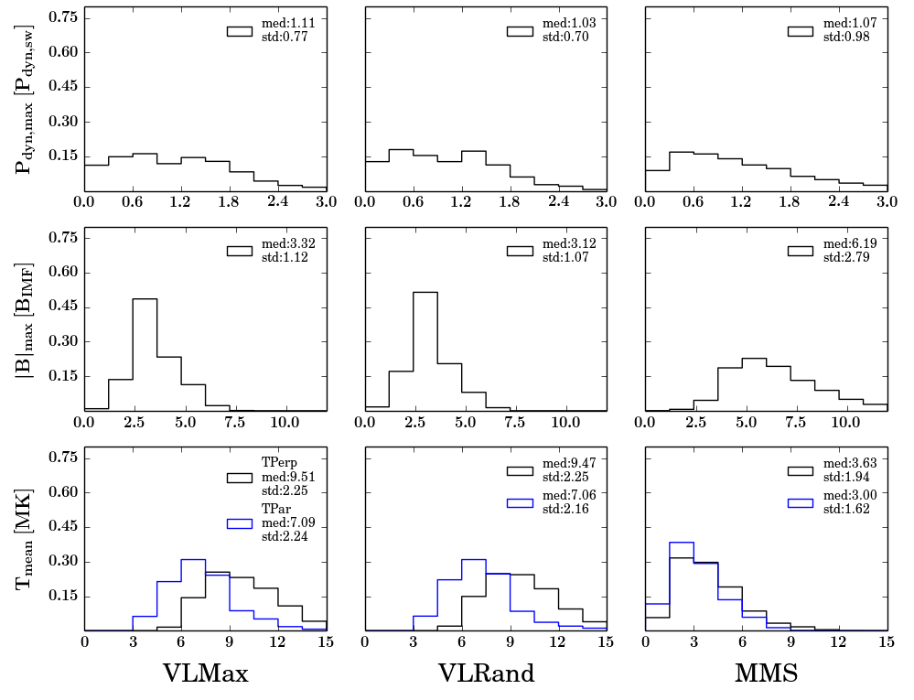
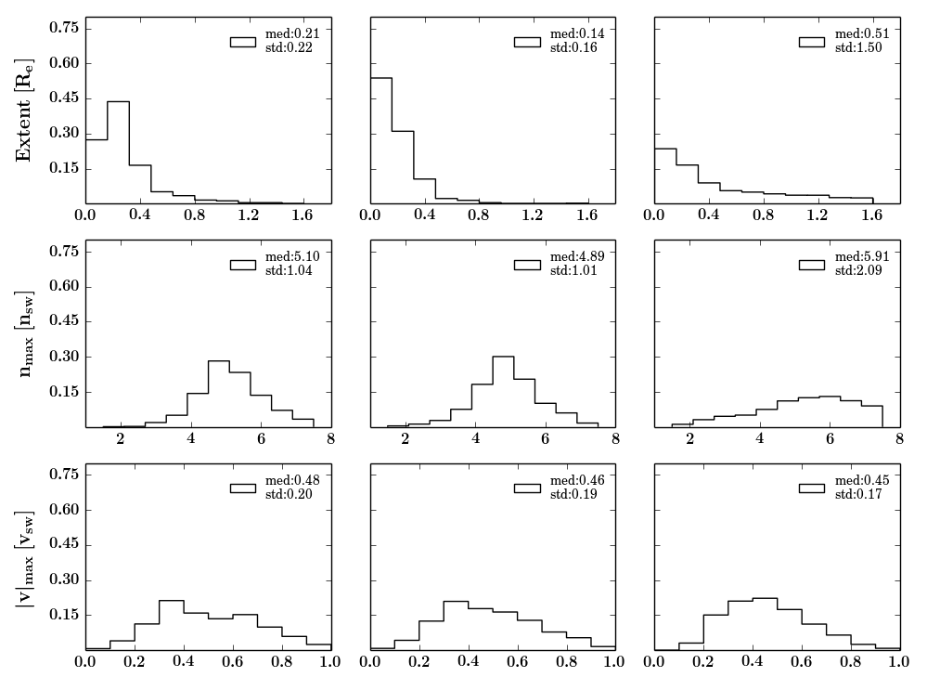
Main Results – Some Statistical Properties

Slide 15
Main Results – Some Statistical Properties

Slide 16
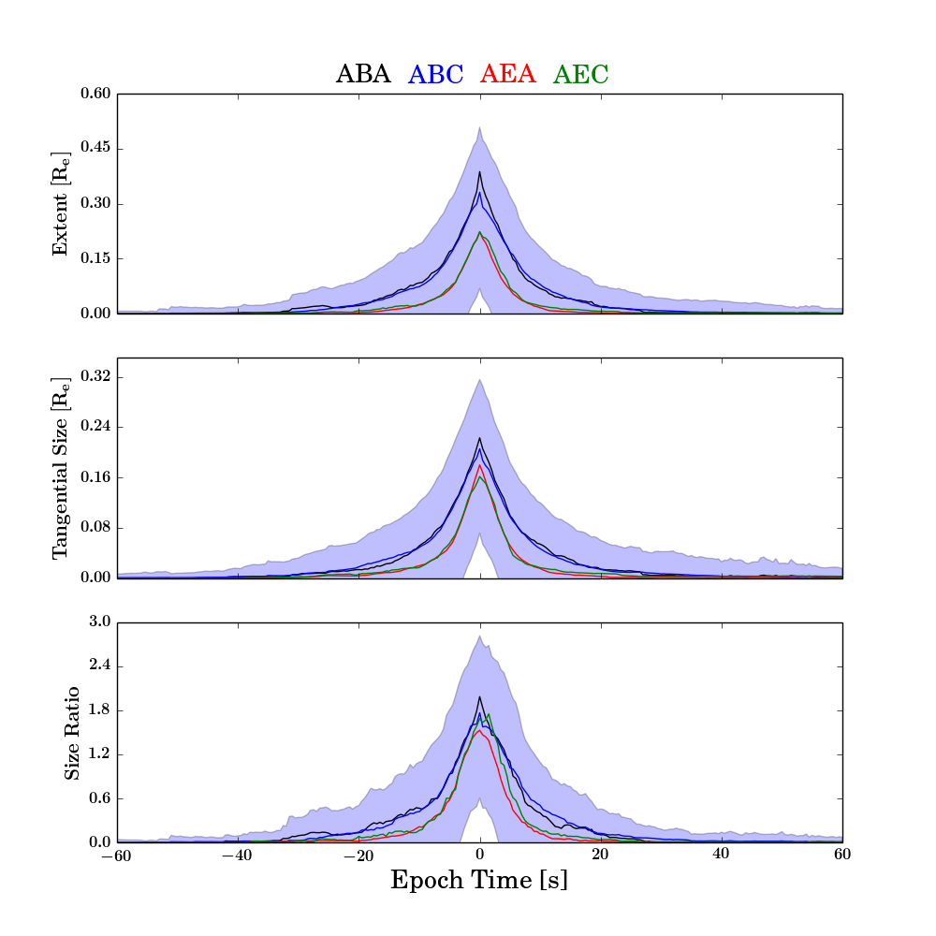
Only Vlasiator Statistics – Superposed Epoch Analysis
Extend (# Cells)
Tangential Size
(# Cells)
Radial/Tangential

Slide 17

Back to Overview
Data vs Simulations | Classification (Data Analysis) | Classification (Machine Learning)
Question: How well can we model magnetosheath jets? Can we verify simulations and then generalize from their result? | Question: Can Jets happen in Quasi-perpendicular bow shocks ? What are the different type of jets ? Do they have different properties? Different generation mechanism? | Question: Can we verify somehow our previous classification? Can Machine learning outperform physical modeling? What is the solar wind doing when jets are happening?
Vlasiator can model jets
MMS data support Vlasiator results
New results:
  Sizes
  Lifetime
Future work:
Follow the simulations! how jets are created? Can we follow the creation of the jet upstream ?
Notes:
Lifetime ~ 10 seconds

Slide 18

Part 2:
Classification of Magnetosheath Jets
Submitted
* https://www.essoar.org/doi/10.1002/essoar.10501493.1

Slide 19
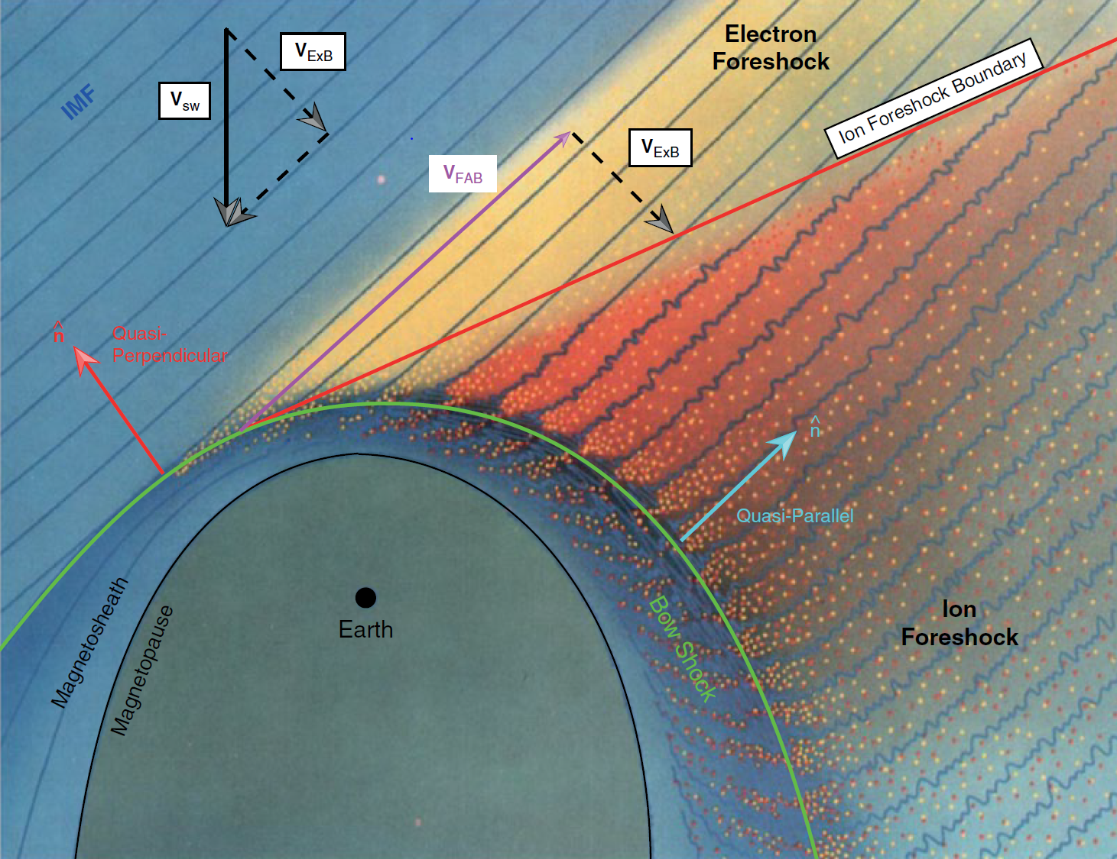
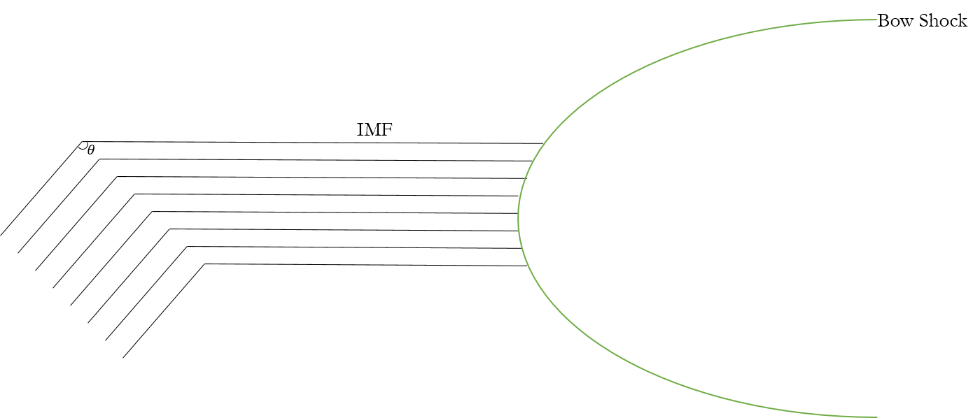

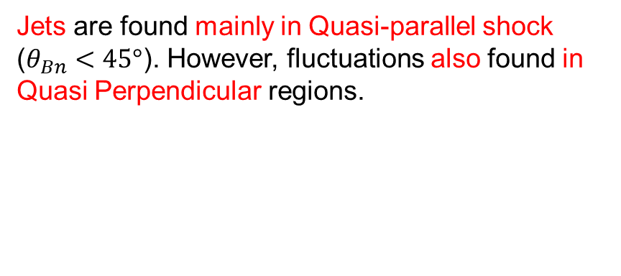


Motivation – Main Subcategories
Jets are found mainly in Quasi-parallel shock ($θ_{Bn}<45°$). However, fluctuations also found in Quasi Perpendicular regions.
$$Q_{par}$$ | $$Q_{per}$$ | $$Boundary$$
$$\vec{B}$$
$$\vec{B}$$
Rotation of IMF
L. B. Wilson (2016)

Slide 20

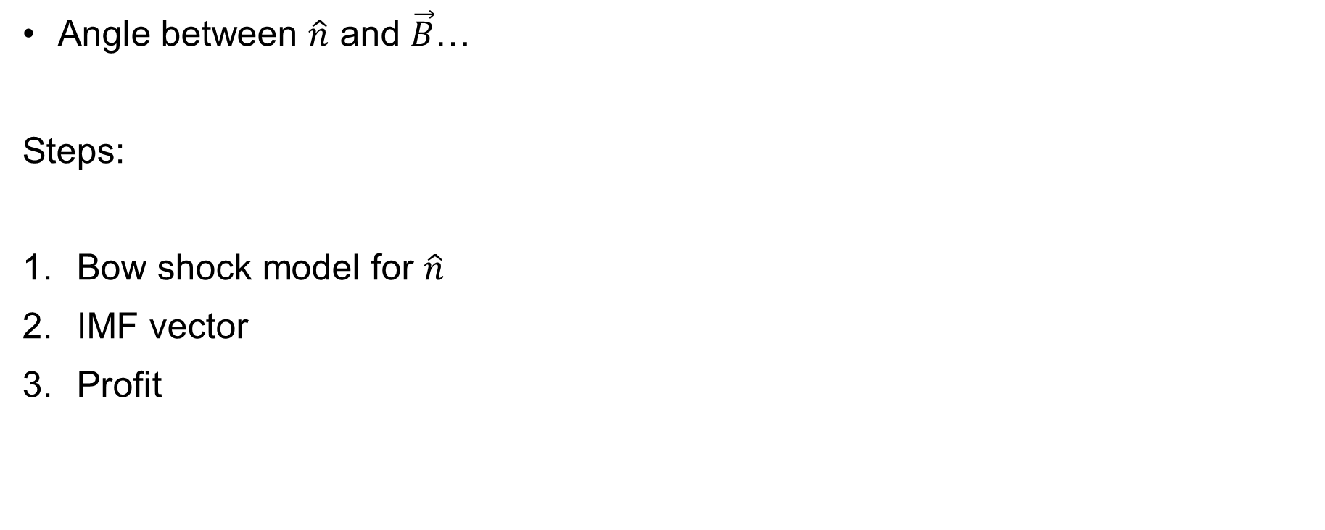



Task – Find $Θ_{Bn}$
Angle between $\hat{n}$ and $\vec{B}$…
Steps:
Bow shock model for $\hat{n}$
IMF vector
Profit
Bow Shock
Solar Wind
$$\hat{n}$$
$$\vec{B}$$
$$Θ_{Bn}$$
$$\hat{n}$$

Slide 21
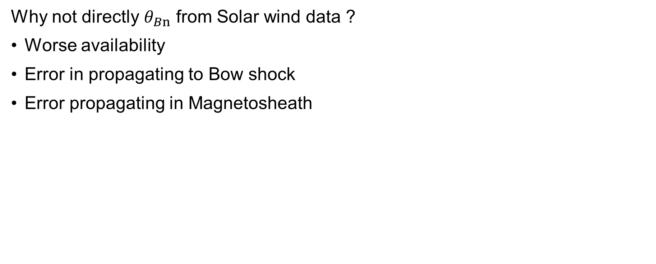



Task – Find $Θ_{Bn}$
Why not directly $θ_{Bn}$ from Solar wind data ?
Worse availability
Error in propagating to Bow shock
Error propagating in Magnetosheath
Bow Shock
Magnetopause
$$t_{2}$$
Jets
$$ACE$$
ΗRO Data (1 min average)
$$t_{1}$$
MMS

Slide 22
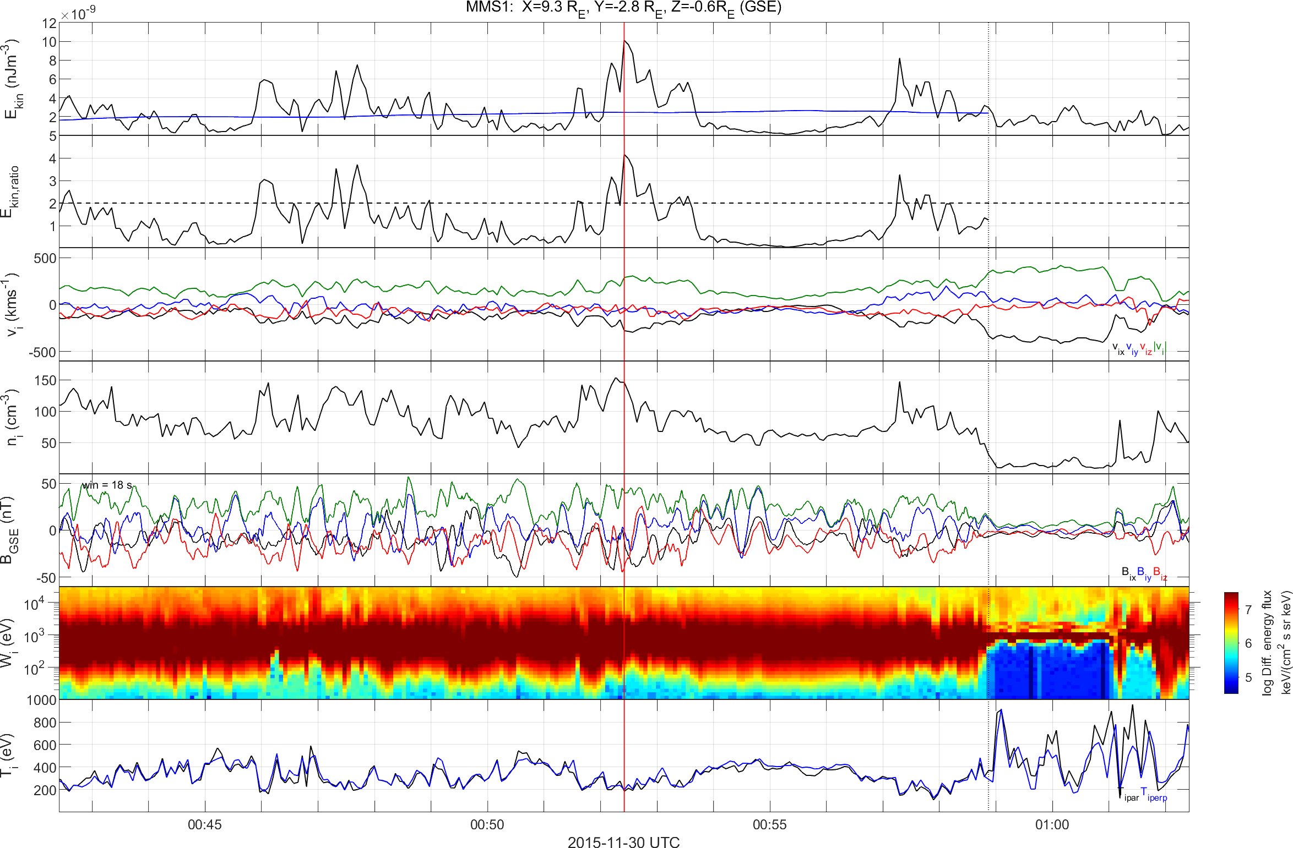
Quasi-parallel jet using MMS
High $B$ Variance, High Energetic Particles, Low Anisotropy
Dynamic Pressure
Jet
Dynamic Pressure Ratio
Velocity
Density
Magnetic Field
Ion Energy Spectrum
Temperature

Slide 23
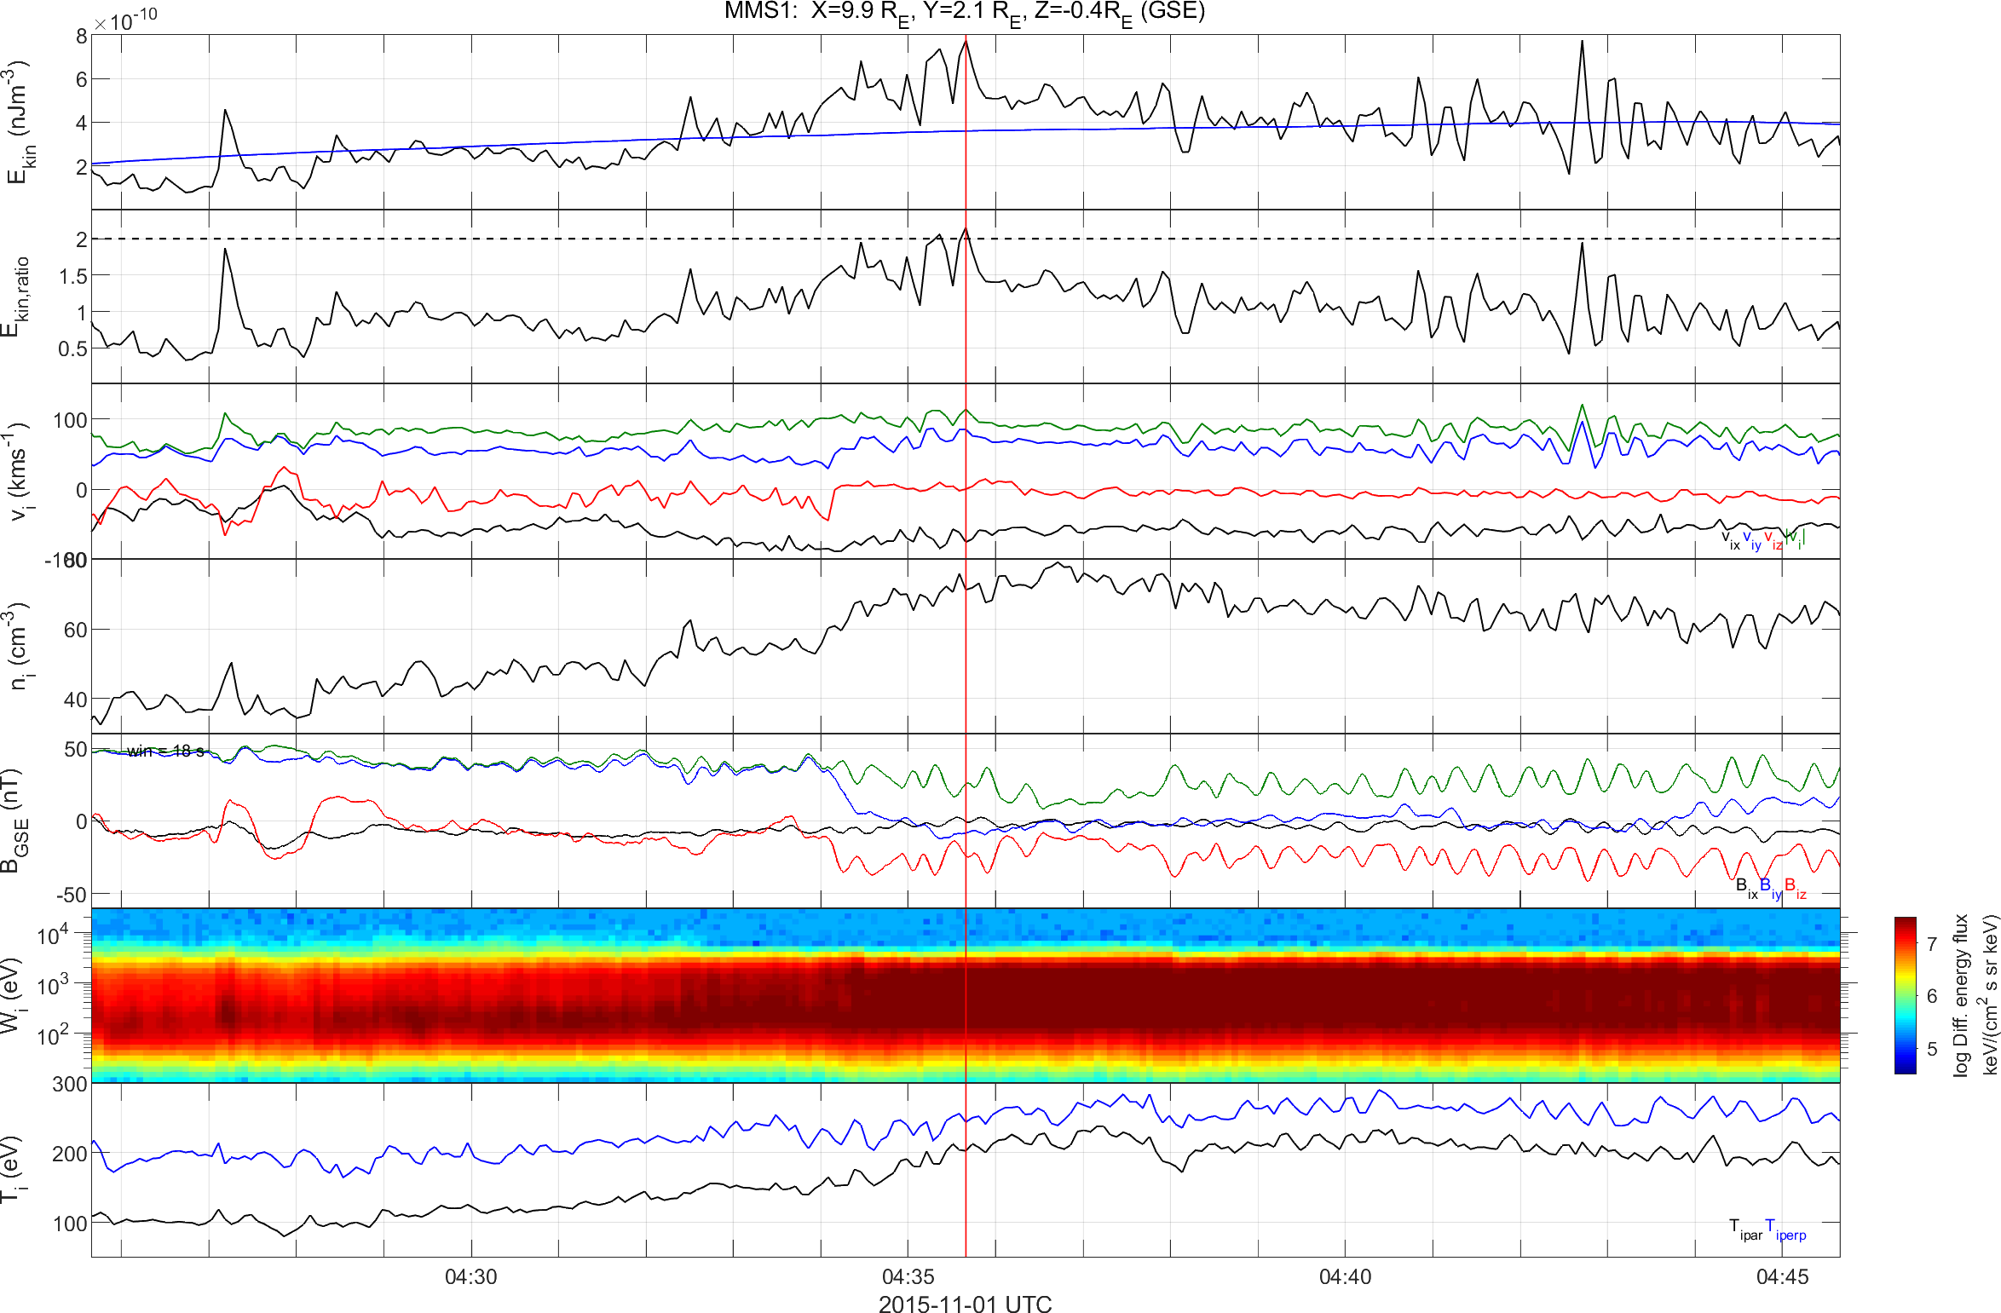
Quasi-perpendicular jet using MMS
Low $B$ Variance, Low Energetic Particles, High Anisotropy
Dynamic Pressure
Dynamic Pressure Ratio
Velocity
Density
Magnetic Field
Ion Energy Spectrum
Temperature

Slide 24
Differences of each class
High Variance, High Energetic Particles, Low Anisotropy
Low Variance, No Energetic Particles, High Anisotropy
Quasi – Parallel Jet
Quasi – Perpendicular

Slide 25
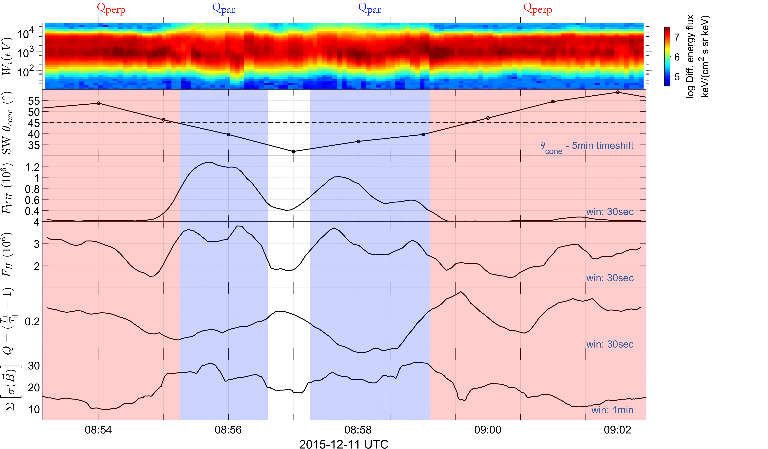
Classification Procedure in progress
Cone Angle
Very High Energy
Flux
High Energy Flux
Anisotropy
Magnetic Field Variance

Slide 26
Main Categories
Qpar Jet
Qperp Jet
Boundary Jet
Encapsulated Jet

Slide 27
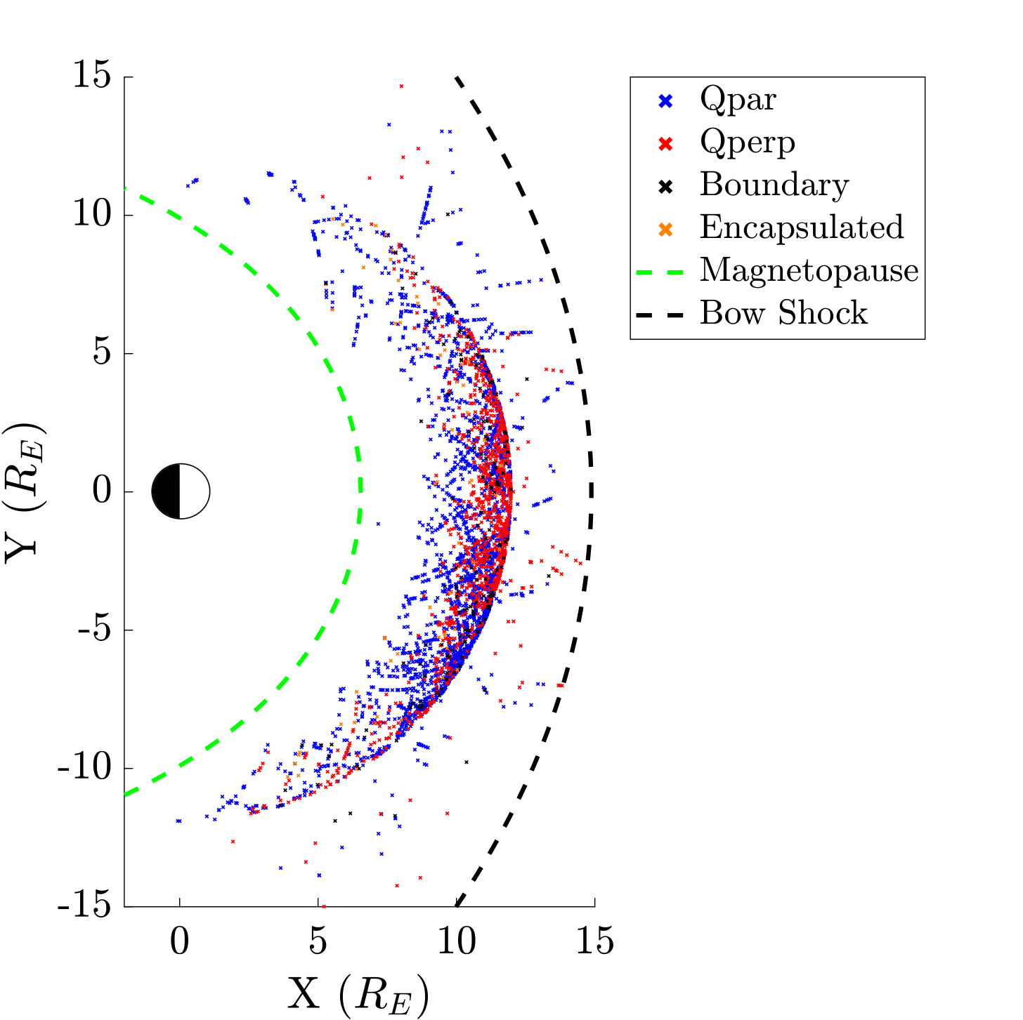
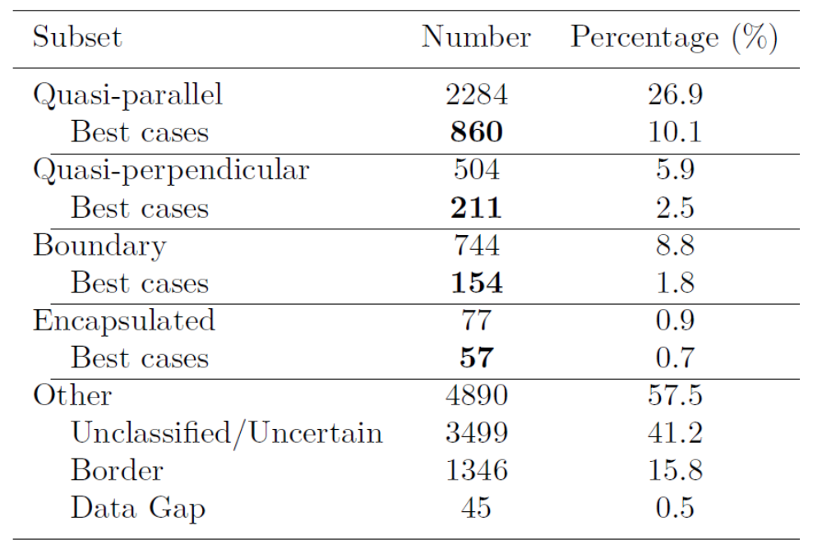

Database of Jets
$$n=8499$$

Slide 28
What are we looking for (?)
Problem: No idea where Jet come from?
Lets think, any clues from previous works?
Boundary Jets = Pressure pulses associated to IMF (Archer et al. 2013)
Quasi – Parallel jets = Ripples in the bow shock + SLAMS (Hietalla et al. 2009, Karlsson et al. 2018)
Quasi – Perpendicular jets = Ripples in the shock (Jolander et al. 2016)
Encapsulated jets = ????

Slide 29
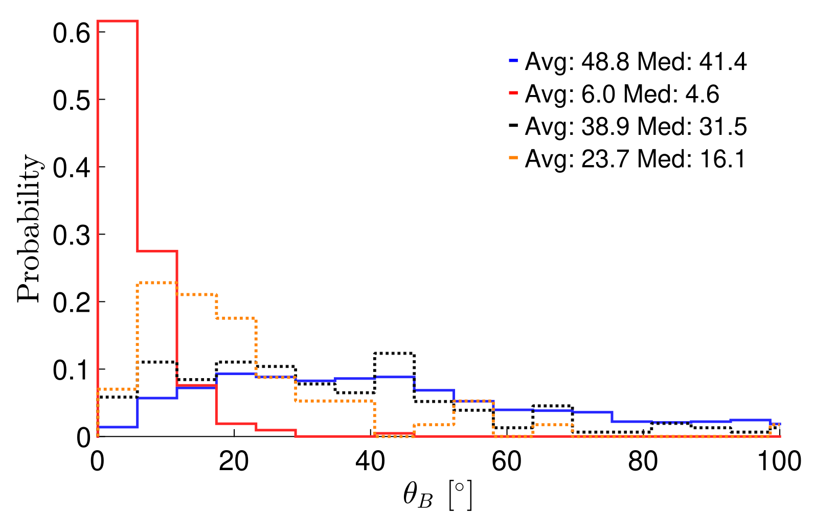
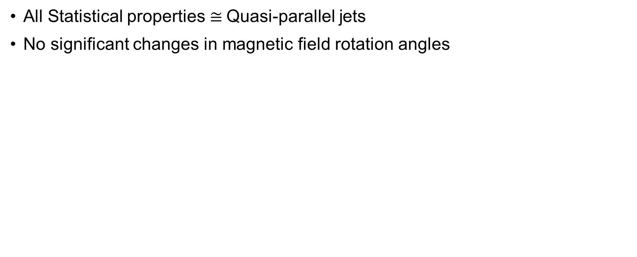
Boundary Jets
All Statistical properties $≅$Quasi-parallel jets
No significant changes in magnetic field rotation angles
Verdict: Subset of Quasi-parallel jets, more careful analysis could:
Show difference in frequency.
Show smaller scale variations in magnetic field.

Slide 30
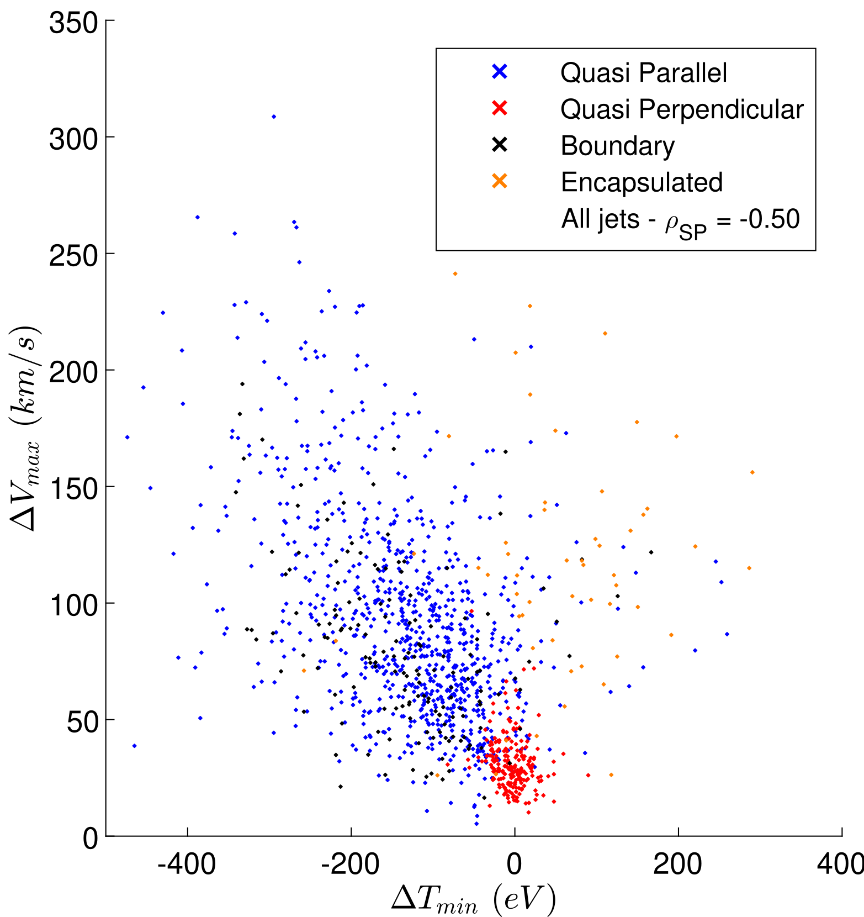
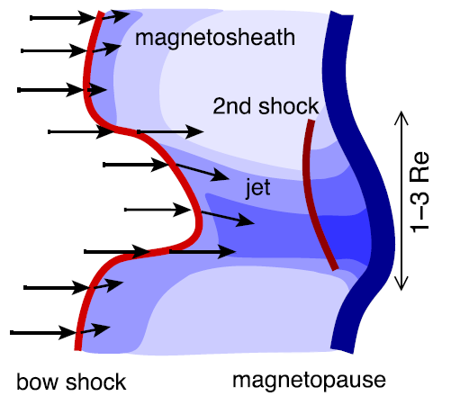


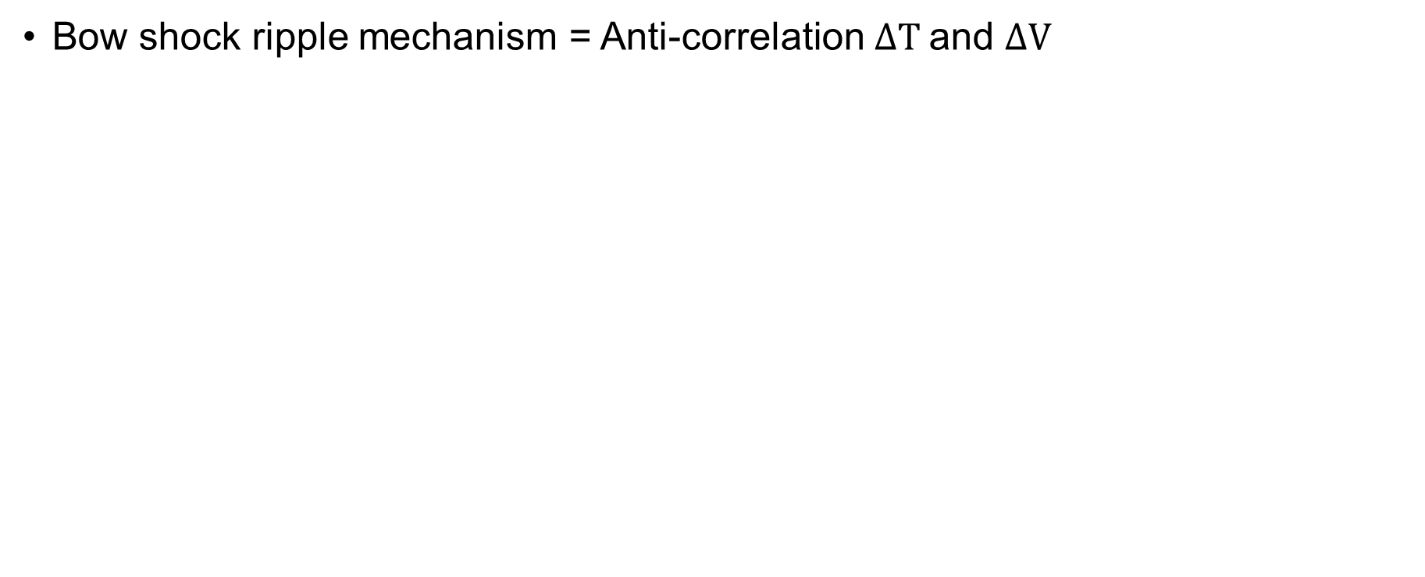
Quasi Parallel Jets – Shock ripples
Bow shock ripple mechanism = Anti-correlation $ΔΤ$and $ΔV$
Close to BS, $ρ_{SP}≈−0.8$
Verdict: Seems to be “supported” requires more careful analysis… (future)
$$ΔΧ=Χ−{\left\langle Χ\right\rangle }_{10min}$$

Slide 31
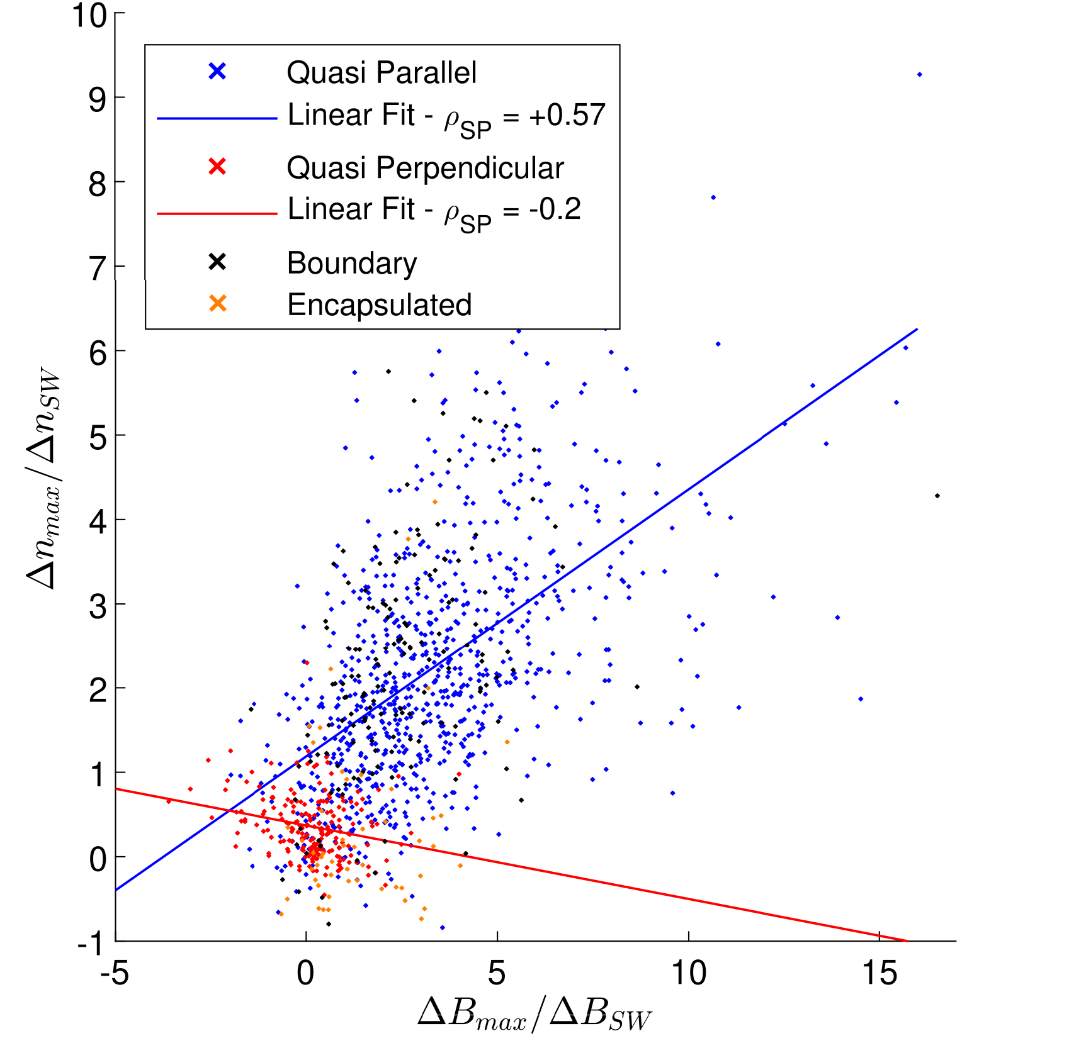
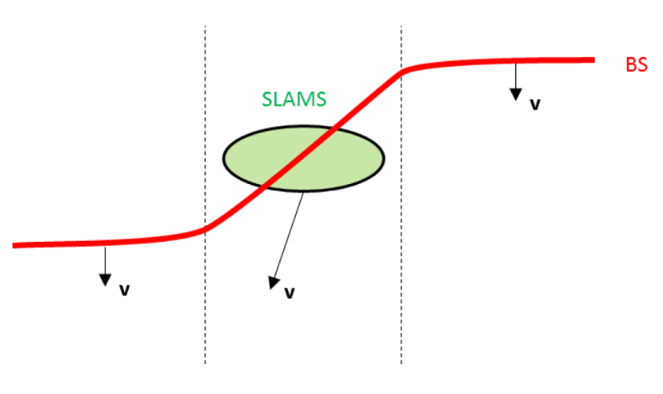
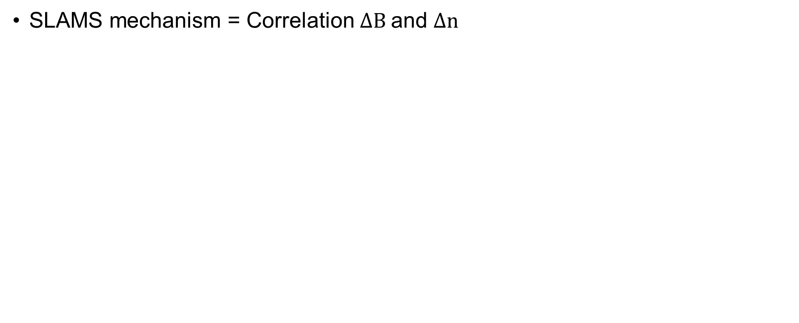

Quasi Parallel Jets – SLAMS
SLAMS mechanism = Correlation $ΔΒ$and $Δn$
All variations of $ΔΒ\backslash Δn \sim 0.6$
Verdict: Seems to be “supported”. Only Qpar and Boundary jets give correlations (cases that we expect SLAMS)… still more work to be done (future)
$$ΔΧ=Χ−{\left\langle Χ\right\rangle }_{10min}$$

Slide 32
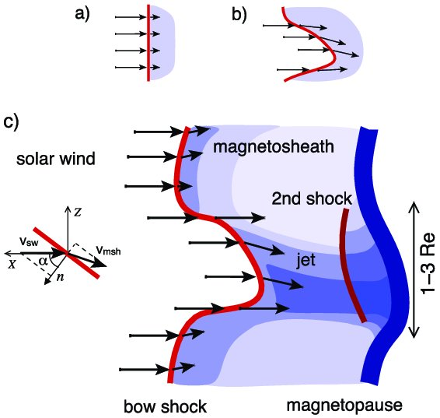
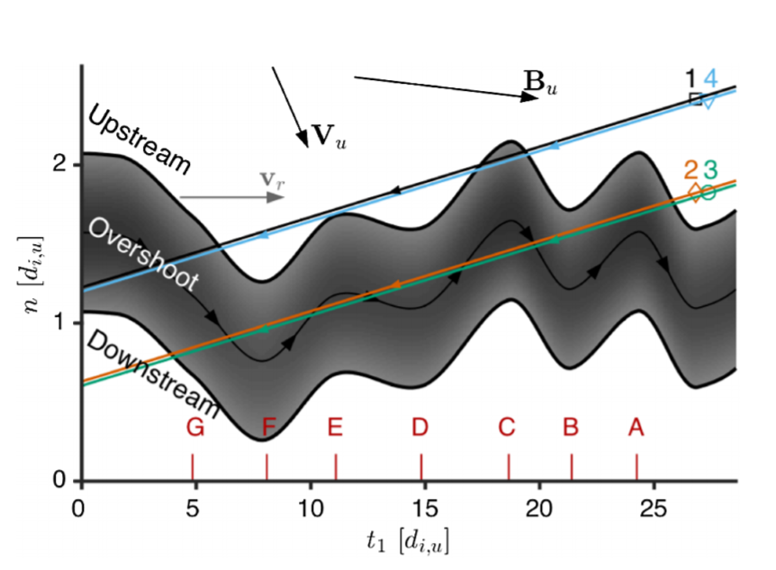

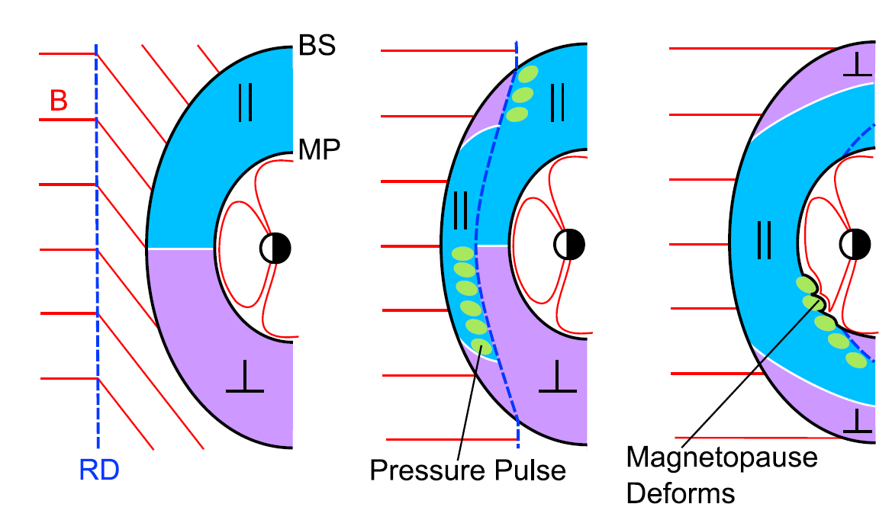
Mechanisms ideas for each jets
Quasi – Parallel
Quasi – Perpendicular
Hietala et al. (2012)
Johlander et al. (2016)
Boundary
Encapsulated
???
Archer et al. (2012)

Slide 33
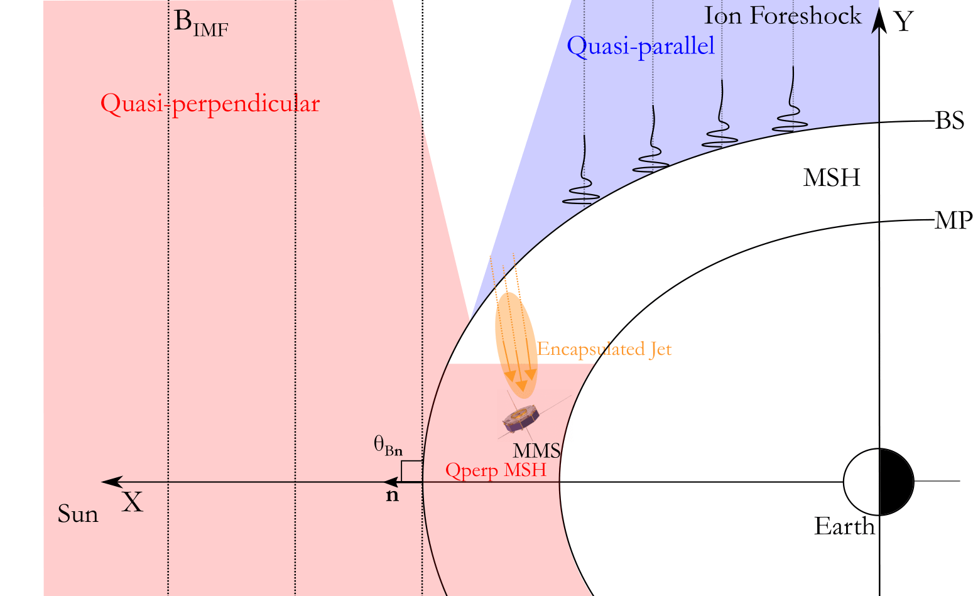
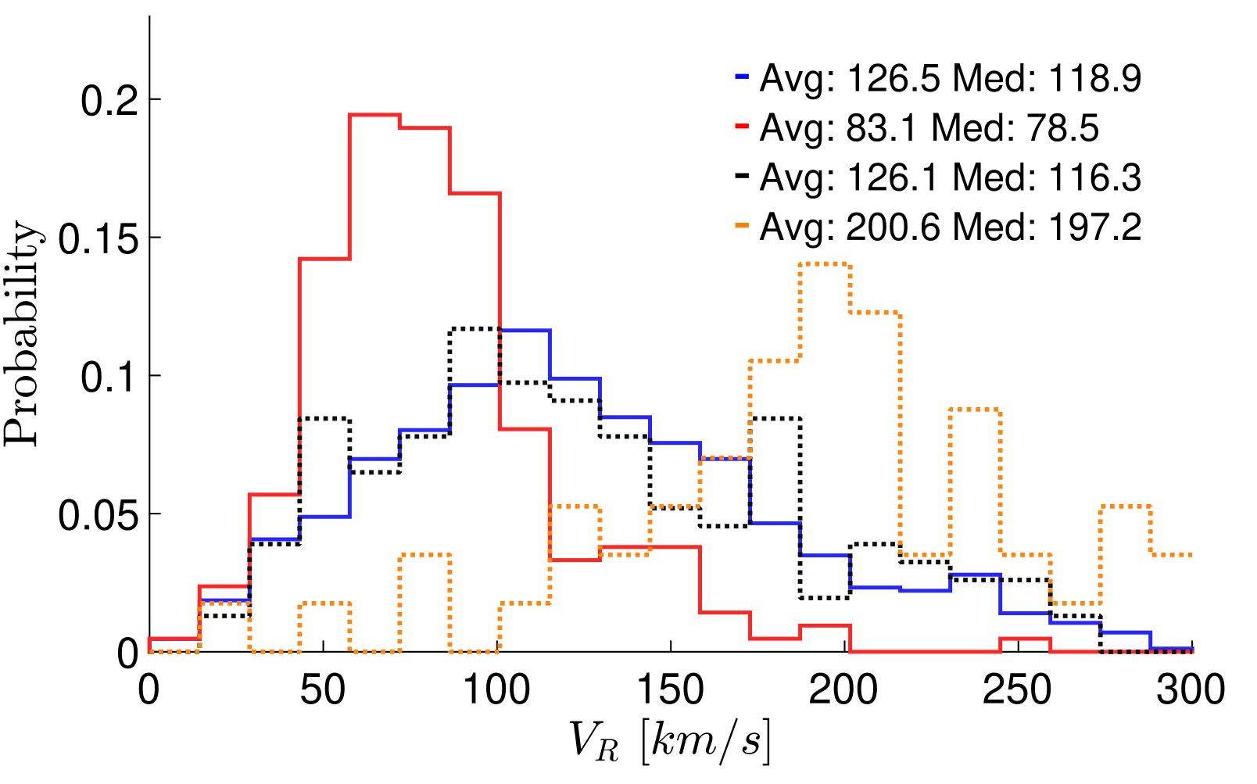
Encapsulated Hypothesis
Qpar like characteristics
Different velocity distribution
Closer to flanks of bow shock

Slide 34
Back to Overview
Data vs Simulations | Classification (Data Analysis) | Classification (Machine Learning)
Question: How well can we model magnetosheath jets? Can we verify simulations and then generalize from their result? | Question: Can Jets happen in Quasi-perpendicular bow shocks? What are the different type of jets? Do they have different properties? Different generation mechanism? | Question: Can we verify somehow our previous classification? Can Machine learning outperform physical modeling? What is the solar wind doing when jets are happening?
Quasi-Perp jets exist although weak
Bow shock ripple mechanism is supported
SLAMS associated mechanism is supported
Future: See closer to the bow shock. More robust association of ripples and SLAMS to jets

Slide 35
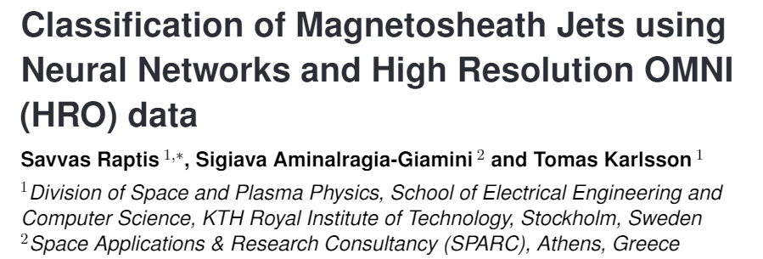
Part 3:
Machine Learning
Ongoing (Q1 2020)

Slide 36
Part 3:
Machine Learning

Slide 37
Main Categories
Qpar Jet
Qperp Jet

Slide 38



Motivation
Quasi-Parallel
Quasi-Perpendicular
Bow Shock
Neural Networks
Magnetopause
Jets
$$L_{1}$$
ΗRO Data (1 min averaged)
Earth
$$ACE$$
MMS

Slide 39
Neural Networks & Backpropagation
Output

Slide 40
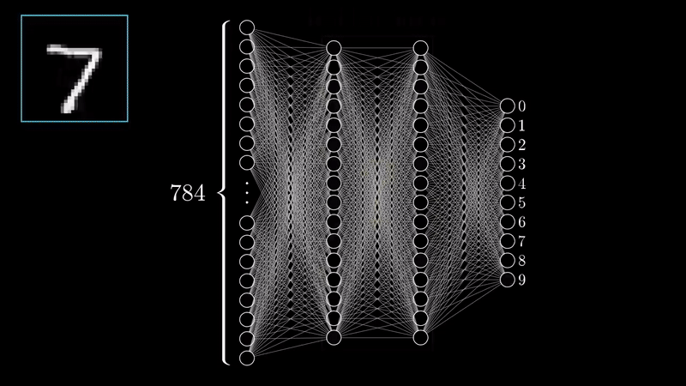
A Trained Neural Network
*Video Courtesy: 3Blue1Brown (Check him on YouTube!)

Slide 41


Schematic of Procedure
Input
Solar Wind Data
Neural Network
Classification
Output
MMS Jet’s Class
$\vec{B}, P, β, Τ, \vec{v},ρ$…
Quasi – Parallel
0
$$…$$
Quasi – Perpendicular
1
Solar Wind -----------------------------------------------------> Magnetosheath

Slide 42


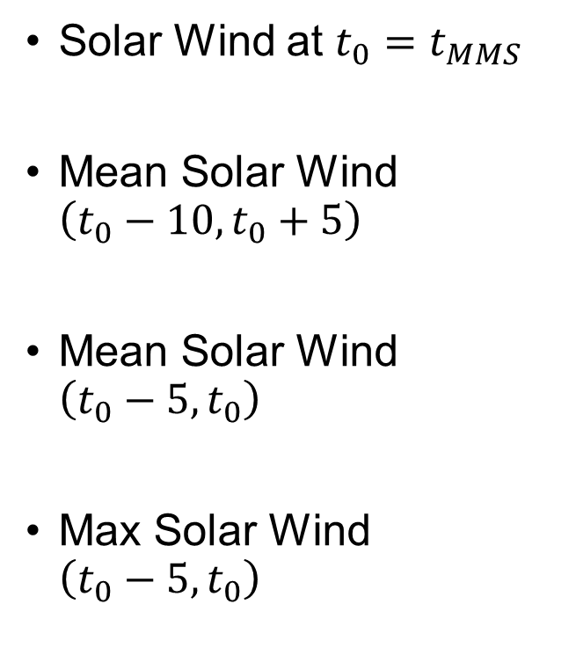

Input (Solar Wind)
Solar Wind at $t_{0}=t_{MMS}$
Mean Solar Wind $\left(t_{0}−10,t_{0}+5\right)$
Mean Solar Wind $\left(t_{0}−5,t_{0}\right)$
Μax Solar Wind $\left(t_{0}−5,t_{0}\right)$
Bow Shock
Magnetopause
$$t^{′′}$$
OMNIweb
Earth
$$t$$
$$t^{′}$$

Slide 43
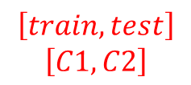
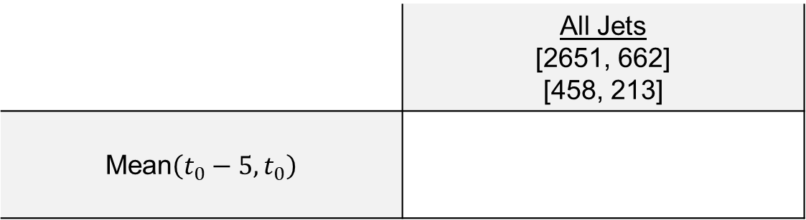
Results – Example
$$\left[train,test\right]$$
$$\left[C1,C2\right]$$
 | All Jets [2651, 662] [458, 213]
Mean$\left(t_{0}−5,t_{0}\right)$
360 | 89
32 | 181
80%
86%

Slide 44

Results – Example
$$Input$$
 | All Jets [2651, 662] [458, 213]
Mean$\left(t_{0}−5,t_{0}\right)$
360 | 89
32 | 181
80%
86%

Slide 45
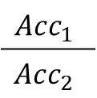
Results – Example
 | All Jets [2651, 662] [458, 213]
Mean$\left(t_{0}−5,t_{0}\right)$
360 | 89
32 | 181
80%
86%
True | False
False | True
$$Acc_{1}$$
$$Acc_{2}$$

Slide 46
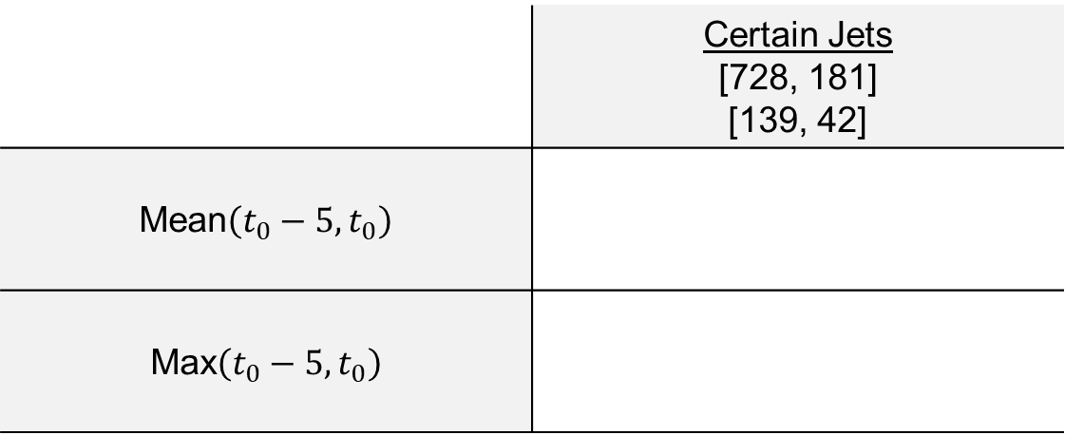
Results – Classification Accuracies
 | Certain Jets [728, 181] [139, 42]
Mean$\left(t_{0}−5,t_{0}\right)$
Max$\left(t_{0}−5,t_{0}\right)$
135 | 4
2 | 40
97%
95%
131 | 8
4 | 38
94%
90%

Slide 47
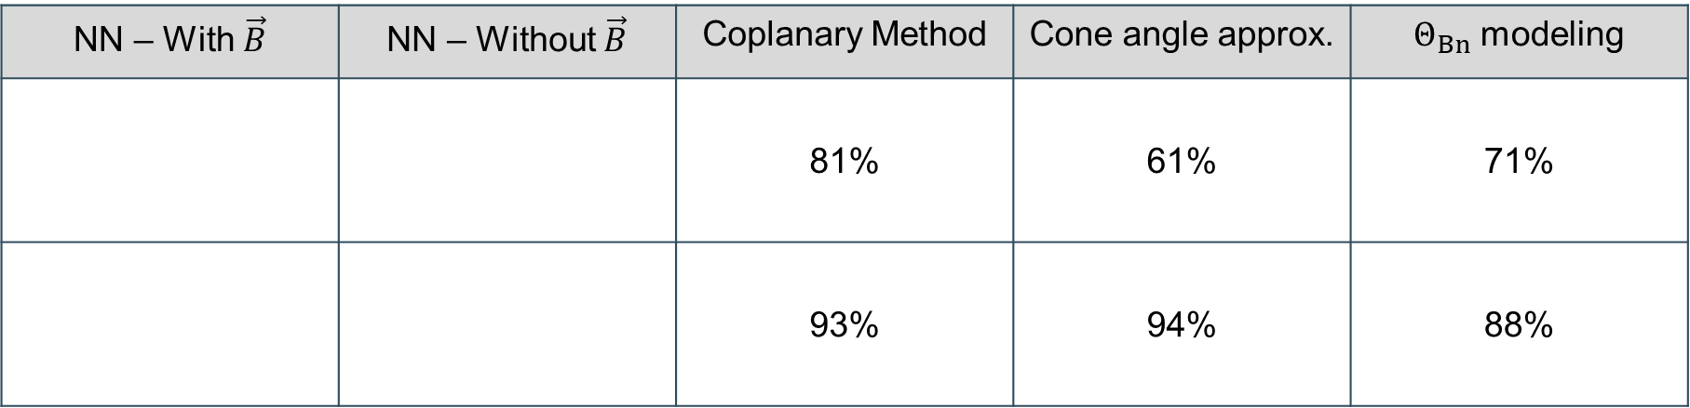



Results – Comparison to Traditional Methods
Machine Learning
Physical Methods
NN – With$\vec{B}$ | NN – Without $\vec{B}$ | Coplanary Method | Cone angle approx. | $Θ_{Bn}$ modeling
 |  | 81% | 61% | 71%
 |  | 93% | 94% | 88%
$$Q_{∥}$$
$$Q_{⊥}$$
$Q_{∥}$ Jets : 860
$Q_{⊥}$ Jets : 211
And the winner is………..

Slide 48

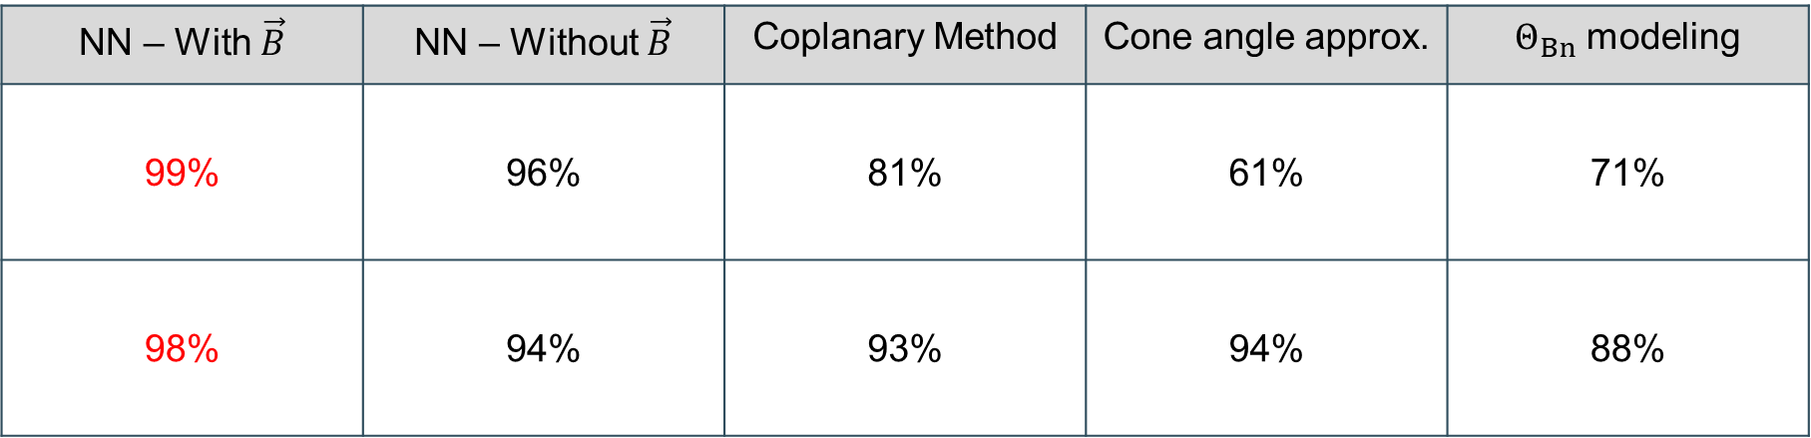
Results – Comparison to Traditional Methods
Machine Learning
Physical Methods
NN – With$\vec{B}$ | NN – Without $\vec{B}$ | Coplanary Method | Cone angle approx. | $Θ_{Bn}$ modeling
99% | 96% | 81% | 61% | 71%
98% | 94% | 93% | 94% | 88%
$$Q_{∥}$$
$$Q_{⊥}$$
$Q_{∥}$ Jets : 860
$Q_{⊥}$ Jets : 211
And the winner is………..

Slide 49
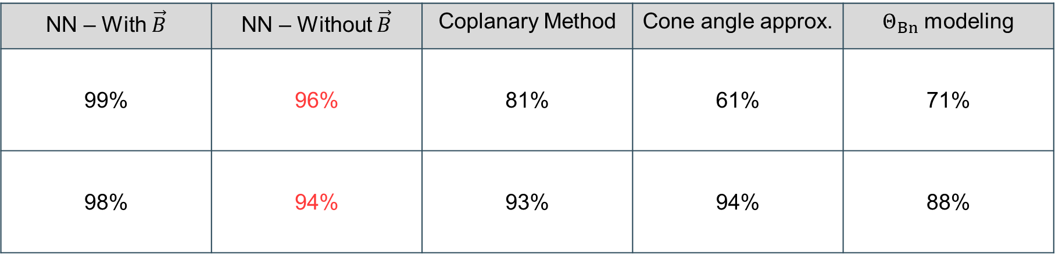
Results – Comparison to Traditional Methods
Machine Learning
Physical Methods
NN – With$\vec{B}$ | NN – Without $\vec{B}$ | Coplanary Method | Cone angle approx. | $Θ_{Bn}$ modeling
99% | 96% | 81% | 61% | 71%
98% | 94% | 93% | 94% | 88%
$$Q_{∥}$$
$$Q_{⊥}$$
$Q_{∥}$ Jets : 860
$Q_{⊥}$ Jets : 211
Interesting result!

Slide 50
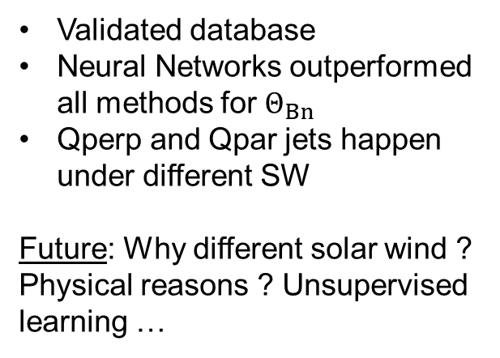
Back to Overview
Data vs Simulations | Classification (Data Analysis) | Classification (Machine Learning)
Question: How well can we model magnetosheath jets? Can we verify simulations and then generalize from their result? | Question: Can Jets happen in Quasi-perpendicular bow shocks ? What are the different type of jets ? Do they have different properties? Different generation mechanism? | Question: Can we verify somehow our previous classification? Can Machine learning outperform physical modeling? What is the solar wind doing when jets are happening?
Validated database
Neural Networks outperformed all methods for $Θ_{Bn}$
Qperp and Qpar jets happen under different SW
Future: Why different solar wind ? Physical reasons ? Unsupervised learning …

Slide 51

Work in progress …
Solar Wind
Magnetosheath & Magnetosphere
Bow Shock
Solar wind Clusters (?)
Cluster
Magnetopause
MMS
Neural Networks
Earth
$$ACE$$
Physical
Modeling (?)
Qpar MSH
Qperp MSH

Slide 52
Take home Message
Magnetosheath Jets are very important and an interesting topic to do research.
For every space phenomenon there are many different ways to conduct research, Theory, Data, Simulations, Machine learning etc.

Slide 53
Extras

Slide 54
Neural Networks

Slide 55

(Main) Types of Machine Learning Problems

Slide 56

Neural Networks
Let’s see what happens here!!
Output

Slide 57



A Neural Network Input and Output
$y$ : Output of Neuron
$x_{i}$: Inputs of Neuron
$w_{i}$: Weights of each Input
$b$ : bias for each neuron
$$y=f\left(x_{1}w_{1}+x_{2}w_{2}+…+x_{n}w_{n}+b\right)$$
Random Numbers
Magic happens here

Slide 58






Activation Function
$$b$$
$$w_{1}$$
$$w_{2}$$
$$w_{n}$$
Sum of all Data$\left(x_{i}\right)$, Weights ($w_{i}$) and Biases ($b$)
$$z=\sum{x_{i}w_{i}+b}$$

Slide 59

Activation Function
$$b$$
$$w_{1}$$
$$w_{2}$$
$$w_{n}$$
Apply $f\left(z\right)$ depending on goal

Slide 60



Activation function Examples
Goal: Classification
$$\sum{x_{i}w_{i}+b}=2$$
$$y=0.8 →Class 1$$

Slide 61


Activation function Examples
Goal: Regression
$$\sum{x_{i}w_{i}+b}=2$$
$$y=2$$

Slide 62
Neural Networks & Backpropagation
Output
Notes:
επίπεδα layers

Slide 63

Neural Networks with Images

Slide 64

Neural Networks with Images – Dog example

Slide 65
Convolution Neural Networks

Slide 66


Convolution Neural Network (CNN) Layers
Convolution
Extract features & Keep spatial relationship
Pooling/Subsampling
Reduce dimensionality & retain information
*Figure Courtesy: Erik Reppel
*Figure Courtesy: Cambridge Spark Ltd
Notes:
συνελικτικό νευρωνικό δίκτυο,

Slide 67


Example of CNN
*Figure Courtesy: Suhyun Kim iSystems Design Labs

Slide 68

NN vs CNN
Input: MNIST database
Neural Network Result:
97.3%
Convolution Neural Network Result:
99.07%

Slide 69

Why normalization is vital?

Slide 70


Gradient Descent - Training
Loss Function/Error:
$$E=\frac{1}{2}\sum_{i}{{\left(a_{i}−t_{i}\right)}^{2}}$$

Slide 71

Advanced Activation functions
Goal → Complexity
Non-linear activations (Hidden Layers)

